Slide 1

Název školy : Základní škola a mateřská škola,
Svoboda nad Úpou, okres Trutnov
Autor : Bc. Lucie Ševčíková Datum : 20. 1. 2013
Název : VY_22_INOVACE_2.2.1 AJ6,7g_31
Téma : předpřítomný čas - hra
Ročník : 6., 7.
Číslo projektu : CZ.1.07/1.4.00/21.3068

Slide 2
Anotace:
Tato hra je určena k procvičení předpřítomného času. Žáci vybírají ze čtyřech možností jednu správnou odpověď. Žáci se mohou například střídat ve dvojici nebo týmech a získávat za správné odpovědi body. Hra je určena pro žáky 7. a vyšších ročníků.

Slide 3
Present perfect
Game

Slide 4
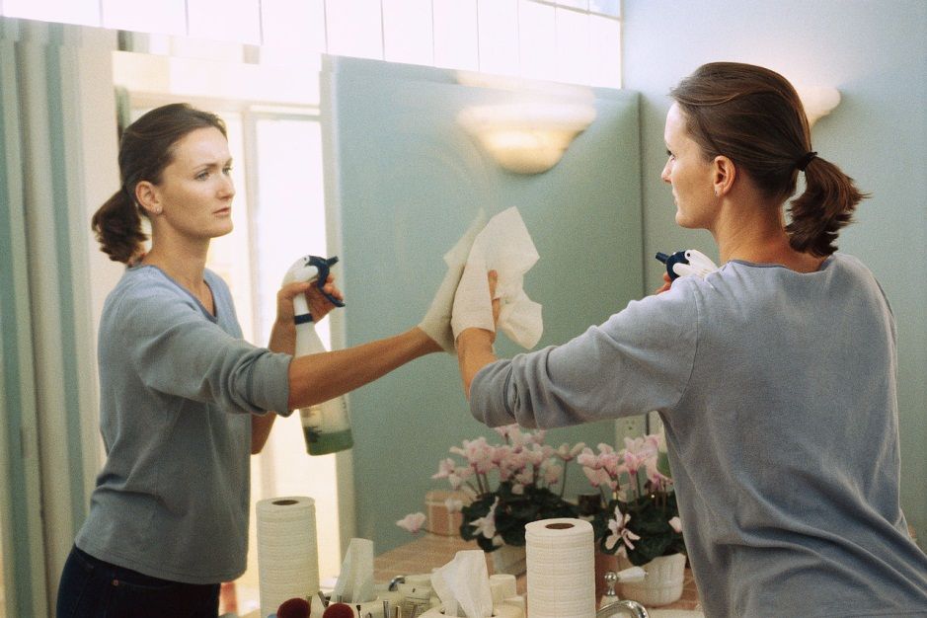
She have cleaned the house.
She has cleaned the house.
She have clean the house.
She has never cleaned the house.

Slide 5
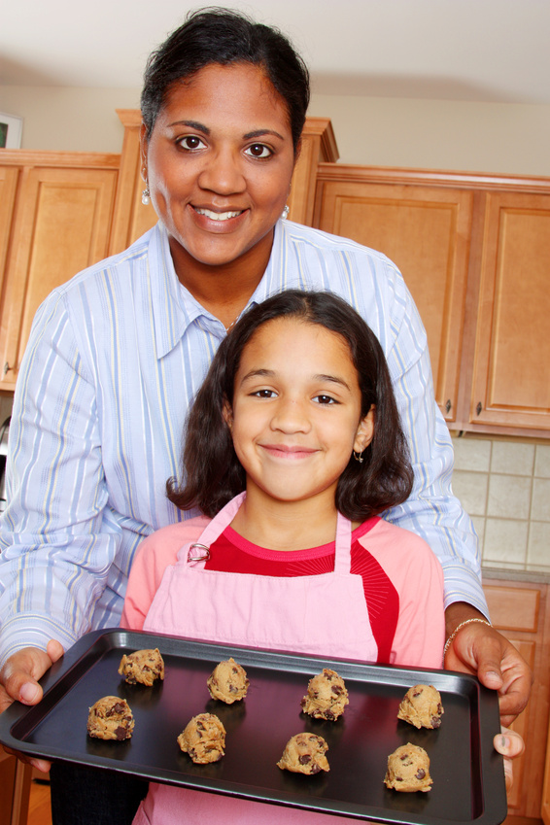
They has baked the cookies.
They haven´t baked the cookies
They have bake the cookies.
They have baked the cookies.

Slide 6
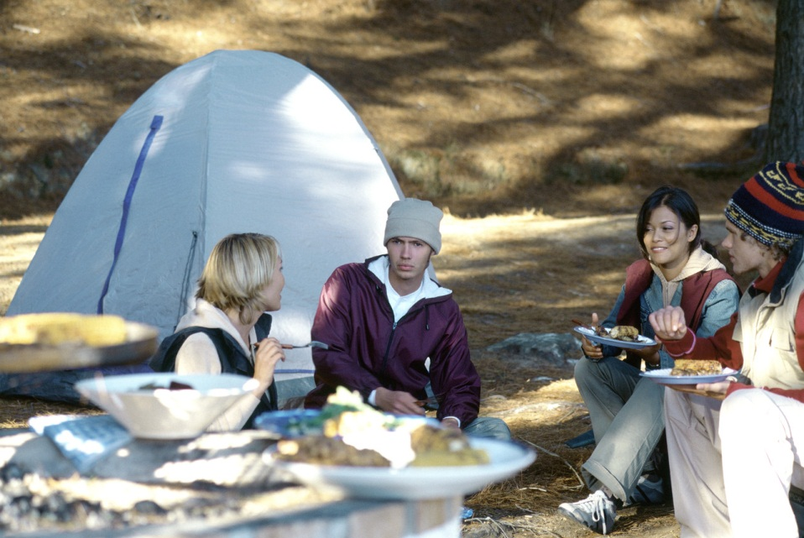
They have went camping.
They has gone camping.
They have gone camping.
They have go camping.

Slide 7
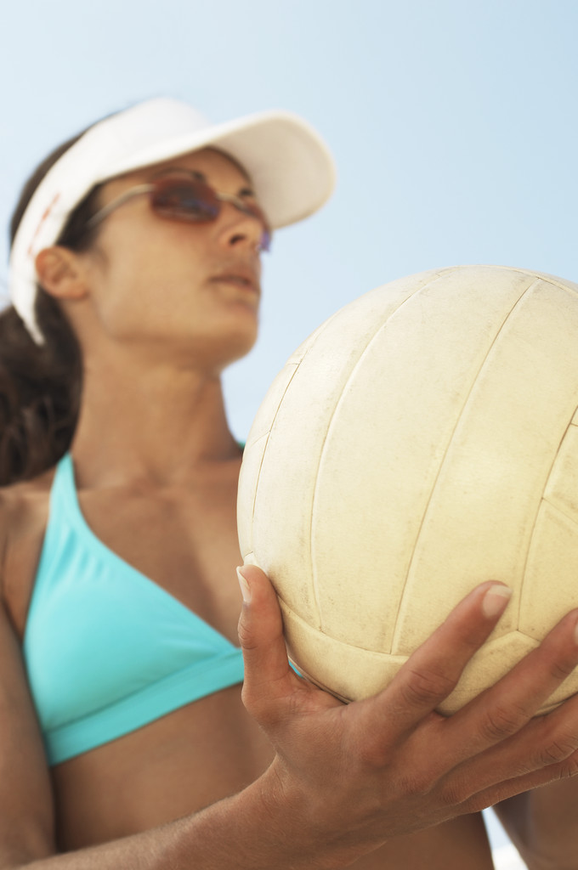
She has played volleyball.
She have played the volleball.
She has play the volleyball.
She have play the volleybal.

Slide 8
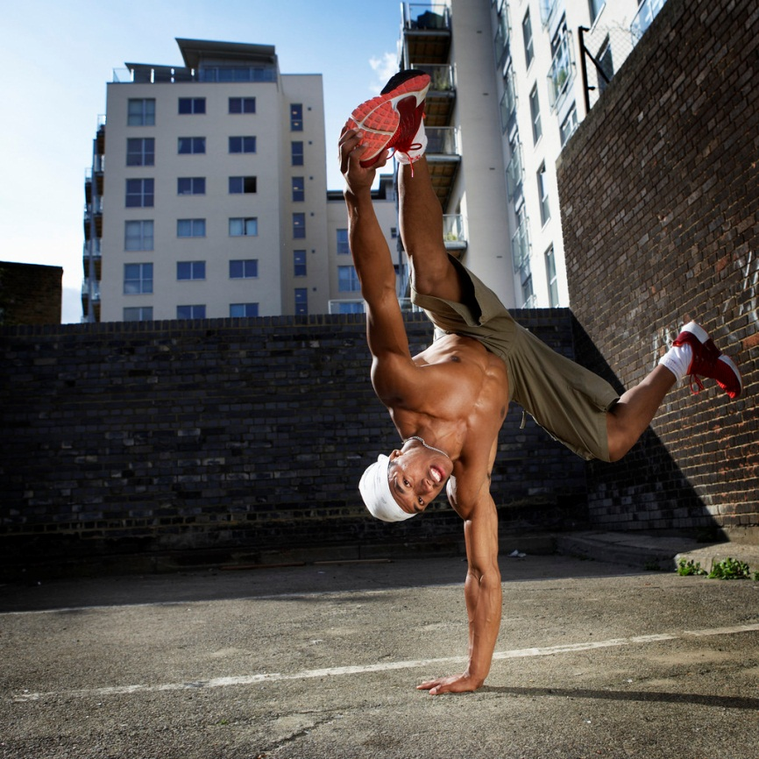
He haven´t written a letter.
He has written a letter.
He hasn´t write the letter.
He hasn´t written a letter.

Slide 9
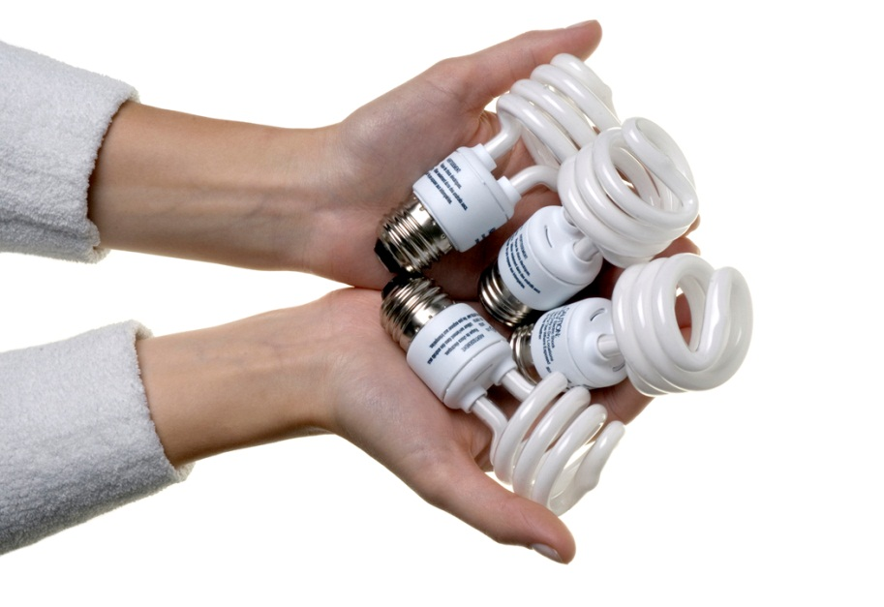
Has she buy the lightbulbs?
Have she bought the lightbulbs?
Has she bought the ligtbulbs?
Have she buy the lightbulbs?

Slide 10
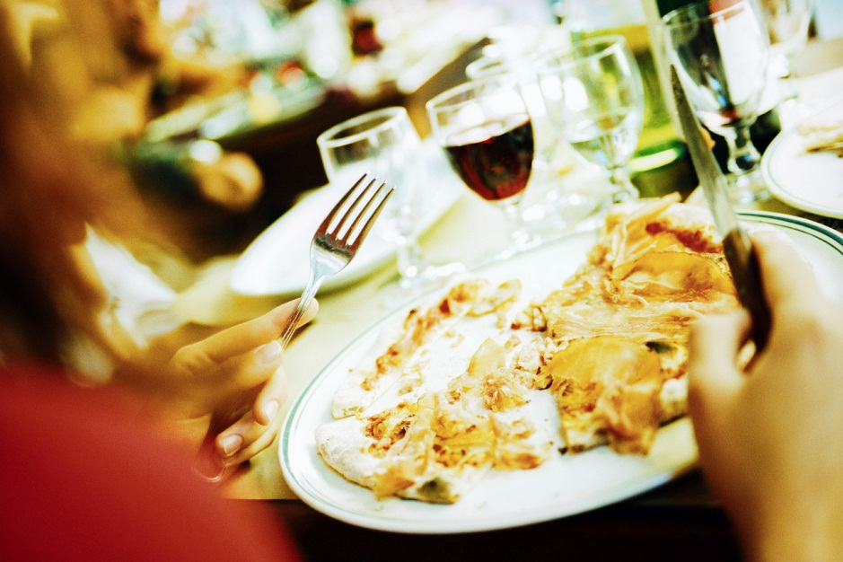
They have ate pizza.
They have eaten pizza.
They has eaten pizza.
They haven´t ate pizza.

Slide 11
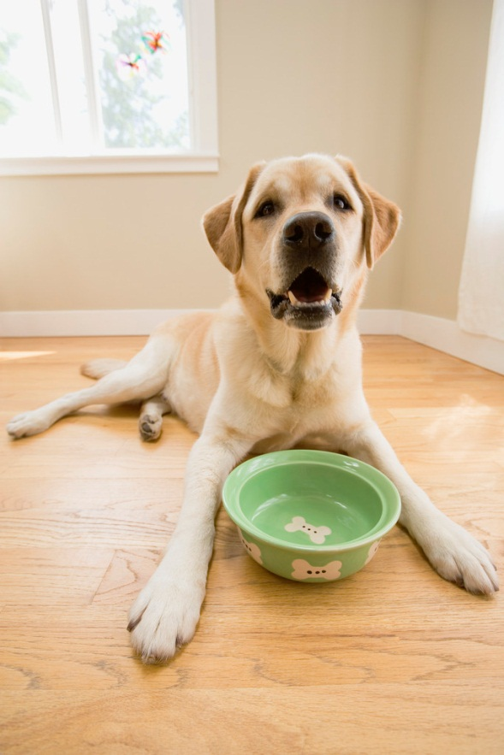
The dog has eaten yet.
The dog haven´t eaten yet.
The dog have ate yet.
The dog hasn´t eaten yet.

Slide 12
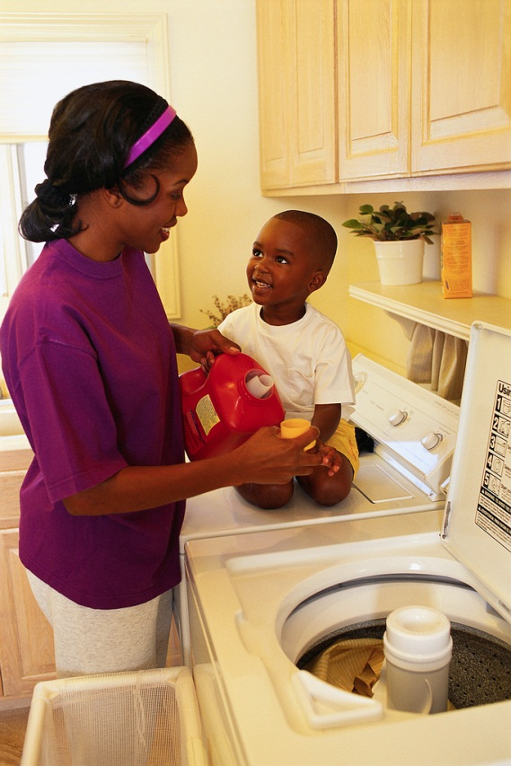
Has she already washed the clothes?
Have she already washed the clothes?
Has she washed already the clothes?
Has she already wash the clothes?

Slide 13
obrázky - http://office.microsoft.com/cs-cz/images

