Slide 1

Základní škola a mateřská škola, Svoboda nad Úpou, okres Trutnov
Bc. Lucie Ševčíková
VY_22_INOVACE_2.2.1 AJ6,7k_18
Téma: My town – Svoboda nad Úpou
11. 10. 2012
6. a 7. ročník
Číslo projektu : CZ.1.07/1.4.00/21.3068

Slide 2
Anotace
Tato prezentace představuje žákům známá místa z jejich bydliště. Žáci pojmenovávají jednotlivá místa anglicky. Na základě znalostí vytvoří svůj informační plakát o Svobodě nad Úpou pro turisty.

Slide 3
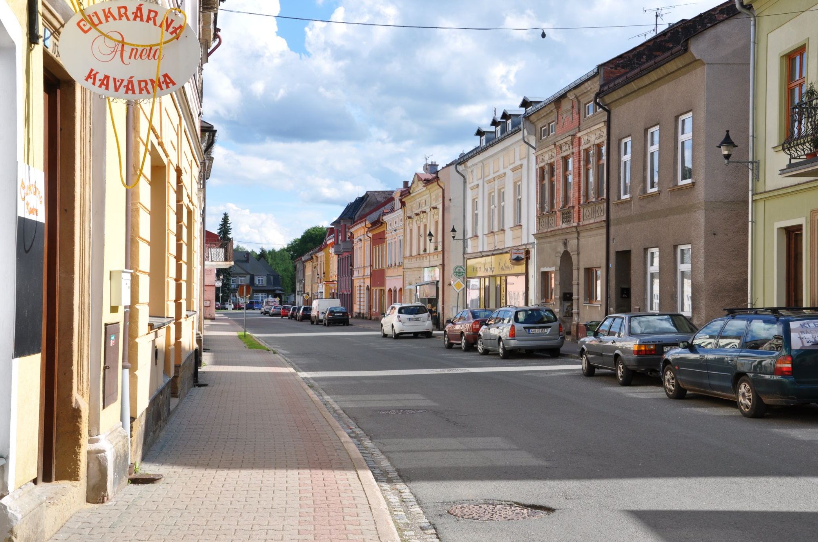
Welcome to
Svoboda nad Úpou

Slide 4
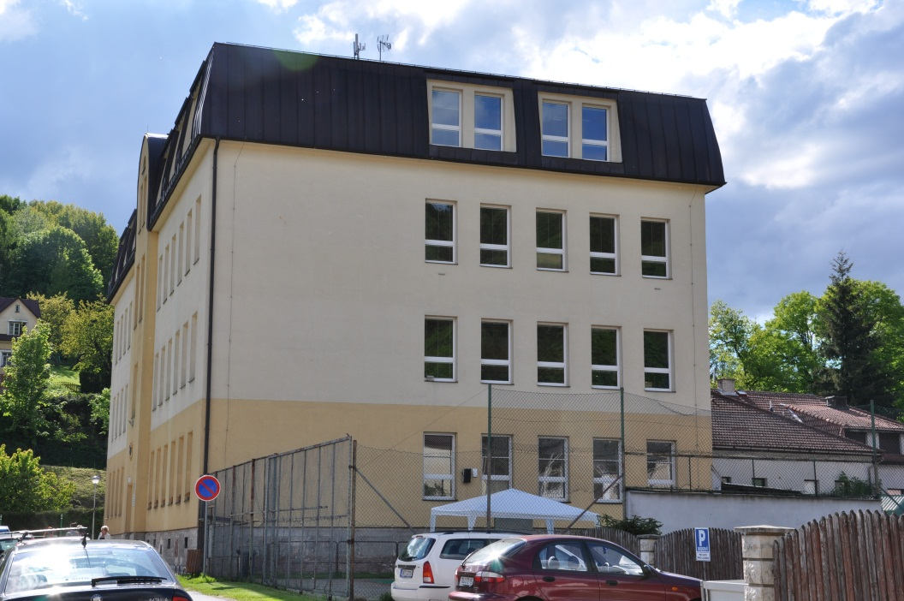
This is the primary school. Children learn a lot of new things there.

Slide 5
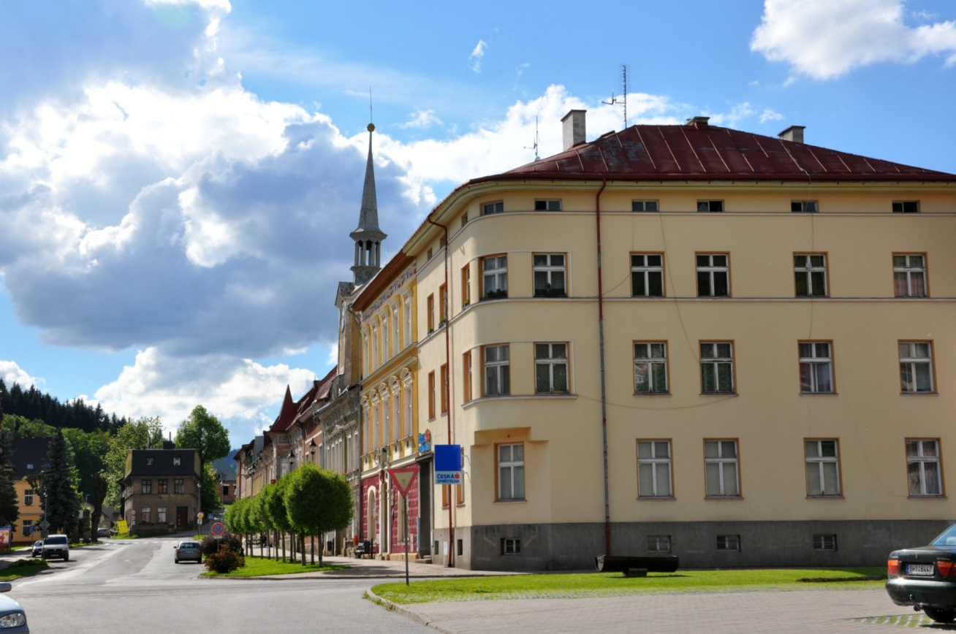
This is the town hall .The Mayor has got its office there.
This is the library. You can borrow books here.

Slide 6
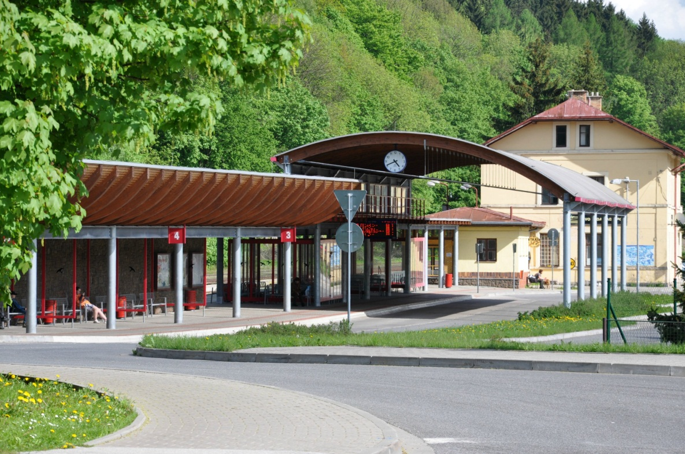
This is the bus and railway station. It is very modern.

Slide 7
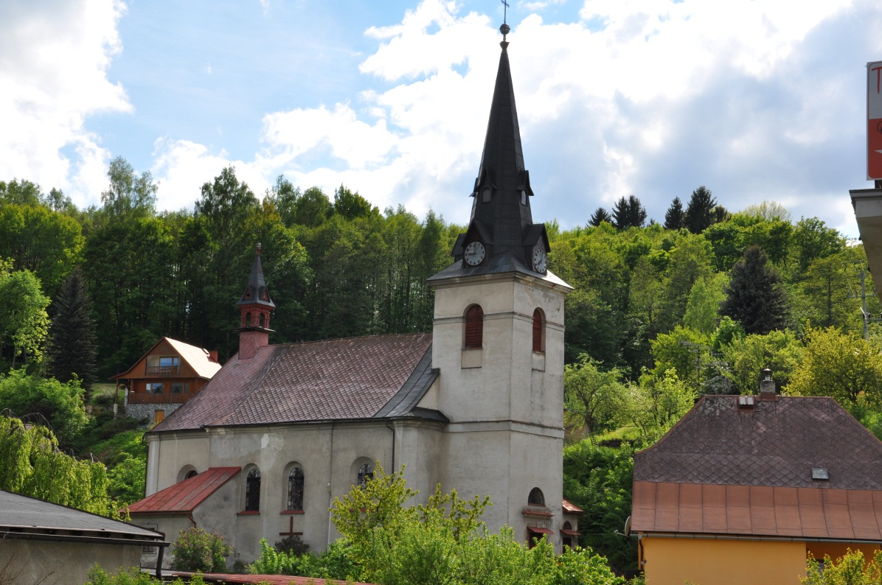
This is the church. At Christmas we sing Christmas carols there. It is very old building.

Slide 8
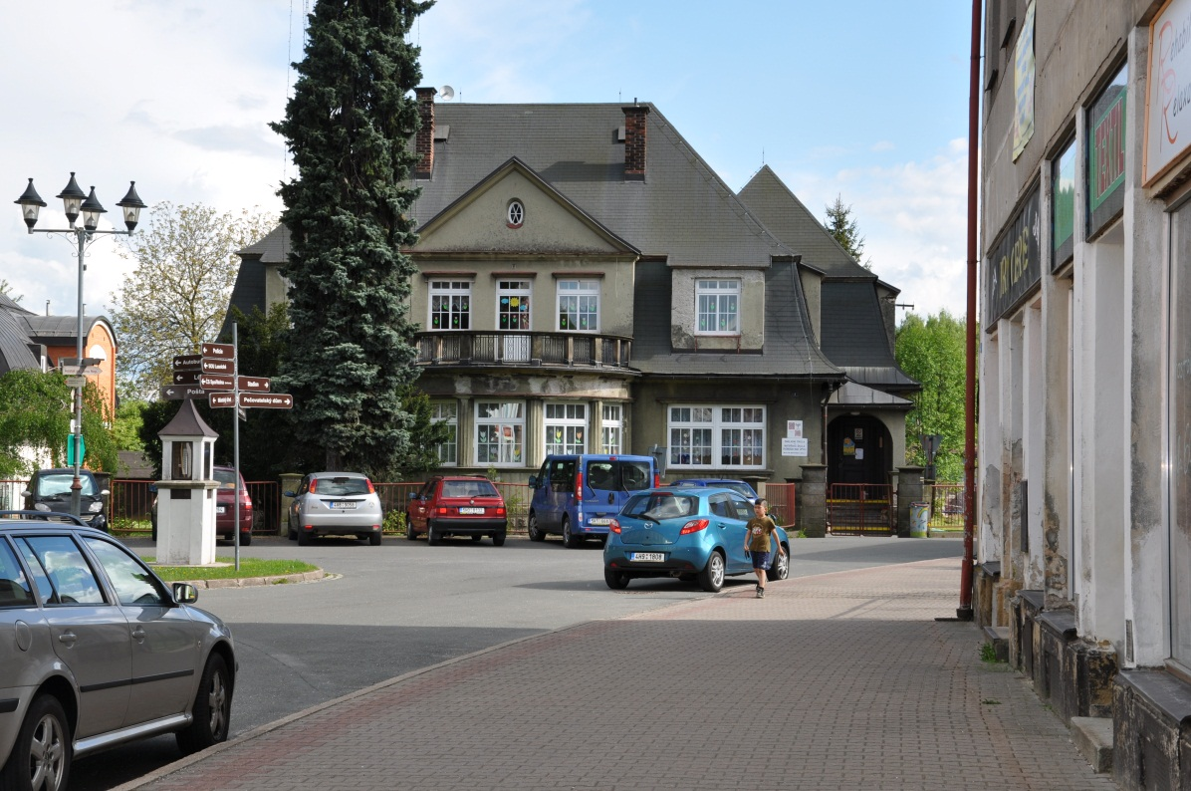
This is the nursery school.Small children go and play there.

Slide 9
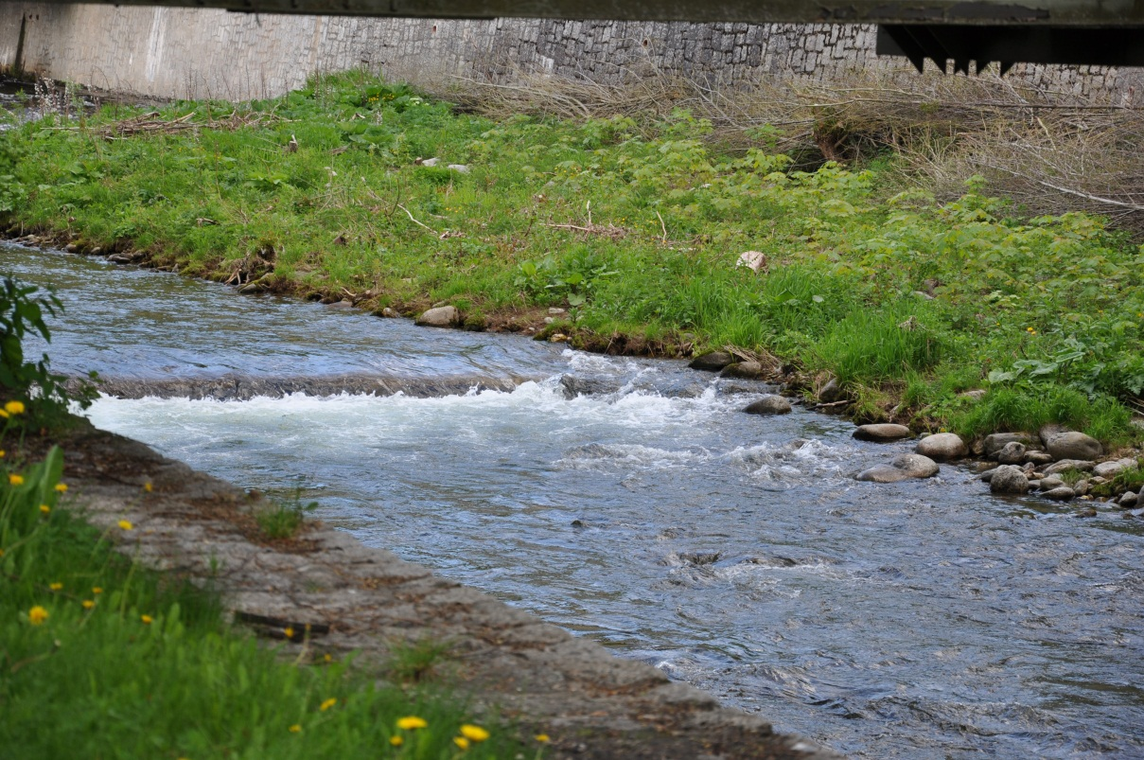
This is the Úpa river. It flows to the Elbe.

Slide 10
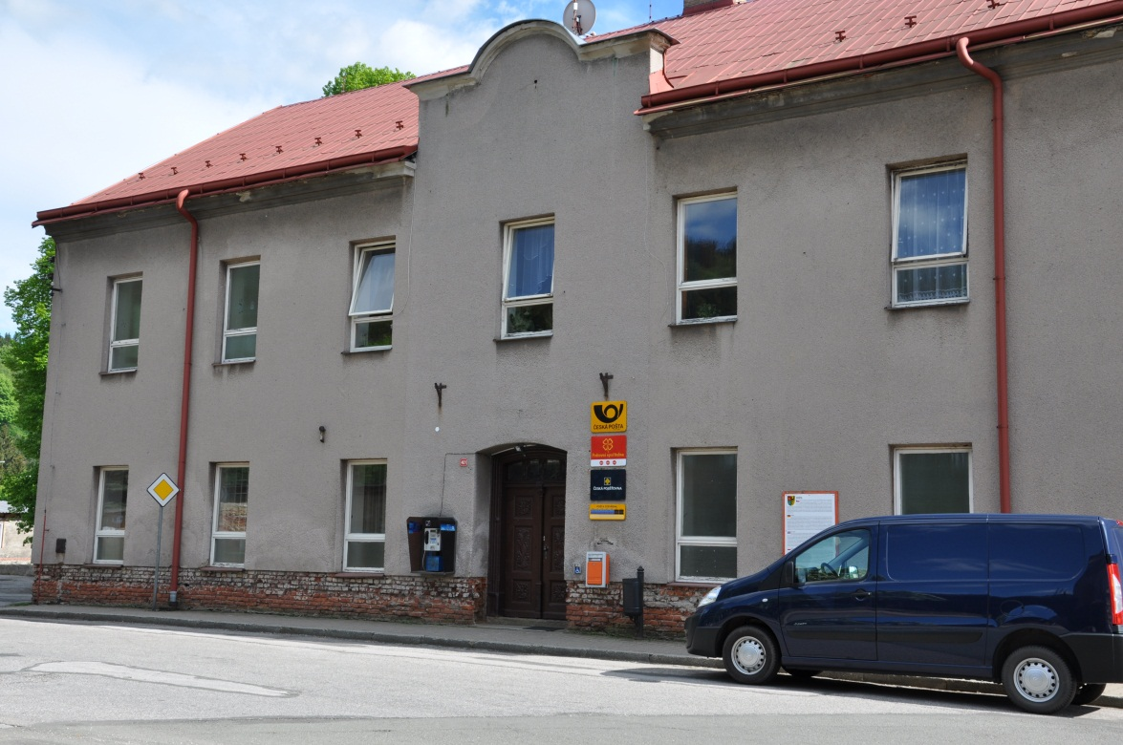
This is the post office. People go there to send their letters.

Slide 11
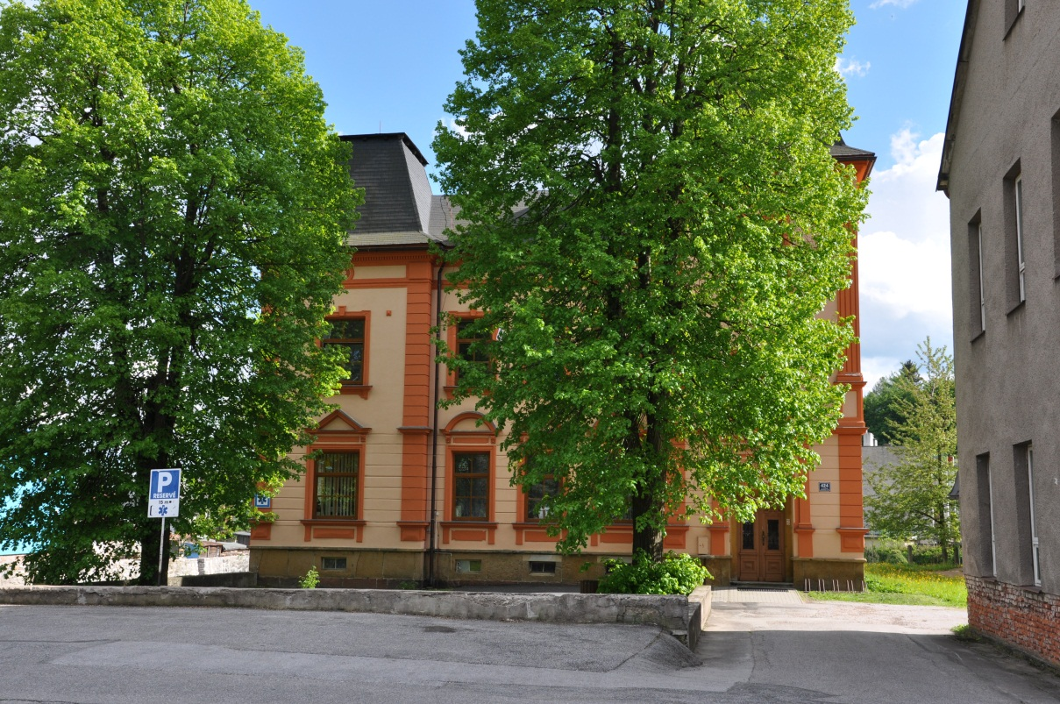
This is the health centre. You can visit a doctor or a dentist there.

Slide 12
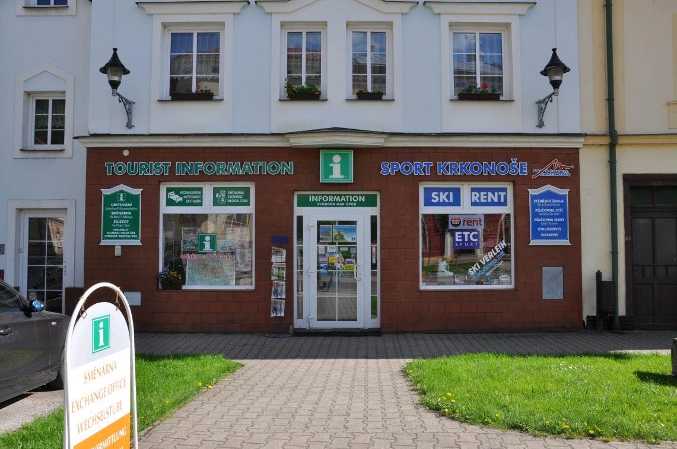
Tourists can get some information in the information office.

Slide 13
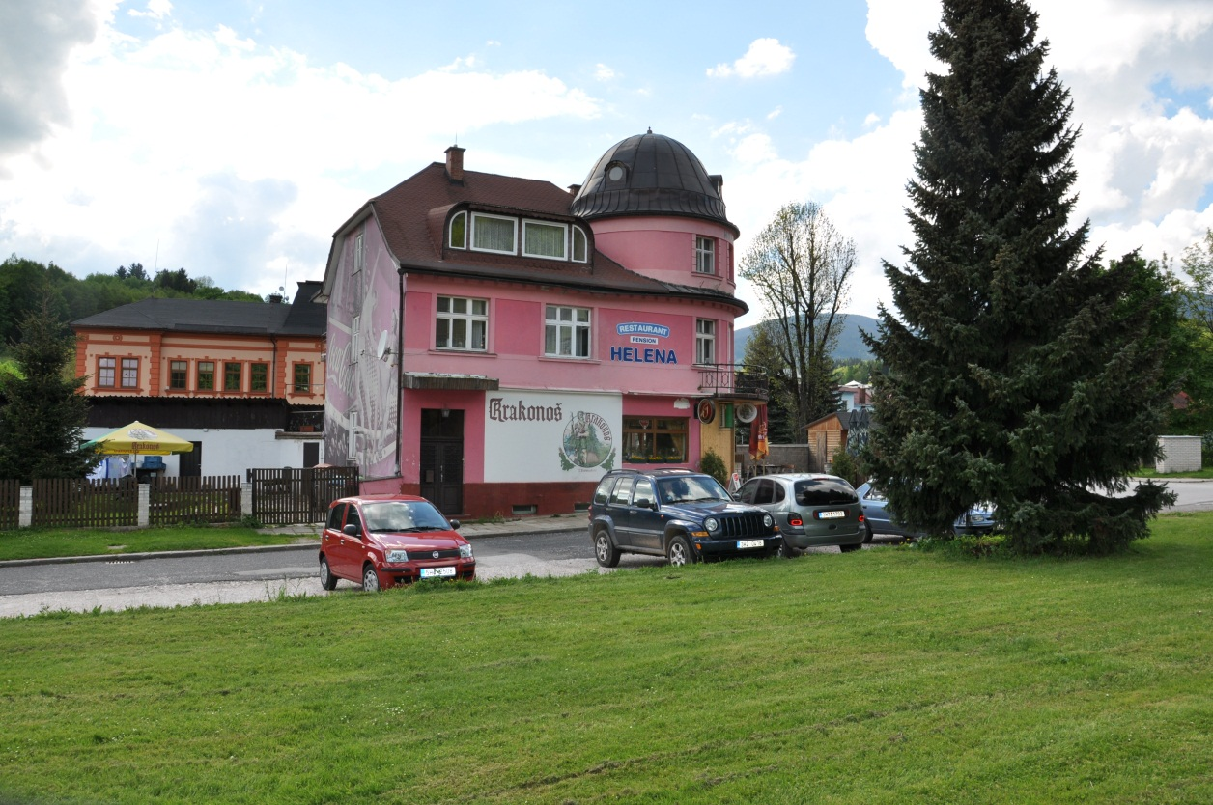
You can get a fine meal in one of the restaurants.

Slide 14
Obrázky: autorské fotografie Lucie Ševčíková

