Slide 1

Základní škola a mateřská škola, Svoboda nad Úpou, okres Trutnov
Bc. Lucie Ševčíková
VY_22_INOVACE_2.2.2 AJ8,9g_5
Téma: vztažné souvětí
28.10.2012
8. a 9. ročník
Číslo projektu : CZ.1.07/1.4.00/21.3068

Slide 2
Anotace
Tento materiál je určen k pochopení a procvičení spojovacích výrazů, who, which, that, whose a where v souvětí vztažném. Žáci ze dvou vět tvoří souvětí za pomocí spojovacích výrazů. Správné řešení se zobrazí po kliknutí. Materiál je určen pro interaktivní tabule.

Slide 3
Relative clauses
Vedlejší vztažné věty

Slide 4
I met John who is kind to everybody.
VĚTA HLAVNÍ
VĚTA VEDLEJŠÍ

Slide 5
Who is used for people
The man is my uncle.
He is sweeping the floor.
The man who is sweeping the floor is my uncle.

Slide 6

Which is used for things
The plane is big.
It flies to Japan.
The plane which flies to Japan is big.

Slide 7
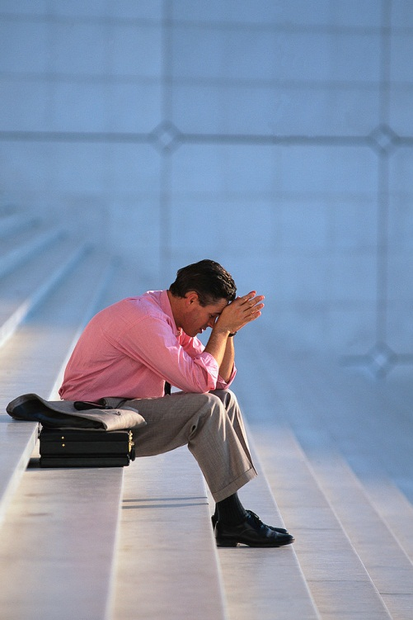
Whose is used as possessive
This is the man.
His money was stolen.
This the man whose money was stolen.

Slide 8
that is used for people, things and animals.
This is the duck.
It was flying in the sky.
This the duck that was flying in the sky.

Slide 9

Where is used for places
The new bookshop is open.
We can buy some books.
This the new bookshop where we can buy some books.

Slide 10
Let´s practice!
The police officer was very friendly. He gave me directions.
The police officer who (that) was very friendly gave me directions.
There is the woman. Her cat died.
There is the woman whose cat died.
This is the castle. I visited it last year.
This is the castle which(that) I visited last year.

Slide 11
This is the park. We can ride bikes there.
This is the park where we can ride bikes.
This is the dog. It was in our garden yesterday.
This is the dog that was in our garden yesterday.
WELL DONE!!!.

Slide 12
Obrázky:
Kliparty Galerie Microsoft - www.office.microsoft.com

