Slide 1

Obrázky: http://office.microsoft.com
Název školy : Základní škola a mateřská škola,
Svoboda nad Úpou, okres Trutnov
Autor : Bc. Lucie Ševčíková
Datum : 16. 12. 2012
Název : VY_22_INOVACE_2.2.2 AJ8,9k_8
Téma : Multicultural Britain
Ročník : 8. a 9.
Číslo projektu : CZ.1.07/1.4.00/21.3068

Slide 2
Anotace
Tento materiál slouží k představení multikulturní Británie. Jaké národnosti zde žijí, jaké jsou jejich zvyky a kde se můžeme setkat s jejich tradičními festivaly. Prezentace obsahuje i odkazy na videoukázky z těchto festivalů. Poslední snímek obsahuje kontrolní otázky. Materiál je určen pro žáky 8. a 9. ročníku.

Slide 3

Multicultural Britain
Multikulturní Británie

Slide 4
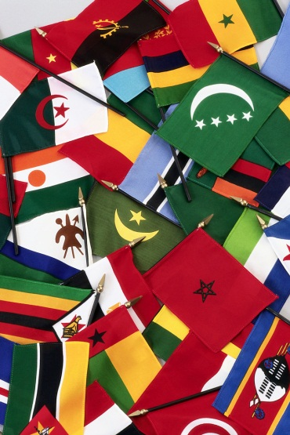
Multiculturalism
=different ethnic cultures within a community
Pakistani (43%), Bangladeshi (17%) and Indians (7%)
others from e.g. Africa, the Caribbean, Eastern Europe (Bosnia), the Middle East

Slide 5
Coming to the UK
The large immigration of Muslims began in the 1950s. They came from South Asia to look for a job.
They settled in London, the textile towns of northern England and the Strathclyde region of Scotland.

Slide 6
Where can you find Muslims in the UK?
There are Muslim communities all over Britain, but the largest populations are in London, Manchester, Birmingham and Bradford.

Slide 7
How many Muslims are there in the UK?
The 2001 Census noted that there were about 1.6 million Muslims in Britain – this is now probably closer to 2 million…
.. that’s about 5% of the population

Slide 8
Indian restaurants
Indian restaurants are the most favourite ones in the UK.
The first curry house in Britain opened in London in 1808.
The Muslims from Pakistan and Bangladesh usually make the food in these restaurants.

Slide 9
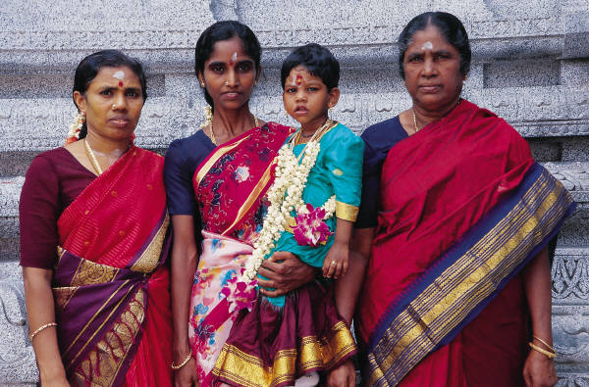
The fashion
British Muslims wear a wide variety of dress. While many still wear traditional clothing.

Slide 10
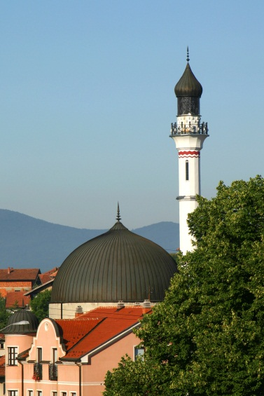
The mosques
In 2007 there were 1,500 mosques in Britain.

Slide 11
Sport
British Muslims like to play cricket and badminton.

Slide 12
The Mela
Every summer the city of Bradford hosts the annual "Mela" festival - a celebration of Asian arts and culture which is one of the largest events of its kind in Europe.

Slide 13
The Notting Hill Carnival
People moving to Britain have brought their own cultures and try to keep two cultures alive. An excellent example of this is the Notting Hill Carnival which is celebrates the Caribbean Culture and is now a very big part of the British life today.

Slide 14
What do you remember?
What is multiculturalism?
What other nationalities can you find in the UK?
What is Mela?
What kind of sport is favourite in multicultural Britain?
What kind of culture can you see in the Notting Hill Carnival?

Slide 15
Obrázky: http://office.microsoft.com

