Slide 1

Název školy : Základní škola a mateřská škola,
Svoboda nad Úpou, okres Trutnov
Autor : Bc. Lucie Ševčíková Datum : 9. 9. 2012
Název : VY_22_INOVACE_2.2.2 AJ8,9k_10
Téma : School subjects
Ročník : 8. a 9.
Číslo projektu : CZ.1.07/1.4.00/21.3068

Slide 2
Anotace:
Tento DUM procvičuje slovní zásobu na téma školní předměty. Žáci se na základě čtení složitějších definic snaží uhodnout, o jaký předmět se jedná .

Slide 3

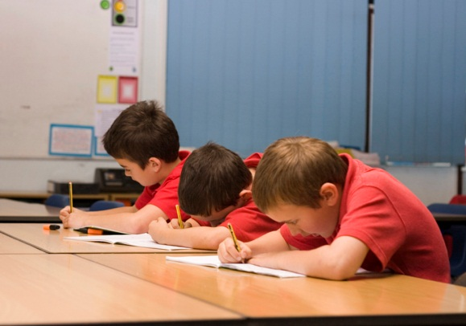

School subjects
PUZZLE

Slide 4


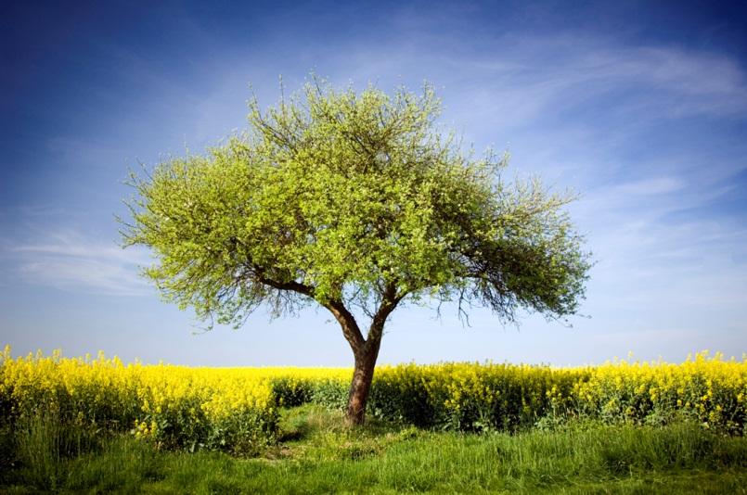
CHEMISTRY
The study of the structure of substances and of the way that they react with other substances.

Slide 5



MUSIC
The study of sounds made by musical instruments or people singing.

Slide 6



ENGLISH
The Germanic language of the British Isles, widespread and standard also in the U.S. and most of the British Commonwealth

Slide 7
HISTORY
The study dealing with past events.

Slide 8
GEOGRAPHY
The study of the natural features of the earth's surface, including topography, climate, soil, vegetation, etc.

Slide 9

ART
The study of paintings, sculptures, and other objects made by famous artists. Also creating paintings.

Slide 10

PHYSICAL EDUCATION(P.E.)
Education in the care and development of the human body, stressing athletics and including hygiene.

Slide 11
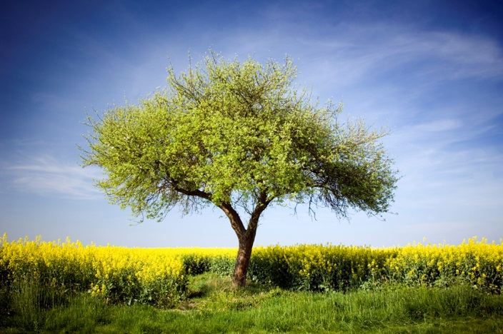
PHYSICS
The study of forces such as heat, light, sound, pressure, gravity, and electricity, and the way that they affect objects.

Slide 12
MATHEMATICS -MATHS
A group of related sciences, including algebra, geometry, and calculus, concerned with the study of number, quantity, shape, and space

Slide 13
BIOLOGY
The study of living organisms, including their structure, functioning, evolution, distribution

Slide 14
obrázky - http://office.microsoft.com/cs-cz/images

