Slide 1

Název školy : Základní škola a mateřská škola,
Svoboda nad Úpou, okres Trutnov
Autor : Bc. Lucie Ševčíková
Datum : 17. 9. 2013
Název : VY_22_INOVACE_2.2.2 AJ8,9k_20
Téma : American schools
Ročník : 8. a 9.
Číslo projektu : CZ.1.07/1.4.00/21.3068

Slide 2
Anotace
Tento materiál představuje žákům 8. a 9. tříd jak probíhá učební proces v amerických školách. Seznámí se i s volnočasovými aktivitami. Následně diskutují o rozdílech mezi českým a americkým školstvím a kterému by dali přednost?

Slide 3

American schools
The daily life of
a student.

Slide 4
School year
The School Year starts around the beginning of September and ends around the middle of June.
Students often have 2 weeks break in December and 1 week of break in February and April.
180 days of school each year

Slide 5
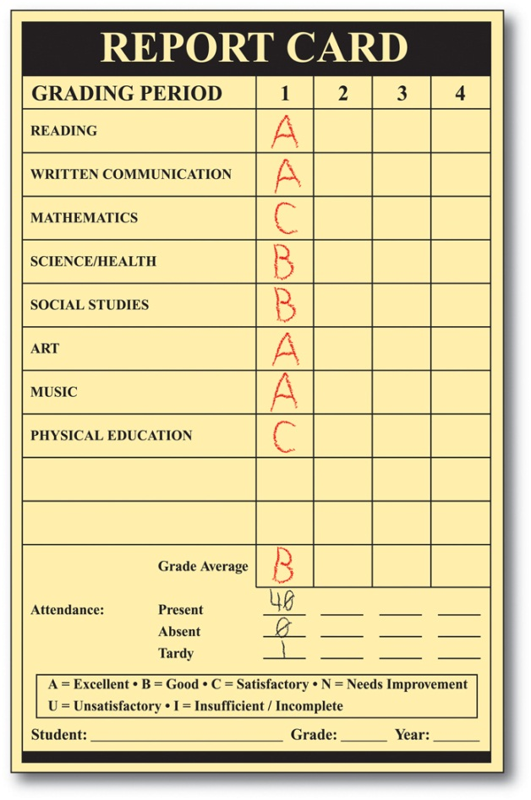
School day
The length of the school day is usually 7 hours.
7:45 am - 3 pm
Every student takes Science, Social Studies, Reading/Writing, Maths
Students in Middle and High school can often choose a special class such as Computers, Ceramics, Wood working, Band…

Slide 6
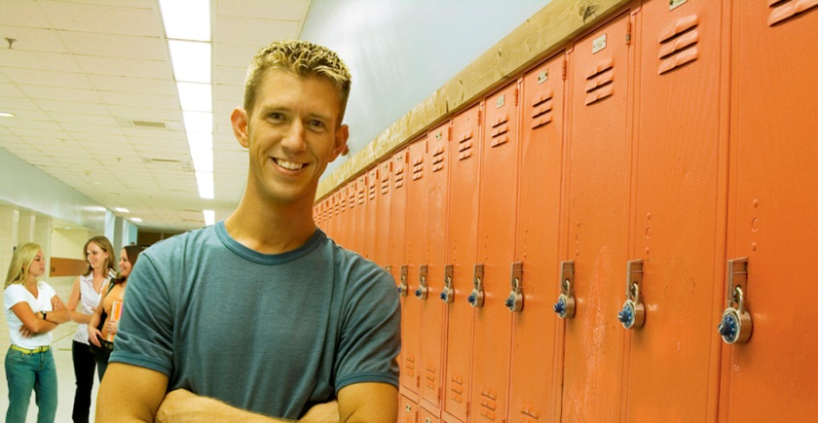
Structure of the school
Students have lockers in the hallway where they keep their things.
Teachers have their own classrooms and students have to move from class to class.
Students have only 4 minutes to pass from class to class.
When the students move they may not be with the same students for all of their classes.

Slide 7

Student participation
(zapojení se do výuky)
Students are expected to participate actively - grades for participation
Students are not allowed to talk or pass papers when the teacher is speaking
Students must raise their hand if they want to speak.
The teacher values students effort, so it is important that students answer the questions even if they are wrong.

Slide 8
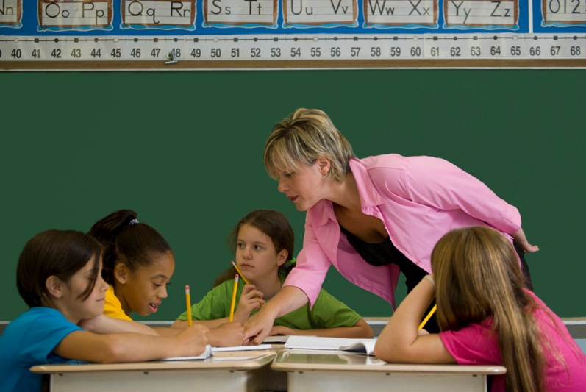
Student participation
Most teacher arrange their lessons in groups in certain times.
By working in groups students learn to work cooperatively. (učí se spolupracovat)
Students do work or projects and play educational games that must complete together.

Slide 9
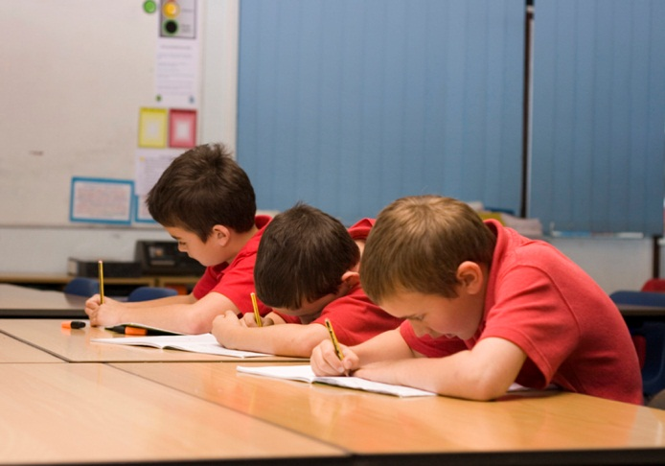
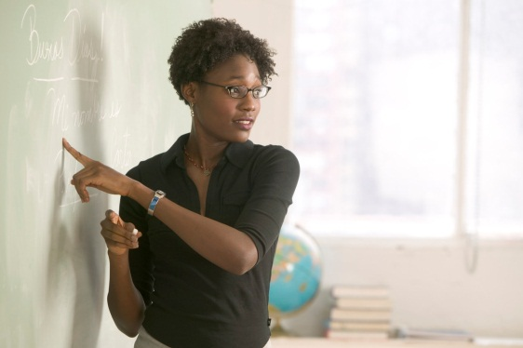
Classroom consequences
Classroom consequences include filling the reflection sheet, after school detention, phone calls home, being sent to the headmaster´s office.
Detention – student must stay after school and do some sort of work.
Suspension – students have to stay at home and this goes on their final report.

Slide 10
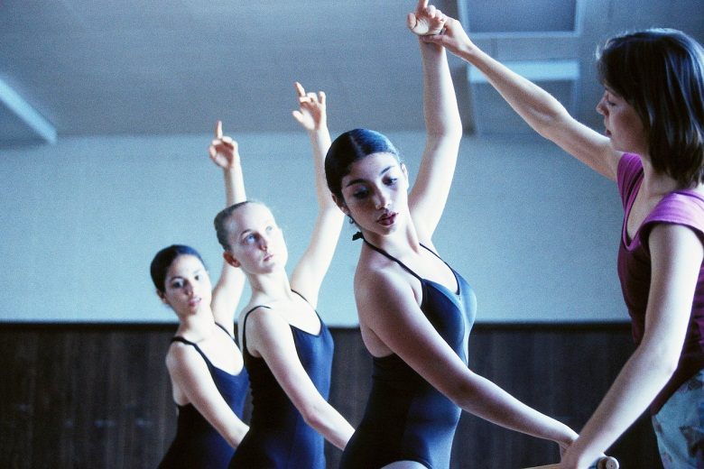
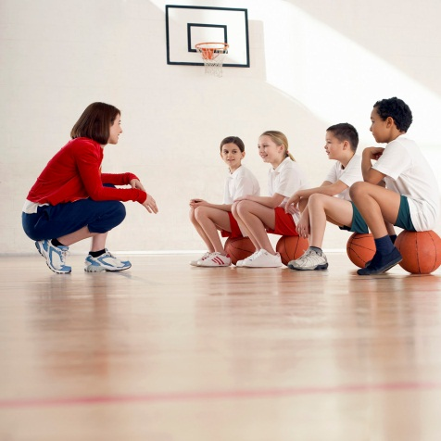
After school
After school students usually take part in extracurricular activities.
These activities are sometimes at school or sometimes parents pay for private activities.
Newspaper – chess – math – football – cheerleading – dance – baseball – volleyball – debate – volunteer work – martial arts – drama ……

Slide 11
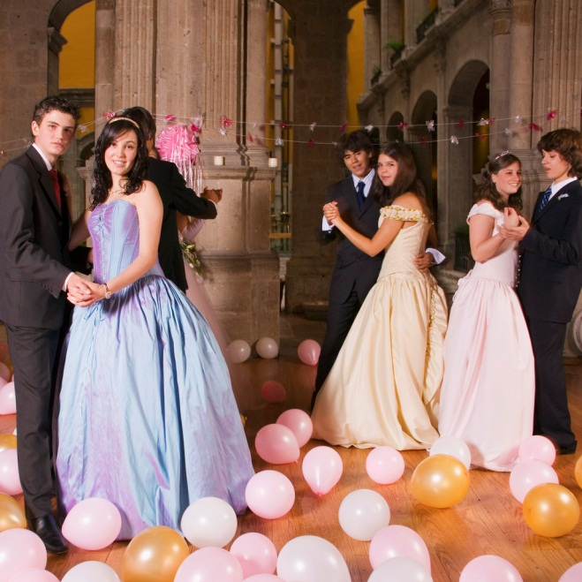
Dances
Prom – a fancy dance usually held in Spring
Students usually plan the prom.
Students often rent limousines as transportation.
Boys were tuxedos and girls wear fancy gowns.
Friends meet before prom and parents take pictures of them.
Proms are usually held at hotels.

Slide 12
Discuss…
What are the differences between American and Czech school?
Would you like to be an American student?
Would you use some of the things in the Czech school system?

Slide 13
Obrázky: http://office.microsoft.com

