Slide 1
Work and Professions
General Topics for The New Maturita Exam
Mgr. Veronika Richterová
VY_32_INOVACE_43-07_VP_Work_and_Professions

Slide 2
Guess the Jobs
BEAUTICIAN
This person looks after your face and skin.
This person cooks a meal for you.
In this job you look after people‘s teeth.
This person stays at home and she does housework.
In this job you write articles for newspapers.
This person prepares contracts for you.
In this job you work under the ground.
COOK
DENTIST
HOUSEWIFE
JOURNALIST
LAWYER
MINER

Slide 3
This person works as a doctor‘s assistent and looks after the patients.
In this job you work with pipes and you construct toilets.
This person is a kind of doctor and he looks after and heals animals.
In this job you do research in a field and you can explore a discovery.
N
U
R
S
E
P
L
U
M
B
E
R
V
E
T
S
C
I
E
N
T
I
S
T

Slide 4
What do you call these jobs in English?
ACCOUNTANT
TAILOR
ÚČETNÍ
KREJČÍ
CONDUCTOR
CHEF
PRŮVODČÍ
ŠÉFKUCHAŘ
DIRECTOR
WAITER
WAITRESS
REŽISÉR, ŘEDITEL
ČÍŠNÍK
ČÍŠNICE
FLIGHT ATTENDANT
JUDGE
LETUŠKA
SOUDCE

Slide 5
HAIRDRESSER
LIBRARIAN
KADEŘNÍK
KNIHOVNÍK
MUSICIAN
POLITICIAN
HUDEBNÍK
POLITIK
PSYCHOLOGIST
TRANSLATOR
PSYCHOLOG
PŘEKLADATEL
SALES REPRESENTATIVE
POSTMAN
POSTWOMAN
OBCHODNÍ
ZÁSTUPCE
POŠŤÁK
POŠŤAČKA

Slide 6

Match the jobs with the pictures
COMPUTER PROGRAMMER
ELECTRICIAN
CAR MECHANIC
DRIVING INSTRUCTOR
DOCTOR

Slide 7
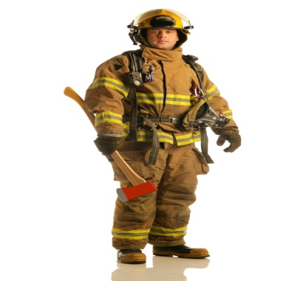
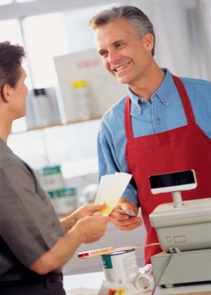
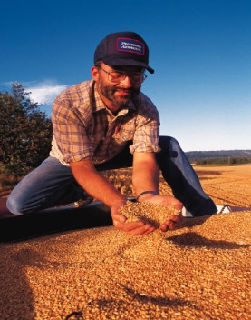
SHOP ASSISTANT
PILOT
CASHIER
FARMER
FIREFIGHTER
FIREMAN

Slide 8
Job can be …
Create the opposites
WELL-PAID
BADLY PAID
FULL-TIME
PART-TIME
PERMANENT
TEMPORARY
MENTAL
MANUAL

Slide 9


People at Work
BOSS
COLLEAGUES
STAFF
These people work with you in one company.
This person manages the firm and tells what to do.
These people are the employees of a company.
EMPLOYER
EMPLOYEE

Slide 10
Looking for a Job …
Match the vocabulary
Inzerát
Životopis
Žádost
Pracovní smlouva
Pohovor
INTERVIEW
CURRICULUM VITAE
EMPLOYMENT CONTRACT
JOB
ADVERT
APPLICATION FORM

Slide 11
COMPLETE
THE
CROSSWORD
A
P
P
L
I
C
A
N
T
C
O
N
T
R
A
C
T
V
I
T
A
E
A
D
V
E
R
T
I
S
E
M
E
N
T
S
A
L
A
R
Y
V
A
C
A
N
C
Y
S
K
I
L
L
S
E
X
P
E
R
I
E
N
C
E
W
O
R
K
I
N
G
1. A person who wants to apply for a job is an …
5. As a reward for your work you get a …
2. When you start your job you sign a working…
6. If the offered job is free it is a …
3. To show your qualifications you write a Curriculum…
7. In a CV you show your qualifications and…
4. Job offers can be found in a newspaper …
8. If you have used something already, you have.
9. In every job there are … conditions

Slide 12
Money
The money you get for your work
Choose from the vocabs below
Income that you receive for a done work
Fixed monthly-received income
When you get more money for your work
INCOME
EARNING
SALARY
WAGE
PAY RISE

Slide 13
Extra money as a part of your salary
Money that you get when you are retired
An amount of money that you have to pay for something
The pure amount of money your company earns
PROFIT
BONUS
FEE
PENSION

Slide 14
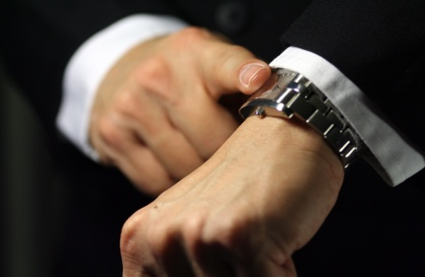
Being at work …
TO WORK OVERTIME
TO DEAL WITH PEOPLE
PRACOVAT PŘESČAS
JEDNAT S LIDMI
A BAD WORKPLACE
TO ASSIST A COLLEAGUE
ŠPATNÉ PRACOVNÍ MÍSTO
POMÁHAT KOLEGOVI
TEAMWORK
TO MANAGE A COMPANY
TÝMOVÁ PRÁCE
ŘÍDIT FIRMU
TO EARN 5 POUNDS PER HOUR
VYDĚLÁVAT 5 LIBER ZA HODINU
FAIR MANAGEMENT
SPRAVEDLIVÉ VEDENÍ

Slide 15

Not being at work …
When you are free from work for a while to relax you are on a __ __ __ __ __ __ __.
When you decide to leave the work on your own, you __ __ __ __ __ __.
When your boss decides you leave your job, you are __ __ __ __ __
H
O
L
I
D
A
Y
R
E
S
I
G
N
TELL THE SYNONYM
TO GIVE UP WORK
F
I
R
E
D
TELL THE SYNONYM
TO BE SACKED

Slide 16
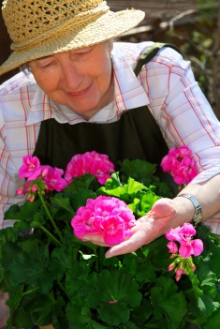

When you leave your job because of your age (you are old) you ….
When you leave your job because of an illness or injury you are…
If you stay at home and don‘t work because you can‘t find a job you are …
When you are unemployed, you receive an unemployment …
ON A SICK LEAVE
UNEMPLOYED
BENEFIT
RETIRE

Slide 17
Match the prepositions
WITH
APPLY
FOR
BE IN CHARGE
ON
BE RESPONSIBLE
OF
CONCENTRATE
OFF
DEAL
FOR
TAKE A DAY

Slide 18
Complete the sentences
„What do you do ___ a living?“ „I work ___ a secretary.“
If you want to apply ___ this job, you have to fill ___ this application form.
If you are dissatissfied with the working conditions, you have to go ___ strike!
„What are you doing?“ „I‘m looking ___ a job.“
FOR
AS
FOR
IN
ON
FOR

Slide 19
Job Carrier – Complete with suitable words
I started my job career ___ a shop assistant ___ a company Tesco. I was in _______ of supply. I worked on ______ - daily and night. Because I ____ my job well, I got ___________. Now I worked ___ a manager of food section. I was responsible ___ managing the people so I dealt _____ people a lot. But it was mentally demanding and I also worked _____ hours and I took day ___ very often. And then I was _______. I was unemployed and desperate. I had been looking ___ a new job for whole seven months. I applied for 23 jobs, filled in several application forms but still nothing. I even went __ strike! Then I decided to be self-_________ . Now I earn my ______ as a dog-sitter. My job _________ taking care of dogs while their owners aren‘t at home. And I am happy!
as
for
charge
shifts
did
promoted
as
for
with
long
off
fired
for
on
employed
living
involves

Slide 20
Sources
Klipart Microsoft PowerPoint Presentation 2007, 2010
HASTINGS, Bob. Maturita activator: intenzivní příprava k maturitě : anglický jazyk - základní úroveň obtížnosti. Warszawa: Pearson Education Polska, 2009, 215 s. ISBN 978-83-7600-055-8.
http://www.bridge-online.cz/
http://www.bridge-online.cz/aitom/upload/maturita/karty/13_job.pdf

