Slide 1
Sport
General Topics for The New Maturita Exam
Mgr. Veronika Richterová
VY_32_INOVACE_43-15_VP_Sport

Slide 2
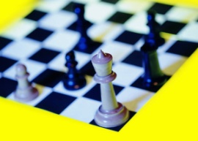
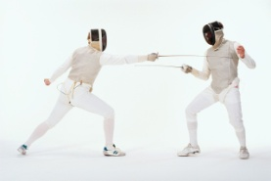
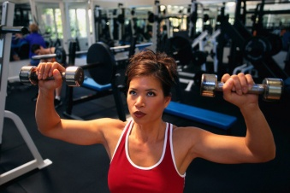
Match the Sports with the Pictures
FENCING
HAMMER THROWING
COMBAT
SPORT
ARCHERY
DIVING
CHESS
WEIGHT
LIFTING
DARTS
WREST
LING
HORSE
RACING

Slide 3
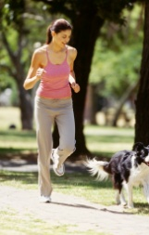
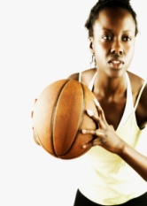
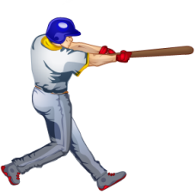
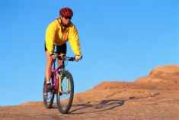
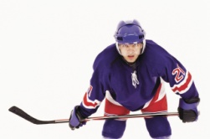
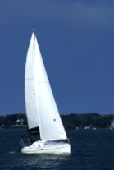
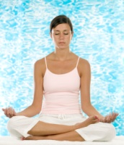
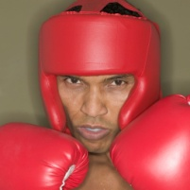
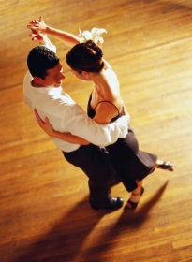
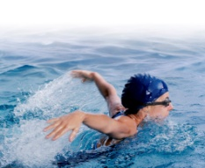
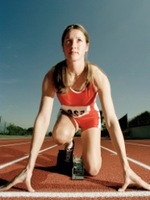
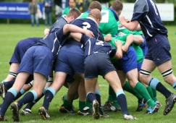
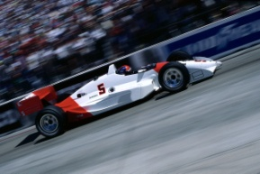
What do we call these sports…?
BADMINTON
JOGGING
BASKET
BALL
GYMNASTICS
BASEBALL
SKIING
CYCLING
ICE HOCKEY
SAILING
YOGA
AEROBICS
BOXING
DANCING
SWIMMING
GOLF
SKATING
RUGBY
ATHLETICS
CAR RACING
CRICKET

Slide 4
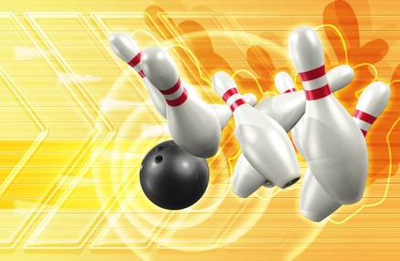
Types of Sports
When a sport is played INSIDE, not outside, it is
INDOOR SPORT
When a sport is played outside, not inside, it is
OUTDOOR SPORT
A sport which is played by many players is called
TEAM SPORT
A sport which is played only by one person is called
INDIVIDUAL SPORT
Tell examples

Slide 5
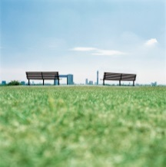
Divide the Sports
INDOOR SPORTS
OUTDOOR SPORTS
TENNIS
VOLLEYBALL
HORSERACING
FENCING
THROW THE HAMMER
WRESTLING
CRICKET
SQUASH

Slide 6
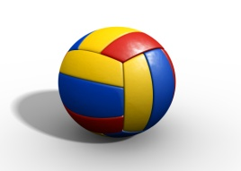
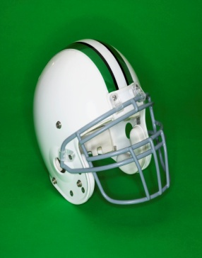
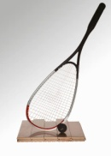
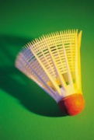

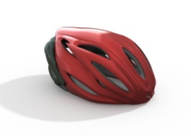
Equipment
For playing football you need …
B
A
L
L
G
O
A
L
B
O
O
T
S
For playing badminton you need …
R
A
C
K
E
T
S
H
U
T
T
L
E
C
O
C
K
For playing tennis you need a racket, a ball and a …
N
E
T
For skating you need …
S
K
A
T
E
S
H
E
L
M
E
T

Slide 7
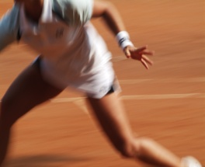
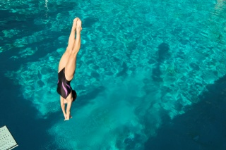

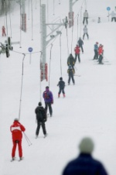
Places
TENNIS
RINK
RINK
ICE
PITCH
PITCH
FOOTBALL
POOL
POOL
SWIMMING
SLOPE
SLOPE
BOXING
COURT
COURT
SKI
RING
RING

Slide 8
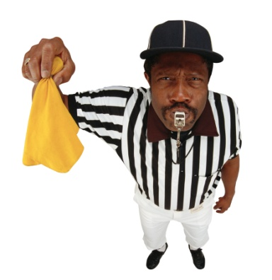
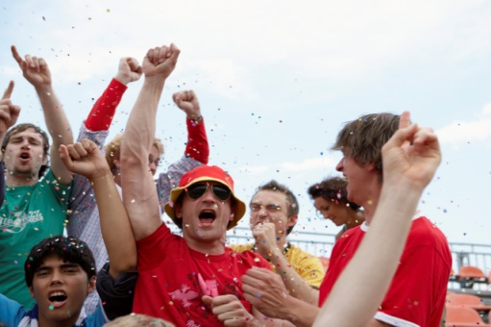
People
CROSS OUT THE WORD THAT DOES NOT CORRESPOND
WITH THE OTHERS
FAN
SPECTATOR
COACH
SUPPORTER
ATHLETE
TEAM
PROFE
SSIONAL
CHAMPION
COMPETITOR
OPPONENT
RIVAL
CONTESTANT

Slide 9
Translate the Vocabulary
PROHRÁT
LOSE
PENALTA
VICTORY
PENALTY
VÍTĚZSTVÍ
REMÍZA
DRAW
BEAT
PORAZIT
BODY
POINTS
CHEER
POVZBU
ZOVAT
MATCH
COMPETITION/RACE
SOUTĚŽ,
ZÁVOD
TRAIN
TRÉNOVAT
ATTACK
ZAÚTOČIT
HALF-TIME
POLOČAS
DEFEND
BRÁNIT
BOJOVAT
FIGHT
VZDÁT SE
GIVE UP
SCORE
ZABODOVAT
MEDAILE
MEDAL

Slide 10
Divide the Sports
DO
GO
PLAY
KARATE
ATHLETICS
SQUASH
BRIDGE
SWIMMING
JOGGING
FOOTBALL
YOGA
SKATE
BOARDING
ROLLER
BLADING
CYCLING
AEROBICS
AIKIDO
CHESS
DARTS

Slide 11
Complete the Sentences
„Who‘s in the _________?“ „It‘s Mary who‘s the captain.“
lead
„What sport do you _____?“ „I _____ cycling every weekend.“
do
go
„Did you win the match?“ „No, we‘ve _______ it – 0:3.“
lost
We were winning the match until the time when our rival ________ the goal.
scored
„I‘d like to lose some weight after Christmas.“ „Why don‘t you take _____ a sport?“
up
Michael‘s been doing thai box for six years but it hasn‘t been until last year when he _________ professional.
turned
out
„You‘ve got awesome figure!“ „You know, I work ______ every day.“

Slide 12
Sources
Klipart Microsoft PowerPoint Presentation 2007, 2010
HASTINGS, Bob. Maturita activator: intenzivní příprava k maturitě : anglický jazyk - základní úroveň obtížnosti. Warszawa: Pearson Education Polska, 2009, 215 s. ISBN 978-83-7600-055-8.
http://www.bridge-online.cz/

