Slide 1
Health
General Topics for The New Maturita Exam
Mgr. Veronika Richterová
VY_32_INOVACE_43-17_VP_Health

Slide 2
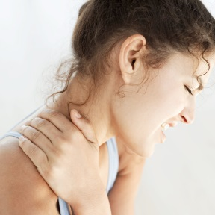
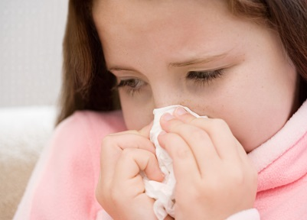
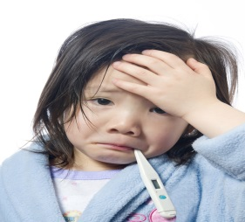


Illnesses
What‘s the synonym of illness?
DISEASE/SICKNESS/CONDITION
Match the words with the pictures
CANCER
TO CHOKE
WOUND
BROKEN ARM
FEVER
TO SNEEZE

Slide 3
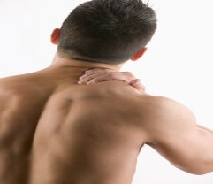

Pains and Aches
ACHE
BACKACHE
ACHE
EARACHE
ACHE
STOMACHACHE
ACHE
HEADACHE
ACHE
TOOTHACHE
You can feel …
SICK
TERRIBLE
ŠPATNĚ
STRAŠNĚ
SLABĚ
WEAK
ZÁVRAŤ
DIZZY

Slide 4
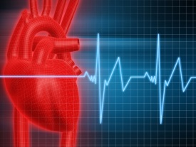
WHAT DO YOU SUFFER FROM …
A JAUNDICE
AN INSOMNIA
When your eyes and skin have yellow colour?
When you can‘t sleep?
When you have problems with lungs?
When you have strange stains all over your body?
A PNEUMONIA
A RASH
A FEVER
When you have a high temperature?
When your heart collapses?
A HEART ATTACK
A SKIN CONDITION
A FOOD POISONING
When you have problems with your skin?
When you have eaten a bad food?
A STROKE
When your brain veins are choked?
When you have touched a hot saucepan?
A BURN
When you can‘t stop coughing?
When you have a runny nose and high temperature?
A COUGH
A FLU

Slide 5
Are these sentences TRUE or FALSE?
When you bleed it means that you can be wounded.
T
When you are terminally ill, it means that your illness can be cured.
F
can‘t
To feel dizzy means the same as to faint.
F
závrať
omdlít
An injury is a synonym of an illness.
F
A disease
If you regain your sight it means that you can‘t see at all now.
can see again
F
Side effects of pills are possible problems that the pills can cause you.
T
When you sneeze all day it means that you suffer from a cough.
F
cold/runny nose
Vomitting can be a symptom of food poisoning.
T

Slide 6
SENSES PROBLEMS
HARD OF HEARING
You can‘t see at all
You can‘t see at all
DEAF
You can‘t move
You can‘t move
DUMB
You can‘t speak at all
You can‘t speak at all
MENTALLY DISABLED
You don‘t see well
You don‘t see well
SHORT-SIGHTED
You can‘t hear at all
You can‘t hear at all
BLIND
Your brain is not ok
Your brain is not ok
PHYSICALLY DISABLED
MATCH THE VOCABULARY
You can‘t hear well
You can‘t hear well
SORE
TWISTED
SWOLLEN
UPSET
DREADFUL
SERIOUSLY
PAIN
ILL
STOMACH
THROAT
ANKLE
TONSILS

Slide 7
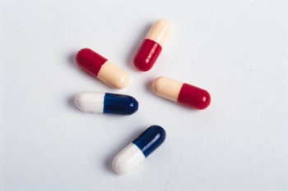
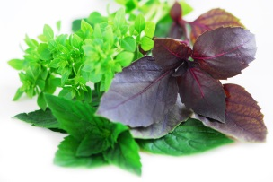

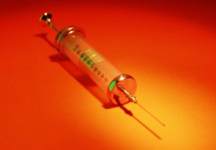
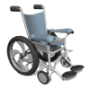
Treatment
SURGERY
THERMOMETER
WHEEL
CHAIR
PLASTER
DROPS
PILLS
HERBS
X-RAY
PRESCRI
PTION
INJECTION

Slide 8
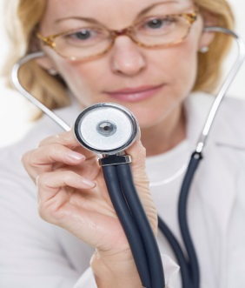
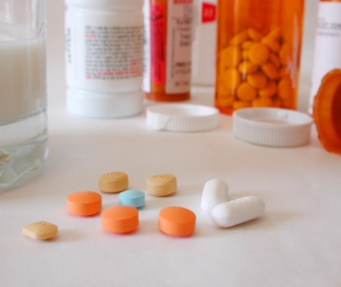
Translate:
MEDICINE
CURE
CHECK-UP
LÉK
PROHLÍDKA
EXAMINE
GET BETTER
VYŠETŘIT
UZDRAVIT SE
FIRST AID
PRVNÍ POMOC
PAIN
KILLERS
RUN TESTS
SEDATIVA
PROVÉST TESTY
TREAT
CURE
VACCINE
LÉČIT
VAKCÍNA

Slide 9
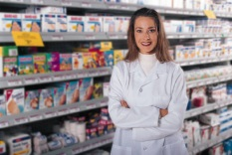
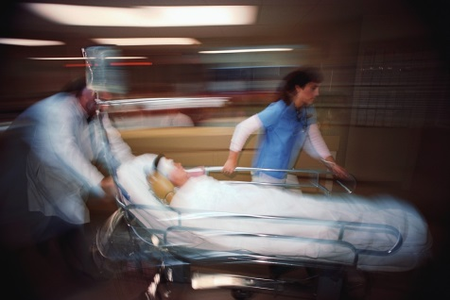
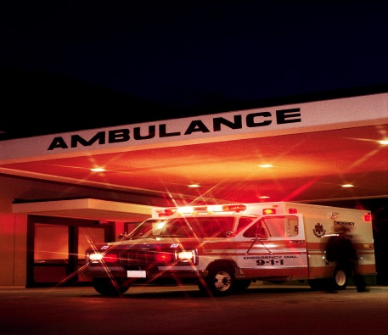
Health Care
SANITKA
WARD
AMBULANCE
ODDĚLENÍ
DENTIST
DOCTOR
ZUBAŘ
LÉKAŘ
SPECIALIST
PACIENT
ZDRAVOTNÍ PÉČE
PRAKTICKÝ LÉKAŘ
PATIENT
NURSE
HEALTH CARE
GP
SPECIALISTA
ZDRAVOTNÍ SESTRA
ZDRAVOTNÍ STŘEDISKO
HOSPITAL
HEALTH CENTRE
NEMOCNICE
CHIRURG
SURGEON
CHIRURGIE
SURGERY

Slide 10
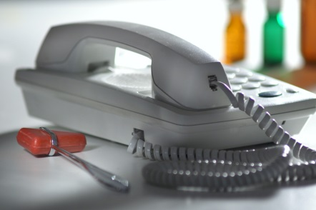

At the Doctor‘s
MAKING AN APPOINTMENT
Mark Johnston. Ok, I‘ll be there on Friday. Thanks.
Good morning. Can I please make an ______________ to see Doctor Smith?
1.
Good morning. Of course. Mr. Smith is free on Friday at 8 a.m. Your name?
appointment
BZZZZ …

Slide 11
2.
AT THE DOCTOR‘S SURGERY
Well, doctor, I ______ terrible. I have a shiver, my whole body hurts , I also have a head______, runny _______ and a cough.
feel
Ok, I see. Now I am going to _______ you. I‘m going to ______ your temperature and blood ________.
examine
ache
So, what‘s the matter?
take
nose
pressure

Slide 12
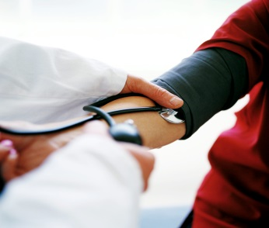
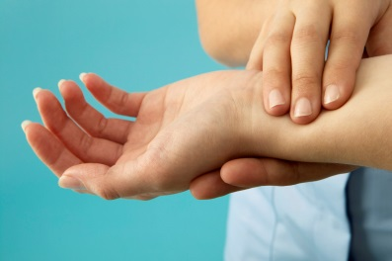
3.
MEDICAL CHECK-UP/
MAKING THE EXAMINATION
Look Mr. Johnston. According to your symptoms, you suffer ______ flu. I‘m going to __________ you some pills and drops. But you should also stay in _____, ______ a lot of liquids and eat plenty of fruit and _________.
Right, thanks very much, doctor Smith. Goodbye.
So, what‘s my diagnosis?
from
prescribe
bed
drink
vegetable

Slide 13
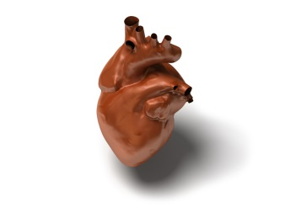
Organs of the Body
SPINE
LUNGS
HEART
STOMACH
MUSCLES
BONE
INTESTINES
LIVER

Slide 14
Healthy Lifestyle
AVOID STRESS
VYHNOUT SE STRESU
OMEZIT TUČNÁ JÍDLA
TAKE UP A SPORT
CUT DOWN ON FATTY FOOD
ZAČÍT SE SPORTEM
HOW TO LIVE A HEALTHY LIFE?
CVIČIT
OMEZIT STRES
DO EXERCISE
REDUCE STRESS
ZANECHAT KOUŘENÍ
GIVE UP SMOKING
FOLLOW A SENSIBLE DIET
DODRŽOVAT ROZUMNOU STRAVU
GET ENOUGH SLEEP
DOSTATEČNĚ SPÁT

Slide 15
What do you do to keep fit?
To keep myself fit I do many things. Firstly, I do regular ______ – every Friday I work ___ in a local gym. I am also thinking about taking __ jogging. Secondly, I try to cut ____ on fatty food – I eat _____ food and I try to _____ a sensible diet. Last year I also gave __ smoking.
Thirdly, I also try to get enough ____ because sleeping is very important. Lastly but not leastly, I try to _____stress as much as possible. Every evening I relax by listening __ my favourite music.
exercise
out
up
down
healthy
follow
up
sleep
avoid
to

Slide 16
Phrases
BE ADDICTED TO
BE ALLERGIC TO
BÝT ZÁVISLÝ NA
BÝT ALERGICKÝ NA
DIE OF
OPEROVAT NĚKOHO
ZEMŘÍT NA
OPERATE ON SOMEBODY
SUFFER FROM
RECOVER FROM
TRPĚT ČÍM
ZOTAVIT SE Z
MAKE AN APPOINTMENT
PORADIT SE S LÉKAŘEM
OBJEDNAT SE U LÉKAŘE
CONSULT A DOCTOR
NEROZČILOVAT SE
BÝT V DOBRÉ FORMĚ
TAKE THINGS EASY
BE IN GOOD SHAPE
TAKE TEMPERATURE
ZMĚŘIT TLAK
ZMĚŘIT TEPLOTU
TAKE BLOOD PRESSURE

Slide 17
Correct the Mistakes
I love chocolate so much! I think that I am addicted on it!
to
My grandmother Louisa died from stroke last year.
of
Have you already recovered of your illness?
from
Don‘t stress! Just calm down and take things ok!
easy
„How are you? You look so weak.“ „Yeah, I suffer of insomnia.“
from
„Can I speak to Doctor Smith now?“ „I‘m sorry but he is just operating an old woman.“
on
I can‘t eat nuts. I am allergic on it.
to

Slide 18
Translate the Sentences
What are you allergic to? I am allergic to antibiotics.
Na co jste alergický? Jsem alergický na antibiotika.
My uncle has died of a cancer.
Můj strýc zemřel na rakovinu.
Take things easy and you‘ll be in a good shape!
Nerozčiluj se a budeš v dobré formě!
„Mám bolest v noze!“ „Měl by ses poradit s lékařem.“
„I have a pain in my leg!“ „You should consult your doctor.“
First you must make an appointment to see your doctor.
Nejprve se musíš u lékaře objednat.
Doktor ti změří krevní tlak a teplotu.
The doctor will take your blood pressure and temperature.
I am addicted to smoking. I can‘t give it up.
Jsem závislý na kouření. Nemůžu toho nechat/přestat.
My brother suffered from pneumonia, but he has already recovered from it.
Můj bratr měl trpěl zápalem plic, ale už se zotavil.

Slide 19
Sources
Klipart Microsoft PowerPoint Presentation 2007, 2010
HASTINGS, Bob. Maturita activator: intenzivní příprava k maturitě : anglický jazyk - základní úroveň obtížnosti. Warszawa: Pearson Education Polska, 2009, 215 s. ISBN 978-83-7600-055-8.
http://www.bridge-online.cz/

