Slide 1



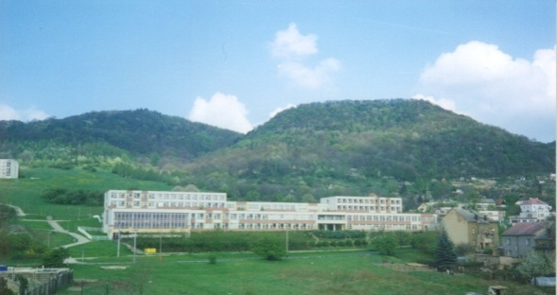
ZÁKLADNÍ ŠKOLA ÚSTÍ NAD LABEM, HLAVNÍ 193, 403 31
Tel.:472731819, 472731253 Tel.řed./fax:472731480, e-mail:skola@zsmojzir.cz
VÝUKOVÝ MATERIÁL ZPRACOVANÝ V RÁMCI PROJEKTU
MODERNÍ ŠKOLA
Registrační číslo projektu: CZ.1.07/1.400/21.3095

Slide 2
Číslo klíčové aktivity: III/2
Název klíčové aktivity:
Inovace a zkvalitnění výuky prostřednictvím ICT
Autor: Mgr. Radka Kainová
Vytvořeno: 5. 9. 2012
Ročník: 4.
Vzdělávací oblast: ANGLICKÝ JAZYK - PROTIKLADY
Anotace: Výukový materiál je určen pro žáky 4. ročníku. Slouží k osvojení protikladných přídavných jmen, jejich použití ve větách za pomoci přítomného času průběhového.

Slide 3
Protiklady
Opposites

Slide 4
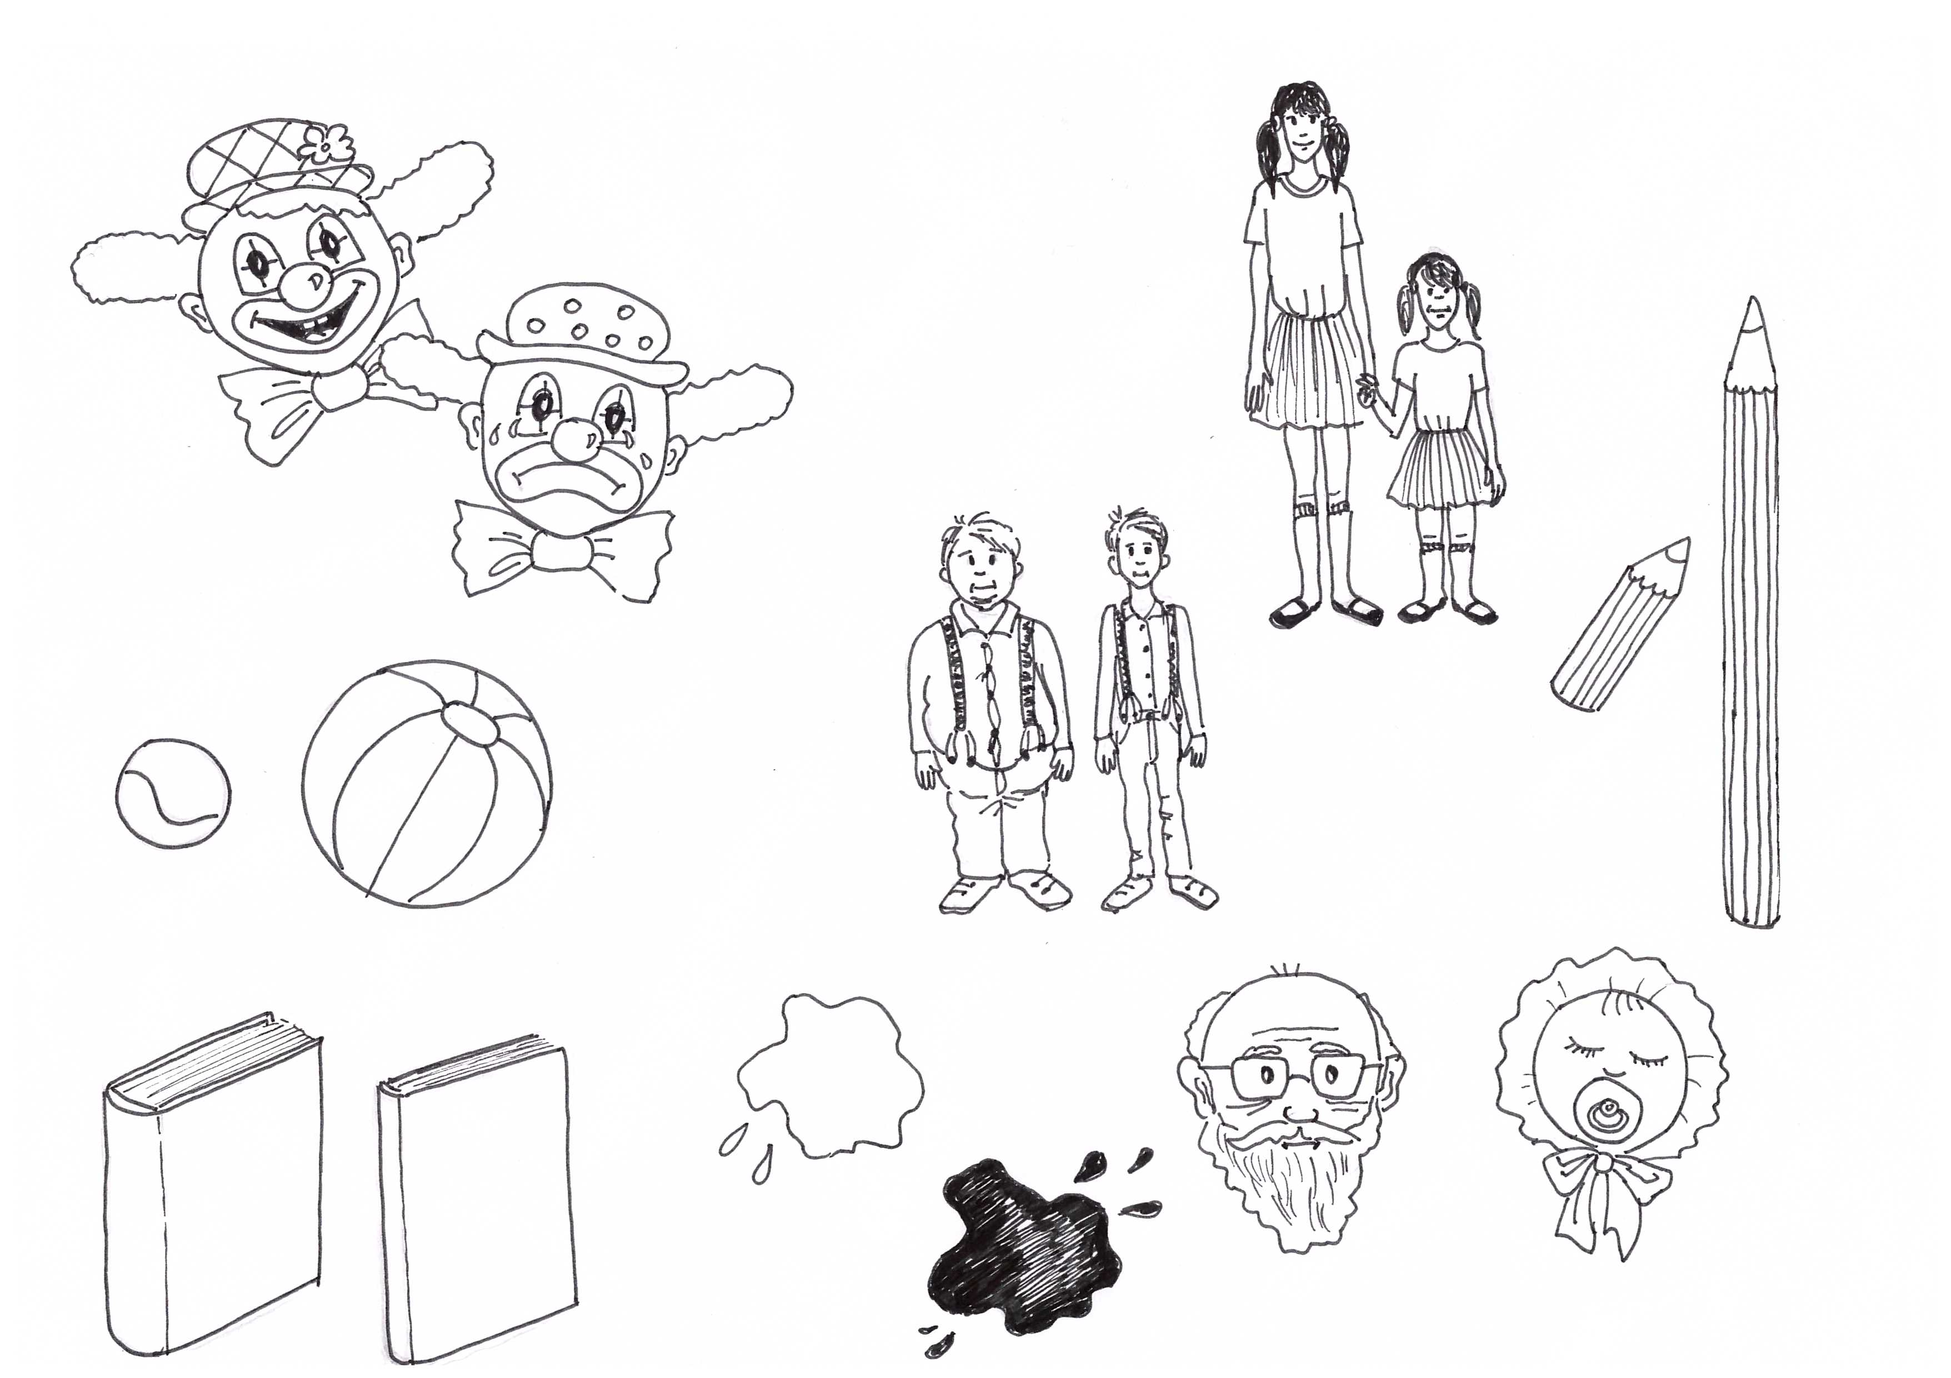
tall
short
happy
sad
short
fat
slim
long
small
big
light
young
thick
thin
old
dark

Slide 5
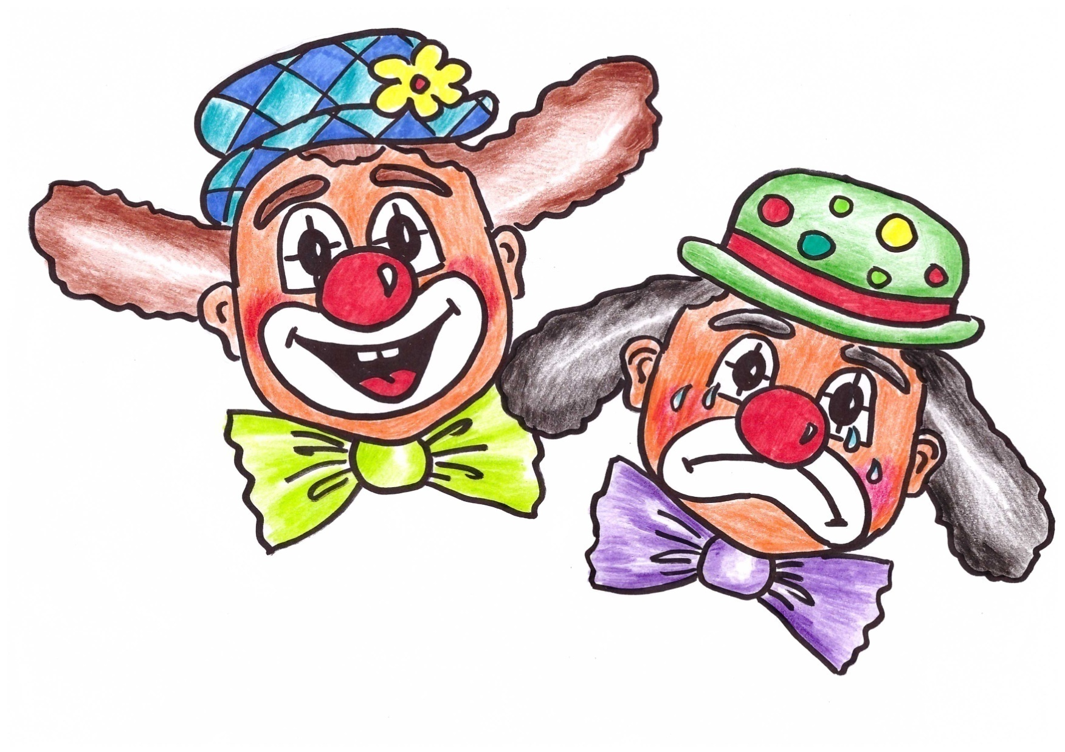
The clown on the left is
happy.
What is he doing?
He is smiling.
The clown on the right is
sad.
What is he doing?
He is crying.

Slide 6
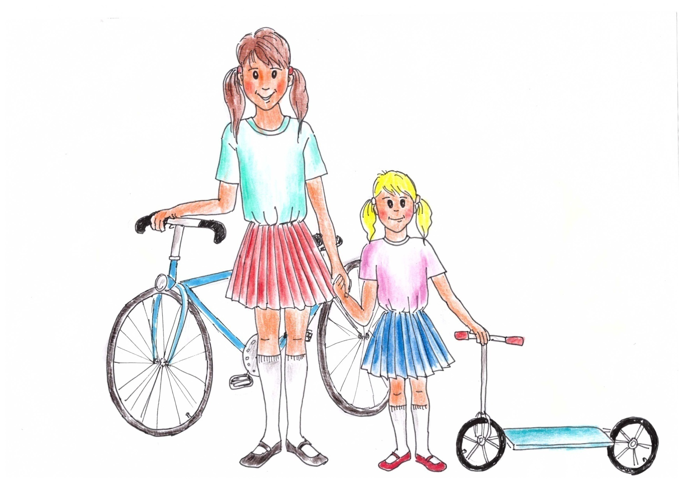
The girl on the left is
tall.
What has she got?
She has got a bicycle.
The girl on the right is
short.
What has she got?
She has got a scooter.

Slide 7
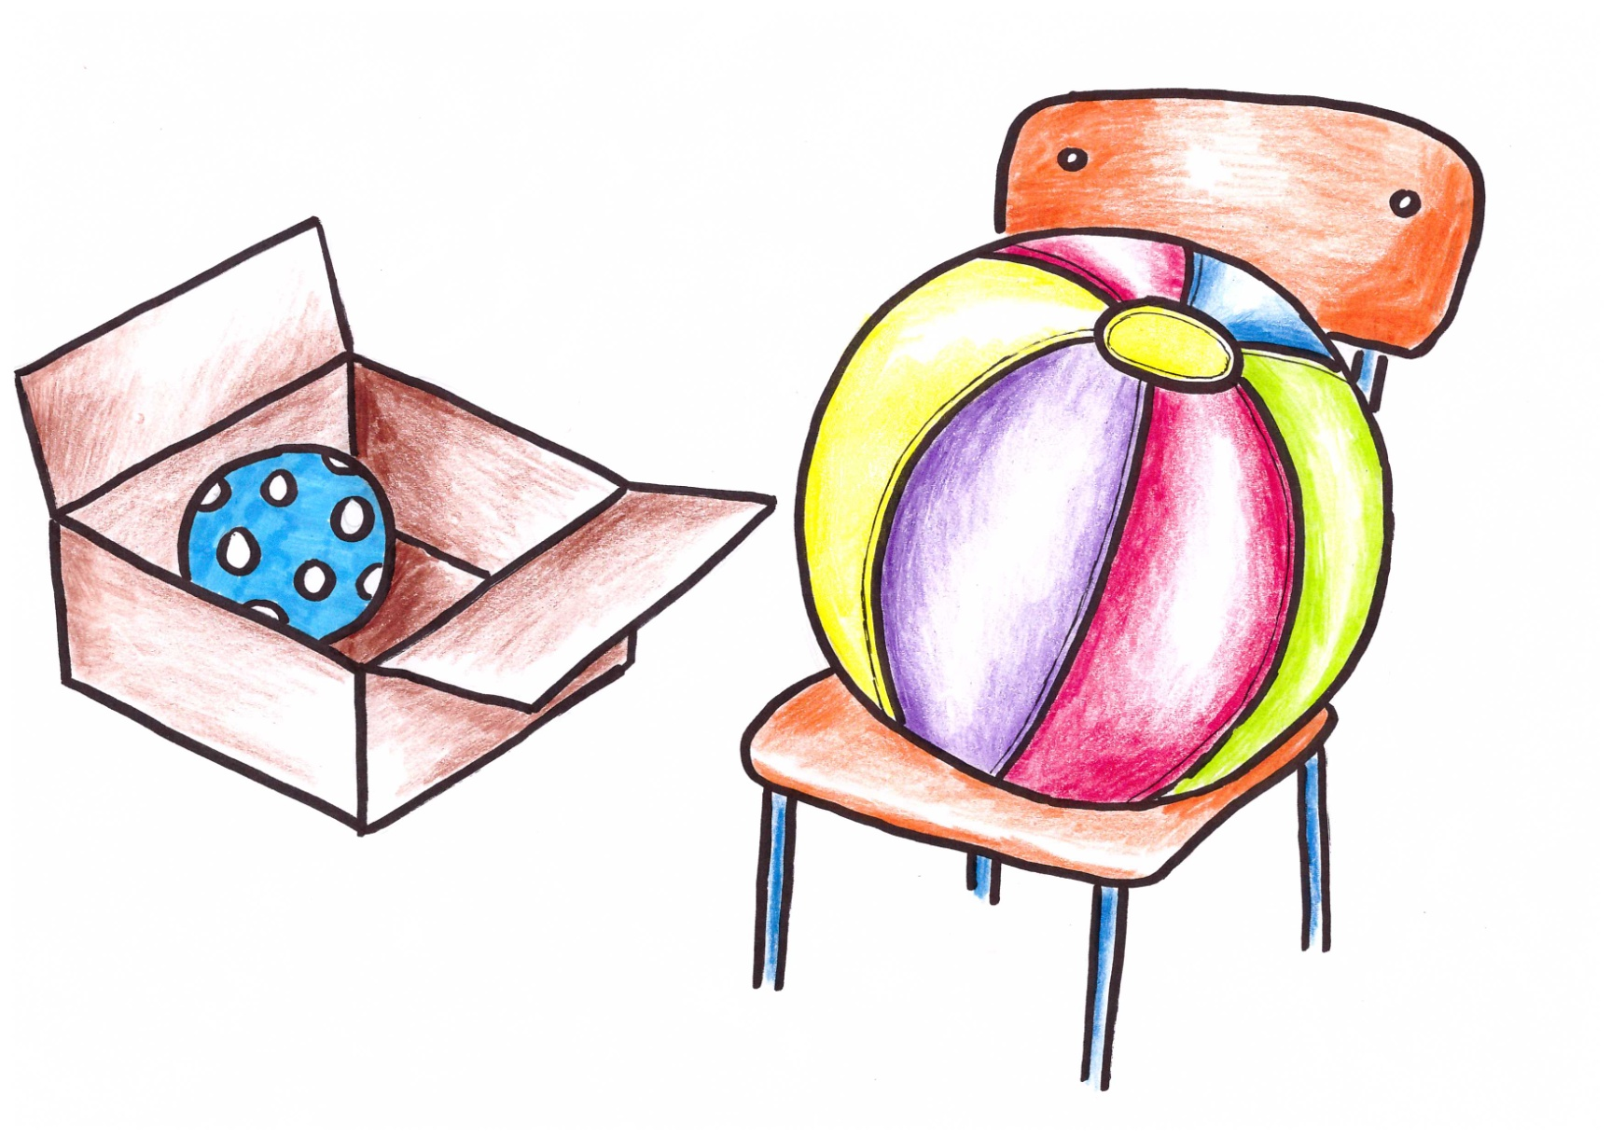
The ball on the left is
small.
Where is it?
It is in the box.
The ball on the right is
big.
Where is it?
It is on the chair.

Slide 8
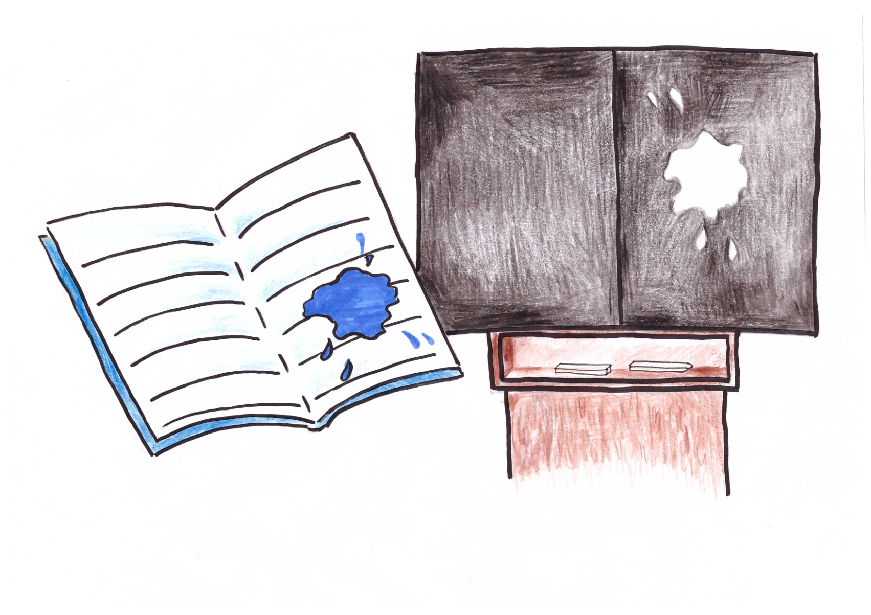
The colour on the left is
dark.
Where is it?
It is in the notebook.
The colour on the left is
light.
Where is it?
It is on the blackboard.

Slide 9
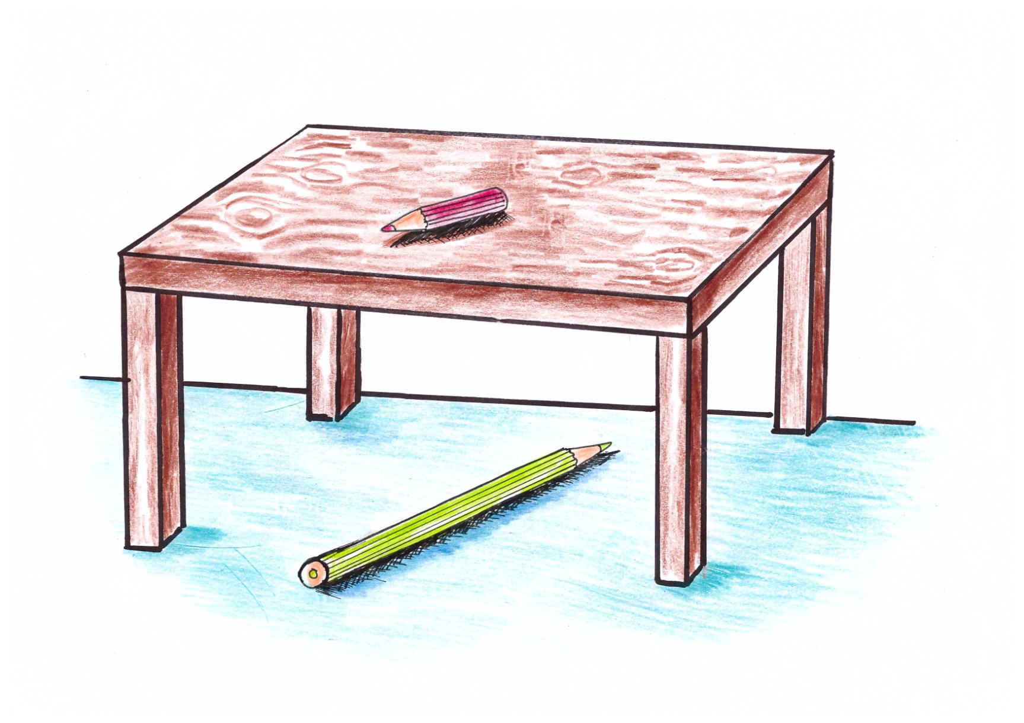
The red crayon is
short.
Where is it?
It is on the table.
The green crayon is
long.
Where is it?
It is under the table.

Slide 10
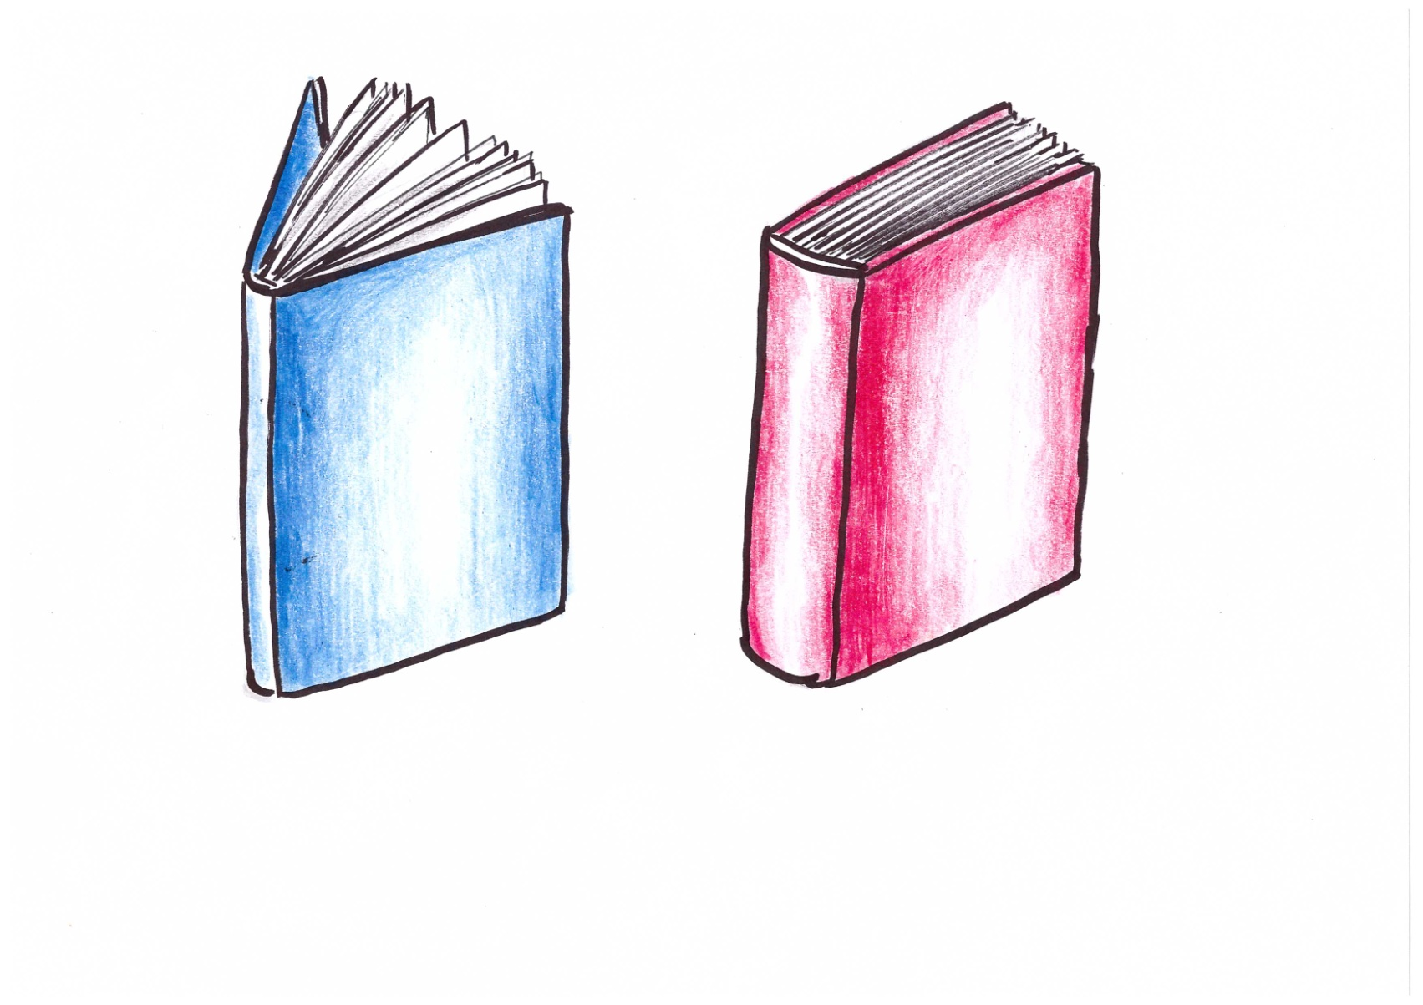
The blue book is
thin.
Is it close?
No, it is open.
The red book is
thick.
Is it open?
No, it is close.

Slide 11
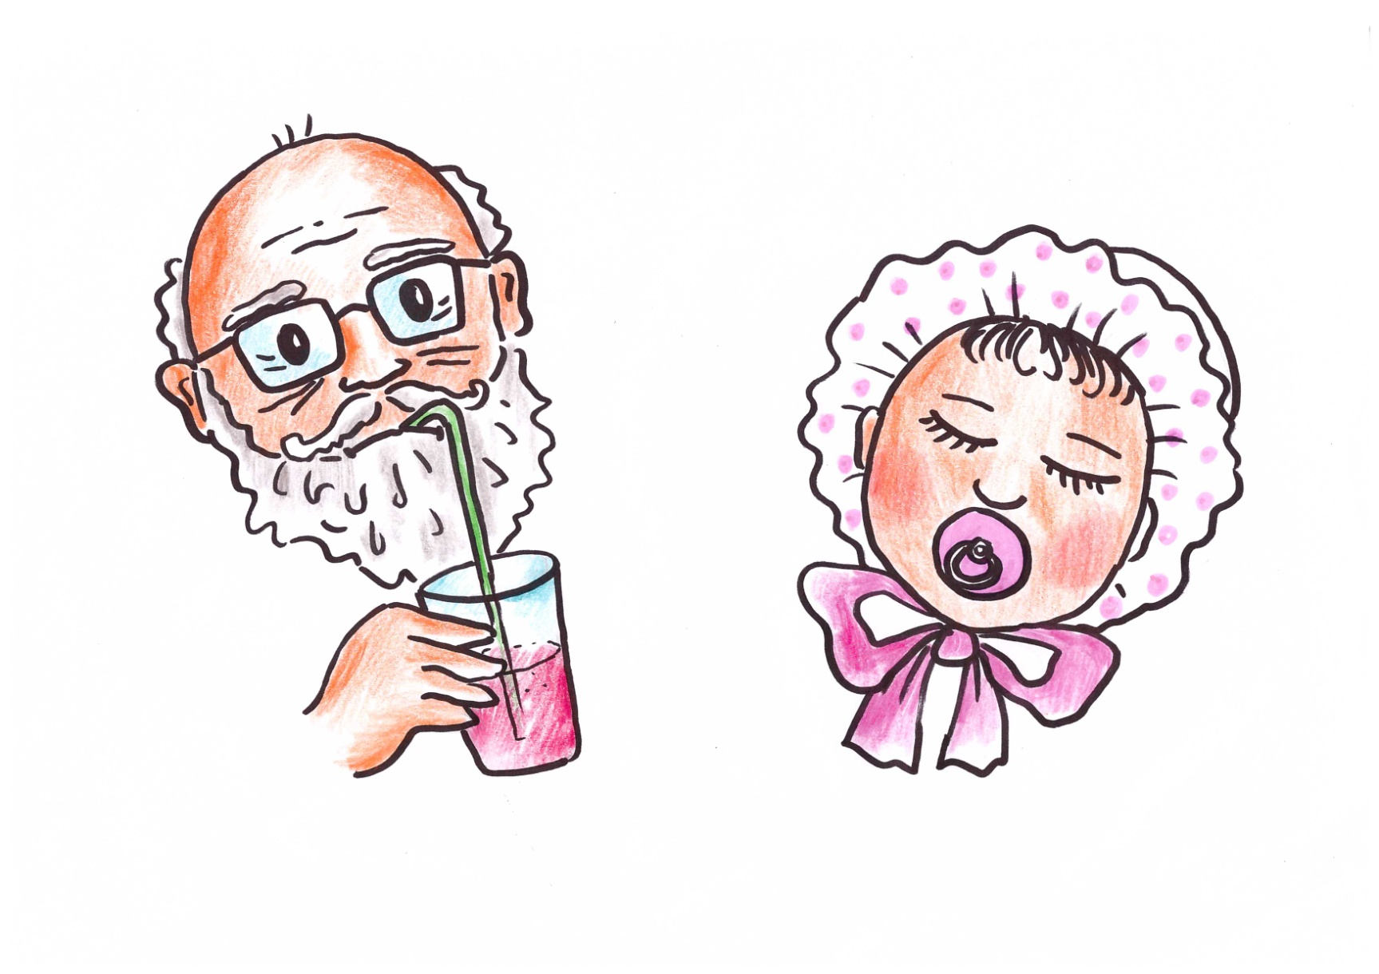
The grandpa is
old.
What is he doing?
He is drinking.
The baby is
young.
What is the baby doing?
The baby is sleeping.

Slide 12
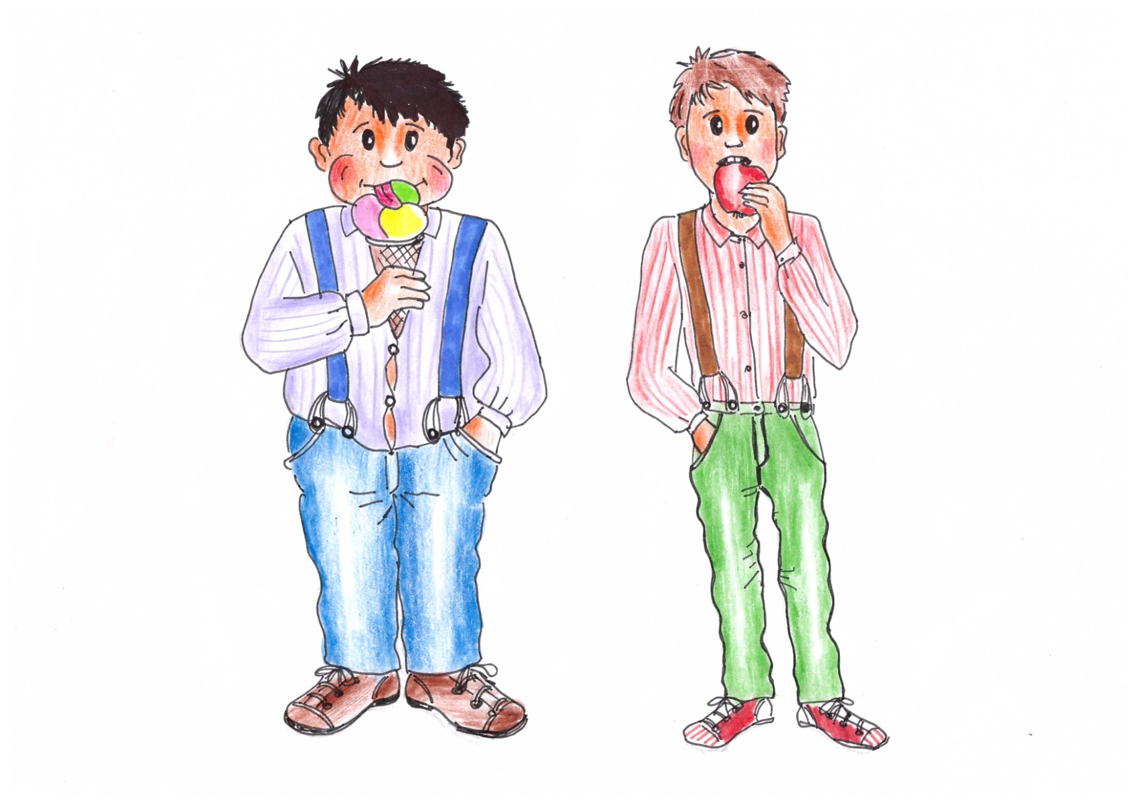
The boy on the left is
fat.
What is he eating?
He is eating an ice cream.
The boy on the right is
slim.
What is he eating?
He is eating an apple.

Slide 13
Zdroj obrázků: vlastní kresby autorky

