Slide 1

ZÁKLADNÍ ŠKOLA SLOVAN, KROMĚŘÍŽ, PŘÍSPĚVKOVÁ ORGANIZACE
ZEYEROVA 3354, 767 01 KROMĚŘÍŽ
projekt v rámci vzdělávacího programu
VZDĚLÁNÍ PRO KONKURENCESCHOPNOST
ŠABLONA ČÍSLO: III/2
NÁZEV: INOVACE A ZKVALITNĚNÍ VÝUKY PROSTŘEDNICTVÍM ICT
PŘEDMĚT: Anglický jazyk
ROČNÍK: 8. ročník
TÉMA: The USA - presentation
AUTOR: Jana Veselá, DiS.
DATUM VYTVOŘENÍ: 2. 3. 2012
VY_32_INOVACE_18_JV

Slide 2
Anotace:
VM je prezentace o USA, která je doplňkovým materiálem k učebnici Project 2 (5. lekce, oddíl Culture). Prezentace je věnována žákům 8. ročníku. Učitel pomocí vhodně volených otázek může prezentaci oživit. Na konci prezentace je úkol – speaking activity a samotná prezentace je uzavřena 14 otázkami k prezentaci, NA které žáci odpovídají.
Ilustrace: www.office.microsoft.com
Pilotáž:
Pilotáž byla provedena v hodinách anglického jazyka u žáků 8. ročníku. Prezentací žáci získali ucelený pohled O SpojenÝCH státECH americkÝCH. Během prezentace se Žáci aktivně zapojovali a Řadu věcí vysvětlovali sami.

Slide 3
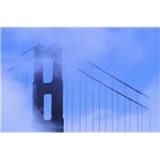
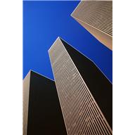
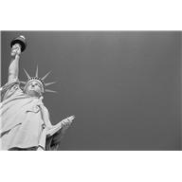
The UNITED STATES OF AMERICA
Basic and interesting information about the USA.
´ONE NATION, UNDER GOD, WITH LIBERTY AND JUSTICE FOR ALL.´

Slide 4
Here are some basic facts about the USA:
A federal constitutional republic
50 states
The 3rd biggest country (9 826 675 km2)
The capital is Washington D. C., but the largest city is N. Y.
The US president is Barack Obama
The Vice president of the USA is Joe Biden
Motto: IN GOD WE TRUST (official)

Slide 5
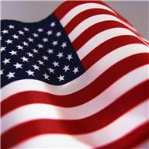
The flag and the anthem:
The American anthem is called: The Star-Spangled Banner.
The flag of the USA consists of 13 equal horizontal stripes of red (top and bottom) and white, with a blue rectangle in the upper left corner with 50 white and five-pointed stars. The stars are arranged into 9 rows of 6 stars and 5 stars. The 50 stars represent the 50 states and the 13 stripes represent the 13 British colonies that became the first states in the Union.
The flag has its nickname: Stars and Stripes or Old Glory or the Star-Spangled Banner.

Slide 6
The important dates in History of the USA:
1492 - Christopher Columbus explored America.
1513 - 1st European Juan Ponce de Léon landed on Florida.
1565 - Spanish established their first settlements.
1607 - English established their center in Jamestown (Virginia).
1619 - first slaves from Africa.
1620 - Puritans arrived by a boat called Mayflower and they established their colony in Massachusetts. At the end there were 13 British colonies in the Union.
1775 - American Revolutionary War = colony´s war against Great Britain.
4th July 1776 - Declaration of Independance.
1860 – 1865: Civil war.

Slide 7
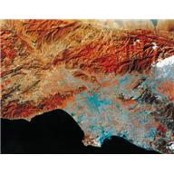
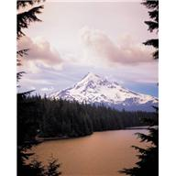
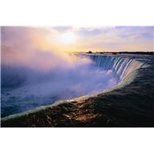
Geographical facts:
The Mississippi-Missouri River = the world´s fourth river system
The Appalanchian Mountains in Eastern North America (Mount Mitchell 6684m)
Great Lakes: Superior, Michigan, Huron, Erie, Ontario
The Rocky Mountains in Western North America (Mount Elbert 4401m)
Mount McKinley is the highest peak (6196m) in Alaska

Slide 8
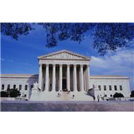
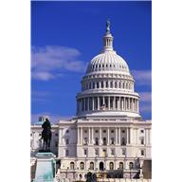
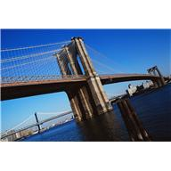
The most important Landmarks:

Slide 9
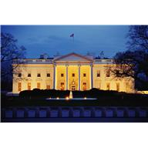
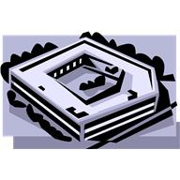
Important buildings:
The White House:
Official residence and workplace of the President of the USA
In Neoclassical style
Pentagon:
Its name is from Greek word pente = number 5
It is five-sided polygon
It is the building for US Department of Defence

Slide 10
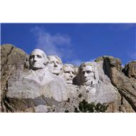
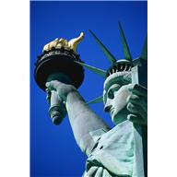
THE IMPORTANT STATUES:
The Statue of Liberty:
Neoclassical sculpture on Liberty Island in N.Y. Harrbour
Designed by Frédéric Bartholdi
A gift to the USA from the people of France
A female figure of a Roman goddess of freedom
Carries a torch and a tablet (tabula ansata) with American Declaration of Independence
Mount Rushmore:
18 m sculptures of the heads of US presidents: in order from left to right George Washington, Thomas Jefferson, Theodore Roosevelt and Abraham Lincoln

Slide 11
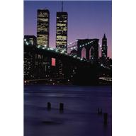
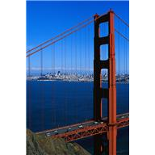
The most important Bridges:
Golden Gate – San Francisco
The bridge that connects North American Strait to the Pacific Ocean.
It is the symbol of San Francisco.
The second longest suspension bridge span in the USA (after Verrazano-Narrows Bridge in N. Y.).
Completed in 1937.
Verrazzano-Narrows Bridge – N. Y
It is a double-decked suspension bridge.
It connects Staten Island and Brooklyn.
It is named for the Italian explorer Giovanni da Verrazzano .

Slide 12
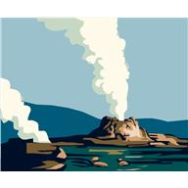
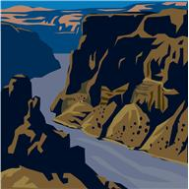
National parks:
YELLOWSTONE National Park:
In Wyoming (state)
The 1st national park in the world.
Wildlife, geothermal features: Old Faithful Geyser, subalpine forest
GLACIER National Park:
In Montana (state)
130 lakes
1000 different species of plants
100 of species of animals: grizzly, mountain goats

Slide 13
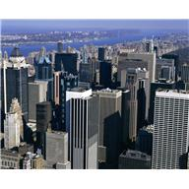
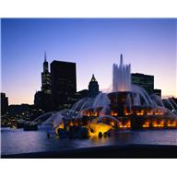
The most famous cities:
NEW YORK
Population over 8 million
Center for finance and culture
The largest gateway for immigration
Favourite destination for many foreign visitors
CHICAGO
2.7 million people
3rd most populous city
The center of culture – Navy Pier, Chicago Theatre

Slide 14




Hollywood
It is in Los Angeles in California.
It is a favourite touristic attraction.
This place is famous for American film and TV industry.
There is a world-famous heading in the hills.
You can see there a ´Hollywood Walk of Fame´.

Slide 15
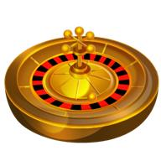
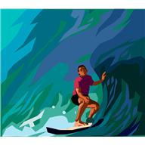
The places for entertaintment:
LAS VEGAS
Casinos and hotels
CALIFORNIA
Long beaches

Slide 16
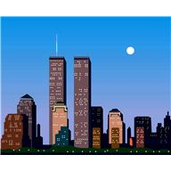
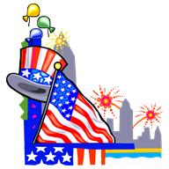
The most important dates:
4th July
Americans celebrate the Day of Independance.
It is a federal holiday = many people take advantage of the day off and the sunny weather = they have parties, parades, picnics, fireworks.
11th September
In 2001 a terroristic attack: - an Islamic militant group Al-Qaeda hijacked planes - 2 planes crashed into the World Trade Center in N. Y. and 1 plane into the Western side of the Pentagon in Washington , the fourth plane crashed into a field near Shanksville in Pennsylvania.

Slide 17
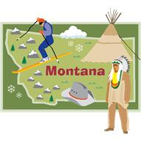
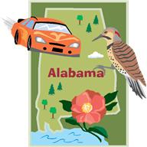
Some interesting information about the chosen states:
Nordic ski competitions
Yellowhammer birds
Tree: Longleaf Pine
State flower Camelia

Slide 18
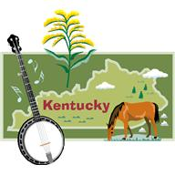
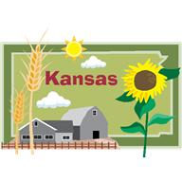
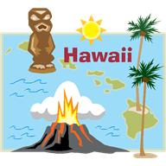
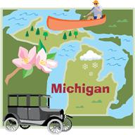
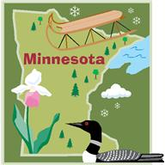
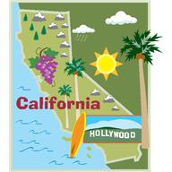
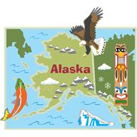
What would you like to visit in the USA?

Slide 19
Answer the questions:
What basic information about the USA do you know?
What do you know about Geography of the USA?
3. What do you know about History of the USA?
4. What National parks do you know?

Slide 20
Answer the questions:
5. What do you know about the American flag?
6. What is the name of the American
anthem?
7. What can you find in Pentagon?
8. What is the White House for?
9. Why is Mount Rushmore famous?
10. What do you know about the Statue of Liberty?

Slide 21
Answer the questions:
11. What is Golden Gate?
12. What do Americans celebrate on 4th July?
13. What happened on 11th September?
14. What is Hollywood?

