Slide 2
Food

Slide 3
Connect right expressions.
/Spoj správné výrazy./
meat | parsley, basil, ……..
fruit | salmon, carp, ……..
vegetable | bread, roll, cake, ……..
herbs | grapes, apple, ……..
dairy products | carrot, cucumber, ……..
bakery products | pork, beef, chicken, ……..
fish | cheese, yoghurt, ……..

Slide 4
Which word doesn’t belong to the group?
/ Které slovo nepatří do skupiny?/
coffee beer mineral water orange juice
carp salmon chicken trout
fish beef pork mutton
milk cheese sausages butter
soup apple pie ice-cream cake

Slide 5
Connect right expressions.
/Spoj správné výrazy./
a bar of | tea
a cup of | bread
a slice of | cake
a loaf of | wine
a packet of | chocolate
a piece of | crisps
a bottle of | cheese

Slide 6
Discuss healthy and unhealthy food.
/Diskutujte o zdravé a nezdravé stravě./
Healthy food
Unhealthy food
oranges
carrot
fish
yoghurt
vegetable salads
broccoli
apples
sweets
fat meat
sausages
crisps
bacon
ice-cream
hamburgers

Slide 7
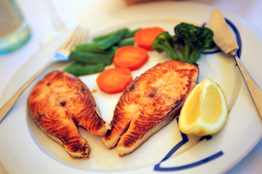
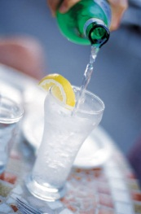
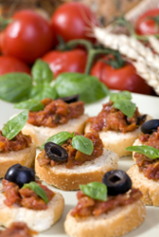
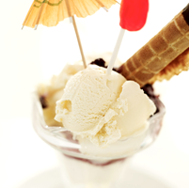
Find the right pictures.
/Najděte správné obrázky./
Starters
Main courses
Sweets
Drinks

Slide 8
Zdroje obrázků: http://office.microsoft.com

