Slide 2
Housing and Living

Slide 3
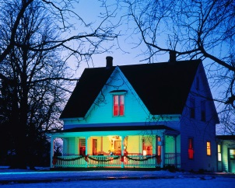
Types of houses
block of flats
thatched cottage
semi-detached house
terraced house
detached house

Slide 4
Parts of the house
chimney
garage
roof
window
front door

Slide 5
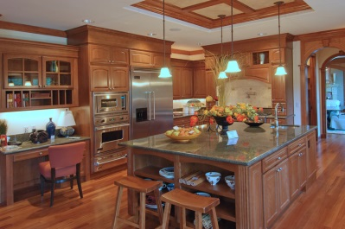
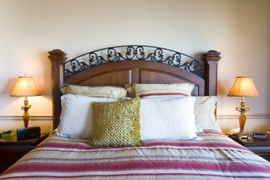
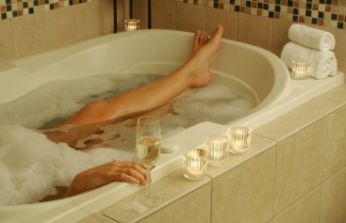
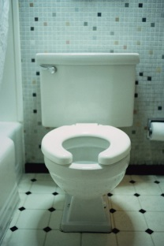
Rooms in the house
kitchen
living room
dining room
bedroom
bathroom
toilet

Slide 6
Where can we find?
dishwasher fridge
cooker bath
bedside table sink
washing machine shower
wardrobe coffee table
cupboard sofa
armchair washbasin
kitchen
living room
bedroom
bathroom

Slide 7
Where would you like to live?
in a house or in a flat?
in a town or in a village?

Slide 8
Zdroje obrázků: http://office.microsoft.com

