Slide 2
Town and country

Slide 3

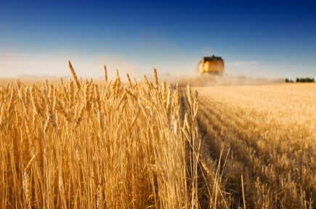

What can we find in a village?
field
meadow
forest
cottage

Slide 4
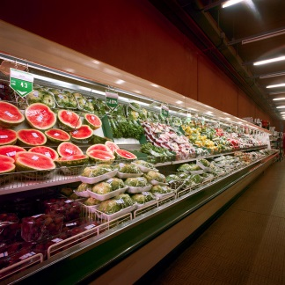

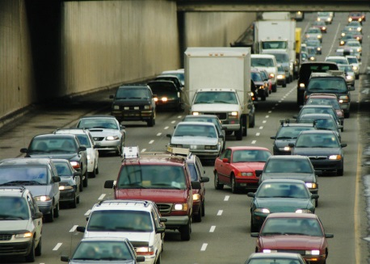
What can we find in a town?
supermarket
traffic lights
traffic jam
zebra crossing
underground

Slide 5
Advantages of living in a town/city
schools, jobs
shops, department stores
restaurants, bars
cultural events
sporting facilities

Slide 6
Disadvantages of living in a town/city
air pollution
water pollution
noise
busy traffic

Slide 7
Advantages of living in a village
beautiful nature
fresh air
quiet
gardening
domestic animals

Slide 8
Disadvantages of living in a village
transportation
commuting
few jobs
few schools

Slide 9
Odpovězte na otázky.
Is it better to live in a town or in a village?
Where would you like to live in the future?

Slide 10
Zdroje obrázků: http://office.microsoft.com

