Slide 2
Sloveso „like“
/mít něco rád, rád něco dělat/

Slide 3
What do these people like?
/Doplň správný tvar slovesa like./
I _______ apples.
You _______ oranges.
Jenny _______ ice-cream.
We _______ chocolate.
Helen and Sandy _______ sweets.
like
like
likes
like
like

Slide 4
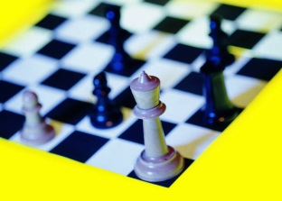
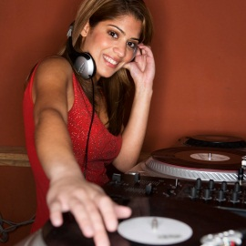
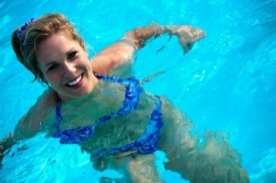
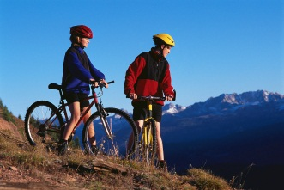
What do these people like doing?
/Doplňte věty podle obrázků./
I like ___________.
You like _______________.
Jenny likes ______________.
Helen and Jake like ___________.
playing chess
listening to music
going swimming
going cycling

Slide 5
What don’t these people like doing?
/Doplňte správný tvar slovesa like v záporu./
I __________ playing volleyball.
You __________ going jogging.
Susan _____________ watching TV.
We __________ doing our homework.
Henry and Paul __________ playing cards.
don’t like
don’t like
doesn’t like
don’t like
don’t like

Slide 6
What kinds of films do these people like?
/Utvořte otázky./
/you / like / comedies /?
Do you like comedies?
/your sister / like / horror films /?
Does your sister like horror films?
/your parents / like / war films /?
Do your parents like war films?
/Jack / like / action films /?
Does Jack like action films?

Slide 7
Do you like ……….?
/Odpovězte na otázky. Použijte krátké odpovědi./
Do you like pop music? Yes, _____.
Does your mum like jazz? No, ____________.
Does your brother like hip hop? Yes, ________.
Do Tom and Alice like classical music? No, __________.
I do
she doesn’t
he does
they don’t

Slide 8
Zdroje obrázků: http://office.microsoft.com

