Slide 2
Minulý čas prostý
Past Simple

Slide 3

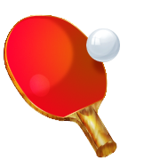
What did you do last weekend?
/Odpovězte podle obrázků./
I
watched TV.
(watch TV)
I
read a book.
(read a book)
played table tennis.
I
(play table tennis)

Slide 4

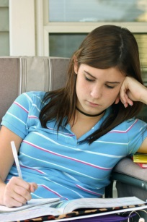
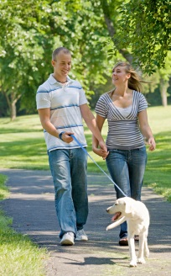
What did these people do last weekend?
/Odpovězte podle obrázků./
Susan
worked in the garden.
(work in the garden)
Kate
did her homework.
(do her homework)
Ben and Kate
walked in the park.
(walk in the park)

Slide 5
/Utvořte záporné věty podle obrázků./
Susan
didn’t work in the garden.
Kate
didn’t do her homework.
Ben and Kate
didn’t walk in the park.

Slide 6
What did these people do?
/Utvořte otázky z následujících slov./
John / play computer games/ last weekend?
Did John play computer games last weekend?
you /do your homework /yesterday?
Did you do your homework yesterday?
your parents / travel to London / last year?
Did your parents travel to London last year?

Slide 7
What, where, how……………..?
/Utvořte otázky z následujících slov./
What / you / do / last weekend?
What did you do last weekend?
Where / your mum / work / last year?
Where did your mum work last year?
How / Jake / travel to London?
How did Jake travel to London?

Slide 8
Yes, I did. / No, I didn’t.
/Odpovězte na následující otázky./
Did you go to the seaside last summer? Yes
Yes, I did.
Did your friends go swimming yesterday? No
No, they didn’t.
Did Susan work in the garden on Saturday? No
No, she didn’t.

Slide 9
Zdroje obrázků: http://office.microsoft.com

