Slide 2
There is, there are

Slide 3
Vazba there is, there are
slouží k vyjádření existence něčeho/někoho někde.
There is a dictionary on the desk.
Na lavici je slovník.
There are thirty pupils in the class.
Ve třídě je třicet žáků.

Slide 4

Kladné tvary vazby there is, there are
There is a rubber on the desk.
There are two pencils on the desk.
Zkrácené tvary jsou there’s, there’re.

Slide 5
Záporné tvary vazby there is, there are
tvoříme přidáním not.
There is not any milk in the fridge.
There are not any eggs in the fridge.
Zkrácené tvary jsou there isn’t, there aren’t.

Slide 6
Otázka vazby there is, there are
se tvoří otočením slovosledu.
Is there a post office near here?
Are there any pencils in the pencil case?

Slide 7
Krátké odpovědi
Is there a cinema in your town? Yes, there is.
Is there any cream in the fridge? No, there isn’t.
Are there any dogs in the garden? Yes, there are.
Are there any boys in the class? No, there aren’t.

Slide 8
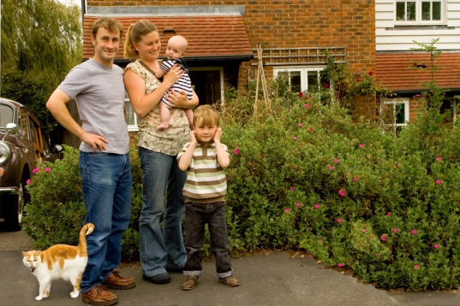
Doplňte věty podle obrázku.
__________ two children in the picture.
__________ a cat in the picture.
__________ a dog in the picture.
__________ any big animals in the picture.
There are
There is
There isn’t
There aren’t

Slide 9
Zdroje obrázků: http://office.microsoft.com

