Slide 2
Shopping and Services
Shops and Buildings in the Town

Slide 3
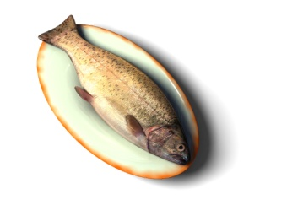
Shops
baker’s florist’s
greengrocer’s fishmonger’s
butcher’s chemist’s
jeweller’s bookshop
newsagent’s clothes shop

Slide 4
Where can you buy the following things?
sausages, meat
bread, cakes,
rings, bracelets,
magazines, newspapers
bananas, carrots,
at the butcher’s
at the baker’s
at the jeweller's
at the newsagent’s
at the greengrocer’s

Slide 5
Where do you go if you need to buy the following things?
books, textbooks,
trousers, jackets,
shampoo, perfume
fish, seafood
flowers, flowerpots
to a bookshop
to a clothes shop
to the chemist’s
to the fishmonger’s
to the florist’s

Slide 6
Services
Where do you go if you need to clean your clothes?
to the dry cleaner’s
Where can you send a postcard?
at the post office
Where do you go if you want a new haircut?
to the hairdresser’s

Slide 7
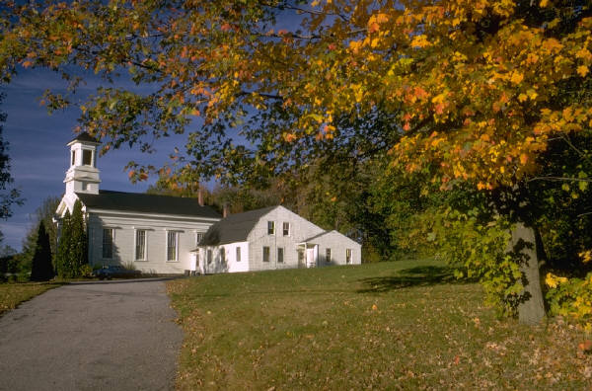
Try to guess the name of the building.
It is a building where people go to pray and where priests give a religious speech.
church

Slide 8
Try to guess the name of the building.
It is a large building where there are a lot of offices of the local government and where there is a room for weddings and other special occasions.
town hall

Slide 9
Zdroje obrázků: http://office.microsoft.com

