Slide 1

Make up essentials and tools
Číslo projektu | CZ.1.07/1.5.00/34.0479
Číslo materiálu | VY_32_INOVACE_IVA_DVORAKOVA_Makeup_essentials_and_Tools_05
Název školy | Střední škola služeb, obchodu a gastronomie Hradec Králové
Ročník | Třetí, čtvrtý
Vzdělávací oblast | Anglický jazyk
Vzdělávací obor | Kosmetické služby
Tematický okruh | Odborná terminologie k oboru
Téma | Makeup essentials and tools
Jméno autora | Mgr. Iva Dvořáková
Vytvořeno dne | 22.3.2013
Metodický popis (anotace) | Prezentace seznamuje s novou slovní zásobou týkající se líčidel a pomůcek, kterými se nanáší. Je vytvořena v programu PowerPoint.

Slide 2
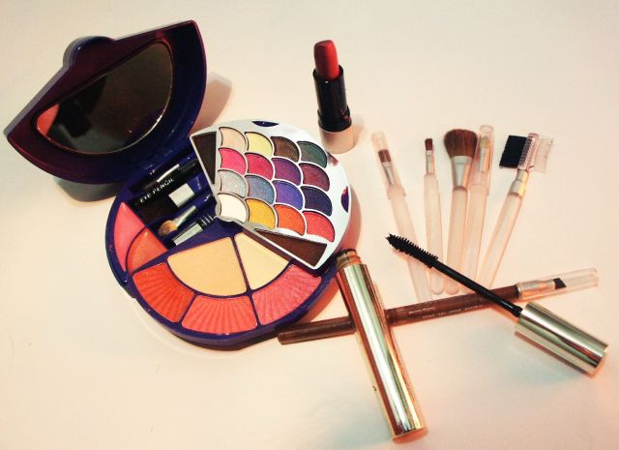
Make up essentials and tools
Pict.1

Slide 3
Make up essentials and tools
Essentials
- products which emphasize the natural beauty of your face or hide skin imperfections
Tools
- things you use to put makeup on

Slide 4
Essentials for skin
PRIMER
FOUNDATION
acts as a base for your makeup
helps your makeup to stay on longer throughout the day
spread with fingers
liquid or cream that matches a person´s skin tone
exists in a lot of shades
imroves your complexion
covers any dark spots like acne marks or blemishes, or any redness in your skin
instead, it can be used tinted moisturizer or tinted sunscreen
spread with fingers or a sponge

Slide 5
CONCEALER
POWDER
stronger coverage than foundation
used to cover up the dark under-eye circles and acne
dabbed or spread with a finger
used for getting rid of shine
2 types:
compact powder - pressed powder in a small case with a powder puff
loose powder – applied by a brush

Slide 6
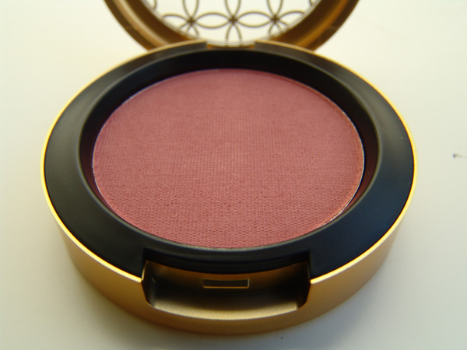
BRONZER
BLUSH
gives your face a sun-kissed look
contours your face
applied to your cheekbones
Pict.2

Slide 7

Parts of eyes
Eyebrow
Brow bone
Eyelid
Crease - záhyb
Eyelashes
Lash line
Eye duct-vnitřní koutek oka pict.3
Waterline

Slide 8

EYEBROWS
EYE SHADOWS
pluck a shape with tweezers
contour with an eye liner
shape it with a brow brush
Pict.4
cream eye shadow
gel eye shadow
powder shadow
hundreds of different colours and shades
applied with an applicator or shader brush

Slide 9
EYELINER
MASCARA
looks like a pencil
gives your eye more definition
give definition or to define=to do sth to make it possible to see something more clearly: a shape or details
also exists liquid eyeliner
used to coat your eyelashes, to make them longer and thicker
to have a darker look, apply more coats
before applying mascara, you can curl your eyelashes with an eyelash curler
many kinds of mascara – volume, waterproof …

Slide 10
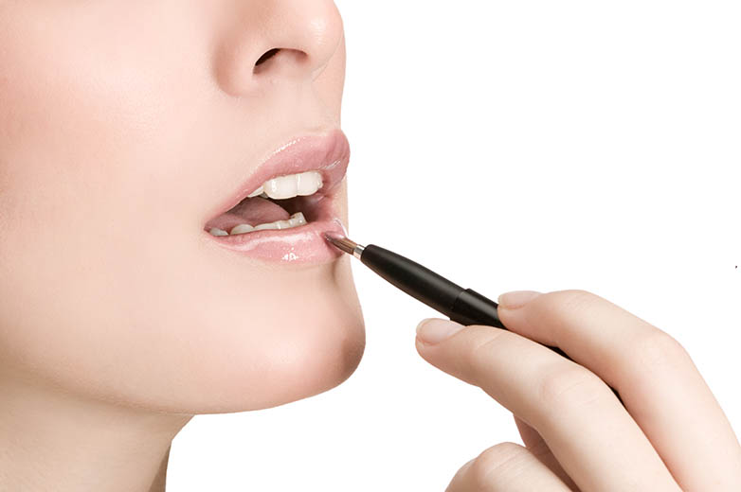
Mouth
it’s a good idea to moisturize your lips before you put on a lip gloss or lipstick
the upper lip is also called Cupid´s bow according to its bow shape
Pict.5

Slide 11
LIP LINER
LIP GLOSS or LIPSTICK
used for defining lips
can change the shape of your lips, if you like fuller or smaller ones
many different colours and shades
lip gloss makes your lips look shiny, but with less color than lipstick
lipstick adds colour to your lips
both applied with a lip brush or if it´s a stick, it´s applied straightly

Slide 12
THANK YOU FOR YOUR ATTENTION

Slide 13
Použité obrázky:
Pict.1. KAURJMEB. commons.wikimedia.org [online]. [cit. 23.3.2013]. Dostupný na WWW: http://commons.wikimedia.org/wiki/File:Cosmetics.JPG
Pict.2. OOKIKIOO. commons.wikimedia.org [online]. [cit. 23.3.2013]. Dostupný na WWW: http://commons.wikimedia.org/wiki/File:2006_Mac_Limited_Edition_Patternmaker_POWDER
Pict.3. ORIGINAL UPLOADER WAS MAKEUPS AT EN.WIKIPEDIA. commons.wikimedia.org[online]. [cit. 23.3.2013]. Dostupný na WWW: http://commons.wikimedia.org/wiki/File:Eye_liner.jpg2
Pict.4. AUSTIN, Deborah. commons.wikimedia.org [online]. [cit. 23.3.2013]. Dostupný na WWW: http://commons.wikimedia.org/wiki/File:Eyeshadow_looking_down.jpg
Pict.5. HERNANDEZ, Andres. commons.wikimedia.org [online]. [cit. 23.3.2013]. Dostupný na WWW: http://commons.wikimedia.org/wiki/File:Prestige_Cosmetics.jpg

Slide 14
Použité zdroje:
DOOLEY, Jenny; EVANS, Virginia. Beauty Salon. Newbury: Express Publishing, 2011, ISBN 978-0-85777-849-9.
Pokud není uvedeno jinak, použitý materiál je z vlastních zdrojů autora.

