Slide 1

Název SŠ: | SŠ-COPt Uherský Brod
Autor: | Ing. Hana Kubišová, Ph.D.
Název prezentace (DUMu): | Hunting and Sports Guns
Název sady: | Technical English for students of study branch Technician gunsmith 2nd, 3rd and 4th classes
Číslo projektu: | CZ.1.07./1.5.00/34.0727
Datum vzniku: | 30.9.2012
Uvedení autoři, není-li uvedeno jinak, jsou autory tohoto výukového materiálu a všech jeho částí. Tento projekt je spolufinancován ESF a státním rozpočtem ČR.

Slide 2
ANOTACE
Záměrem této sady výukových materiálů s názvem Technical English je ukázat žákům, kteří se v této oblasti vzdělávají, jaký byl vývoj zbraní.
Jednotlivé DUMy (prezentace) v této sadě popíší postupně tematické oblasti, které jsou probírány v předmětu Anglický jazyk na naší SŠ.
Konkrétně tato prezentace je zaměřena na sportovní a lovecké zbraně.

Slide 3
REVISION

Slide 4
Do you know any army firearms?
What do you remember about submachine guns?
Do you know the classification of army firearms?
When could a soldier use army firearms?
How many types of conventail arms do you know?

Slide 5
HUNTING AND SPORT GUNS

Slide 6
Hunting guns are guns that can be used for hunting.
Sporting firearms are used for target shooting on a target.
Sporting firearms are designed for basic training in shooting and sporting competitions.
All modern hunting and sporting guns are breech-loading on a single charge with smokeless powder.

Slide 7
EXPANSION DEVICE

Slide 8
Expansion devices are appliences or equipment to perform mechanical work.
Expansion devices are classified according to purpose of use:
  shooting,
  forming,
  joining,
  slaughter,
  starter and alarm,
  other.

Slide 9
Under construction:
  devices with a bullet,
  devices with a thumper,
  devices using direct pressure energy gas.

Slide 10
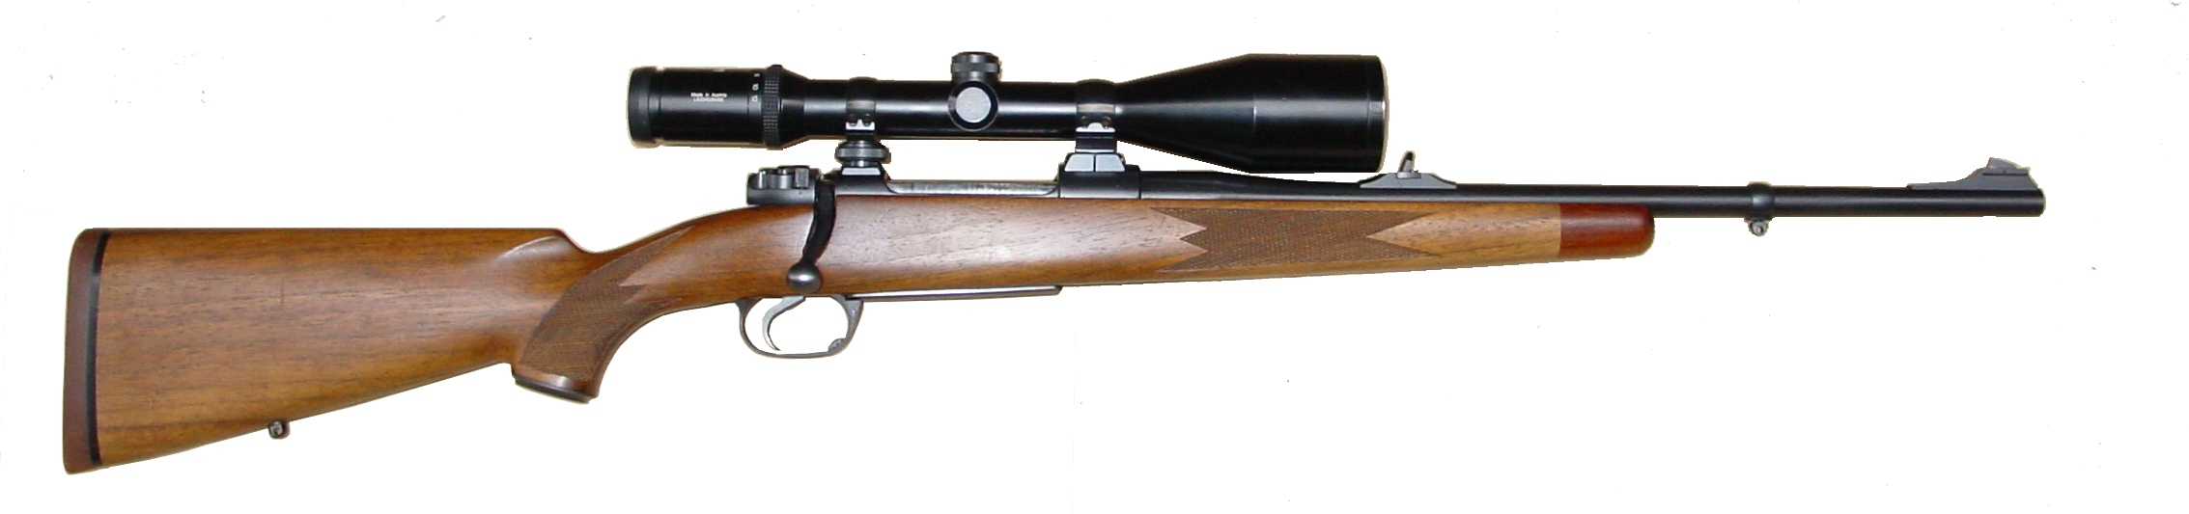
HUNTING GUN

Slide 11
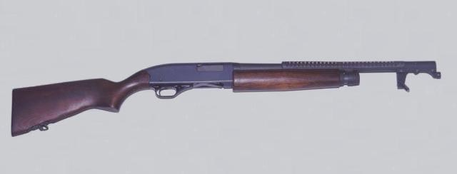
SHOTGUN

Slide 12
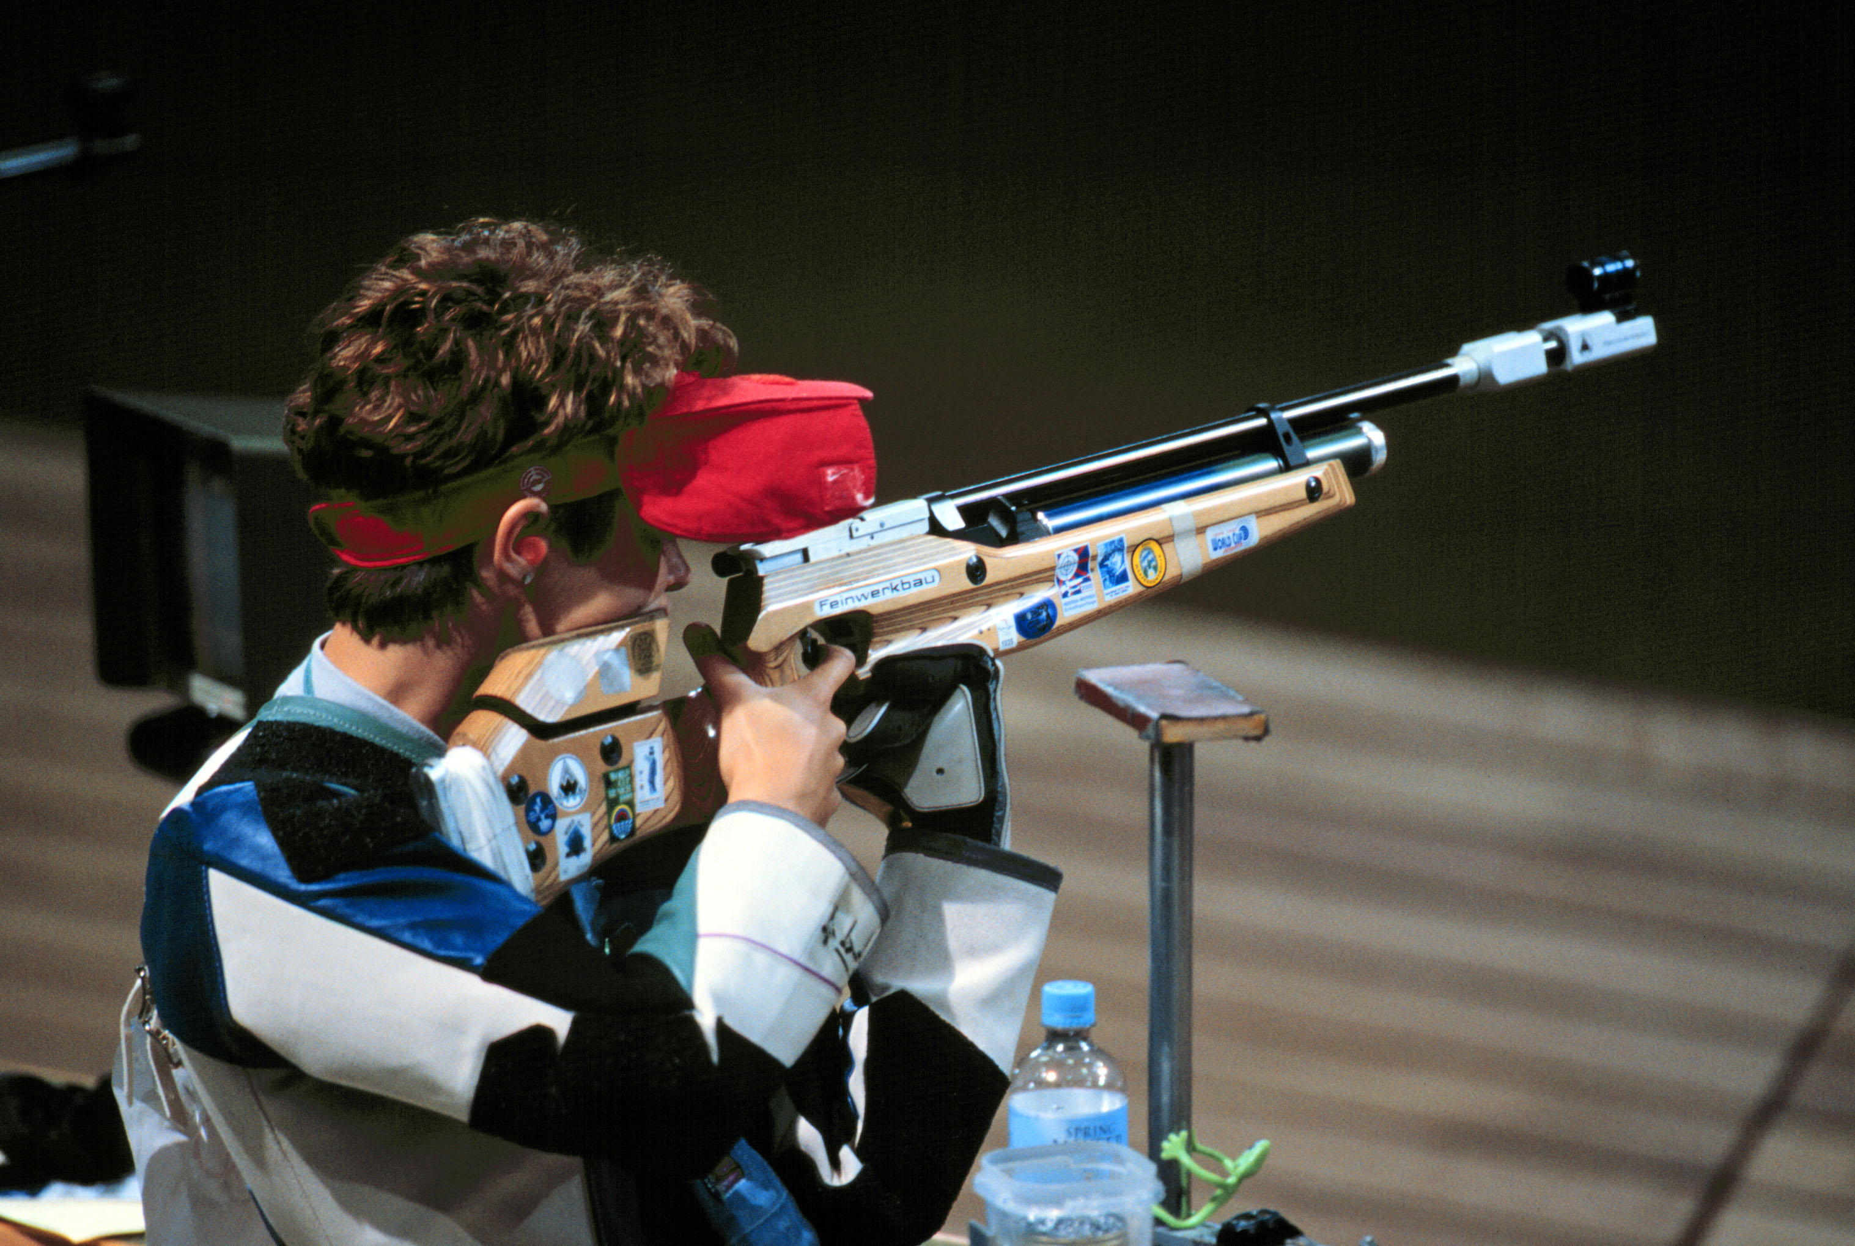
SPORTS GUN

Slide 13
NOMENCLATURE OF HUNTING GUNS

Slide 14
Hunting guns are classified according version of bore:
  a smooth bore-shotgun,
  a pellet borel-combined guns,
  a bore with a folding-rifle.
Hunting guns are divided according to the number of principal to:
  a single barreled,
  a double-barreled.

Slide 15
Under construction is divided into :
  a single-action,
  a pump,
  a self-loading.
According to the method of charging:
  a breech-loader,
  a muzzle-loader.

Slide 16
Gun with exposed hammer is called double barrelled shotgun with exposed hammer.
Gun with concealed hammer is called double swing-down barrelled shutgun with concealed hammer.

Slide 17
A terminal shotgun is called a mill machine.
A double-barreled shotgun is called a deuce.
A double-barreled shotgun is called a superposed gun.
A three barreled shotgun is called a pellet drilling.
A rifle ball with two barrels next to each other is called a double barrelled side-by-side rifle.

Slide 18
A shotgun with two ball barrels underneath is called a superposed rifle.
A shotgun with three barrels is called a three barrelled rifle.
A hunting gun with one spherical and one shotgun side by side is called a double barrelled side-by-side rifle-shortgun.
Less know is the fowling piece and flobert rifle.

Slide 19
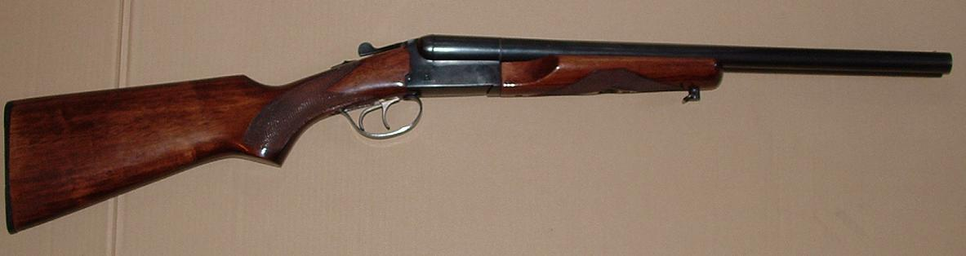
DOUBLE BARRELED SHOTGUN

Slide 20
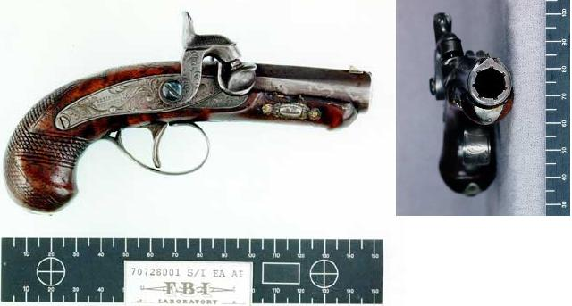
FLOBERT RIFLE

Slide 21
PARTS OF HUNTING GUNS

Slide 22
  A hunting gun consists of the following parts:
    a barrel,
    a slide,
    a trigger mechanism,
    a striking mechanism,
    a safety mechanism,
    a stock.

Slide 23
  The gun is also equipped:
    an extracting mechanism,
    an ejector mechanism,
    a feeding mechanism,
    a sight,
    a fitting.

Slide 24
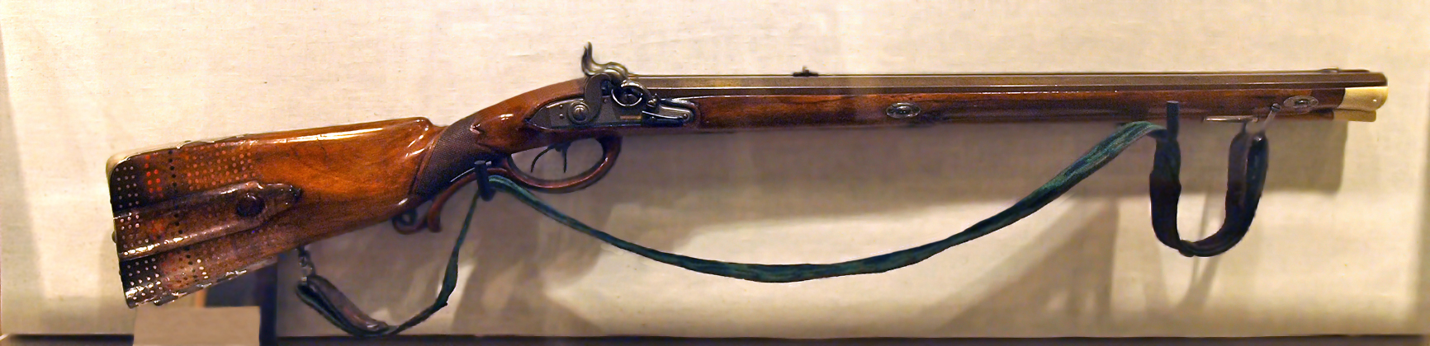
The main parts of hunting rifles are:
  a gun barrel,
  a stock,
  a slide.

Slide 25
QUIZ

Slide 26
What do you remember about hunting gun?
Do you know the main parts of hunting gun?
Do you know the main parts of sports gun?
Do you know the classification of hunting guns according to version of bore?
Do you know classification of hunting guns according to the method of charging?

Slide 27
SUMMARY

Slide 28
Expansion devices are classified according to purpose of use.
A hunting gun consists of a barrel, a slide, a trigger mechanism, a striking mechanism, a safety mechanism and a stock.
Expansion devices are appliences or equipment to perform mechanical work.

Slide 29
REFERENCE-TEXT

Slide 30
KŘÍBEK, J. Střelné zbraně I. část, 2. vyd. Brno: PC-DIR spol. s.r.o., 1995.
ELMAN, J. a Michalíček, V. Česko-Anglický technický slovník, 1. vyd. Praha: Sobotáles, 2002.

Slide 31
REFERENCE-OBRÁZKY

Slide 32
Snímek 10 [cit. 2013-22-08] Dostupný pod licencí Public Domain na WWW http://en.wikipedia.org/wiki/File:Modern_Hunting_Rifle.jpg
Snímek 11 [cit. 2013-22-08] Dostupný pod licencí Public Domain na WWW http://commons.wikimedia.org/wiki/File:Remington_M870_12_Gauge.jpg
Snímek 12 [cit. 2013-22-08] Dostupný pod licencí Public Domain na WWW http://commons.wikimedia.org/wiki/File:Nancy_Johnson_(sport_shooter)_4.jpg?uselang=cs
Snímek 19 [cit. 2013-22-08] Dostupný pod licencí Public Domain na WWW http://commons.wikimedia.org/wiki/File:CoachGun.JPG

Slide 33
Snímek 16 [cit. 2013-22-08] Dostupný pod licencí Public Domain na WWW http://en.wikipedia.org/wiki/File:Booth_deringer.jpg
Snímek 19 [cit. 2013-22-08] Dostupný pod licencí Public Domain na WWW http://commons.wikimedia.org/wiki/File:Double_Rifle_from_Maximilian_Prince_of_Wied.jpg

