Slide 1

Název SŠ: | SŠ-COPt Uherský Brod
Autor: | Ing. Hana Kubišová, Ph.D.
Název prezentace (DUMu): | Production of Guns
Název sady: | Technical English for students of study branch Technician Gunsmith 2nd, 3rd and 4th class
Číslo projektu: | CZ.1.07./1.5.00/34.0727
Datum vzniku: | 11.12.2012
Uvedení autoři, není-li uvedeno jinak, jsou autory tohoto výukového materiálu a všech jeho částí. Tento projekt je spolufinancován ESF a státním rozpočtem ČR.

Slide 2
ANOTACE
Záměrem této sady výukových materiálů s názvem Technical English je ukázat žákům, kteří se v této oblasti vzdělávají, jaký byl vývoj zbraní.
Jednotlivé DUMy (prezentace) v této sadě popíší postupně tematické oblasti, které jsou probírány v předmětu Anglický jazyk na naší SŠ.
Konkrétně tato prezentace je zaměřena na výrobu zbraní a hlavní výrobce.

Slide 3
REVISION

Slide 4
Do you know any army firearms?
What do you remember about submachine guns?
Do you know the classification of army firearms?
When could a soldier use army firearms?
How many types of conventail arms do you know?

Slide 5
Czech makers of guns

Slide 6
Česká zbrojovka Uherský Brod is the biggest producer of
guns in the Czech Republic.
  Zbrojovka Brno
  Zbrojovka Holice
  ALFA - PROJ, spol. s r.o.
  Factory Arms Olomouc
  TAU Brno, s.r.o.
  Czech Small Arms

Slide 7
world makers of guns

Slide 8
The world makers of guns are:
  Heckler and Koch
  Enfield Ordonance Factory
  AKAH Albrecht Kind GmbH
  AKBS
  Alberts, Manfred GmbH
  AmChar Wholesale Inc.

Slide 9
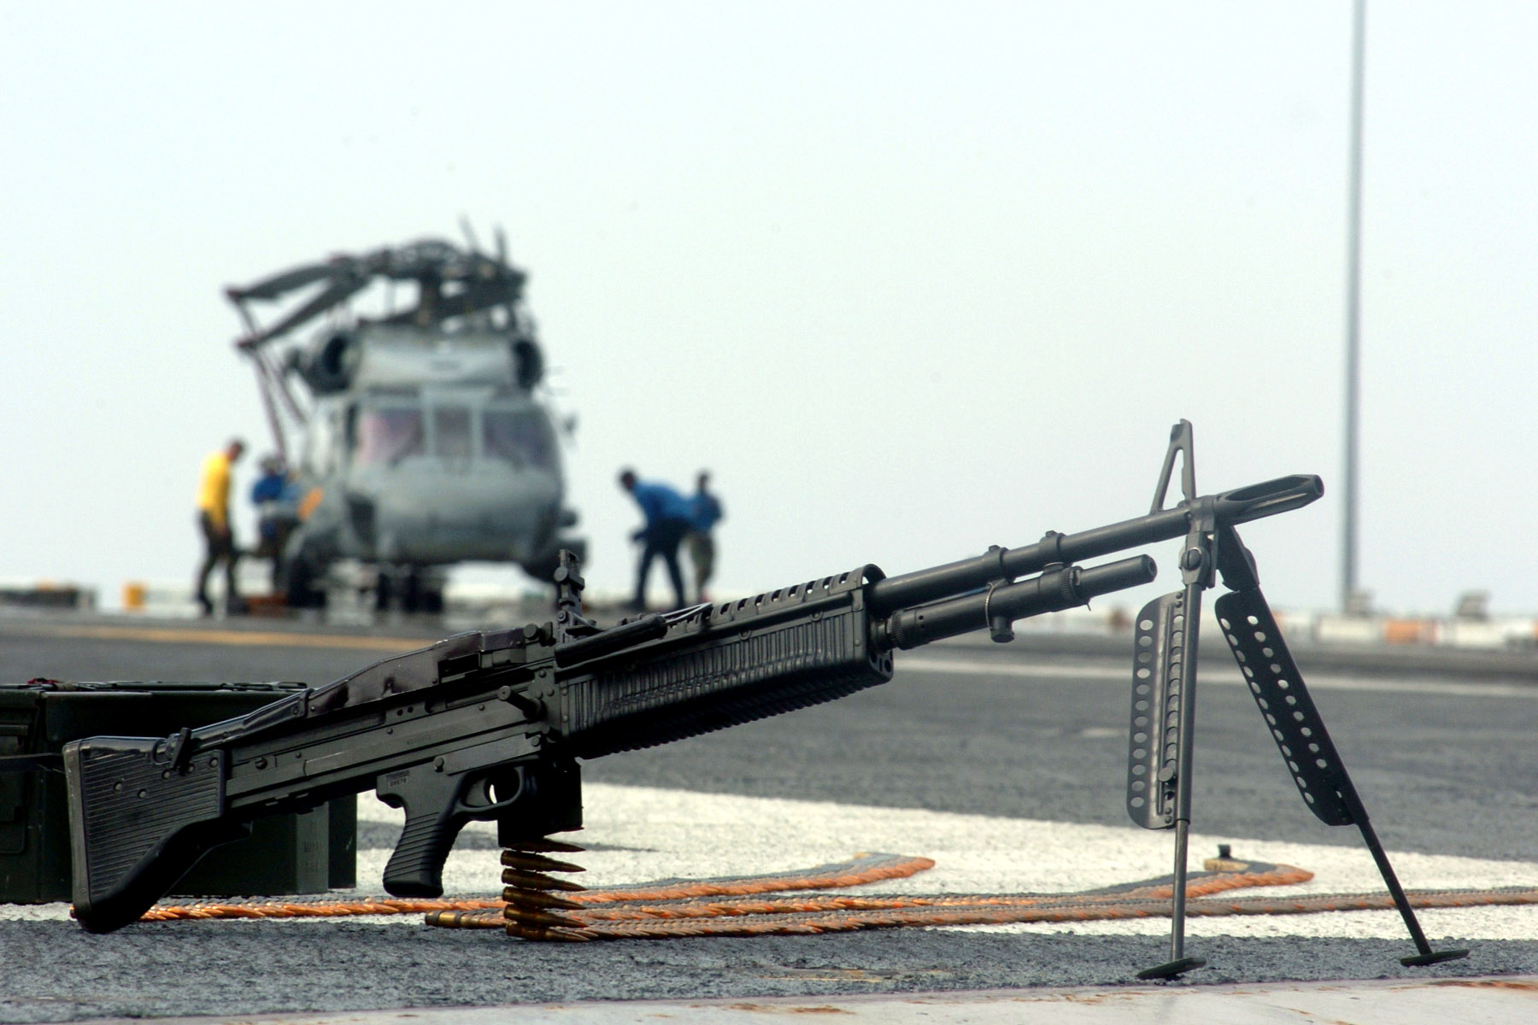
MACHINE
GUN
M60

Slide 10
Current production of hunting and sporting guns is a serial production.
Traditional materials are wood, leather, textiles, paints and paper.
Very less occurs a rubber, glass, hair and other metallic and non-metallic materials.

Slide 11



MATERIALS
Wood is a traditional material.

Slide 12
Production of gun

Slide 13
The instruments used in these machines have got a high technical level.
Using the associated tools, shaping tools and cutters, tools. Carbide caramic materials as a semicrystal.
Reinforce the clamping products.
The world's arms manufacturers have got a fully automatic lines.

Slide 14
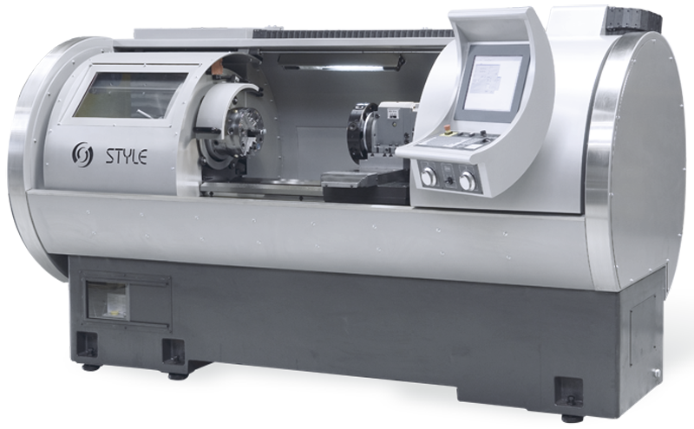
THE LATHE

Slide 15
The specialty is the production of a barrel.
The barrel is the basic of every barrel gun.
The production of barrel is a very demanding as to the shape of a barrel, an accuracy, a smoothness, etc.
In the manufacture of guns are used in various technologies such as an extrusion, a strething e.g.
Furthermore the special metal equipment.

Slide 16
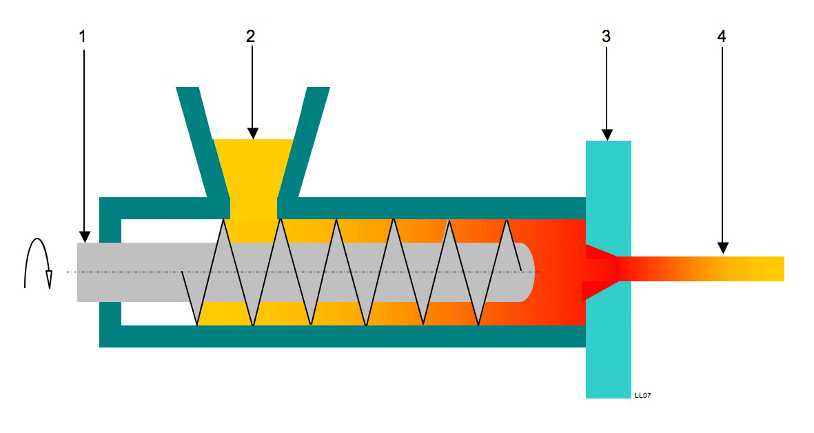
EXTRUDER
1 – a screw 2 – polymer 3 – extrusion head 4 - pipe

Slide 17
Metal stamping belongs to chipless machining.
In the manufacture are used deep drawn steel class 11.
Sheet metal stampings are combined into larger units such as riveting, soldering, etc.
The springs are made of steel towing wire.
Polymeric materials are used in the pressing.

Slide 18
quiz

Slide 19
Do you know the Czech producer?
Do you know the type of steel use for the production of guns?
Do you know any other materials?
Is a polymeric material used in the production of gun?
What polymeric materials are used?

Slide 20
summary

Slide 21
Česká zbrojovka, a.s. Uherský Brod is the biggest maker of guns in the Czech Republic.
The production of guns is a very difficult process because there are used different types of materials.
Steel, wood, polymeric materials are used for production of gun.

Slide 22
The process of production gun is an automatic, a self-automatic or a hand made.
The precision is a very important due to safety of user.
The most difficult is a production of a barrel.

Slide 23
Reference-text

Slide 24
KŘÍBEK, J. Střelné zbraně I. část, 2. vyd. Brno: PC-DIR spol. s.r.o., 1995.
ELMAN, J. a Michalíček, V. Česko-Anglický technický slovník, 1. vyd. Praha: Sobotáles, 2002.

Slide 25
Reference-obrázky

Slide 26
Snímek č. 7 [cit. 2013-22-08] Dostupný pod licencí Public Domain na WWW http://commons.wikimedia.org/wiki/File:M60_machine_gun.jpg?uselang=cs
Snímek č. 15 [cit. 2013-22-08] Dostupný pod licencí Public Domain na WWW http://commons.wikimedia.org/wiki/File:Draaibank.png
Snímek č. 17 [cit. 2013-22-08] Dostupný pod licencí Public Domain na WWW http://upload.wikimedia.org/wikipedia/commons/b/b6/Extrusion_process_1.png?uselang=cs

