Slide 1

Název SŠ: | SŠ-COPt Uherský Brod
Autor: | Ing. Hana Kubišová, Ph.D.
Název prezentace (DUMu): | Propellants
Název sady: | Technical English for students of study branch Technician Gunsmith 2nd, 3rd and 4th class
Číslo projektu: | CZ.1.07./1.5.00/34.0727
Datum vzniku: | 17.10.2012
Uvedení autoři, není-li uvedeno jinak, jsou autory tohoto výukového materiálu a všech jeho částí. Tento projekt je spolufinancován ESF a státním rozpočtem ČR.

Slide 2
ANOTACE
Záměrem této sady výukových materiálů s názvem Technical English je ukázat žákům, kteří se v této oblasti vzdělávají, jaký byl vývoj zbraní.
Jednotlivé DUMy (prezentace) v této sadě popíší postupně tematické oblasti, které jsou probírány v předmětu Anglický jazyk na naší SŠ.
Konkrétně tato prezentace je zaměřena na střeliviny a třaskaviny, zápalková lože.

Slide 3
REVISION

Slide 4
Do you know any Czech producer?
What type of steel is it used for production of gun?
Do you know any other materials?
Is polymeric material used in production of gun?
What polymeric materials are used?

Slide 5
PROPELLANTS AND EXPLOSIVES

Slide 6
The oldest and the longest used propellants is a black powder, which is a mechanical micture :
  a saltpeter 75%,
  a sulfur 10%,
  a wood coal 15%.
Individual components are very fine grind and then most perfectly mixed.

Slide 7
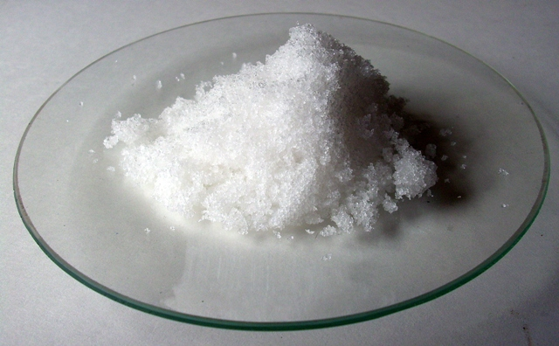
PICTURE OF NITRE

Slide 8
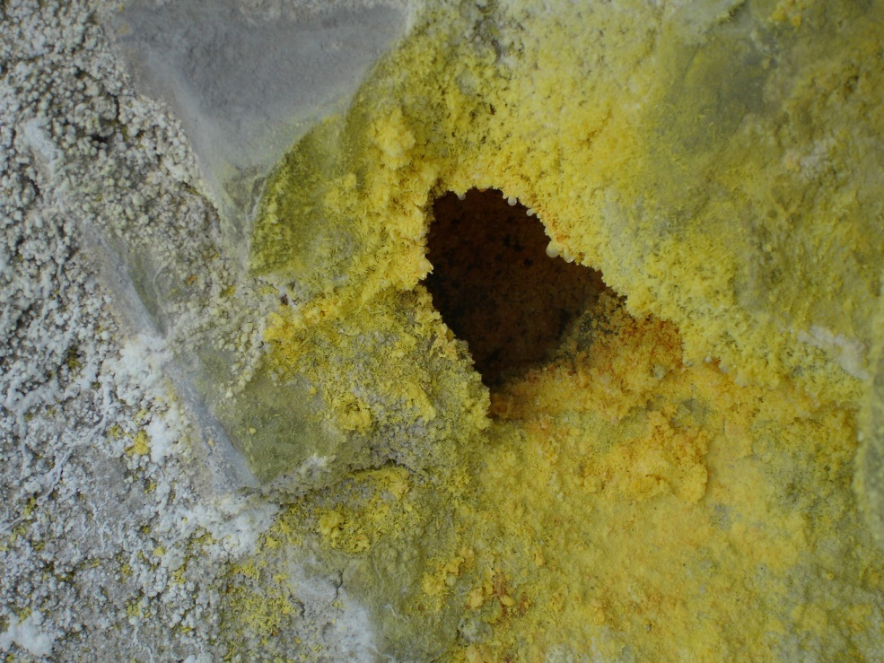
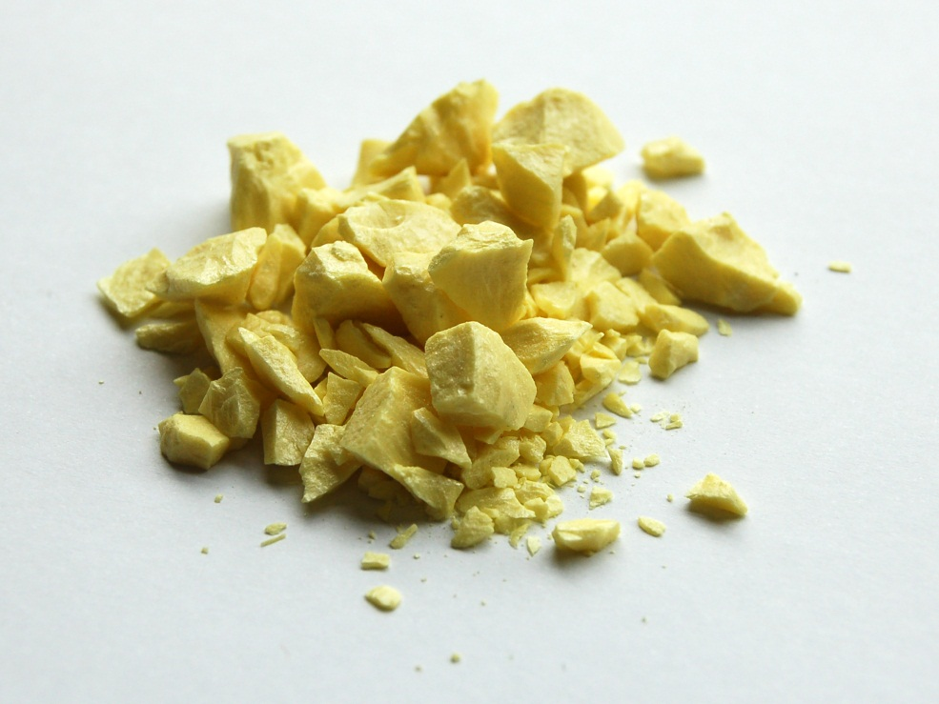
PICTURE OF SULPHUR

Slide 9
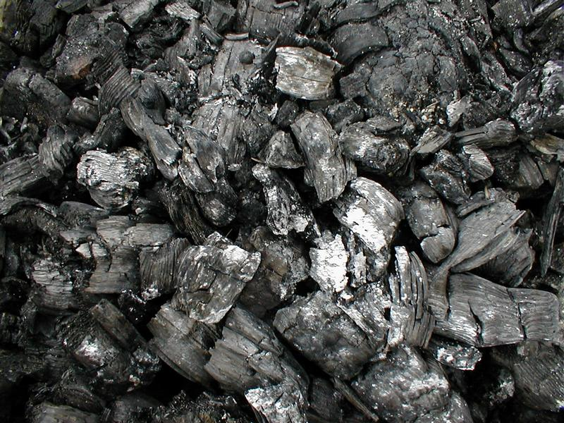
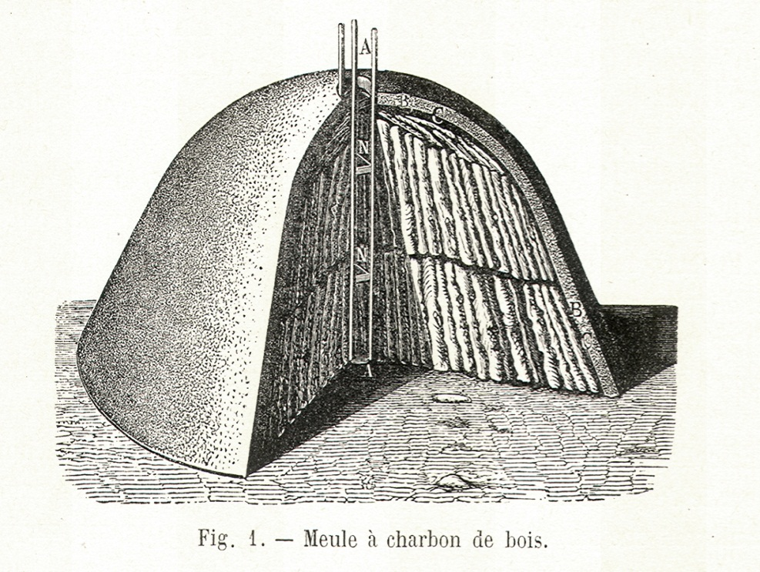
PICTURES OF CHARCOAL

Slide 10
The black powder has a grey, black , matte or metallic luster.
The black powder stains hands and is resistant to dents fingers.
At 15 % of moisture loses its ability to ignition.
The black powder ignites the slightest spark.
The powder mill is used for copper tools.

Slide 11
The main shortcomings of black powder are:
  a low power,
  a big smoke when fired,
  an amount of solid residue after burning,
  a clogging bore.

Slide 12
In the 18th century felt inadequate performance of black powder.
The first more effective powder was Berthollets powder.
This powder exploded during production and thus ceased to produce.

Slide 13
In the first half of the 19th century it has managed to gain exposure nitrating mixture the gun-cotton.
The gun-cotton had higher performance.
The gun-cotton had a slight smoke and did not leave residue in the barrel.
The gun-cotton had prone to spontaneous combustion.
In the 80´s 19th century has managed to handle the gun-cotton to grain dust.
Thus a first usable and safe smokeless gun powder.

Slide 14
Today's fire powders are produced in the same manner.
If it contains smoklless powder a nitrocellulose, we are talking about a nitrocellulose powder or a single component.

Slide 15
The nitroglycerin helps gelation nitrocellulose.
The disandvantage of a nitroglycerine powder is a low ignition, more unburnt residues and prone to whipping flame from the barrel.
The powder combustion takes place at temperature which is called explosion temperature.

Slide 16
The ignition powder charge explosives are used for their ability to respond to the intial mechanical impulse.
The explosive mixture with some auxiliary materials is called matches mixture.
The matches mixture must meet all the prescribed requirements.

Slide 17
The matches mixture does not itself explosive, but also other substances :
  a mercury fulminate –gives weak flame,
  a tetrazen - gives weak flame,
  a tricine – insensitive to blow a pin.
To increase the yield flame is added oxidant.
The matches mixture are susceptible to corrosion.

Slide 18
quiz

Slide 19
What do you know about black powder?
What materials are used for preparation of black powder?
Do you know the history of evolution of black power?
What is a matches mixture?
Is the matches mixture explosive?

Slide 20
summary

Slide 21
The black powder has a grey ,black , matte or metallic luster.
The powder mill is used for copper tools.
The powder combustions take place at temperature which is called explosion temperature.

Slide 22
Reference-text

Slide 23
KŘÍBEK, J. Střelné zbraně I. část, 2. vyd. Brno: PC-DIR spol. s.r.o., 1995.
ELMAN, J. a Michalíček, V. Česko-Anglický technický slovník, 1. vyd. Praha: Sobotáles, 2002.

Slide 24
Reference-obrázky

Slide 25
Snímek č. 7 [cit. 2013-22-08] Dostupný pod licencí Public Domain na WWW http://upload.wikimedia.org/wikipedia/commons/6/6a/Dusi%C4%8Dnan_kademnat%C3%BD.JPG
Snímek č. 8 [cit. 2013-22-08] Dostupný pod licencí Public Domain na WWW http://cs.wikipedia.org/wiki/Soubor:Fumarole.opening(2cm).jpg
http://cs.wikipedia.org/wiki/Soubor:Sulfur-sample.jpg
Snímek č. 9 [cit. 2013-22-08] Dostupný pod licencí Public Domain na WWW
http://cs.wikipedia.org/wiki/Soubor:Charcoal.jpg
http://commons.wikimedia.org/wiki/File:Meule_charbon_bois.jpg

