Slide 1

Název SŠ: | SŠ-COPt Uherský Brod
Autor: | Ing. Hana Kubišová, Ph.D.
Název prezentace (DUMu): | Munitions
Název sady: | Technical English for students of study branch Technician Gunsmith 2nd, 3rd and 4th class
Číslo projektu: | CZ.1.07./1.5.00/34.0727
Datum vzniku: | 15.12.2012
Uvedení autoři, není-li uvedeno jinak, jsou autory tohoto výukového materiálu a všech jeho částí. Tento projekt je spolufinancován ESF a státním rozpočtem ČR.

Slide 2
ANOTACE
Záměrem této sady výukových materiálů s názvem Technical English je ukázat žákům, kteří se v této oblasti vzdělávají, jaký byl vývoj zbraní.
Jednotlivé DUMy (prezentace) v této sadě popíší postupně tematické oblasti, které jsou probírány v předmětu Anglický jazyk na naší SŠ.
Konkrétně tato prezentace je zaměřena na střelivo.

Slide 3
REVISION

Slide 4
What is ballistics?
What does balistic study?
Do you know the general classification of ballistics?
What does internar ballistics study?
What does external ballistics study?

Slide 5
munition

Slide 6
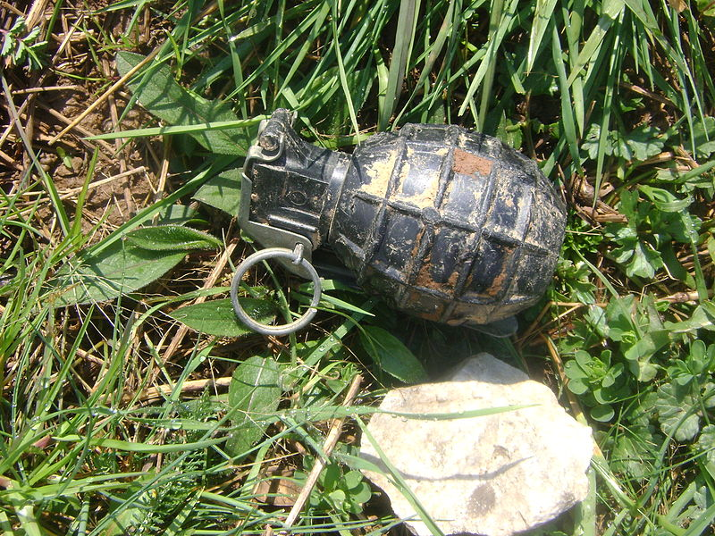
Base matches mixture consists of explosives.
Explosives are based on matches and primers.

Slide 7
Common explosives produce:
  a mercury fulminate white and brown,
  a lead azide technical,
  a tetrazen,
  an azid silver,
  a cuprous acetylide,
  a picric acid salts,
  a dinol.

Slide 8
Propellants are solid.
Propellants have got the capacity to release the combustion gases at high temperature and pressure.
Energy propellants must be released regularly and ensure safe operation of weapons.

Slide 9
Common low explosive are produced:
  a black powder,
  a nitrocellulose powders,
  a nitroglycerine powders,
  etc.

Slide 10
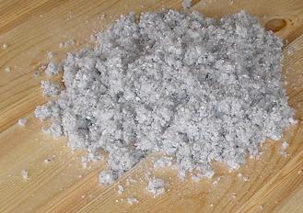
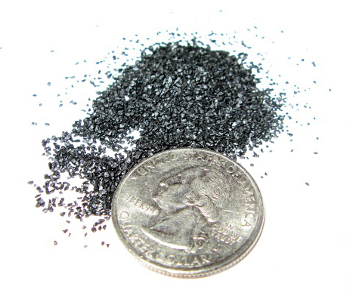
CELLULOSE AND BLACK POWDER

Slide 11
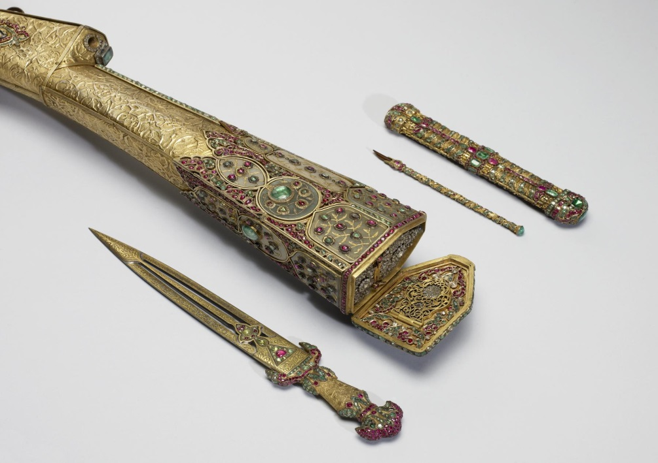
WHAT DO YOU THINK ABOUT THIS PICTURE?

Slide 12
Shape of powder grains :
  a tape powder,
  a platelet powder,
  a disc powder,
  a roller powder,
  a cored powder,
  etc.

Slide 13
  Geometrical characteristics of the powder grains determine its size, shape, width and length.
  The characteristic thickness usually varies with increasing caliber weapons.
  It is from 0.1 mm to 0.5 mm.

Slide 14
  In terms of the method of implementation powder into cartridges are distinguished:
    a powder grains form of tubes,
    a grain shapes, strips and fibers,
    a grain tying into bundles,
    a grain loose,
    a grain given in foil,
    a grain given to the vesicles.

Slide 15
Rifle bullets are designed for shooting firearms.
Rifle ammunition are manufactured in various calibres.
The basic parts of the ball bullets are:
  a primer,
  a powder charge,
  a shot,
  a cartridge.

Slide 16
    Bullet was originally spherical shape and it was shot from plain barrel.
    Turnover occurred using rifled.
    Grooving increased accuracy and increased range.
    Lead shot was equipped for greater speed jacket.
    Copper shells were later replaced by tougher.
    Shells bullets were constructed as a spherical body.

Slide 17
    Mass shot round consists of a set of lead pellets.
    The single shot shotgun is reserved for the shooting of wild boars.
    A single shot for shotgun projectile contains one particular shape.

Slide 18
    The cartridge is the basis pellets charge.
    The cartridge consists of :
      an envelope,
      a bottom of the cartridge,
      fittings,
      stiffen internal quivers.

Slide 19
QUIZ

Slide 20
    Do you know geometrical characteristic of powder?
    Could you tell me the basic parts of the ball bullets?
    What is explosive?
    Which materials are used for production of explosives?
    What materials are not used for productin of explosives?

Slide 21
SUMMARY

Slide 22
Explosives are based on matches and primers.
  Geometrical characteristics of the powder grains determine its size, shape, width and length.
Rifle ammunition are manufactured in various
calibres.
Energy propellants must be released regularly and ensure safe operation of guns.

Slide 23
REFERENCE-TEXT

Slide 24
KŘÍBEK, J. Střelné zbraně I. část, 2. vyd. Brno: PC-DIR spol. s.r.o., 1995.
ELMAN, J. a Michalíček, V. Česko-Anglický technický slovník, 1. vyd. Praha: Sobotáles, 2002.

Slide 25
    Snímek č. 7 [cit. 2013-22-08] Dostupný pod licencí Public Domain na WWW http://commons.wikimedia.org/wiki/File:Yugo_M75.JPG
    Snímek č. 11 [cit. 2013-22-08] Dostupný pod licencí Public Domain na WWW http://commons.wikimedia.org/wiki/File:Ecovata.jpg http://en.wikipedia.org/wiki/File:Black_Powder_Close_Up.jpg
    Snímek č. 12 [cit. 2013-22-08] Dostupný pod licencí Public Domain na WWW http://commons.wikimedia.org/wiki/File:Turkish_-_Rifle_-_Walters_5184_-_Detail_A_(2).jpg

