Slide 1

Název SŠ: | SŠ-COPt Uherský Brod
Autor: | Ing. Hana Kubišová, Ph.D.
Název prezentace (DUMu): | Safety Legislation
Název sady: | Technical English for students of study branch Technician Gunsmith 2nd, 3rd and 4th class
Číslo projektu: | CZ.1.07./1.5.00/34.0727
Datum vzniku: | 30.5.2013
Uvedení autoři, není-li uvedeno jinak, jsou autory tohoto výukového materiálu a všech jeho částí. Tento projekt je spolufinancován ESF a státním rozpočtem ČR.

Slide 2
ANOTACE
Záměrem této sady výukových materiálů s názvem Technical English je ukázat žákům, kteří se v této oblasti vzdělávají, jaký byl vývoj zbraní.
Jednotlivé DUMy (prezentace) v této sadě popíší postupně tematické oblasti, které jsou probírány v předmětu Anglický jazyk na naší SŠ.
Konkrétně tato prezentace je zaměřena na bezpečnostní předpisy.

Slide 3
REVISION

Slide 4
  When was created the first revolver?
  Who constructed and created the revolver?
  When appear Browning's pistols?
  Are Colt's revolver rapid-fire gun?
  Describe an unlocked system.
  Describe a locked system.

Slide 5
  Describe the halflocked systems.
  Describe the principe of locking mechanism.
  Describe advantages of pistols.
  Describe advantages of revolvers.

Slide 6
  How many groups are divided defects guns?
  Describe common defects.
  Describe defects associated with internal ballistics.
  Describe functional defects of guns.
  Describe wear out of guns.

Slide 7
  Describe gradual reduction in the functional properties of the bore.
  Describe protection of the functional properties of the bore.

Slide 8
SAFETY LEGISLATION

Slide 9
  The Law č. 147/1983 Sb. of Firearms and Ammunition Act č. 49/1990 Sb. and amending and supplementing Act č. 147/1983 lays down the conditions for possession and carrying of firearms and ammunition.
  The Act lays down the conditions under which guns and ammunition can develop, manufacture, repair, modify, degrade, export, import, transport in transit, or buy and sell.

Slide 10
  Guns and ammunition are subject to authorization and accounting duties.
  The law distinguishes guns:
    rifles,
    hunting and shotgun,
    military guns,

Slide 11
    historical guns
    alarm, starter and other expansion devices and equipment,
    components of these weapons and equipment,
    ammunition and the components needed for its manufacture, or assembly charges in those arms.

Slide 12
    Rifles are divided into:
      firearms,
      gas guns,
      special guns,
      combined guns.

Slide 13
    A person 18 years old can hold and carry rifles.
    A person must have a gun license.
    A person 18 years old can recieve a gun license.
    A gun license is issue for hunting guns, sports guns or for guns. which a person need for his/her job or for guns which are used for protection.

Slide 14
    The buying permits is necessary for buying.
    Munitions is buying for submission of gun license.
    A hunting license is needed for carry hunting weapons.
    Army guns are for security purposes.
    Historical weapons are weapons manufactured to the 1870 year.

Slide 15
    Munitions are bullets to guns.
    Hold or carry a gun can a person who has a permit.
    Who carries a gun must be very careful.
    Produce and sell weapons and munitions can only qualified person.
    A gun can be also reclaim.

Slide 16
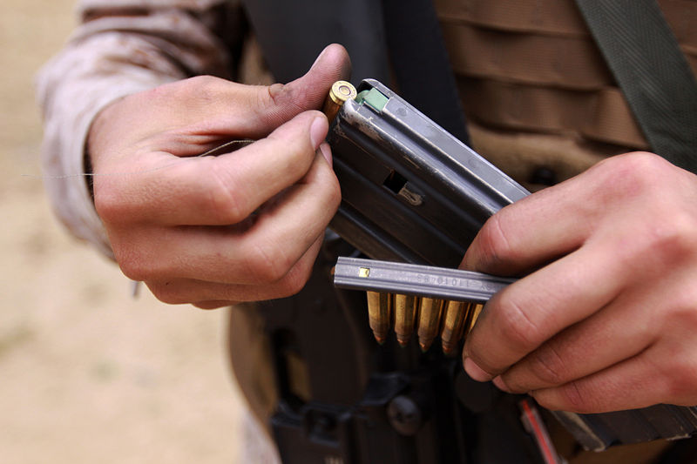

Slide 17
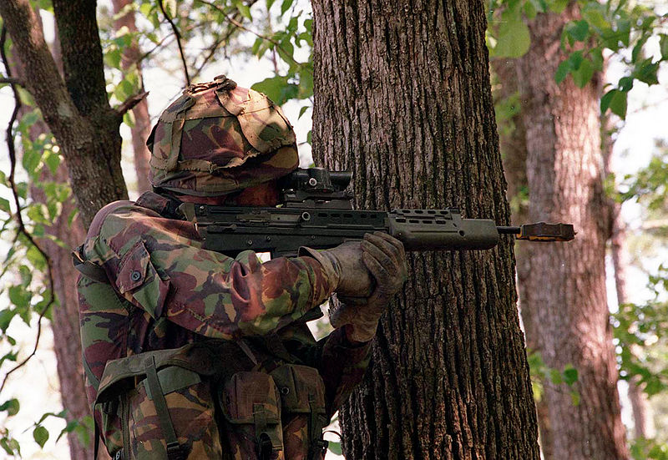

Slide 18
quiz

Slide 19
    How does the law distinguishes guns?
    How do we divide rifles?
    Why do we have a gun license?
    Why do we need a hunting licence?
    How old should you be to hold a gun?

Slide 20
summary

Slide 21
    The Law č. 147/1983 Sb. on Firearms and Ammunition Act č. 49/1990 Sb. and amending and supplementing Act č. 147/1983 lays down the conditions for possession and carrying of firearms and ammunition.
    A person 18 years old can hold and carry rifles.
    A person has got a gun license.
    A person 18 years old can recieve a gun license.

Slide 22
    A gun license is issue for hunting guns, sports guns or for guns. which a person need for his/her job or for guns which are used for protection.
    Rifles are divided into firearms, gas guns, special guns, combined guns.
    Munitions are bullets to guns.
    Hold or carry a gun can a person who has a permit.

Slide 23
    Who carries a gun must be very careful.
    Produce and sell weapons and munitions can only qualified person.
    A gun can be also reclaim.

Slide 24
Reference-text

Slide 25
KŘÍBEK, J. Střelné zbraně I. část, 2. vyd. Brno: PC-DIR spol. s.r.o., 1995.
ELMAN, J. a Michalíček, V. Česko-Anglický technický slovník, 1. vyd. Praha: Sobotáles, 2002.

Slide 26
Reference-obrázky

Slide 27
Snímek č. 16 [cit. 2013-22-08] Dostupný pod licencí Public Domain na WWW http://commons.wikimedia.org/wiki/File:USMC-100517-M-3215R-002.jpg
Snímek č. 17 [cit. 2013-22-08] Dostupný pod licencí Public Domain na WWW http://commons.wikimedia.org/wiki/File:Royal_marine_who_holds_gun.jpeg

