Slide 1

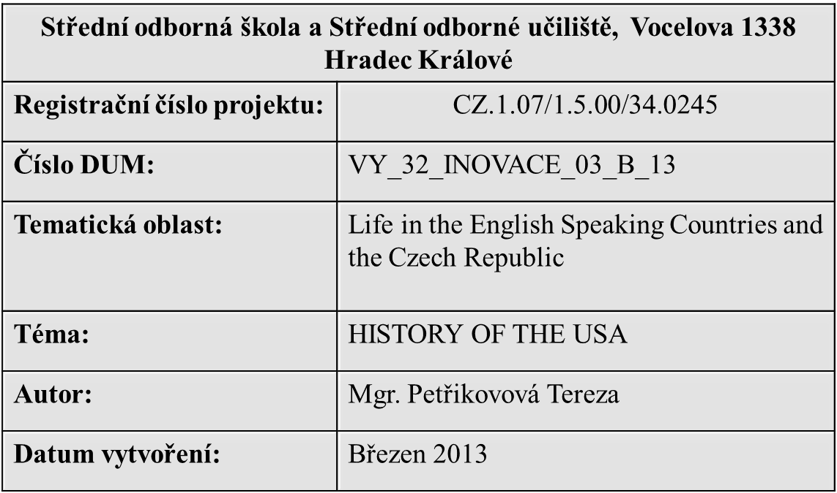

Slide 2
Anotace
Didaktický materiál je určen především žákům 4. ročníků maturujících z anglického jazyka. Prezentace obsahuje téma určené k ústní části maturitní zkoušky.
Očekávaný výstup:
Studenti by měli být schopni aplikovat získané znalosti jak v jejich ústním, tak písemné projevu.

Slide 3
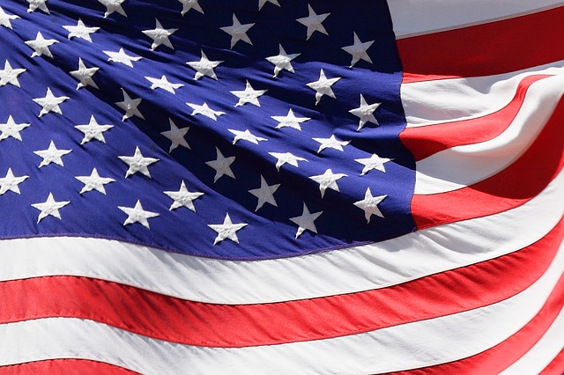
HISTORY OF THE USA

Slide 4
CONTENT
IN THE BEGINNING
THE PILGRIMS FATHERS
THE WAR OF INDEPENDENCE
THE CIVIL WAR
MARTIN LUTHER KING
RESOURCES

Slide 5
IN THE BEGINNING
“Indians“ - The original inhabitants
  They came from Asia
Probably the first Europeans in America were Vikings in 10th century
America was officialy discovered by Christopher Columbus in 1492
  He called Native Americans Indians becaouse he thought that he had reached India

Slide 6
IN THE BEGINNING
America was named after an Italian businessman Amerigo Vespuci
The first English colony was founded in Virginia in 1607

Slide 7
THE PILGRIMS FATHERS
People who had strong ideas about religion
They did not want to live in England because they did not agree with the English church
They sailed to America in a ship called the Mayflower
They landed at place they called Plymouth

Slide 8
THE PILGRIMS FATHERS
They were hungry and often ill
  Some of the Native Americans help them and showed Pilgrims how to hunt and grow corn
In 1621 Pilgrims celebrated their first big harvest
  The day was called Thanksgiving
  Americans still celebrate it the fourth Thursday of November

Slide 9
THE WAR OF INDEPENDENCE
(1775-1783)
Beginning the war is the Boston Tea Party (1773)
  Group of American men threw boxes of tee into the see because at Boston because they did not want to pay The British tax on it
  British goverment was very angry
It was the war between Britain and colonies
  Colonies in America wanted to be ndependent
The leader of the colonists was a rich farmer George Washington

Slide 10
THE WAR OF INDEPENDENCE
(1775-1783)
„Declaration of independence“
  Was written by Thomas Jefferson
  He wrote there people should have their rights: right to life, to freedom and to happiness
American finally won in 1781 and two years after that, they were free to govern themselves
In 1788 the American constitution was adopted

Slide 11
The war of independence
(1775-1783)
In 1789 they made George Washington their first presindent
The names „American“ and „United States of America“ were first used during the War of Independence
The thirteen colonies became the first thirteen American states
The third president was Thomas Jefferson

Slide 12
THE CIVIL WAR (1861-1865)
Conflicts between the North (industry) and the South (farmers)
People from the South wanted to have slaves to work, but people from the North were against this
In 1860 was Abraham Lincoln elected president
  He was against slavery

Slide 13
The civil war (1861-1865)
The North won freedom for slaves
In 1865 (five days after war) president Lincoln was shot at the theatre by a man John Wilkes Booth, who hated Lincoln and was angry about the war

Slide 14
MARTIN LUTHER KING (1929-1968)
After the Civil War people continued to argue about the rights of black people
Black people lived separately, they had to sit separately on buses and eat in separate parts of restaurants, go to different schools
A churchman Martin Luther King fought for the civil rights of black people

Slide 15
Martin LUTHER KING
In 1955 in Montgomery a black woman Rosa Parks refused to give her seat on a bus to a white woman. Black people stopped using buses and the bus companies lost a lot of money
In 1963 M.L. King had a speech where he spoke about the equality between black and white people. He started his speech with words, which have become famous: „I have a dream….“
  Martin Luther King - Speech - Youtube.com

Slide 16
Martin Luther king
In 1964 black people gave their civil rights
M. L. King was given the Nobel Peace Prize
In 1968 he was murdered in Memphis and fighting started again

Slide 17
RESOURCES
BAXTER, Alison. The USA. Oxford: Oxford University Press, 2008, ISBN 978-0-19423391-2.
Zdroj obrázku: http://pixabay.com/cs/%C4%8Dervenec-amerika-americk%C3%A9-modr%C3%A1-16674/

