Slide 1

Název školy: Základní škola T. G. Masaryka a Mateřská škola Poříčany, okr. Kolín
Autor: Mgr. Alena Černá
Název: VY_32_INOVACE_AJ_06_Clothes
Číslo projektu: CZ1.07/1.4.00/21.3085
Anotace: clothes and accessories vocabulary revision, a picture quiz, game

Slide 2
Clothes and accessories
AZ quiz
Can you name all the clothes and accessories?
What is this?
Start
the
Game
Resources

Slide 3
1
1
1
1
2
2
2
2
3
3
3
3
4
4
4
4
5
5
5
5
6
6
6
6
7
7
7
7
8
8
8
8
9
9
9
9
10
10
10
10
11
11
11
11
12
12
12
12
13
13
13
13
14
14
14
14
15
15
15
15
16
16
16
16
17
17
17
17
18
18
18
18
19
19
19
19
20
20
20
20
21
21
21
21
22
22
22
22
23
23
23
23
24
24
24
24
25
25
25
25
26
26
26
26
27
27
27
27
28
28
28
28

Slide 4
1
Check your answer
Jeans

Slide 5
2
Raincoat
Check your answer

Slide 6
3
Underwear
Check your answer

Slide 7
4
Check your answer
T-shirt

Slide 8
5
Check your answer
Pyjamas

Slide 9
6
Shoes
Check your answer

Slide 10
7
Check your answer
Jacket

Slide 11
8
Trousers
Check your answer

Slide 12
9
Skirt
Check your answer

Slide 13
10
Check your answer
Jumper

Slide 14
11
Track suit
Check your answer

Slide 15
12
Suit
Check your answer

Slide 16
13
Scarf
Check your answer

Slide 17
14
Shirt
Check your answer

Slide 18
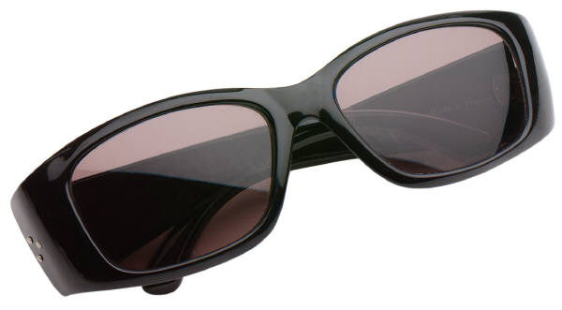
15
Sun glasses
Check your answer

Slide 19
16
Swimsuit
(bikini)
Check your answer

Slide 20
17
Swimming trunks
Check your answer

Slide 21
18
(Baseball) Cap
Check your answer

Slide 22
19
Coat
Check your answer

Slide 23
20
Check your answer
Umbrella

Slide 24
21
Slippers
Check your answer

Slide 25
22
Check your answer
Dress

Slide 26
23
Check your answer
Hat

Slide 27
24
Flip-flops
Check your answer

Slide 28
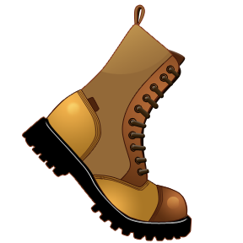
25
Boots
Check your answer

Slide 29

26
Tie
Check your answer

Slide 30
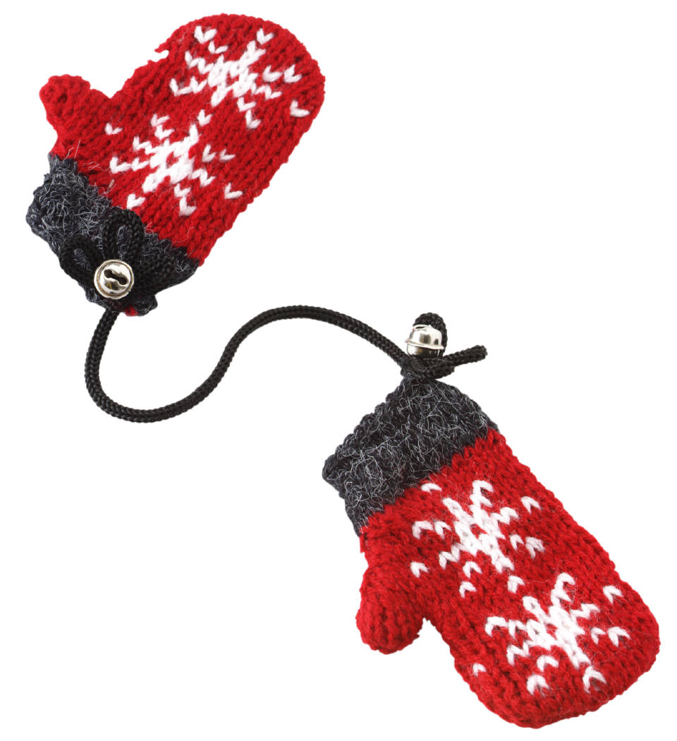
27
Check your answer
Gloves

Slide 31
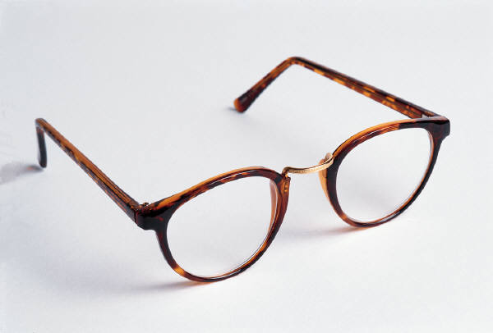
28
Glasses
Check your answer

Slide 32
Zdroje
Všechny použité obrázky jsou z galerie Microsoft Office Klipart Gallery online [cit. 2013-26-01]

