Slide 1

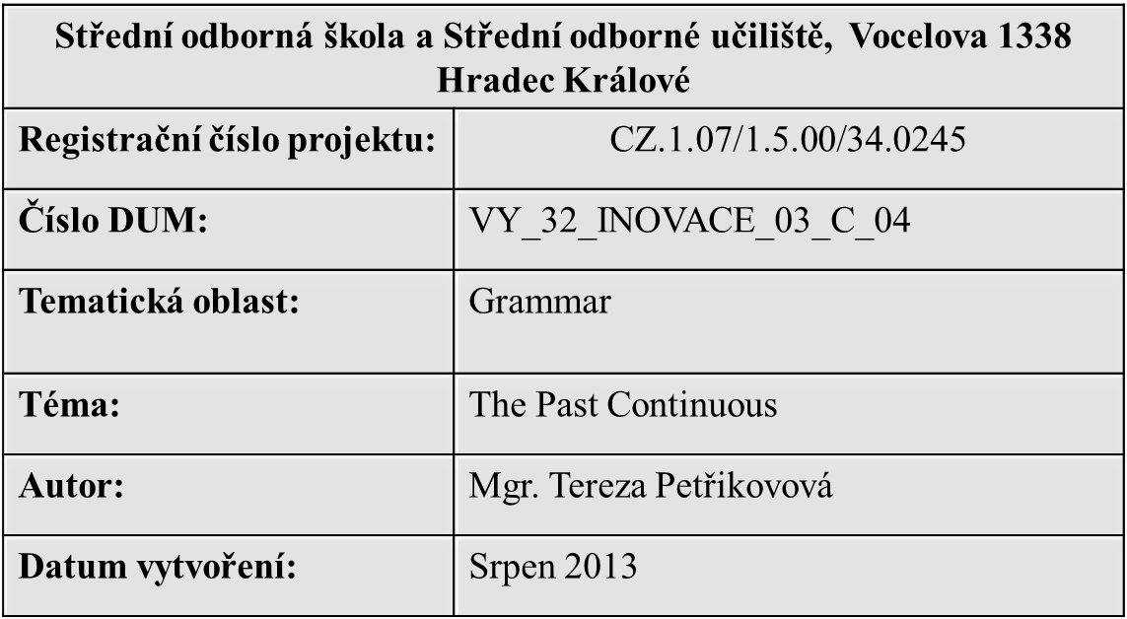

Slide 2
ANOTACE:
Anotace:
Didaktický učební materiál je určen žákům středních škol k zopakování učiva. Prezentace se skládá z přehledu daného učiva a ze cvičení určených k upevnění materiálu.
METODICKÝ POKYN:
Očekávaný výstup: pravidla užívání minulého času průběhového včetně výjimek, na základě znalosti pravidel schopnost doplnění času do textu a jeho užívání v mluvené řeči.

Slide 3
PAST CONTINUOUS

Slide 4
THE PAST CONTINUOUS: AFFIRMATIVE
Affirmative form:
Subject + was/were + present participle (verb+ing)
I was watching TV yesterday.
You were watching TV yesterday.
He/she was watching TV yesterday.
We were watching TV yesterday.
You were watching TV yesterday.
They were watching TV yesterday.

Slide 5
THE PAST CONTINUOUS:NEGATIVE
Negative form:
Subject + was not/were not + present participle (verb+ing)
I wasn´t watching TV yesterday.
You weren´t watching yesterday.
He/she wasn´t watching yesterday.
We weren´t watching TV yesterday.
You weren´t watching TV yesterday.
They weren´t watching TV yesterday.

Slide 6
THE PAST CONTINUOUS: QUESTION
Question form:
Were/was + subject + past participle (verb+ing)
Were you watching TV yesterday?
Yes, I was. No, I wasn´t.
Was he/she watching TV yeterday?
Yes, he/she was. No, he/she wasn´t.
Were they watching TV yesterday?
Yes, they were. No, they weren´t.
Were you watching TV yesterday?
Yes, we were. No, we weren´t.

Slide 7
Use the past continuous
To express actions that have a duration in the past
I was reading a book yesterday evening.
My brother was writing an essay for two hours.
To express actions that happening at the same time
I was studying English while my mum is cooking dinner yesterday.
What were you doing while you were listening to the radio?

Slide 8
USE THE PAST CONTINUOUS
To express that one action is continuing in the past and was interrupt by another action.
I was watching TV when my father came home.
We were having dinner when somebody called my father.
To describe scenery in the stories
The sun was shining.
The birds were singing.

Slide 9
PRACTISE - TRANSLATE
Mluvil jsem s ní skoro čtyři hodiny!
Co jsi dělal, zatímco jsi čekal na nádraží?
Celý večer jsem se učil na test z matematiky.
Viděl jsem ji, když jela domů z práce.
Jeli jsme domů autobuse, protože pršelo.
Když jsem šel včera ze školy, ztratil jsem klíče.
Celý den spal, protože byl nemocný.
Zatímco jsem pomáhal rodičům na zahradě, přinesl pošťák dopis.
O čem jste s ní mluvili?

Slide 10
TRANSLATE - SOLUTION
I was speaking with her almost 4 hours!
What were you doing while were you waiting at the station?
I was studying for the Math test all evening.
I saw her while she was coming back home from work.
We went home by bus because it was raining.
When I was going home from school I lost my keys.
He was sleeping all day because he was ill.
A postman brought the letter while I was helping my parents in the garden.
What were you speaking with her about?

Slide 11
MAKE SENTENCES
What was Jane doing on Monday?
7:30 a.m. – clean her teeth – was cleaning
8:00 a.m. – have a shower – was having a shower
8:15 a.m. – have breakfast – was having breakfast
8:30 a.m. – walt to work – was walking
9:00 a.m – anwer calls and write emails – was answering calls and was writing emails
6:00 p.m. – cook the dinner – was cooking
7:00 p.m. – watch the news – was watching
9:00 p.m. – read a book – was reading
And what about you? What were you doing?

Slide 12
RESOURCES
Slide 3 – 11 Vlastní tvorba

