Slide 1

People
Mgr. Lucia Púčková
VY_32_Inovace_18 PL-3
ZŠ a MŠ Nedašov

Slide 2
Anotace | prezentace slouží jako opakování a prohloubení slovní zásoby spojené s vnější a vnitřní charakteristikou člověka
Autor | Mgr. Lucia Púčková
Jazyk | anglický
Očekávaný výstup | žák si osvojí základní slovní zásobu a gramatické obraty užívané při popisu člověka jakožto jedinečné a neopakovatelné osobnosti
Speciální vzdělávací potřeby | žádné
Klíčová slova | People, family, characteristics
Druh učebního materiálu | prezentace
Druh interaktivity | kombinovaná, samostatný úkol
Cílová skupina | žák
Stupeň a typ vzdělávání | základní vzdělávání – druhý stupeň
Typická věková skupina | Žáci 6. tříd
Celková velikost 1,56 MB Datum | duben 2012

Slide 3
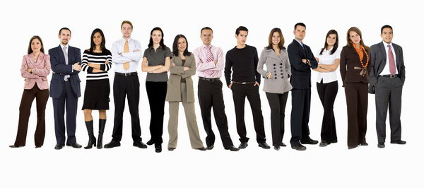
People all over the world are different and interesting. Each of us is unique and unrepeatable personality

Slide 4
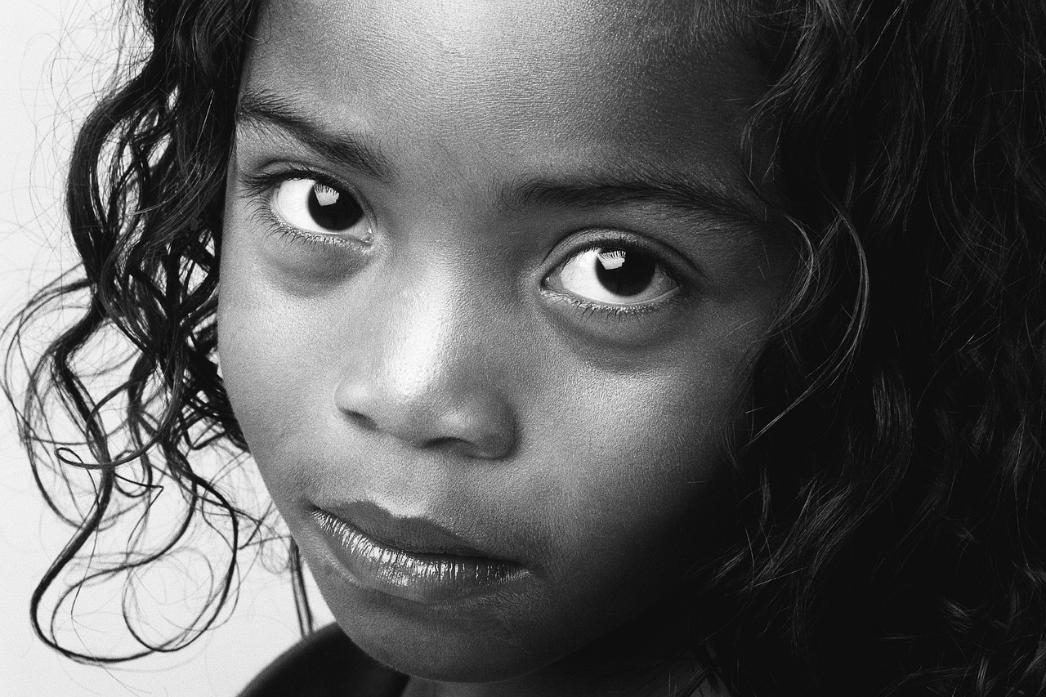
Hello, my name is Sara. I live in London and I am twelve years old.
I would like to introduce you my family.
But at first something about me.
My friends call me Smallie, because I am small and slim. I have got long, dark, wavy hair and big brown eyes.
I love books. In my free time I read books and draw pictures. My favourite subject at school is English

Slide 5
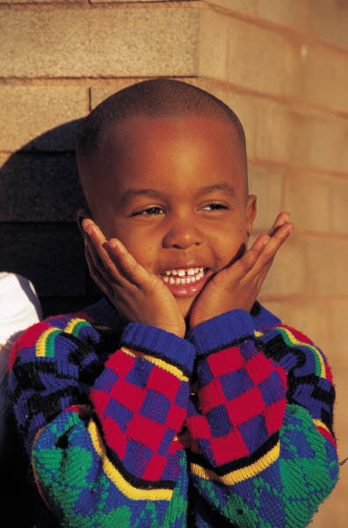
This is my brother and best friend Samuel.
Sammy is ten years old. He is small and slim too, he has got brown eyes and big mouth. Mum cut his hair, so he is bald.
Sammy likes swimming. He won the London swimming competition last year.
My friends say he is very kind and friendly.

Slide 6
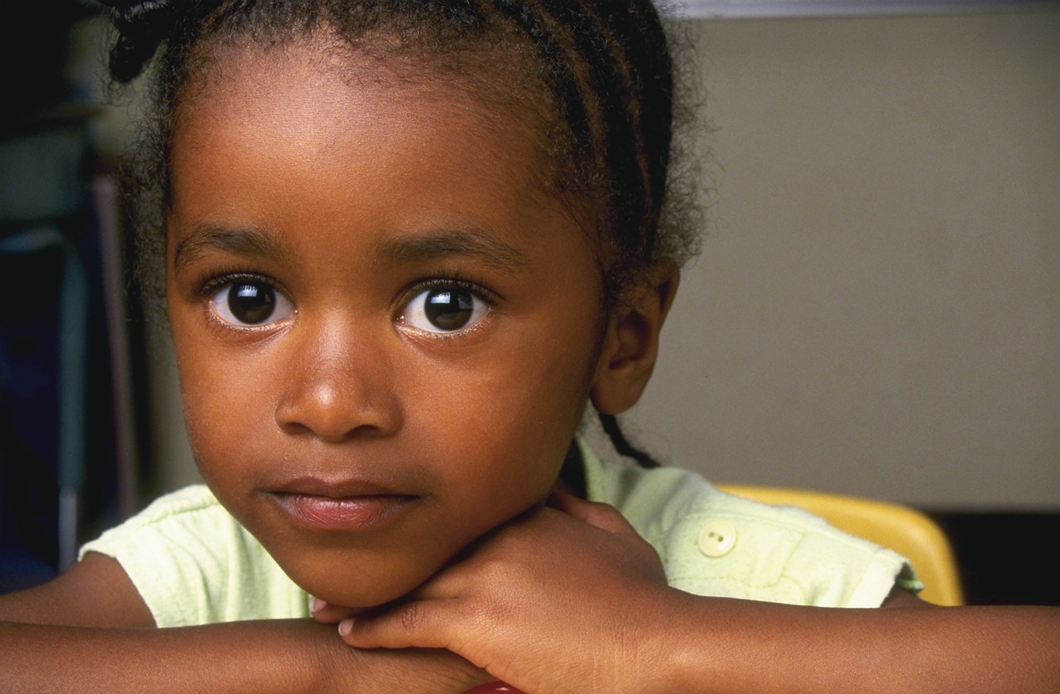
This is my sister Sue. She is young and does not go to school.
Sue is dark-skinned as me and my family. She has got long and dark curly hair. I like her hands. They are lovely.
Sue is very clever and talented. She wants to be a singer. She sings all the time.
We love her because she is pretty and broad-minded.

Slide 7
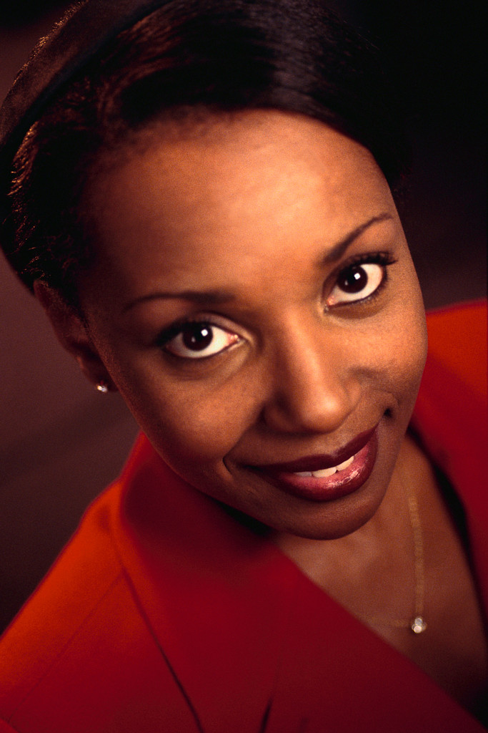
Hello, this is my beloved mum Susan.
Isn`t she beautiful?
My mum is a beautiful woman. She is tall and slim. She has got short dark hair and big eyes.
She works as a doctor. I want to be a doctor too, because I want to help other people.
My mum works in Hope hospital. In her free time she dances and listens to the music. She is very intelligent , elegant and honest.

Slide 8
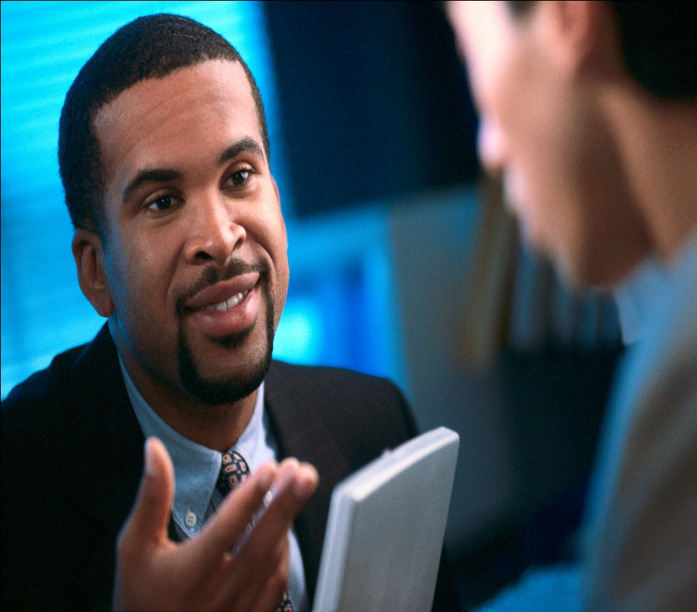
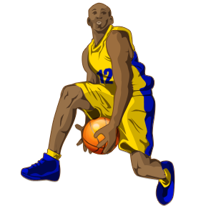
….and my daddy Sean☺)
My daddy is a tall and strong man. He works in a computer company and he likes computers. He has got short dark hair and a beard. He also wears glasses.
My daddy is a big fan of basketball. He watches sport on TV every day. His favourite sportman is Michael Jordan.

Slide 9
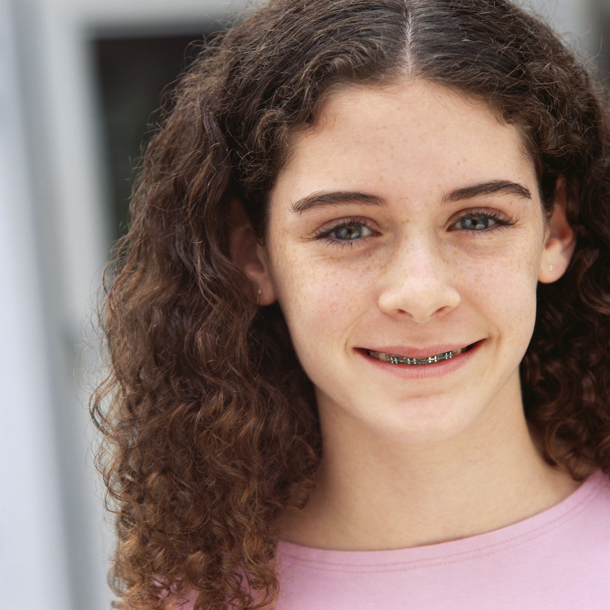
Do you have your best friend? I do. This is Katie. She is my classmate and my best friend.
Katie goes to school with me. She is twelve years old and one day she wants to be a teacher.
She likes Maths, Geography and Art.
In her free time she takes a photos. She is great!!!

Slide 10
This is my family and my friends. I have some task for you: try to describe your family and best friends.
You can see that it is very funny☺

Slide 11
New vocabulary:
Interesting – zajímavý
Unique – jedinečný
Unrepeatable – neopakovatelný
Personality – osobnost
Competition – soutěž
Friendly – přátelský
Kind – milý
Broad – minded – hodný, velkorysý
Elegant – elegantní
Honest – čestný
Company – společnost
Sportman – sportovec
Favourite – oblíbený
Classmate – spolužák, spolužačka
Great – skvělý, úžasný
Describe – popsat, popisovat
Funny – vtipný, směšný
Dark-skinned – tmavá pleť

Slide 12
Metodický list
Tato prezentace je určena pro žáky 6. tříd základních škol. Slouží k opakování, ale také prohloubení slovní zásoby a gramatických konstrukcí, které jsou spojeny s popisováním osob, jejich vnější i vnitřní charakteristikou. Žáci si nejen procvičují anglický jazyk v praxi, ale především rozvíjí své komunikační a paměťové schopnosti.

Slide 13
Zdroje:
× McCarthy, M.; O`Dell, F. English Vocabulary in Use. Cambridge: Cambridge University Press, 2001. 309 s.
ISBN 0-521-66435-7
× Nástroje sady Microsoft Office

