Slide 1

Holidays and celebrations in the English-speaking world
Škola | Katolické gymnázium Třebíč, Otmarova 22, Třebíč 674 01
Název projektu | Moderní škola
Číslo projektu | CZ.1.07/1.5.00/34.0464
Šablona | III/2 Inovace a zkvalitnění výuky prostřednictvím ICT
Autor DUM | Paula Torresan
Název DUM | Holidays and celebrations in the English-speaking world
Kód DUM | VY_32_INOVACE_ 1.1.9_Holidays_and_celebrations
Datum vytvoření | 31/08/2013
Předmět | Anglický jazyk
Tematická oblast | Anglicky mluvicí země
Výstup ŠVP | Reálie anglicky mluvících zemí
Anotace DUM | PowerPoint prezentace o svátky v anglicky mluvících zemích.
Metodický popis | Prezentace slouží k seznámení studentů s nejdůležitějšími informacemi o svátky v anglicky mluvících zemích.
Hodnocení | DUM přispěl k hlubšímu zapamatování či procvičení učiva.
Autor prohlašuje, že řádně uvedl všechny použité zdroje. Pokud není uvedeno jinak, použitý materiál je z vlastních zdrojů autora.

Slide 2
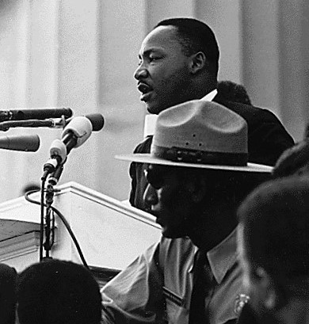
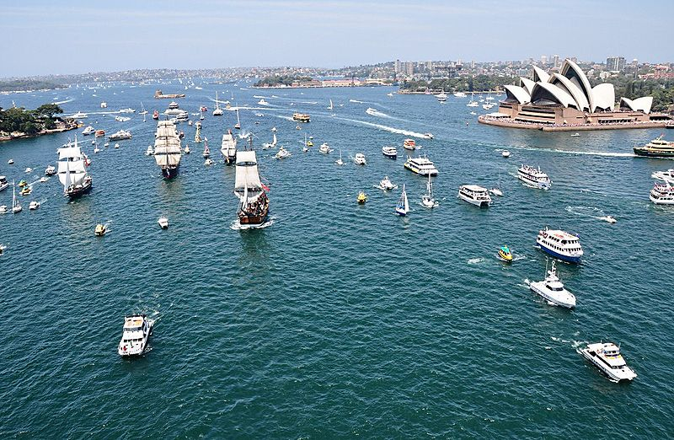
January
USA 3rd Monday in January: Martin Luther Day. Martin Luther King Jr., the clergyman and famous Afro-American civil rights activist, was born this day. He’s widely known thanks to his “I have a dream” speech, in which he demanded the end of racism. He received the Nobel Peace Prize in 1964. He was assassinated in 1968. Nowadays US citizens are asked to celebrate taking part in action volunteer service.
Martin Luther King - March on Washington. In: Wikipedia: the free encyclopedia [online]. San Francisco (CA): Wikimedia Foundation, 2001- [cit. 2013-09-12]. Dostupné z: http://commons.wikimedia.org/wiki/File:Martin_Luther_King_-_March_on_Washington.jpg
AUS 26 January: Australia Day. Australians celebrate the arrival of the First Fleet at Sydney from Britain in 1788. Captain Arthur Phillip took possession of the land in the name of the British Crown. It is celebrated with music festivals, fireworks and citizenship ceremonies, when foreigners are given the Australian citizenship.
TRAVIS SIMON. Australia Day 2010. In: Wikipedia: the free encyclopedia [online]. San Francisco (CA): Wikimedia Foundation, 2001- [cit. 2013-09-12]. Dostupné z: http://commons.wikimedia.org/wiki/File:Australia_Day_2010.jpg?uselang=cs

Slide 3
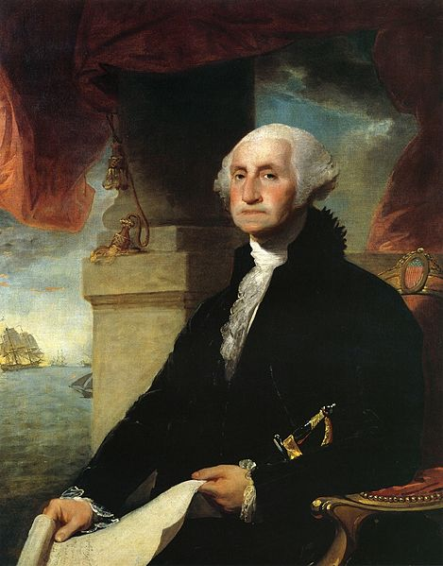
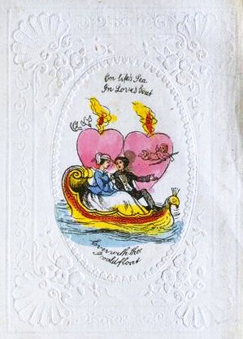
February
14 February: Valentine’s Day. Saint Valentine was a Roman priest who was arrested because he married Christian couples, although it had been forbidden by the emperor. He died on 14 February. Today lovers exchange romantic greeting cards, and give each other gifts such as chocolates and red roses.
Left: Victorian Valentine GT Little. In: Wikipedia: the free encyclopedia [online]. San Francisco (CA): Wikimedia Foundation, 2001- [cit. 2013-09-12]. Dostupné z: http://commons.wikimedia.org/wiki/File:Victorian_Valentine_GT_Little.jpg?uselang=cs
STUART, Gilbert. Stuart-george-washington-constable-1797. In: Wikipedia: the free encyclopedia [online]. San Francisco (CA): Wikimedia Foundation, 2001- [cit. 2013-09-12]. Dostupné z: http://commons.wikimedia.org/wiki/File:Stuart-george-washington-constable-1797.jpg
USA 3rd Monday Presidents’ Day/Washington’s Birthday. It celebrates the birthday of the American president, George Washington, and the work of all American presidents. Community celebrations take place all over the country.

Slide 4
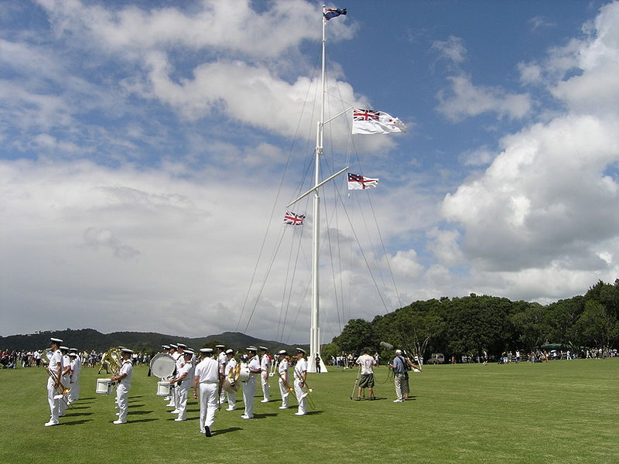
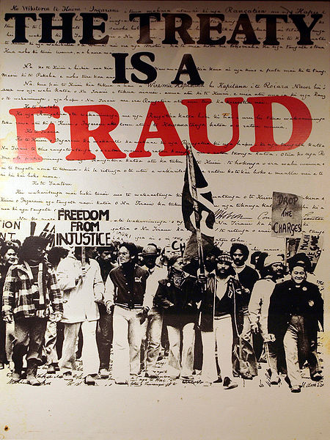
February (continueD)
New Zealand 6 February: Waitangi Day. It commemorates the day in 1840 when the Treaty of Waitangi was signed. The treaty was signed between the British and the Māoris, making New Zealand a British colony but granting the Māoris rights to their land. Nowadays the holiday is celebrated around a flagpole, with a naval salute, a Māori cultural performance, and speeches from a range of notables.
BREWER, Charlie. New Zealand Navy by the flag post - Waitangi Day. In: Wikipedia: the free encyclopedia [online]. San Francisco (CA): Wikimedia Foundation, 2001- [cit. 2013-09-14]. Dostupné z: http://commons.wikimedia.org/wiki/File:New_Zealand_Navy_by_the_flag_post_-_Waitangi_Day.jpg?uselang=cs
In the 1970s and 1980s many protests were made by Māori activists who found that the Treaty had been unjust.
ULANWP. The Treaty is a Fraud. In: Wikipedia: the free encyclopedia [online]. San Francisco (CA): Wikimedia Foundation, 2001- [cit. 2013-09-12]. Dostupné z: http://commons.wikimedia.org/wiki/File:The_Treaty_is_a_Fraud.jpg

Slide 5
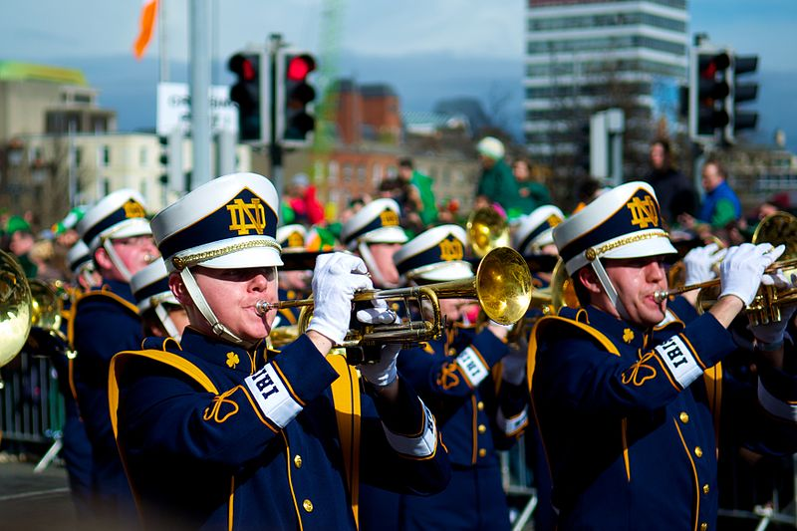
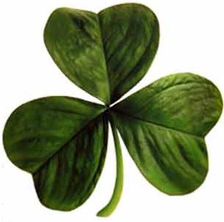
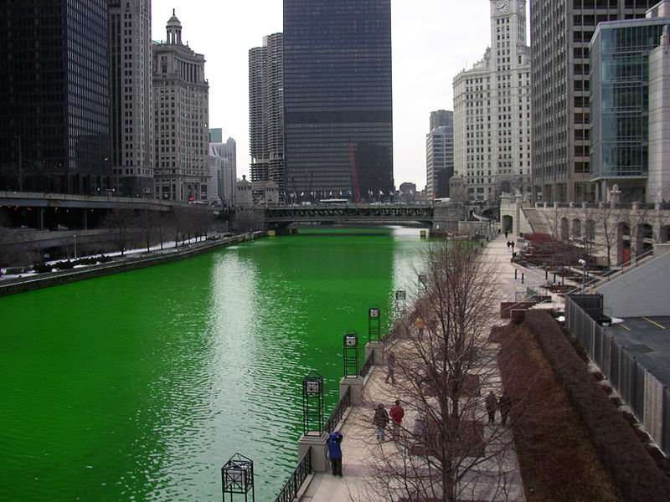
March
Ireland/USA 17 March St. Patrick’s Day
St. Patrick is the patron saint of Ireland who is believed to have died on 17 March. He brought Christianity to the island in the fifth century. His symbol is the shamrock, which he used to explain the Holy Trinity.
St. Patrick’s Day is celebrated also in the USA because of the presence of huge communities of Irish immigrants.
Green is a colour associated with Ireland and that’s why on St. Patrick’s Day people wear green clothes, dye their hair green and drink green Guinness. Chicago was the first city to dye its river green, and has since been imitated by other places in the USA.
Parades take place in many cities, both in Ireland and in the US.
Left: Irish clover. In: Wikipedia: the free encyclopedia [online]. San Francisco (CA): Wikimedia Foundation, 2001- [cit. 2013-09-12]. Dostupné z: http://commons.wikimedia.org/wiki/File:Irish_clover.jpg
Right: MENDEZ, Miguel. St. Patricks Festival, Dublin (6844464826). In: Wikipedia: the free encyclopedia [online]. San Francisco (CA): Wikimedia Foundation, 2001- [cit. 2013-09-12]. Dostupné z: http://commons.wikimedia.org/wiki/File:St._Patricks_Festival,_Dublin_(6844464826).jpg?uselang=cs
KNOWLEDGE SEEKER. Chicago River dyed green, buildings more prominent. In: Wikipedia: the free encyclopedia [online]. San Francisco (CA): Wikimedia Foundation, 2001- [cit. 2013-09-12]. Dostupné z: http://commons.wikimedia.org/wiki/File:Chicago_River_dyed_green,_buildings_more_prominent.jpg

Slide 6
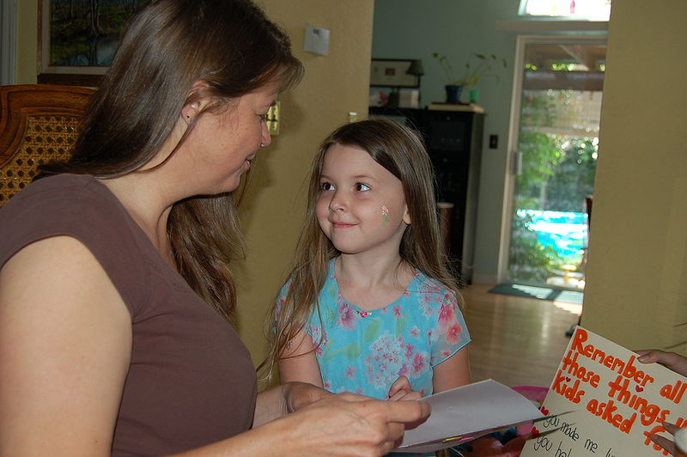
March (continueD)
UK 4th Sunday in Lent (usually in March) Mothering Sunday
USA,AUS, New Zealand 2nd Sunday in May Mothers’ Day
The two celebrations are mixed up nowadays because they take place on the same day.
Mothering Sunday was an occasion on which believers visited their mother church (original church).
However, Mothers’ Day is now a celebration in honour of all mothers. Mothers are presented with thank-you cards and small gifts.
PARKER, Dave. Mother's day card. In: Wikipedia: the free encyclopedia [online]. San Francisco (CA): Wikimedia Foundation, 2001- [cit. 2013-09-12]. Dostupné z: http://commons.wikimedia.org/wiki/File:Mother%27s_day_card.jpg

Slide 7
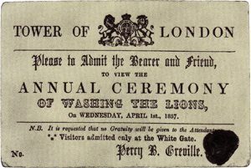
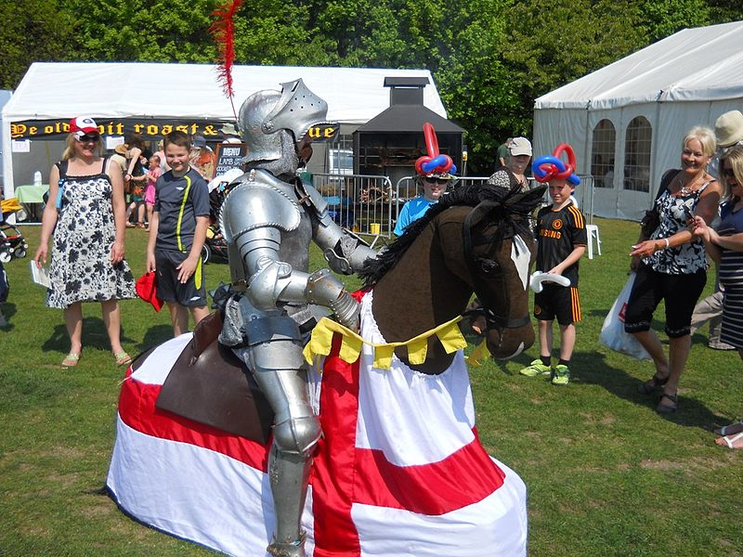
April
UK/French-speaking Canada 1 April April Fools’ Day
In the UK, people play pranks on each other, an April fool joke, which is then revealed by shouting "April fool!" at the victim, who becomes the "April fool".
In French/speaking Canada children and adults attempt to attach a paper fish (poisson d’avril, literally “April’s fish) to somebody's back without being noticed.
UK 23 April St. George’s Day St. George is the patron saint of England, who died on 23 April. The saint is often portrayed while slaying the dragon, according to the famous legend. A traditional custom on this day was to wear a red rose in one's lapel.
Washing of the Lions. In: Wikipedia: the free encyclopedia [online]. San Francisco (CA): Wikimedia Foundation, 2001- [cit. 2013-09-12]. Dostupné z: http://commons.wikimedia.org/wiki/File:Washing_of_the_Lions.jpg
English Festival, St. George's Day, RIverside, Medway George. In: Wikipedia: the free encyclopedia [online]. San Francisco (CA): Wikimedia Foundation, 2001- [cit. 2013-09-12]. Dostupné z: http://commons.wikimedia.org/wiki/File:English_Festival,_St._George%27s_Day,_RIverside,_Medway_George.jpg?uselang=cs

Slide 8
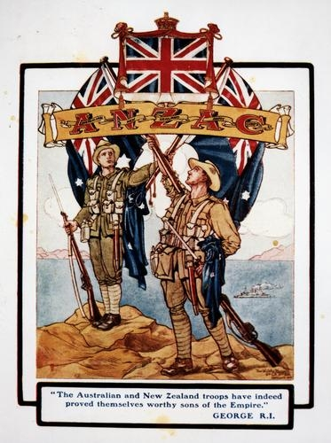
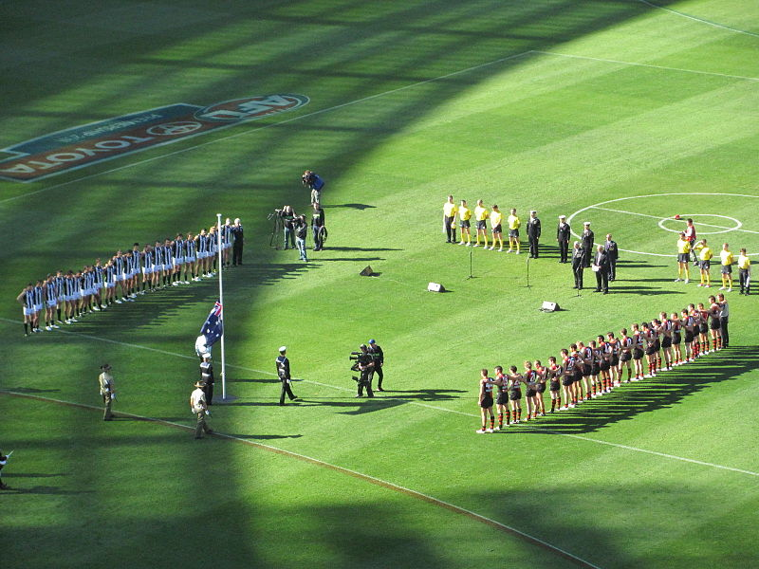
April (continueD)
AUS/New Zealand 25 April Anzac Day Originally it honoured the troops (ANZAC) fighting in the First World War at the battle of Gallipoli, Turkey.
Nowadays, it commemorates all Australians and New Zealanders who have fought in wars. Marches by veterans from all past war take place.
On this day there is the annual Australian rules football match between Collingwood and Essendon at the Melbourne Cricket Ground.
Coloured illustration of Anzac troops after the fighting at Gallipoli during World War I (1). In: Wikipedia: the free encyclopedia [online]. San Francisco (CA): Wikimedia Foundation, 2001- [cit. 2013-09-12]. Dostupné z: http://en.wikipedia.org/wiki/File:Coloured_illustration_of_Anzac_troops_after_the_fighting_at_Gallipoli_during_World_War_I_(1).jpg
ORDERINCHAOS. Anzac Day 2011 game 2. In: Wikipedia: the free encyclopedia [online]. San Francisco (CA): Wikimedia Foundation, 2001- [cit. 2013-09-14]. Dostupné z: http://commons.wikimedia.org/wiki/File:Anzac_Day_2011_game_2.jpg?uselang=cs

Slide 9
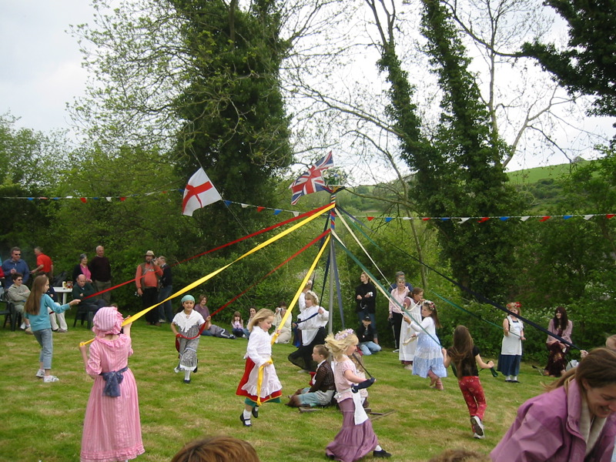
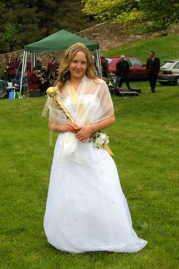
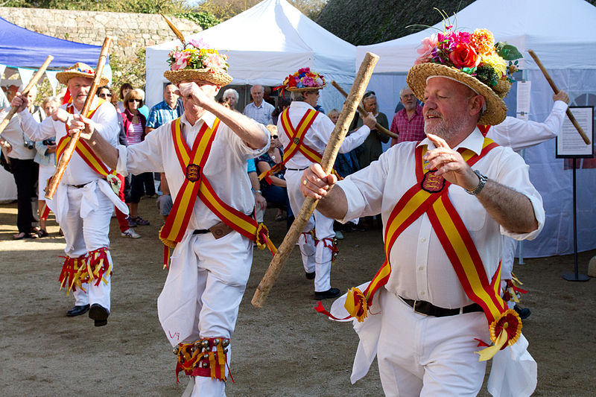
May
UK 1 May May Day
It is a spring festival which coincides with International Workers’s Day. The celebrations in the UK includes Morris dance, the crowning of a May Queen and dancing around a maypole.
The Morris dance is a traditional folk dance, performed by men wearing traditional costumes and bell pads, while stepping and moving sticks, swords or handkerchiefs.
Each year a May Queen is chosen among young girls. She begins the May Day celebrations and walks at the front of May Day parades.
May Day is also celebrated in some parts of Canada and the USA.
LINDA. MaypoleDanceWinterbourneHoughton2006. In: Wikipedia: the free encyclopedia [online]. San Francisco (CA): Wikimedia Foundation, 2001- [cit. 2013-09-16]. Dostupné z: http://commons.wikimedia.org/wiki/File:MaypoleDanceWinterbourneHoughton2006.jpg?uselang=cs
RISPIN, Charles. Melmerby May Queen on Village Green - geograph.org.uk - 233648. In: Wikipedia: the free encyclopedia [online]. San Francisco (CA): Wikimedia Foundation, 2001- [cit. 2013-09-12]. Dostupné z: http://commons.wikimedia.org/wiki/File:Melmerby_May_Queen_on_Village_Green_-_geograph.org.uk_-_233648.jpg
DANROK. Cider Festival Jersey 2011 0006. In: Wikipedia: the free encyclopedia [online]. San Francisco (CA): Wikimedia Foundation, 2001- [cit. 2013-09-12]. Dostupné z: http://commons.wikimedia.org/wiki/File:Cider_Festival_Jersey_2011_0006.jpg

Slide 10
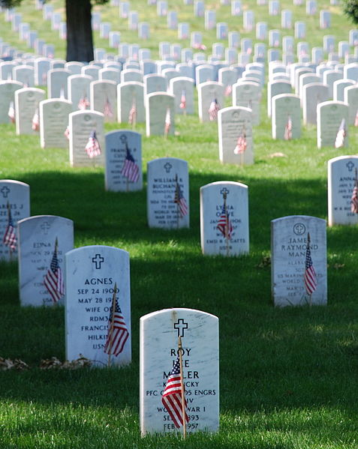
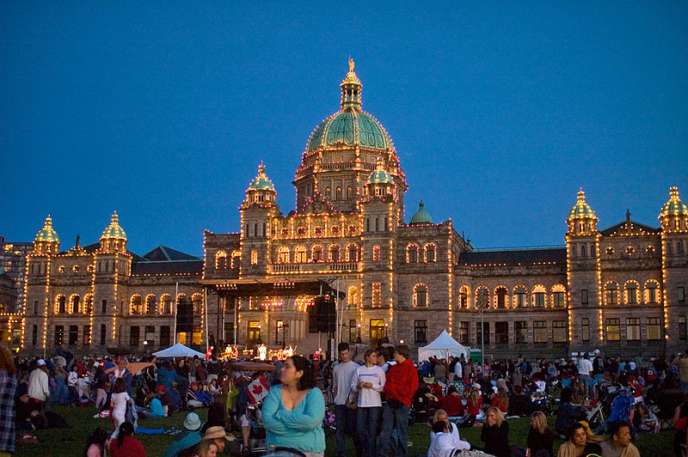
May (continueD)
USA Last Monday in May Memorial Day
It is a celebration to remember and honour all soldiers who died for their country. People visit cemeteries; parades and speeches by dignitaries are held.
Canada 23 May Victoria Day
It commemorates Queen Victoria’s birthday. She was the first monarch of a confederated Canada. The Union Jack is flown at federal government buildings and there are parades and gun salutes (firing of cannons and firearms).
REMEMBER. Graves at Arlington on Memorial Day. In: Wikipedia: the free encyclopedia [online]. San Francisco (CA): Wikimedia Foundation, 2001- [cit. 2013-09-12]. Dostupné z: http://en.wikipedia.org/wiki/File:Graves_at_Arlington_on_Memorial_Day.JPG
BUTTERFIELD, Stewart. CanadaDayVictoriaBCLegislature. In: Wikipedia: the free encyclopedia [online]. San Francisco (CA): Wikimedia Foundation, 2001- [cit. 2013-09-12]. Dostupné z: http://commons.wikimedia.org/wiki/File:CanadaDayVictoriaBCLegislature.jpg

Slide 11
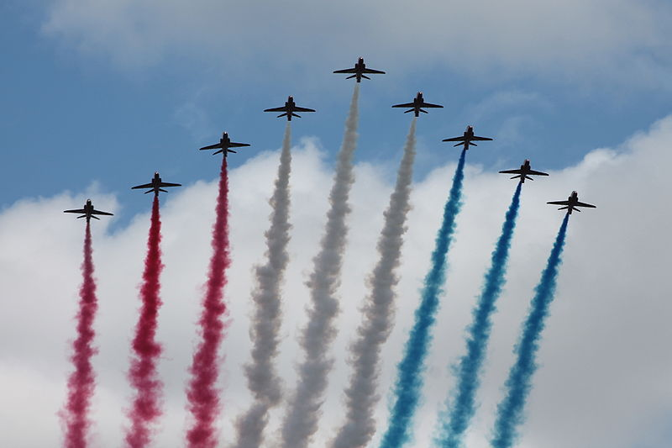
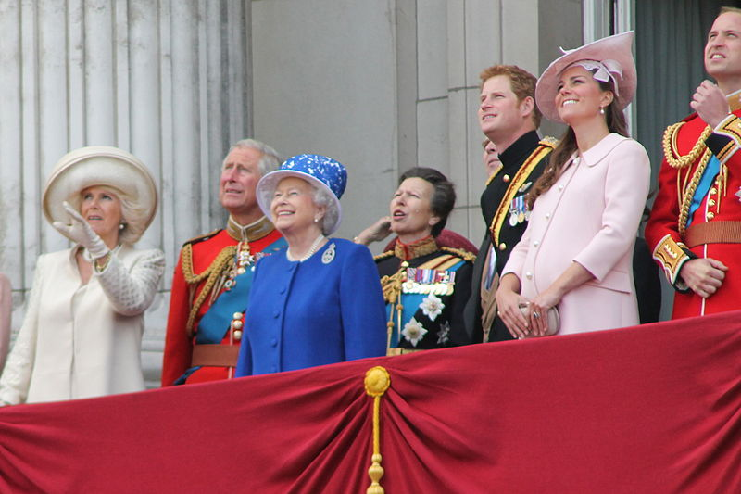
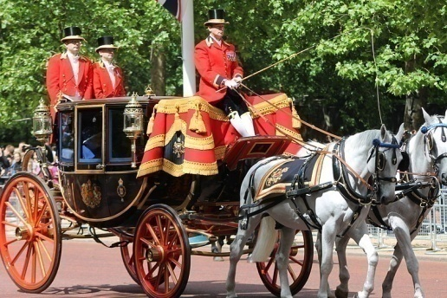
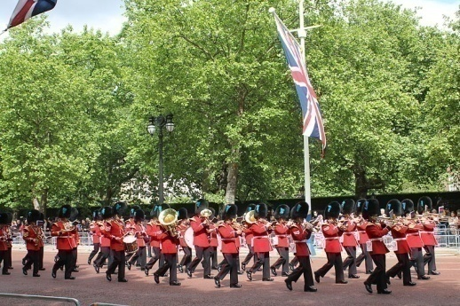
June
UK 1st/2nd/3rd Saturday Trooping the Colours
It is the official celebration of the Queen’s birthday. The Queen and the horse guards parade along the Mall. A foot guard then troops its colour (waves the military flag). Then the Queen returns to Buckingham Palace where from the palace balcony she watches with her family a Royal Air Force flypast.
CARFAX2. Red Arrows June 2013. In: Wikipedia: the free encyclopedia [online]. San Francisco (CA): Wikimedia Foundation, 2001- [cit. 2013-09-12]. Dostupné z: http://commons.wikimedia.org/wiki/File:Red_Arrows_June_2013.JPG?uselang=cs
CARFAX2. The Royal Family June 2013. In: Wikipedia: the free encyclopedia [online]. San Francisco (CA): Wikimedia Foundation, 2001- [cit. 2013-09-12]. Dostupné z: http://commons.wikimedia.org/wiki/File:The_Royal_Family_June_2013.JPG?uselang=cs
CARFAX2. Trooping the Colour 2013, the Queen's coach. In: Wikipedia: the free encyclopedia [online]. San Francisco (CA): Wikimedia Foundation, 2001- [cit. 2013-09-12]. Dostupné z: http://commons.wikimedia.org/wiki/File:Trooping_the_Colour_2013,_the_Queen%27s_coach.JPG?uselang=cs
CARFAX2. Trooping the Colour June 2013. In: Wikipedia: the free encyclopedia [online]. San Francisco (CA): Wikimedia Foundation, 2001- [cit. 2013-09-12]. Dostupné z: http://commons.wikimedia.org/wiki/File:Trooping_the_Colour_June_2013.JPG?uselang=cs

Slide 12
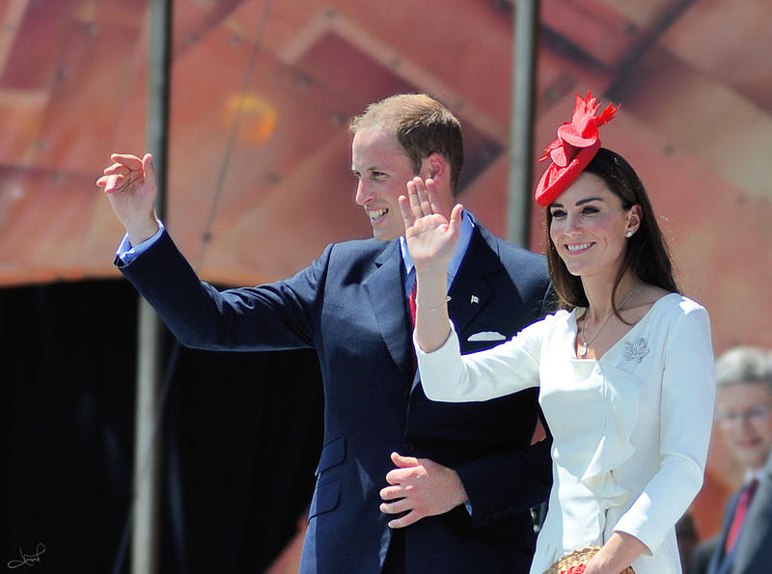
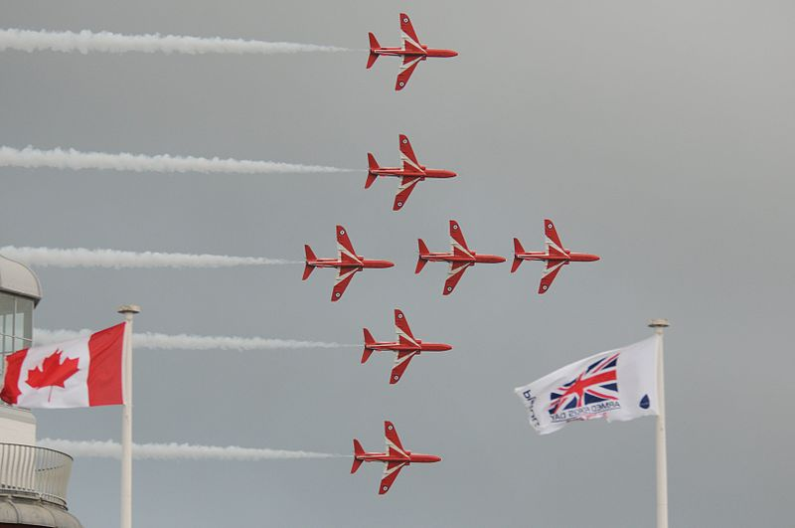
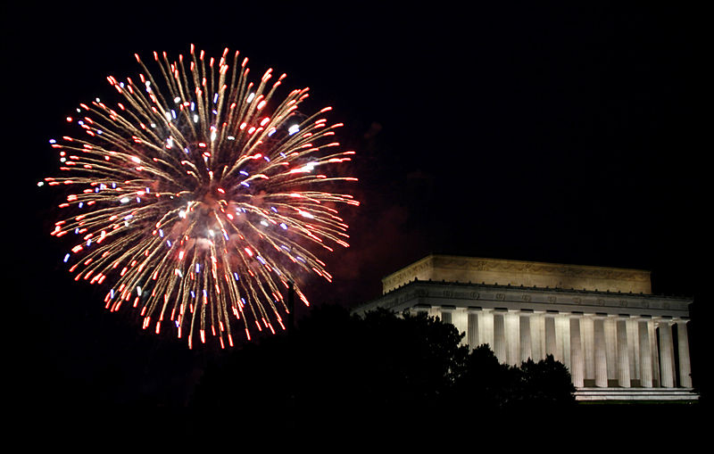
July
Canada 1 July Canada Day Canadians celebrate the day when, in 1867, Canada became an independent dominion. Usual events include citizenship ceremonies, parades, air shows, fireworks and musical concerts.
USA 4 July Independence Day It commemorates the day in 1776 when the Declaration of Independence (from Britain) was adopted. Nowadays it is celebrated with with fireworks, parades, concerts, barbecues/picnics and political speeches.
Video of President Obama’s speech in 2013: http://commons.wikimedia.org/wiki/File:2013-07-04_President_Obama%27s_Weekly_Address.ogv?uselang=cs
TSAIPROJECT. Kate and William, Canada Day, 2011, Ottawa, Ontario, Canada. In: Wikipedia: the free encyclopedia [online]. San Francisco (CA): Wikimedia Foundation, 2001- [cit. 2013-09-13]. Dostupné z: http://commons.wikimedia.org/wiki/File:Kate_and_William,_Canada_Day,_2011,_Ottawa,_Ontario,_Canada.jpg?uselang=cs
DBKING. Lincoln Memorial - fireworks. In: Wikipedia: the free encyclopedia [online]. San Francisco (CA): Wikimedia Foundation, 2001- [cit. 2013-09-13]. Dostupné z: http://commons.wikimedia.org/wiki/File:Lincoln_Memorial_-_fireworks.jpg
SAC, Ben Tritta. Armed Forces Day National Event in Plymouth MOD 45154079. In: Wikipedia: the free encyclopedia [online]. San Francisco (CA): Wikimedia Foundation, 2001- [cit. 2013-09-18]. Dostupné z: http://commons.wikimedia.org/wiki/File:Armed_Forces_Day_National_Event_in_Plymouth_MOD_45154079.jpg?uselang=cs

Slide 13
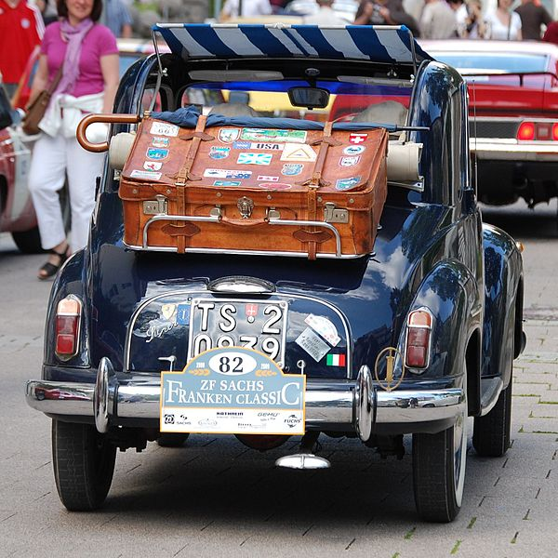
August
VON DOBSCHÜTZ, Sigismund. FIAT Topolino 1948. In: Wikipedia: the free encyclopedia [online]. San Francisco (CA): Wikimedia Foundation, 2001- [cit. 2013-09-13]. Dostupné z: http://commons.wikimedia.org/wiki/File:FIAT_Topolino_1948.JPG?uselang=cs

Slide 14

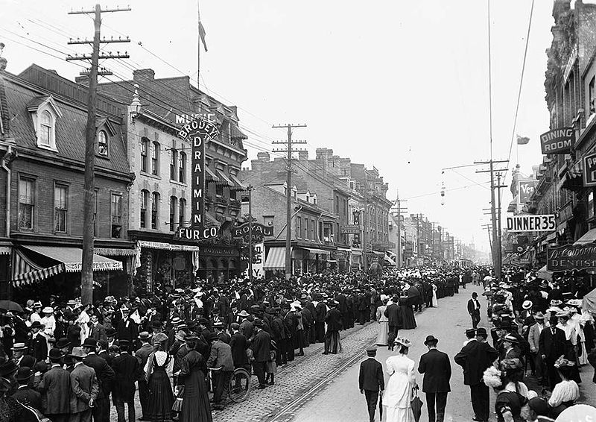
September
USA/Canada 1st Monday in September Labor/Labour Day
In Europe it corresponds to International Workers' Day (1 May). It is a day of celebration of the labour movement and all workers. There are parades and political speeches.
It also marks the end of the summer holiday.
Furthermore, Labor Day is one of the largest sale dates of the year.
WEB DESIGN HOT. Sale Tags. In: Wikipedia: the free encyclopedia [online]. San Francisco (CA): Wikimedia Foundation, 2001- [cit. 2013-09-18]. Dostupné z: http://commons.wikimedia.org/wiki/File:Sale_Tags.jpg?uselang=cs
1900s Toronto LabourDay Parade. In: Wikipedia: the free encyclopedia [online]. San Francisco (CA): Wikimedia Foundation, 2001- [cit. 2013-09-13]. Dostupné z: http://en.wikipedia.org/wiki/File:1900s_Toronto_LabourDay_Parade.jpg

Slide 15
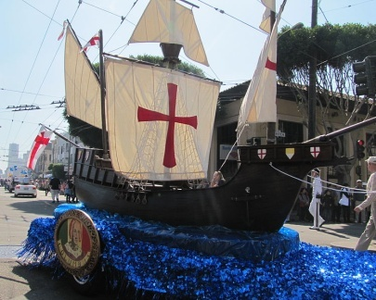
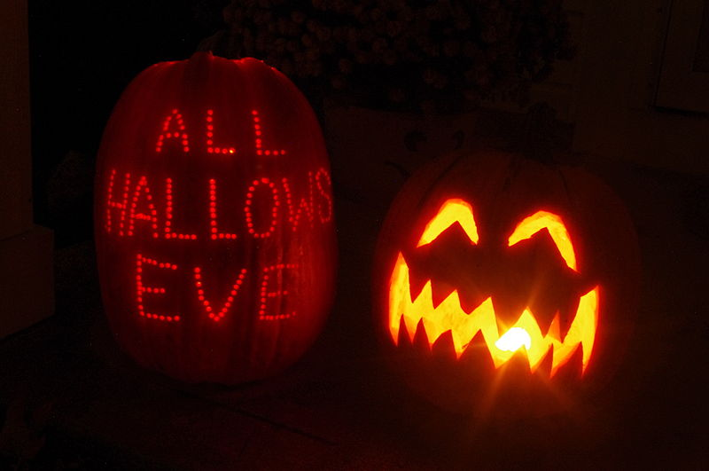
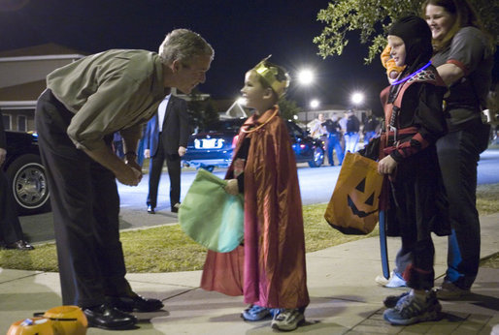
October
USA 2nd Monday in October Columbus Day It commemorates the discovery of America by Christopher Columbus in 1492. There are parades, e.g. in San Francisco and in New York, organised by the Italian/American community.
USA/Canada/UK 31 October Halloween It is rooted in the Celtic festival Samhain and the Christians’ All Saints’ Day. People wear scary costumes, make jack-o'-lantern out of pumpkins and go trick-or-treating.
TEAM AT CARNAVAL.COM STUDIOS. Columbus Day Italian Heritage Parade in SF North Beach 2011 02. In: Wikipedia: the free encyclopedia [online]. San Francisco (CA): Wikimedia Foundation, 2001- [cit. 2013-09-13]. Dostupné z: http://commons.wikimedia.org/wiki/File:Columbus_Day_Italian_Heritage_Parade_in_SF_North_Beach_2011_02.jpg
MORSE, Paul. George W Bush with trick-or-treaters, Robins Air Force Base, Georgia - 20061031. In: Wikipedia: the free encyclopedia [online]. San Francisco (CA): Wikimedia Foundation, 2001- [cit. 2013-09-13]. Dostupné z: http://commons.wikimedia.org/wiki/File:George_W_Bush_with_trick-or-treaters,_Robins_Air_Force_Base,_Georgia_-_20061031.jpg
NHEYOB. Jack-o-lanterns 2012. In: Wikipedia: the free encyclopedia [online]. San Francisco (CA): Wikimedia Foundation, 2001- [cit. 2013-09-13]. Dostupné z: http://commons.wikimedia.org/wiki/File:Jack-o-lanterns_2012.JPG

Slide 16

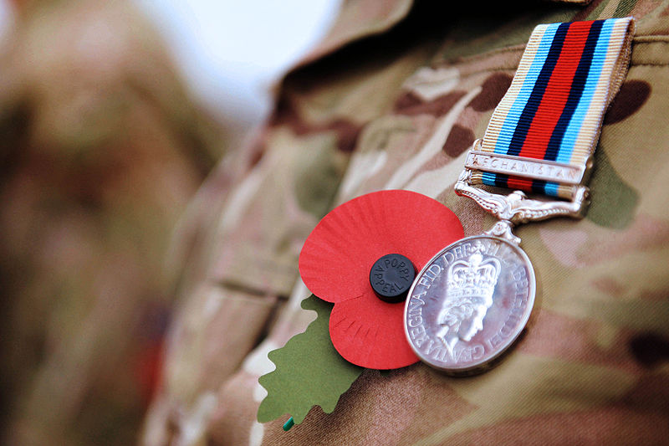
November
USA Veteran’s Day/
Canada Remembrance Day/ New Zealand Armistice Day
AUS/UK/Commonwealth countries Remembrance Day (or Poppy Day) 11 November
It commemorates the end of the World War I, which according to the armistice ended at 11 o’clock on 11/11.
In this day the soldiers who fought in all wars are honoured. In the UK and in some parts of Australia two minutes of silence are observed. Ceremonies are held at war memorials. Poppy wreaths are laid at cenotaphs (a public monument built in memory of particular people who died in war).
In the UK remembrance poppies made of paper are sold by The Royal British Legion and nearly everybody wear one of them on Remembrance Day. The poppy is a symbol taken from poem "In Flanders Fields“ by John McCrae.
UNITED STATES DEPARTMENT OF VETERANS AFFAIRS. Veterans Day 2012 Poster. In: Wikipedia: the free encyclopedia [online]. San Francisco (CA): Wikimedia Foundation, 2001- [cit. 2013-09-13]. Dostupné z: http://commons.wikimedia.org/wiki/File:Veterans_Day_2012_Poster.jpg
MORRISON, Paul (Cpl). Soldier Wearing Poppy and Afghanistan Medal MOD 45154706. In: Wikipedia: the free encyclopedia [online]. San Francisco (CA): Wikimedia Foundation, 2001- [cit. 2013-09-13]. Dostupné z: http://commons.wikimedia.org/wiki/File:Soldier_Wearing_Poppy_and_Afghanistan_Medal_MOD_45154706.jpg

Slide 17
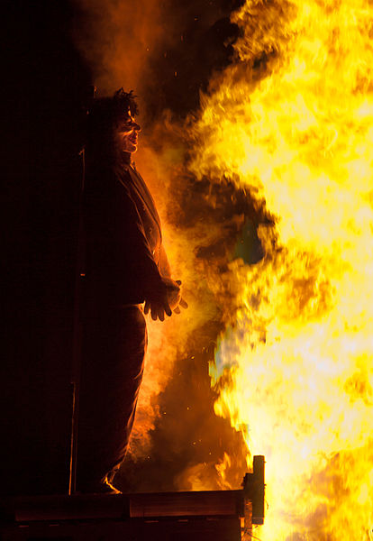
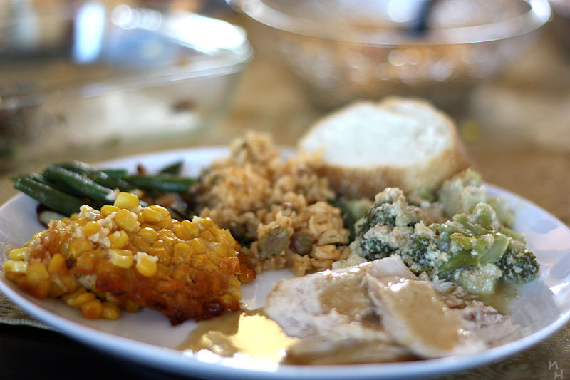
November (continueD)
UK 5 November Guy Fawkes Night It’s a reminder of the Gunpowder Plot (1605), when the Catholic Guy Fawkes wanted to blow up the Parliament. He failed and he was imprisoned and then hanged. Nowadays people celebrate with bonfires and fireworks.
USA 4th Thursday in November Thanksgiving People give thanks at the end of the harvest season. The first Thanksgiving dates back to 1621, when the Pilgrims invited Native Americans to share a feast after the first successful harvest in their new homeland. Today families gather to celebrate by sharing Thanksgiving Dinner, which usually consists of roasted turkey with stuffing and cranberry sauce, sweet potatoes, squash, sweetcorn, and pumpkin pie.
Guy Fawkes effigy by William Warby from Flickr. In: Wikipedia: the free encyclopedia [online]. San Francisco (CA): Wikimedia Foundation, 2001- [cit. 2013-09-13]. Dostupné z: http://commons.wikimedia.org/wiki/File:Guy_Fawkes_effigy_by_William_Warby_from_Flickr.jpg?uselang=cs
QUIGMIRE, Marcus. Thanksgiving Dinner (3065145964). In: Wikipedia: the free encyclopedia [online]. San Francisco (CA): Wikimedia Foundation, 2001- [cit. 2013-09-13]. Dostupné z: http://commons.wikimedia.org/wiki/File:Thanksgiving_Dinner_(3065145964).jpg

Slide 18
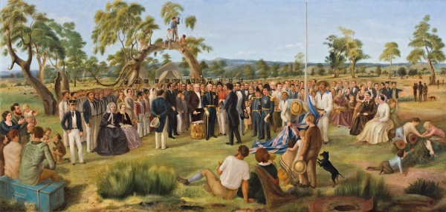
December
Australia 26 December Proclamation Day
It commemorates the proclamation of South Australia as a British Province which happened in 1836 by the Old Gum Tree in Glenelg. It meant that the native population and the settlers were now protected under the same laws. It has been celebrated in this region of Australia ever since.
On this day, many sports events take place, e.g. the Boxing Day test match, which is a cricket game at the Melbourne Cricket Ground. In many places the post-Christmas sales begin.
Charles Hill The Proclamation of South Australia 1836. In: Wikipedia: the free encyclopedia [online]. San Francisco (CA): Wikimedia Foundation, 2001- [cit. 2013-09-13]. Dostupné z: http://en.wikipedia.org/wiki/File:Charles_Hill_The_Proclamation_of_South_Australia_1836.jpg

Slide 19
Použitý materiál
Video:
2013-07-04 President Obama's Weekly Address.ogv. In: Wikipedia: the free encyclopedia [online]. San Francisco (CA): Wikimedia Foundation, 2001- [cit. 2013-09-18]. Dostupné z: http://commons.wikimedia.org/wiki/File:2013-07-04_President_Obama%27s_Weekly_Address.ogv?uselang=cs
Obrázky:
Martin Luther King - March on Washington. In: Wikipedia: the free encyclopedia [online]. San Francisco (CA): Wikimedia Foundation, 2001- [cit. 2013-09-12]. Dostupné z: http://commons.wikimedia.org/wiki/File:Martin_Luther_King_-_March_on_Washington.jpg
TRAVIS SIMON. Australia Day 2010. In: Wikipedia: the free encyclopedia [online]. San Francisco (CA): Wikimedia Foundation, 2001- [cit. 2013-09-12]. Dostupné z: http://commons.wikimedia.org/wiki/File:Australia_Day_2010.jpg?uselang=cs
Victorian Valentine GT Little. In: Wikipedia: the free encyclopedia [online]. San Francisco (CA): Wikimedia Foundation, 2001- [cit. 2013-09-12]. Dostupné z: http://commons.wikimedia.org/wiki/File:Victorian_Valentine_GT_Little.jpg?uselang=cs
STUART, Gilbert. Stuart-george-washington-constable-1797. In: Wikipedia: the free encyclopedia [online]. San Francisco (CA): Wikimedia Foundation, 2001- [cit. 2013-09-12]. Dostupné z: http://commons.wikimedia.org/wiki/File:Stuart-george-washington-constable-1797.jpg
BREWER, Charlie. New Zealand Navy by the flag post - Waitangi Day. In: Wikipedia: the free encyclopedia [online]. San Francisco (CA): Wikimedia Foundation, 2001- [cit. 2013-09-14]. Dostupné z: http://commons.wikimedia.org/wiki/File:New_Zealand_Navy_by_the_flag_post_-_Waitangi_Day.jpg?uselang=cs
ULANWP. The Treaty is a Fraud. In: Wikipedia: the free encyclopedia [online]. San Francisco (CA): Wikimedia Foundation, 2001- [cit. 2013-09-12]. Dostupné z: http://commons.wikimedia.org/wiki/File:The_Treaty_is_a_Fraud.jpg
Irish clover. In: Wikipedia: the free encyclopedia [online]. San Francisco (CA): Wikimedia Foundation, 2001- [cit. 2013-09-12]. Dostupné z: http://commons.wikimedia.org/wiki/File:Irish_clover.jpg
MENDEZ, Miguel. St. Patricks Festival, Dublin (6844464826). In: Wikipedia: the free encyclopedia [online]. San Francisco (CA): Wikimedia Foundation, 2001- [cit. 2013-09-12]. Dostupné z: http://commons.wikimedia.org/wiki/File:St._Patricks_Festival,_Dublin_(6844464826).jpg?uselang=cs
KNOWLEDGE SEEKER. Chicago River dyed green, buildings more prominent. In: Wikipedia: the free encyclopedia [online]. San Francisco (CA): Wikimedia Foundation, 2001- [cit. 2013-09-12]. Dostupné z: http://commons.wikimedia.org/wiki/File:Chicago_River_dyed_green,_buildings_more_prominent.jpG
PARKER, Dave. Mother's day card. In: Wikipedia: the free encyclopedia [online]. San Francisco (CA): Wikimedia Foundation, 2001- [cit. 2013-09-12]. Dostupné z: http://commons.wikimedia.org/wiki/File:Mother%27s_day_card.jpg
Washing of the Lions. In: Wikipedia: the free encyclopedia [online]. San Francisco (CA): Wikimedia Foundation, 2001- [cit. 2013-09-12]. Dostupné z: http://commons.wikimedia.org/wiki/File:Washing_of_the_Lions.jpg
English Festival, St. George's Day, RIverside, Medway George. In: Wikipedia: the free encyclopedia [online]. San Francisco (CA): Wikimedia Foundation, 2001- [cit. 2013-09-12]. Dostupné z: http://commons.wikimedia.org/wiki/File:English_Festival,_St._George%27s_Day,_RIverside,_Medway_George.jpg?uselang=cs
Coloured illustration of Anzac troops after the fighting at Gallipoli during World War I (1). In: Wikipedia: the free encyclopedia [online]. San Francisco (CA): Wikimedia Foundation, 2001- [cit. 2013-09-12]. Dostupné z: http://en.wikipedia.org/wiki/File:Coloured_illustration_of_Anzac_troops_after_the_fighting_at_Gallipoli_during_World_War_I_(1).jpg
ORDERINCHAOS. Anzac Day 2011 game 2. In: Wikipedia: the free encyclopedia [online]. San Francisco (CA): Wikimedia Foundation, 2001- [cit. 2013-09-14]. Dostupné z: http://commons.wikimedia.org/wiki/File:Anzac_Day_2011_game_2.jpg?uselang=cs
LINDA. MaypoleDanceWinterbourneHoughton2006. In: Wikipedia: the free encyclopedia [online]. San Francisco (CA): Wikimedia Foundation, 2001- [cit. 2013-09-16]. Dostupné z: http://commons.wikimedia.org/wiki/File:MaypoleDanceWinterbourneHoughton2006.jpg?uselang=cs
RISPIN, Charles. Melmerby May Queen on Village Green - geograph.org.uk - 233648. In: Wikipedia: the free encyclopedia [online]. San Francisco (CA): Wikimedia Foundation, 2001- [cit. 2013-09-12]. Dostupné z: http://commons.wikimedia.org/wiki/File:Melmerby_May_Queen_on_Village_Green_-_geograph.org.uk_-_233648.jpg
POKRAČOVÁNÍ NA DALŠÍ STRÁNKU

Slide 20
DANROK. Cider Festival Jersey 2011 0006. In: Wikipedia: the free encyclopedia [online]. San Francisco (CA): Wikimedia Foundation, 2001- [cit. 2013-09-12]. Dostupné z: http://commons.wikimedia.org/wiki/File:Cider_Festival_Jersey_2011_0006.jpg
REMEMBER. Graves at Arlington on Memorial Day. In: Wikipedia: the free encyclopedia [online]. San Francisco (CA): Wikimedia Foundation, 2001- [cit. 2013-09-12]. Dostupné z: http://en.wikipedia.org/wiki/File:Graves_at_Arlington_on_Memorial_Day.JPG
BUTTERFIELD, Stewart. CanadaDayVictoriaBCLegislature. In: Wikipedia: the free encyclopedia [online]. San Francisco (CA): Wikimedia Foundation, 2001- [cit. 2013-09-12]. Dostupné z: http://commons.wikimedia.org/wiki/File:CanadaDayVictoriaBCLegislature.jpg
CARFAX2. Red Arrows June 2013. In: Wikipedia: the free encyclopedia [online]. San Francisco (CA): Wikimedia Foundation, 2001- [cit. 2013-09-12]. Dostupné z: http://commons.wikimedia.org/wiki/File:Red_Arrows_June_2013.JPG?uselang=cs
CARFAX2. Trooping the Colour 2013, the Queen's coach. In: Wikipedia: the free encyclopedia [online]. San Francisco (CA): Wikimedia Foundation, 2001- [cit. 2013-09-12]. Dostupné z: http://commons.wikimedia.org/wiki/File:Trooping_the_Colour_2013,_the_Queen%27s_coach.JPG?uselang=cs
CARFAX2. Trooping the Colour June 2013. In: Wikipedia: the free encyclopedia [online]. San Francisco (CA): Wikimedia Foundation, 2001- [cit. 2013-09-12]. Dostupné z: http://commons.wikimedia.org/wiki/File:Trooping_the_Colour_June_2013.JPG?uselang=cs
CARFAX2. The Royal Family June 2013. In: Wikipedia: the free encyclopedia [online]. San Francisco (CA): Wikimedia Foundation, 2001- [cit. 2013-09-12]. Dostupné z: http://commons.wikimedia.org/wiki/File:The_Royal_Family_June_2013.JPG?uselang=cs
TSAIPROJECT. Kate and William, Canada Day, 2011, Ottawa, Ontario, Canada. In: Wikipedia: the free encyclopedia [online]. San Francisco (CA): Wikimedia Foundation, 2001- [cit. 2013-09-13]. Dostupné z: http://commons.wikimedia.org/wiki/File:Kate_and_William,_Canada_Day,_2011,_Ottawa,_Ontario,_Canada.jpg?uselang=cs
SAC, Ben Tritta. Armed Forces Day National Event in Plymouth MOD 45154079. In: Wikipedia: the free encyclopedia [online]. San Francisco (CA): Wikimedia Foundation, 2001- [cit. 2013-09-18]. Dostupné z: http://commons.wikimedia.org/wiki/File:Armed_Forces_Day_National_Event_in_Plymouth_MOD_45154079.jpg?uselang=cs
DBKING. Lincoln Memorial - fireworks. In: Wikipedia: the free encyclopedia [online]. San Francisco (CA): Wikimedia Foundation, 2001- [cit. 2013-09-13]. Dostupné z: http://commons.wikimedia.org/wiki/File:Lincoln_Memorial_-_fireworks.jpg
VON DOBSCHÜTZ, Sigismund. FIAT Topolino 1948. In: Wikipedia: the free encyclopedia [online]. San Francisco (CA): Wikimedia Foundation, 2001- [cit. 2013-09-13]. Dostupné z: http://commons.wikimedia.org/wiki/File:FIAT_Topolino_1948.JPG?uselang=cs
WEB DESIGN HOT. Sale Tags. In: Wikipedia: the free encyclopedia [online]. San Francisco (CA): Wikimedia Foundation, 2001- [cit. 2013-09-18]. Dostupné z: http://commons.wikimedia.org/wiki/File:Sale_Tags.jpg?uselang=cs
1900s Toronto LabourDay Parade. In: Wikipedia: the free encyclopedia [online]. San Francisco (CA): Wikimedia Foundation, 2001- [cit. 2013-09-13]. Dostupné z: http://en.wikipedia.org/wiki/File:1900s_Toronto_LabourDay_Parade.jpg
TEAM AT CARNAVAL.COM STUDIOS. Columbus Day Italian Heritage Parade in SF North Beach 2011 02. In: Wikipedia: the free encyclopedia [online]. San Francisco (CA): Wikimedia Foundation, 2001- [cit. 2013-09-13]. Dostupné z: http://commons.wikimedia.org/wiki/File:Columbus_Day_Italian_Heritage_Parade_in_SF_North_Beach_2011_02.jpg
MORSE, Paul. George W Bush with trick-or-treaters, Robins Air Force Base, Georgia - 20061031. In: Wikipedia: the free encyclopedia [online]. San Francisco (CA): Wikimedia Foundation, 2001- [cit. 2013-09-13]. Dostupné z: http://commons.wikimedia.org/wiki/File:George_W_Bush_with_trick-or-treaters,_Robins_Air_Force_Base,_Georgia_-_20061031.jpg
NHEYOB. Jack-o-lanterns 2012. In: Wikipedia: the free encyclopedia [online]. San Francisco (CA): Wikimedia Foundation, 2001- [cit. 2013-09-13]. Dostupné z: http://commons.wikimedia.org/wiki/File:Jack-o-lanterns_2012.JPG
UNITED STATES DEPARTMENT OF VETERANS AFFAIRS. Veterans Day 2012 Poster. In: Wikipedia: the free encyclopedia [online]. San Francisco (CA): Wikimedia Foundation, 2001- [cit. 2013-09-13]. Dostupné z: http://commons.wikimedia.org/wiki/File:Veterans_Day_2012_Poster.jpg
MORRISON, Paul (Cpl). Soldier Wearing Poppy and Afghanistan Medal MOD 45154706. In: Wikipedia: the free encyclopedia [online]. San Francisco (CA): Wikimedia Foundation, 2001- [cit. 2013-09-13]. Dostupné z: http://commons.wikimedia.org/wiki/File:Soldier_Wearing_Poppy_and_Afghanistan_Medal_MOD_45154706.jpg
Guy Fawkes effigy by William Warby from Flickr. In: Wikipedia: the free encyclopedia [online]. San Francisco (CA): Wikimedia Foundation, 2001- [cit. 2013-09-13]. Dostupné z: http://commons.wikimedia.org/wiki/File:Guy_Fawkes_effigy_by_William_Warby_from_Flickr.jpg?uselang=cs
QUIGMIRE, Marcus. Thanksgiving Dinner (3065145964). In: Wikipedia: the free encyclopedia [online]. San Francisco (CA): Wikimedia Foundation, 2001- [cit. 2013-09-13]. Dostupné z: http://commons.wikimedia.org/wiki/File:Thanksgiving_Dinner_(3065145964).jpg
Charles Hill The Proclamation of South Australia 1836. In: Wikipedia: the free encyclopedia [online]. San Francisco (CA): Wikimedia Foundation, 2001- [cit. 2013-09-13]. Dostupné z: http://en.wikipedia.org/wiki/File:Charles_Hill_The_Proclamation_of_South_Australia_1836.jpg

