Slide 1

Škola | Katolické gymnázium Třebíč, Otmarova 22, Třebíč 674 01
Název projektu | Moderní škola
Číslo projektu | CZ.1.07/1.5.00/34.0464
Šablona | III/2 Inovace a zkvalitnění výuky prostřednictvím ICT
Autor DUM | Paula Torresan
Název DUM | Canada Images
Kód DUM | VY_32_INOVACE_ 1.1.17_Canada_Images
Datum vytvoření | 31/08/2013
Předmět | Anglický jazyk
Tematická oblast | Anglicky mluvicí země
Výstup ŠVP | Reálie anglicky mluvících zemí
Anotace DUM | PowerPoint prezentace o Kanadě (obrázky).
Metodický popis | Prezentace slouží k seznámení studentů s krajinou Kanady.
Hodnocení | DUM přispěl k hlubšímu zapamatování učiva.
Autor prohlašuje, že řádně uvedl všechny použité zdroje. Pokud není uvedeno jinak, použitý materiál je z vlastních zdrojů autora.

Slide 2
CANADA
IMAGES

Slide 3
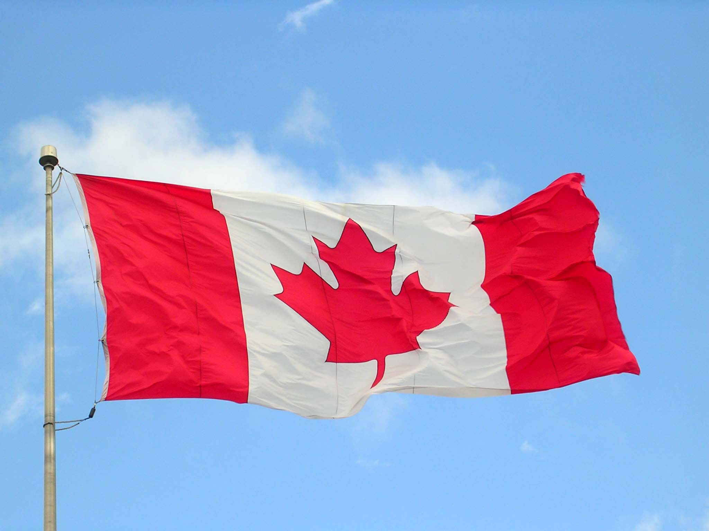
The Canadian flag, the Maple Leaf, adopted in 1965
GROVE, Jared. Canadian Flag Halifax 09-04. In: Wikipedia: the free encyclopedia [online]. San Francisco (CA): Wikimedia Foundation, 2001- [cit. 2013-08-20]. Dostupné z: http://commons.wikimedia.org/wiki/File%3ACanada_flag_halifax_9_-04.JPG

Slide 4
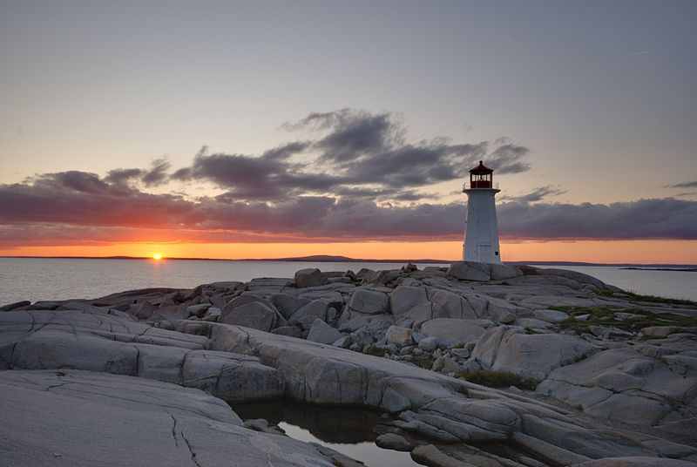
Peggys Point Lighthouse, a famous tourist attraction in Nova Scotia
WLADYSLAW. Peggy`s Point Leuchtturm bei Sonnenuntergang. In: Wikipedia: the free encyclopedia [online]. San Francisco (CA): Wikimedia Foundation, 2001- [cit. 2013-08-20]. Dostupné z: http://commons.wikimedia.org/wiki/File:Peggys_Cove_-_NS_-_Leuchtturm_bei_Sonnenuntergang.jpg

Slide 5
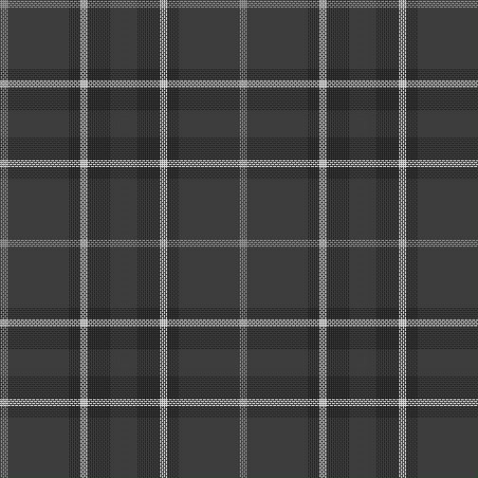
The tartan of Newfoundland and Labrador shows the importance of the Scottish Heritage
MR. ABSURD. Tartan of Newfoundland and Labrador. In: Wikipedia: the free encyclopedia [online]. San Francisco (CA): Wikimedia Foundation, 2001- [cit. 2013-08-20].
Dostupné z: http://commons.wikimedia.org/wiki/File%3ATartan_of_Newfoundland_and_Labrador.png

Slide 6
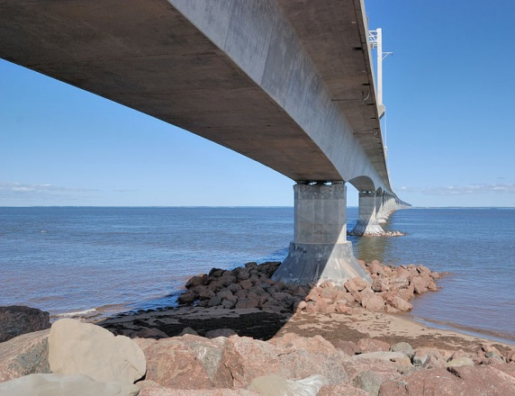
The Confederation Bridge, which is 12.9 km long, links New Brunswick with Prince Edward Island
WLADYSLAW. Blick unter die Confederation Bridge. In: Wikipedia: the free encyclopedia [online]. San Francisco (CA): Wikimedia Foundation, 2001- [cit. 2013-08-20]. Dostupné z: http://commons.wikimedia.org/wiki/File:Confederation_Bridge_-_Blick_von_unten.jpg

Slide 7
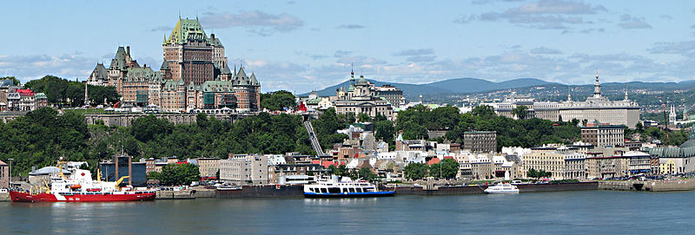
Skyline of Québec City, Quebec, with the Saint Lawrence river and the famous hotel Château Frontenac, which is a National Historic Site of Canada dating 1893
DATCH78. Quebec city-Vieux-Québec. In: Wikipedia: the free encyclopedia [online]. San Francisco (CA): Wikimedia Foundation, 2001- [cit. 2013-08-20]. Dostupné z: http://commons.wikimedia.org/wiki/File:Quebec_city-Vieux-Qu%C3%A9bec.jpg

Slide 8
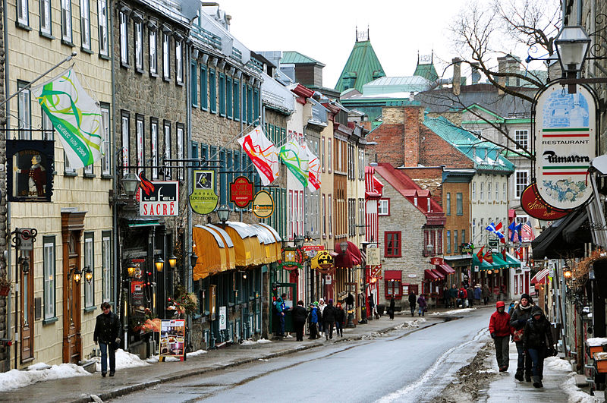
Rue St.-Louis in Québec city, with its French feel
CHENSIYUAN. Quebec City Rue St-Louis 2010. In: Wikipedia: the free encyclopedia [online]. San Francisco (CA): Wikimedia Foundation, 2001- [cit. 2013-08-20]. Dostupné z: http://commons.wikimedia.org/wiki/File:Quebec_City_Rue_St-Louis_2010.jpg

Slide 9
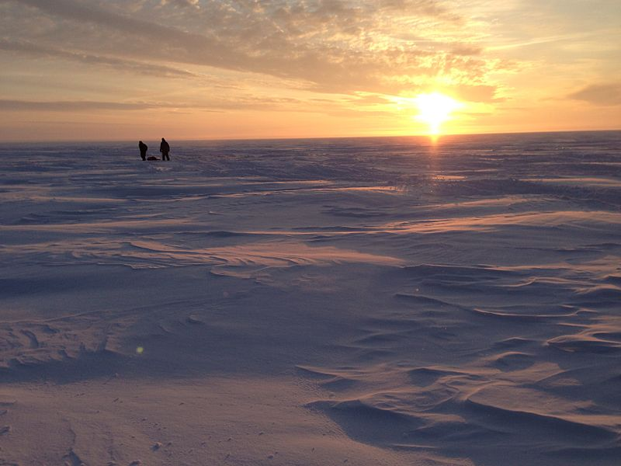
Ice fishing in northern Ontario
ICE EFFECT. Ice fishing in Ontario. In: Wikipedia: the free encyclopedia [online]. San Francisco (CA): Wikimedia Foundation, 2001- [cit. 2013-08-20]. Dostupné z: http://commons.wikimedia.org/wiki/File:Ice_fishing_in_Ontario,_Canada.jpg

Slide 10
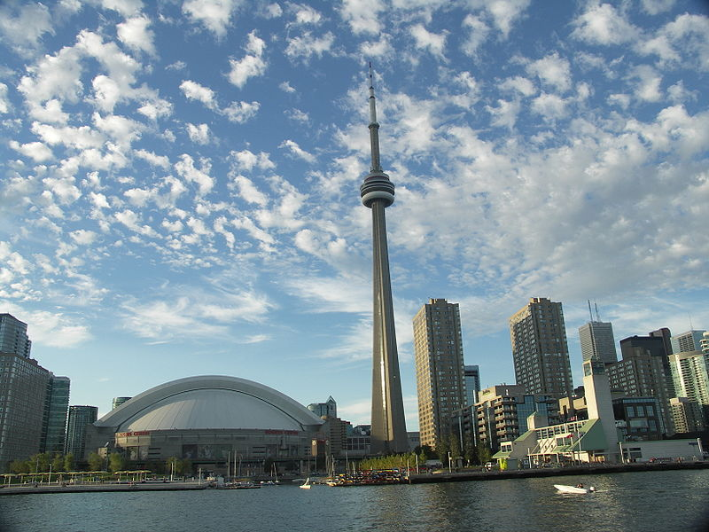
The skyline of Toronto, Ontario, with the CN Tower and the Rogers Centre, a multi-purpose stadium. Toronto is the biggest city in Canada.
OHCANADAGAIL. Toronto Skyline. In: Wikipedia: the free encyclopedia [online]. San Francisco (CA): Wikimedia Foundation, 2001- [cit. 2013-08-20]. Dostupné z: http://commons.wikimedia.org/wiki/File:Toronto_Skyline.JPG

Slide 11
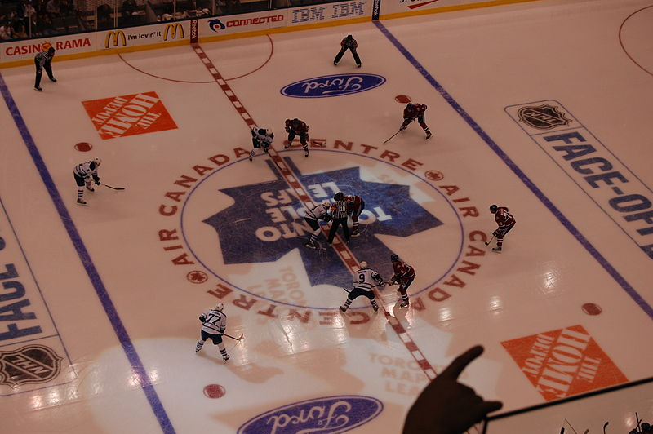
Ice hockey at Air Canada Centre, which is the home of the Toronto Maple Leafs
ETERNALSLEEPER. NHL faceoff. In: Wikipedia: the free encyclopedia [online]. San Francisco (CA): Wikimedia Foundation, 2001- [cit. 2013-08-20]. Dostupné z: http://commons.wikimedia.org/wiki/File:NHL_faceoff.jpg

Slide 12
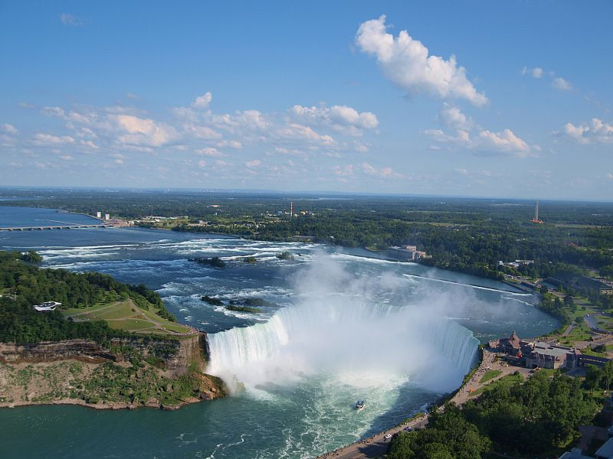
The Horseshoe Falls, part of the Niagara Falls, Ontario, are a popular tourist destination. They are also a source of hydroelectric power.
UJJWALKUMAR. Canadian Horseshoe Falls with Buffalo in background. In: Wikipedia: the free encyclopedia [online]. San Francisco (CA): Wikimedia Foundation, 2001- [cit. 2013-08-20]. Dostupné z: http://commons.wikimedia.org/wiki/File:Canadian_Horseshoe_Falls_with_Buffalo_in_background.jpg

Slide 13
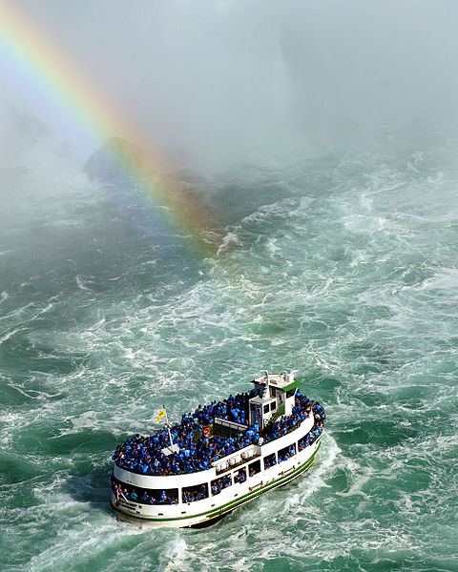
The Maid of the Mist is a boat tour of Niagara Falls, Ontario
SAFFRON BLAZE. Maid of the Mist - pot-o-gold. In: Wikipedia: the free encyclopedia [online]. San Francisco (CA): Wikimedia Foundation, 2001- [cit. 2013-08-20]. Dostupné z: http://commons.wikimedia.org/wiki/File:Maid_of_the_Mist_-_pot-o-gold.jpg

Slide 14
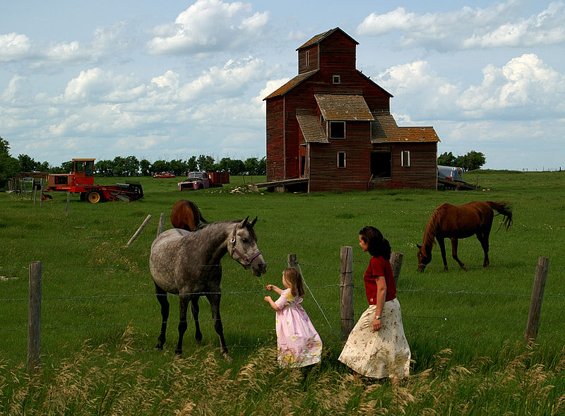
A grain elevator in a farm in Saskatchewan
SAFFRON BLAZE. Saskatchewan Farm Elevator. In: Wikipedia: the free encyclopedia [online]. San Francisco (CA): Wikimedia Foundation, 2001- [cit. 2013-08-20]. Dostupné z: http://commons.wikimedia.org/wiki/File:Saskatchewan_Farm_Elevator.jpg

Slide 15
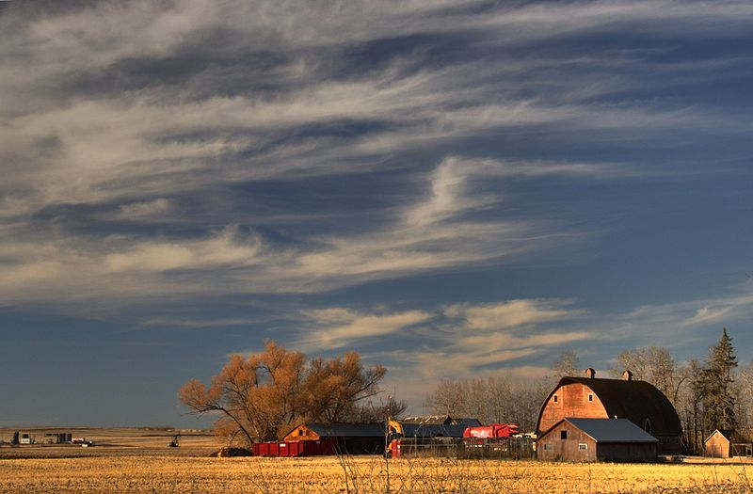
Canadian prairie in Alberta, part of Canada’s Breadbasket
WINTERE229. Farm Hwy 37 Alberta Canada 02A. In: Wikipedia: the free encyclopedia [online]. San Francisco (CA): Wikimedia Foundation, 2001- [cit. 2013-08-20]. Dostupné z: http://commons.wikimedia.org/wiki/File:Farm_Hwy_37_Alberta_Canada_02A.jpg

Slide 16
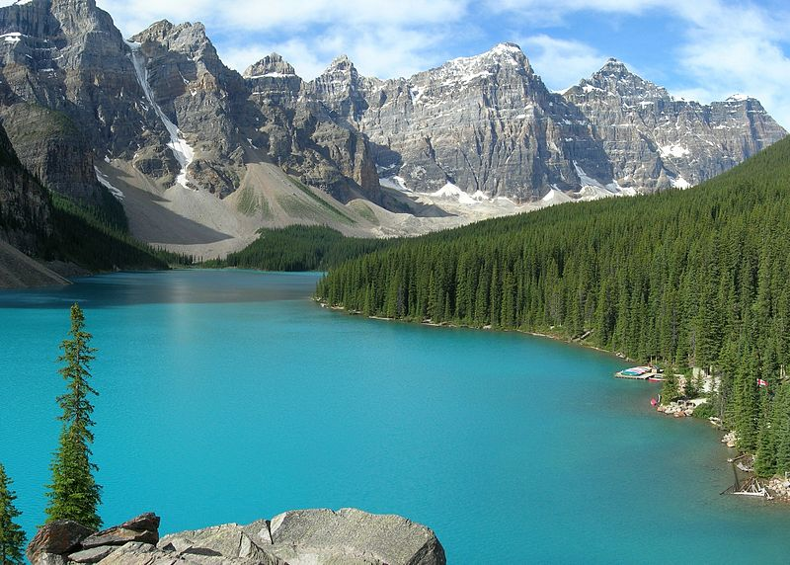
Lake Moraine, Alberta, a glacial lake in the Rocky Mountains
ALT, Tobias, Tobi 87. Moraine Lake-Banff NP. In: Wikipedia: the free encyclopedia [online]. San Francisco (CA): Wikimedia Foundation, 2001- [cit. 2013-08-20]. Dostupné z: http://commons.wikimedia.org/wiki/File:Moraine_Lake-Banff_NP.JPG

Slide 17
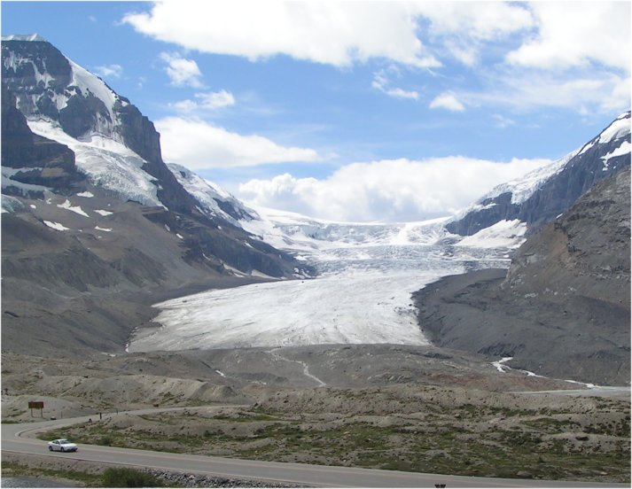
Athabasca Glacier in the Canadian Rockies, Alberta, is the most visited glacier in North America
BELL, Ben W. Athabasca Glacier. In: Wikipedia: the free encyclopedia [online]. San Francisco (CA): Wikimedia Foundation, 2001- [cit. 2013-08-20]. Dostupné z: http://commons.wikimedia.org/wiki/File:Athabasca_Glacier_BenWBell.jpg

Slide 18
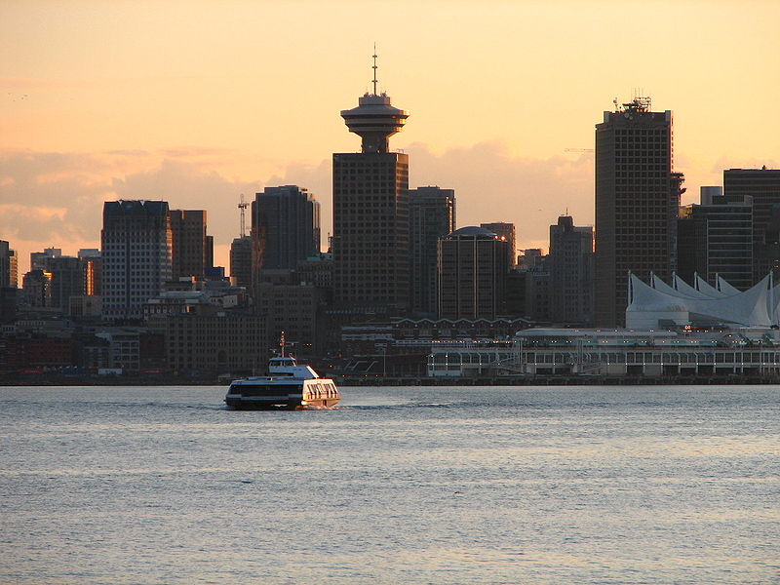
Vancouver, British Columbia, is the biggest city in western Canada. It has the largest and busiest port in Canada.
Seabus Vancouver. In: Wikipedia: the free encyclopedia [online]. San Francisco (CA): Wikimedia Foundation, 2001- [cit. 2013-08-20]. Dostupné z: http://commons.wikimedia.org/wiki/File:Seabus_Vancouver.jpg

Slide 19
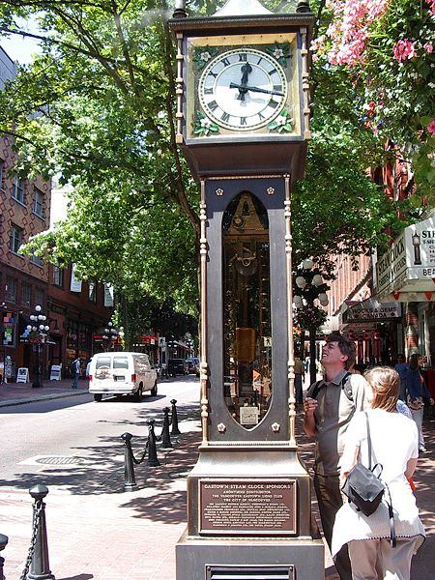
Gastown is the oldest part of Vancouver, BC. The steam clock is Gastown’s most famous monument.
MIKANO. Vancouver Gastown Steam Clock. In: Wikipedia: the free encyclopedia [online]. San Francisco (CA): Wikimedia Foundation, 2001- [cit. 2013-08-20]. Dostupné z: http://commons.wikimedia.org/wiki/File:Vancouver_Gastown_Steam_Clock.jpg

Slide 20
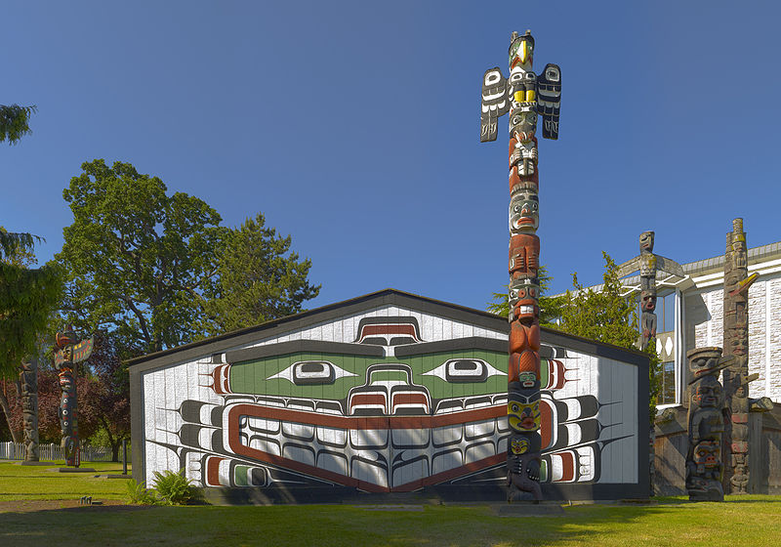
In Victoria, the capital of BC, there is a large presence of First Nations. Totem poles are their traditional sculptures, which represent family trees, legends or important events.
HIGHINBC ATTRIBUTE TO RYAN BUSHBY. Wawadit'la(Mungo Martin House) a Kwakwaka'wakw big house. In: Wikipedia: the free encyclopedia [online]. San Francisco (CA): Wikimedia Foundation, 2001- [cit. 2013-08-20]. Dostupné z: http://commons.wikimedia.org/wiki/File:Wawadit%27la(Mungo_Martin_House)_a_Kwakwaka%27wakw_big_house.jpg

Slide 21
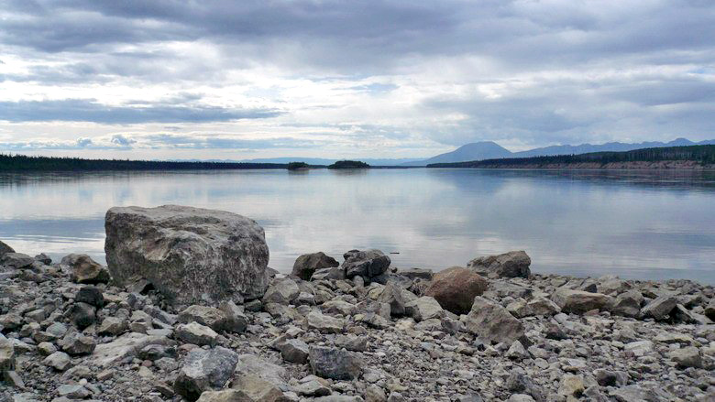
Yukon is the smallest federal territory in canada and boasts beautiful unspoiled nature.
ADAMEC, David. Liard-River-Nahanni Ranges. In: Wikipedia: the free encyclopedia [online]. San Francisco (CA): Wikimedia Foundation, 2001- [cit. 2013-08-20]. Dostupné z: http://commons.wikimedia.org/wiki/File:Liard-River-Nahanni_Ranges.jpg

Slide 22
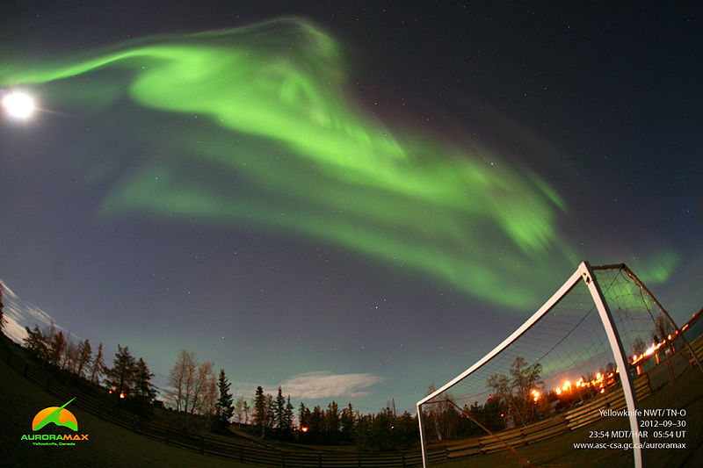
The Aurora Borealis, or Northern Lights, can be seen in Northern Canada
SPACE.COM. Auroramax-northern-lights-sept-30-2012. In: Wikipedia: the free encyclopedia [online]. San Francisco (CA): Wikimedia Foundation, 2001- [cit. 2013-08-20]. Dostupné z: http://commons.wikimedia.org/wiki/File:Auroramax-northern-lights-sept-30-2012.jpg

Slide 23
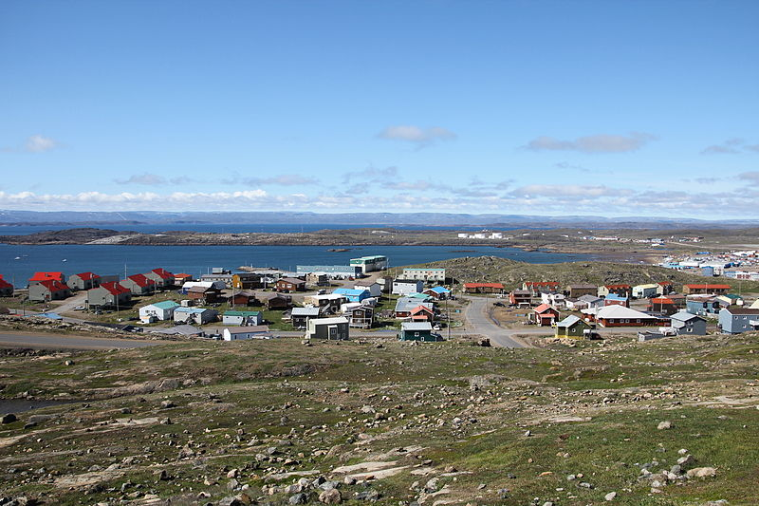
Iqaluit is the capital of Nunavut, the newest territory, founded in 1999. It has a population of about 7,000.
SEBASTIAN. Bayview Iqaluit. In: Wikipedia: the free encyclopedia [online]. San Francisco (CA): Wikimedia Foundation, 2001- [cit. 2013-08-20]. Dostupné z: http://commons.wikimedia.org/wiki/File:Bayview_Iqaluit.JPG

Slide 24
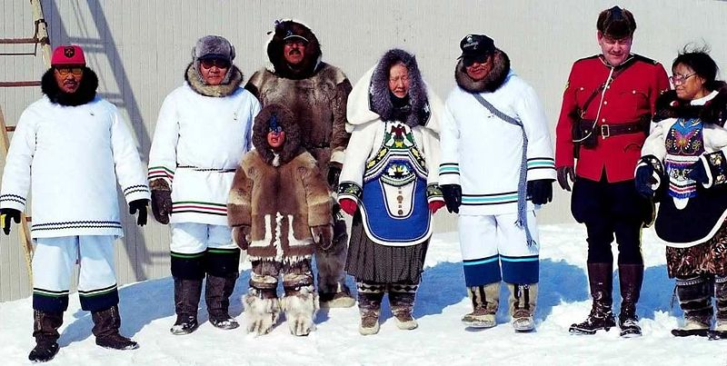
Ceremony on occasion of the foundation of Nunavut
ANSGAR WALK. Nunavut-Feierlichkeit. In: Wikipedia: the free encyclopedia [online]. San Francisco (CA): Wikimedia Foundation, 2001- [cit. 2013-08-20]. Dostupné z: http://commons.wikimedia.org/wiki/File:Nunavut-Feierlichkeit.jpg

Slide 25
Použitý obrázky
GROVE, Jared. Canadian Flag Halifax 09-04. In: Wikipedia: the free encyclopedia [online]. San Francisco (CA): Wikimedia Foundation, 2001- [cit. 2013-08-20]. Dostupné z: http://commons.wikimedia.org/wiki/File%3ACanada_flag_halifax_9_-04.JPG
WLADYSLAW. Peggy`s Point Leuchtturm bei Sonnenuntergang. In: Wikipedia: the free encyclopedia [online]. San Francisco (CA): Wikimedia Foundation, 2001- [cit. 2013-08-20]. Dostupné z: http://commons.wikimedia.org/wiki/File:Peggys_Cove_-_NS_-_Leuchtturm_bei_Sonnenuntergang.jpg
MR. ABSURD. Tartan of Newfoundland and Labrador. In: Wikipedia: the free encyclopedia [online]. San Francisco (CA): Wikimedia Foundation, 2001- [cit. 2013-08-20]. Dostupné z: http://commons.wikimedia.org/wiki/File%3ATartan_of_Newfoundland_and_Labrador.png
WLADYSLAW. Blick unter die Confederation Bridge. In: Wikipedia: the free encyclopedia [online]. San Francisco (CA): Wikimedia Foundation, 2001- [cit. 2013-08-20]. Dostupné z: http://commons.wikimedia.org/wiki/File:Confederation_Bridge_-_Blick_von_unten.jpg
DATCH78. Quebec city-Vieux-Québec. In: Wikipedia: the free encyclopedia [online]. San Francisco (CA): Wikimedia Foundation, 2001- [cit. 2013-08-20]. Dostupné z: http://commons.wikimedia.org/wiki/File:Quebec_city-Vieux-Qu%C3%A9bec.jpg
CHENSIYUAN. Quebec City Rue St-Louis 2010. In: Wikipedia: the free encyclopedia [online]. San Francisco (CA): Wikimedia Foundation, 2001- [cit. 2013-08-20]. Dostupné z: http://commons.wikimedia.org/wiki/File:Quebec_City_Rue_St-Louis_2010.jpg
ICE EFFECT. Ice fishing in Ontario. In: Wikipedia: the free encyclopedia [online]. San Francisco (CA): Wikimedia Foundation, 2001- [cit. 2013-08-20]. Dostupné z: http://commons.wikimedia.org/wiki/File:Ice_fishing_in_Ontario,_Canada.jpg
OHCANADAGAIL. Toronto Skyline. In: Wikipedia: the free encyclopedia [online]. San Francisco (CA): Wikimedia Foundation, 2001- [cit. 2013-08-20]. Dostupné z: http://commons.wikimedia.org/wiki/File:Toronto_Skyline.JPG
UJJWALKUMAR. Canadian Horseshoe Falls with Buffalo in background. In: Wikipedia: the free encyclopedia [online]. San Francisco (CA): Wikimedia Foundation, 2001- [cit. 2013-08-20]. Dostupné z: http://commons.wikimedia.org/wiki/File:Canadian_Horseshoe_Falls_with_Buffalo_in_background.jpg
SAFFRON BLAZE. Maid of the Mist - pot-o-gold. In: Wikipedia: the free encyclopedia [online]. San Francisco (CA): Wikimedia Foundation, 2001- [cit. 2013-08-20]. Dostupné z: http://commons.wikimedia.org/wiki/File:Maid_of_the_Mist_-_pot-o-gold.jpg
WINTERE229. Farm Hwy 37 Alberta Canada 02A. In: Wikipedia: the free encyclopedia [online]. San Francisco (CA): Wikimedia Foundation, 2001- [cit. 2013-08-20]. Dostupné z: http://commons.wikimedia.org/wiki/File:Farm_Hwy_37_Alberta_Canada_02A.jpg
POKRAČOVÁNÍ NA DALŠÍ STRÁNKU

Slide 26
SAFFRON BLAZE. Saskatchewan Farm Elevator. In: Wikipedia: the free encyclopedia [online]. San Francisco (CA): Wikimedia Foundation, 2001- [cit. 2013-08-20]. Dostupné z: http://commons.wikimedia.org/wiki/File:Saskatchewan_Farm_Elevator.jpg
ALT, Tobias, Tobi 87. Moraine Lake-Banff NP. In: Wikipedia: the free encyclopedia [online]. San Francisco (CA): Wikimedia Foundation, 2001- [cit. 2013-08-20]. Dostupné z: http://commons.wikimedia.org/wiki/File:Moraine_Lake-Banff_NP.JPG
BELL, Ben W. Athabasca Glacier. In: Wikipedia: the free encyclopedia [online]. San Francisco (CA): Wikimedia Foundation, 2001- [cit. 2013-08-20]. Dostupné z: http://commons.wikimedia.org/wiki/File:Athabasca_Glacier_BenWBell.jpg
ANSGAR WALK. Nunavut-Feierlichkeit. In: Wikipedia: the free encyclopedia [online]. San Francisco (CA): Wikimedia Foundation, 2001- [cit. 2013-08-20]. Dostupné z: http://commons.wikimedia.org/wiki/File:Nunavut-Feierlichkeit.jpg
SEBASTIAN. Bayview Iqaluit. In: Wikipedia: the free encyclopedia [online]. San Francisco (CA): Wikimedia Foundation, 2001- [cit. 2013-08-20]. Dostupné z: http://commons.wikimedia.org/wiki/File:Bayview_Iqaluit.JPG
Seabus Vancouver. In: Wikipedia: the free encyclopedia [online]. San Francisco (CA): Wikimedia Foundation, 2001- [cit. 2013-08-20]. Dostupné z: http://commons.wikimedia.org/wiki/File:Seabus_Vancouver.jpg
MIKANO. Vancouver Gastown Steam Clock. In: Wikipedia: the free encyclopedia [online]. San Francisco (CA): Wikimedia Foundation, 2001- [cit. 2013-08-20]. Dostupné z: http://commons.wikimedia.org/wiki/File:Vancouver_Gastown_Steam_Clock.jpg
HIGHINBC ATTRIBUTE TO RYAN BUSHBY. Wawadit'la(Mungo Martin House) a Kwakwaka'wakw big house. In: Wikipedia: the free encyclopedia [online]. San Francisco (CA): Wikimedia Foundation, 2001- [cit. 2013-08-20]. Dostupné z: http://commons.wikimedia.org/wiki/File:Wawadit%27la(Mungo_Martin_House)_a_Kwakwaka%27wakw_big_house.jpg
ADAMEC, David. Liard-River-Nahanni Ranges. In: Wikipedia: the free encyclopedia [online]. San Francisco (CA): Wikimedia Foundation, 2001- [cit. 2013-08-20]. Dostupné z: http://commons.wikimedia.org/wiki/File:Liard-River-Nahanni_Ranges.jpg
SPACE.COM. Auroramax-northern-lights-sept-30-2012. In: Wikipedia: the free encyclopedia [online]. San Francisco (CA): Wikimedia Foundation, 2001- [cit. 2013-08-20]. Dostupné z: http://commons.wikimedia.org/wiki/File:Auroramax-northern-lights-sept-30-2012.jpg

