Slide 1

DIGITÁLNÍ UČEBNÍ MATERIÁL
Číslo projektu | CZ.1.07/1.5.00/34.0124
Název projektu DUM | Škola budoucnosti s využitím IT VY_3_INOVACE_ANJ27
Název školy | SPŠ a SOŠGS Most
Předmět | ANJ
Tematická oblast | Gastronomie a restaurační provoz
Téma | Oblíbené jídlo - recepty
Ročník | 1, 2, 3 - gastronomie
Jméno autora | Ludmila Křížová
Datum tvorby | 13.6.2013
Anotace | Prezentace slouží k výkladu tématu Oblíbené jídlo - recepty, zároveň lze tuto prezentaci využít jako materiálu pro opakování a prověřování znalostí žáků.

Slide 2
My favourite food
Recipes

Slide 3
Recipes
Soup
Main dish
Dessert

Slide 4
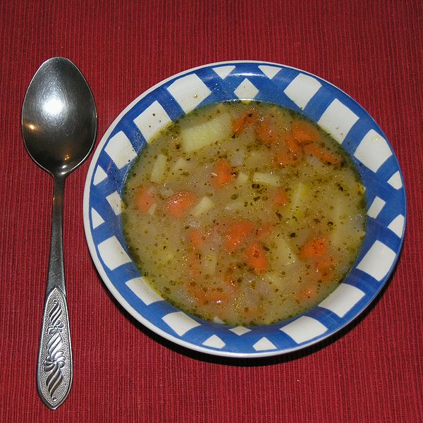
Potatoe soup
Ingredients:
onion (50g)
fat (100g)
plain flour (120g)
dried mushrooms (10g)
root vegetable (130g)
cabbage (50 g)
potatoes (880g)
salt, garlic, water (broth), ground pepper , caraway, marjoram, soup seasoning.

Slide 5
Potatoe soup
Preparation: Pour onion roux with water or stock and cook. Add cooked mushrooms, choped vegetables and potatoes. Season with salt, pepper, cumin, garlic and marjoram. Before serving flavor with soup seasoning. During serving put into soup chopped parsley.

Slide 6
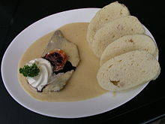
Sirloin with cream
Ingredients:
beef-leg (1000g)
bacon (50g)
fat (100g)
carrot, celery, parsley (160 g)
onion (100g)
plain flour (160g)
cream (500g)
salt, whole pepper, allspice , lemon, sugar, vinegar, water (broth), bay leaf, thyme.

Slide 7
Sirloin with cream
Preparation: lard meat with bacon and salt. Cut cleaned vegetables and onion into slices and fry in fat, add meat and fry. Add allspice, slices of lemon and vinegar. Pour on water or broth, cover and cook all. Thicken the sauce with flour, cook by at least 1 hour. Refine before ending with cream. Season with salt, vinegar and sugar. Boil again. Pass the sauce (through fine sieve).
Serve with dumplings, lemon, cranberries.

Slide 8
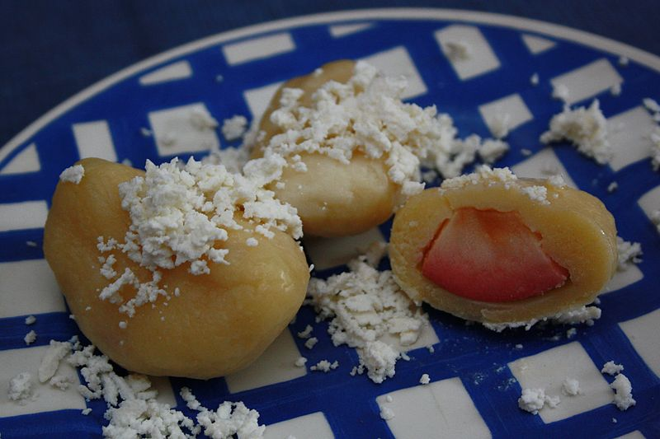
Plum dumplings
Ingredients:
potatoes (1120g)
salt
eggs (2)
semolina (150g)
coarse flour (450g)
plums (1080g)
water for cooking
cream cheese, powdered sugar, butter.

Slide 9
Plum dumplings
Preparation: The cooked potatoes let cool. The cooled potatoes grate finely or press. Add salt, stirred eggs, semolina, sifted flour. Prepare a stronger dough. Roll out the dough not too thin, cut squares about 4x4 cm and put the washed plums on the dough, wrap and make dumplings. Put the dumplings into boiling water and cook slowly. Stir the dumplings carefully after inserting.
Serve with cream cheese, powdered sugar. Pour over with melted butter.

Slide 10

Answer the questions:
What is your favourite soup? Can you describe its preparation?
What do you often eat for a main meal? Is it Czech or meal of foreign cuisine?
What ís your favourite dessert? What ingredients do you need for it?
Can you make any salads? Explain it, please!
Do you eat healthy? Tell about it!

Slide 11
Zdroje:
Křivánek, Mirko. Česko-anglicko-německý průvodce gastronomii a restauračním provozem. Leda: 2004, ISBN 80-7335-036-x
http://upload.wikimedia.org/wikipedia/commons/thumb/3/31/Brambora%C4%8Dka_022.jpg/600px-Brambora%C4%8Dka_022.jpg-autor-Matěj Baťha
http://upload.wikimedia.org/wikipedia/commons/thumb/b/b1/Sv%C3%ADckov%C3%A1_na_smetane%2C_houskov%C3%BD_knedl%C3%ADk%2C_citron%2C_brusinky.jpg/800px-Sv%C3%ADckov%C3%A1_na_smetane%2C_houskov%C3%BD_knedl%C3%ADk%2C_citron%2C_brusinky.jpg-autor Nillerdk

Slide 12
Zdroje:
https://upload.wikimedia.org/wikipedia/commons/thumb/d/d3/Ovocn%C3%A9_tvarohov%C3%A9_knedl%C3%ADky_734.JPG/800px-Ovocn%C3%A9_tvarohov%C3%A9_knedl%C3%ADky_734.JPG-autor-Matěj Baťha
Obrázky: Galerie Klipart /cit.18.6.2013/, dostupné pod licenci Microsoft Office 2007 na http://office.microsoft.com/cs-cz/images/

