Slide 1

Název školy: ZŠ Bor, okres Tachov, příspěvková organizace
Autor: Mgr. Irena Šeneková
Vytvořeno dne: 7.1.2013
Název: VY_32_INOVACE_7A_AJ7_07_Past continuous and past simple
Číslo projektu: CZ.1.07/1.4.00/21.3534
Vzdělávací oblast: Angličtina
Téma: Past continuous
Ročník: 7. ročník
Klíčová slova: past continuous, past simple

Slide 2
Anotace
Minulý průběhový čas (past continuous ) a minulý prostý (past simple).
Vysvětlení použití těchto časů společně.
Příklady otázek a odpovědí.

Slide 3


Past simple and past continuous
Oba časy společně použijeme, když jeden právě probíhal (minulý průběhový) a uprostřed něj se stal jiný děj (minulý prostý).
We use the past simple and past continuous together to say that something hapenned in the middle of something else.
It was raining when I woke up.

Slide 4

When he arrived, I was watching TV.

Slide 5
I was walking home when I met Dave.

Slide 6
I saw an accident.
I was walking home when …………………………………………

Slide 7

Kate phoned when we were having dinner.

Slide 8

had a shower
were having
Kate ………………………. when we …………………….dinner.

Slide 9
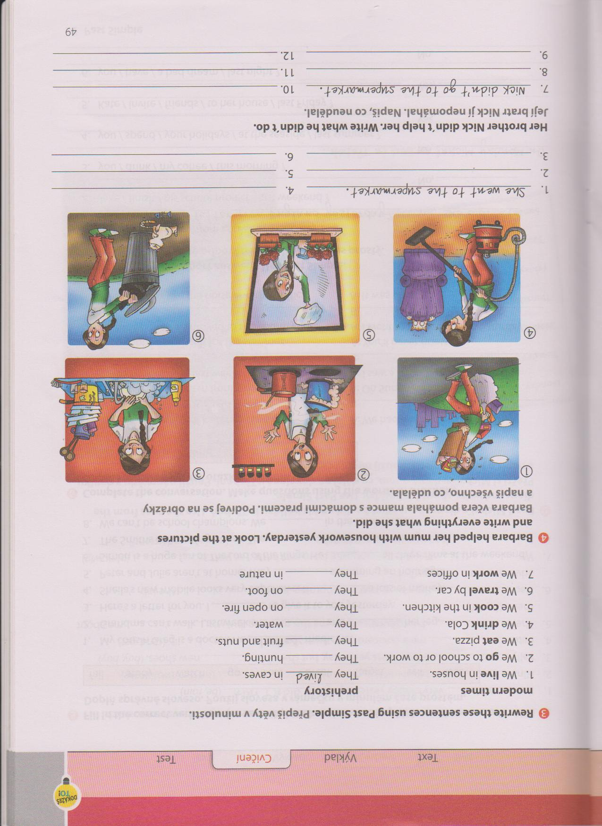
What were you doing when he arrived?
When he arrived, I was vacuuming the house.
What were you doing when he arrived?
When he arrived, ………
What …
When…..

Slide 10
What happened when she was cleaning the window?
When she was cleaning the window, she saw her friend.

Slide 11

What happened when they were playing football?
When they were playing football, it started to rain.

Slide 12
What
happened when you were taking the rubbish out
you
……………………………………………………………………………………….. ?
When
I was taking the rubbish out I saw a mouse.
I
…………………………………………………………………………………………………………….. .
What
happened when she was taking the rubbish out
?
………………………………………………………………………………………………………………….
she
When
she was taking the rubbish out she saw a mouse.
…………………………………………………………………………………………………………….. .
What happened …..
take the rubbish out
see a mouse

Slide 13
What happened when you were reading a book?
When I was reading a book, somebody knocked on the door.
What happened when you were taking your dog for a walk?
When I was taking my dog for a walk, I saw (met) an elephant.

Slide 14


What happened when he was having a shower?
When he was having a shower, the phone rang.

Slide 15

What happened when they were cooking ?
When they were cooking, a bird flew into the kitchen.

Slide 16
Použité zdroje
VÍT, Marek. Minulý průběhový čas(past continuous) [online]. [cit. 4.12.2013]. Dostupný na WWW: http://www.helpforenglish.cz/article/2006123001-minuly-prubehovy-cas-past-continuous
MURPHY, Raymond. English Grammar in Use. Singapore: Cambridge University Press, 2004, ISBN 978 0521 755481.
HUTCHINSON, Tom; EDWARDS, Lynda. Project 3. Oxford: Oxford University Press, 2008, ISBN 978-0-19-476416-2.
PETERS, Sarah; GRÁF, Tomáš. Nová cvičebnice anglické gramatiky. Praha: Polyglot, spol.s r.o., 2007, ISBN 80-86195-00-7.
VÍT, Marek. helpforenglish.cz [online]. [cit. 13.1.2014]. Dostupný na WWW: http://www.helpforenglish.cz/article/2009060704-cviceni-pritomny-prubehovy-cas-1
Obrázky – www.helpforenglish.cz
Použito se svolením majitele autorských práv.

