Slide 1

Základní škola a Mateřská škola Bílá Třemešná, okres Trutnov
Škola pro 21. století
Téma sady: Angličtina 5.tř.
Název: VY_32_INOVACE_TOY_SHOP
Autor: Mgr. Miluše Senetová
Číslo projektu: CZ.1.07/1.4.00/21.3315
Datum/období: leden 2014

Slide 2
Anotace
Materiál slouží k opakování předložek (next to, under, between, above) a procvičení otázky „How much is it?“.
Je určen pro žáky 5. ročníku.
Časová dotace – 20 minut.
Na snímku 4 jsou představeny dětem předložky (po kliknutí na konkrétní větu se přesune plyš.medvěd do pozice, kterou určuje věta), na slidu 5 se zobrazí hračky v hračkářství, po kliknutí na hračku se objeví její název. Slidy 6 – 12 pracují se dvěma otázkami: Kde daná hračka je (jakou má pozici) a kolik stojí liber. Animace: klikem do daných vět se postupně zobrazuje hledaná hračka i její pozice vůči ostatním, dále pak při otázce na cenu se cenovka přesune k otázce(žáci si uvědomí, na co jsou tázáni) a posléze se objevují i bankovky a mince určující cenu.
Minitest na slidech 13 – 26 je určen k zábavnému procvičení: Žáci vybírají a pracují se čtyřmi možnými odpověďmi (opět: Kde se hračka nachází a kolik stojí). Při kliknutí na špatnou se zjeví animace rozzlobeného dinosaura s textem „You are wrong“(zmizí po kliknutí na něj), při kliknutí na správnou se objeví „nadšený bazilišek“ s větou „You are right“, správná odpověď se zároveň prolne a špatné odpovědi zmizí).
Materiál obsahuje 27 stran a je určen k interaktivní výuce.

Slide 3
TOY SHOP

Slide 4
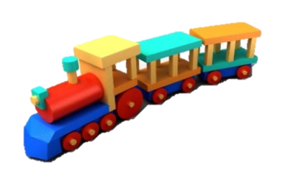
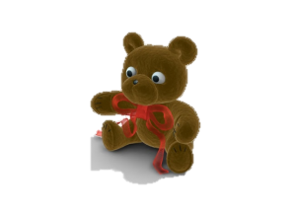
Prepositions
under
The teddy bear is under the train.
above
The teddy bear is above the train.
next to
The teddy bear is next to the train.
between
The teddy bear is between
the trains.

Slide 5
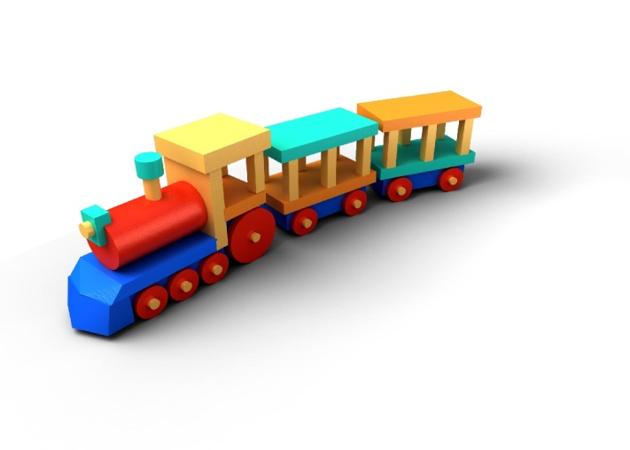
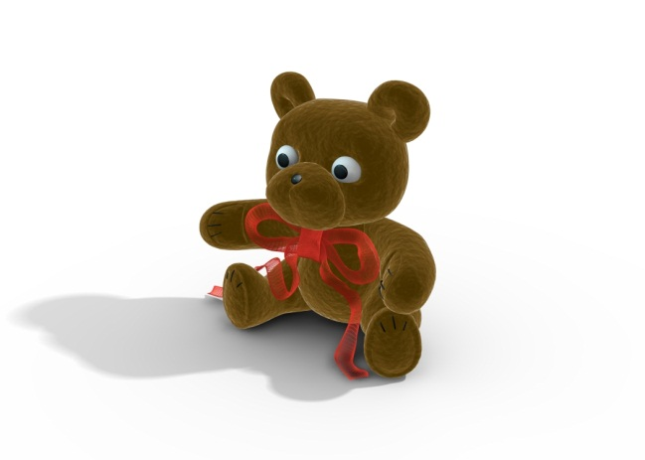
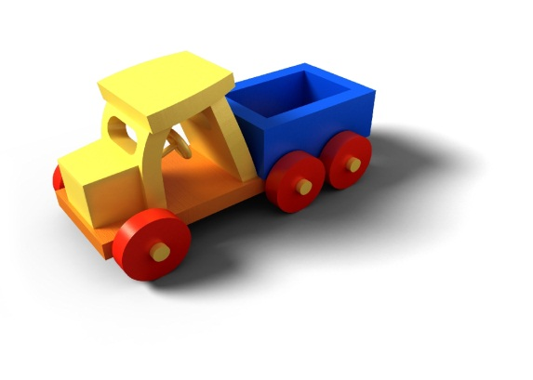
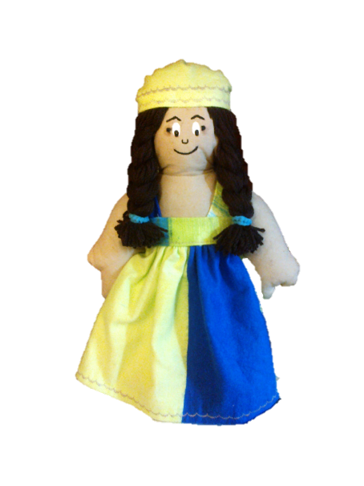

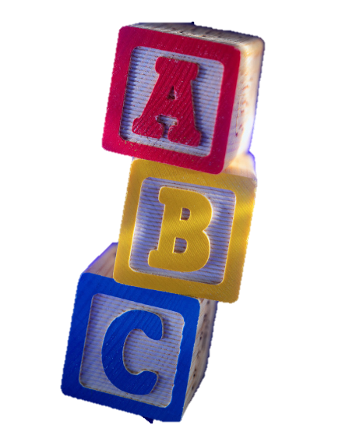
TOY SHOP
TRAIN
TEDDY BEAR
TOY CAR
£ 8
£ 5
£ 7
£ 12
£ 13
BALL
PRAM
£ 15
£ 9
doll
DICE

Slide 6
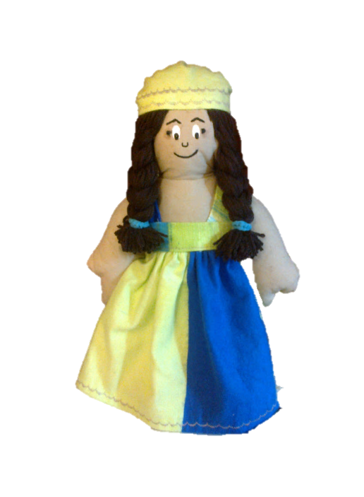
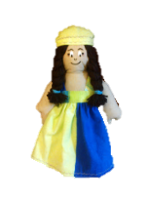



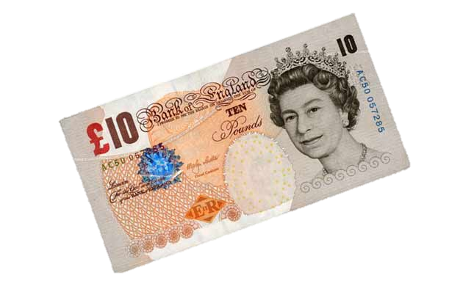

1. Where is the doll?
There is a doll.
The doll is next to the ball.
The doll is next to the pram.
£ 15
The doll is between the ball and pram.
2. How much is the doll?
It is 15 pounds.

Slide 7



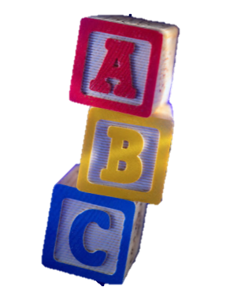
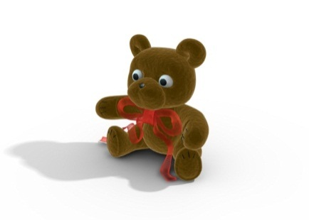


1. Where is the ball?
There is a ball.
The ball is next to the doll.
The ball is under the teddy bear.
£ 13
The ball is between the doll and dice.
2. How much is the ball?
It is 13 pounds.

Slide 8





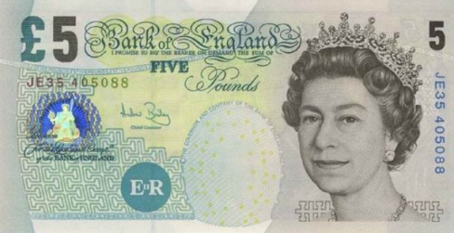
1. Where are the dice?
There are dice.
The dice are next to the ball.
£ 9
The dice are under the toy car.
2. How much are the dice?
They are 9 pounds.

Slide 9


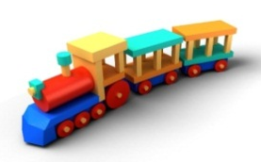
2. Where is the train?
There is a train.
The train is next to the teddy bear.
£ 8
The train is above
the pram.
2. How much is the train?
It is 8 pounds.

Slide 10





1.Where is the teddy bear?
There is a teddy bear.
The teddy bear is next to the train.
£ 7
The teddy bear is above
the doll.
2. How much is the teddy bear?
It is 7 pounds.

Slide 11


1.Where is the toy car?
There is a toy car.
The toy car is next to the teddy bear.
£ 5
The teddy bear is above
the dice.
2. How much is the toy car?
It is 5 pounds.

Slide 12

1. Where is the pram?
There is a pram.
The pram is next to the doll.
£ 12
The pram is under
the train.
2. How much is the pram?
It is 12 pounds.

Slide 13



Click on the correct answer.
Where is the train?
1. The train is next to the dice.
2. The train is next to the ball.
3. The train is under the doll.
4. The train is above the doll.
You are wrong!
YOU ARE RIGHT!

Slide 14
Click on the correct answer.
Where is the toy car?
1. The toy car is next to the dice.
2. The toy car is next to the train.
3. The toy car is above the teddy
bear.
4. The toy car is next to the pram.
You are wrong!
YOU ARE RIGHT!

Slide 15
Click on the correct answer.
Where is the ball?
1. The ball is next to the train.
2. The ball is next to the toy car.
3. The ball is under the train.
4. The ball is above the train.
You are wrong!
YOU ARE RIGHT!

Slide 16
Click on the correct answer.
Where are the dice?
1. The dice are above the pram.
2. The dice are next to the ball.
3. The dice are under the pram.
4. The dice are above the train.
You are wrong!
YOU ARE RIGHT!

Slide 17
Click on the correct answer.
Where is the teddy bear?
1. The teddy bear is
under the toy car.
2. The teddy bear is
next to the doll.
3. The teddy bear is
above the toy car.
4. The teddy bear is
above the train.
You are wrong!
YOU ARE RIGHT!

Slide 18
Click on the correct answer.
Where is the pram?
1. The pram is next to the dice.
2. The pram is under the dice.
3. The pram is next to the toy car.
4. The pram is above the dice.
You are wrong!
YOU ARE RIGHT!

Slide 19
Click on the correct answer.
Where is the doll?
1. The doll is next to the train.
2. The doll is above the dice.
3. The doll is under the train.
4. The doll is next to the ball.
You are wrong!
YOU ARE RIGHT!

Slide 20
Choose the correct price.
£ 57
£ 19
£ 8
£ 34
£ 47
£ 23
£ 40
How much is the pram?
1. It is fifty-seven pounds.
2. It is fourty-seven pounds.
3. It is fourty pounds.
You are wrong!
YOU ARE RIGHT!
4. It is thirty-four pounds.

Slide 21
Choose the correct price.
£ 57
£ 19
£ 8
£ 34
£ 47
£ 23
£ 40
How much is the train?
1. It is twenty-three pounds.
2. It is fourty pounds.
3. It is fourty-seven pounds.
You are wrong!
YOU ARE RIGHT!
4. It is eight pounds.

Slide 22
Choose the correct price.
£ 57
£ 19
£ 8
£ 34
£ 47
£ 23
£ 40
How much is the doll?
1. It is twenty-three pounds.
2. It is thirty pounds.
3. It is nineteen pounds.
You are wrong!
4. It is fourty pounds.
YOU ARE RIGHT!

Slide 23
Choose the correct price.
£ 57
£ 19
£ 8
£ 34
£ 47
£ 23
£ 40
How much are the dice?
1. They are fourty-seven pounds.
2. They are thirty-four pounds.
3. They are twenty-four pounds.
4. They are fifty-four pounds.
You are wrong!
YOU ARE RIGHT!

Slide 24
Choose the correct price.
£ 57
£ 19
£ 8
£ 34
£ 47
£ 23
£ 40
How much is the teddy bear?
1. It is twenty-two pounds.
2. It is fourty-three pounds.
3. It is twenty-three pounds.
You are wrong!
YOU ARE RIGHT!
4. It is seven-three pounds.

Slide 25
Choose the correct price.
£ 57
£ 19
£ 8
£ 34
£ 47
£ 23
£ 40
How much is the ball?
1. It is twenty-nine pounds.
2. It is fourty pounds.
3. It is nine pounds.
You are wrong!
4. It is nineteen pounds.
YOU ARE RIGHT!

Slide 26
Choose the correct price.
£ 57
£ 19
£ 8
£ 34
£ 47
£ 23
£ 40
How much is the toy car?
1. It is fourty-seven pounds.
2. It is eight pounds.
3. It is eighteen pounds.
4. It is nine pounds.
You are wrong!
YOU ARE RIGHT!

Slide 27
Použité zdroje
Galerie: microsoft.office.com
archiv autora(foto: panenka, bankovky, mince)

