Slide 1

Anglický jazyk
VY_32_INOVACE_019_EASTER
Mgr. Ivana Veselá

Slide 2
Here comes the Easter Bunny! (song)
Here comes the Easter Bunny.
My friend, the Easter Bunny.
Here come the Easter Bunny hopping along,
singing a bunny song.
I love the Easter Bunny.
My friend, the Easter Bunny.
Here comes the Easter Bunny, hop, hop, hopping along.
There goes the Easter Bunny.
My friend, the Easter Bunny.
There goea the Easter Bunny hopping along,
singing a bunny song.
I love the Easter Bunny.
My friend, the Easter Bunny.
There goeathe Easter Bunny, hop, hop, hopping along.

Slide 3
Vocabulary
Easter
Easter Bunny
a song
a basket
painting Easter eggs
Happy Easter
spring
a friend
to love
Easter card
a flower
a chicken
Velikonoce
velikonoční zajíček
písnička
košík
malovaná vajíčka
Veselé Velikonoce
jaro
kamarád
mít rád
velikonoční přání
květina
kuřátko

Slide 4
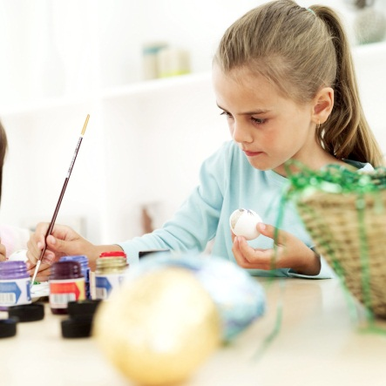
a basket
painting eggs
Easter
Bunny
Easter eggs
Easter card
a chicken
»

Slide 5
Obrázky jsou z webové galerie
http://office.microsoft.com/cs-cz/images/?CTT=97

