Slide 1

Anglický jazyk – cvičení na podporu konverzace
Means of transport
VY_32_INOVACE_02-48
Ročník: | 8.
Vzdělávací oblast: | Jazyk a jazyková komunikace
Vzdělávací obor: | Anglický jazyk
Tematický okruh: | Cvičení na podporu konverzace
Téma: | Means of transport
Jméno autora: | Mgr. Petr Kozlovský
Vytvořeno dne: | 16. 9. 2011
Metodický popis, (anotace): | Materiál je určen k procvičení slovní zásoby na téma „Dopravní prostředky“. Žáci jsou vedeni k samostatnému vyjadřování svých názorů, odpovídají na připravené otázky.

Slide 2
Means of transport

Slide 3
List public and private means of transport:
Public:
Private:

Slide 4
Which mean of transport is connected with:
expensive
travelling with friends
long distance travelling
fast transportation
eating and drinking during the journey
dangerous
comfortable
need a ticket
old and dirty seats
speed limit
cheap
healthy
public

Slide 5
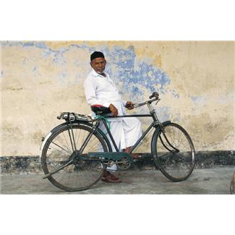
by BICYCLE
1
5 andvantages
5 disadvantages

Slide 6

by CAR
2
5 andvantages
5 disadvantages

Slide 7
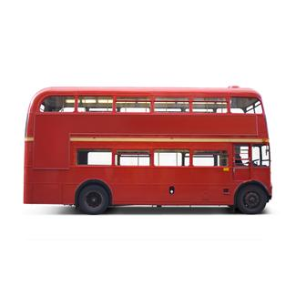
by BUS
3
5 andvantages
5 disadvantages

Slide 8
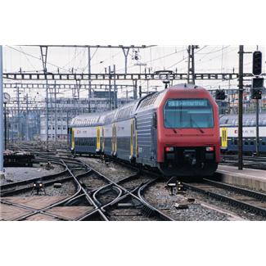
by TRAIN
4
5 andvantages
5 disadvantages

Slide 9
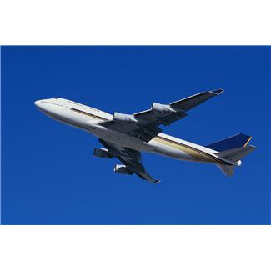
by AEROPLANE
5
5 andvantages
5 disadvantages

Slide 10
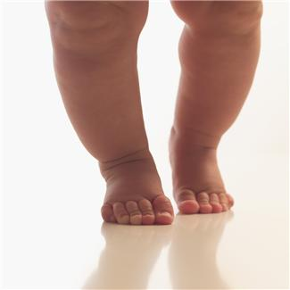
on FOOT
6
5 andvantages
5 disadvantages

Slide 11
Imagine, that you have a friend from abroad.
He/She wants to visit your town.
He/She will arrive to the airport in Prague.
Try to give him/her the instructions about how to get to your town.

Slide 12
What`s your favourite mean of transport?
What means of transport can you see in your town?
How can yout get to Prague?
What means of transport can you see in Prague?
What`s the most expensive mean of transport?
Are you afraid of flying?
Do you prefer holiday abroad or in your country? Why?
What`s the longest journey you have ever made?

Slide 13
Use the verbs in sentenses:
to catch a bus
to get on a bus
to get off a bus
to drive a car
to ride a bike

Slide 14
Přehled zdrojů
Obrázky 1 – 6. Www.office.microsoft.com [online]. c2011 [cit. 2011-09-16].

