Slide 1

Anglický jazyk – Cvičení na podporu konverzace
Jobs, Occupation
VY_32_INOVACE_02-49
Ročník: | 8.
Vzdělávací oblast: | Jazyk a jazyková komunikace
Vzdělávací obor: | Anglický jazyk
Tematický okruh: | Cvičení na podporu konverzace
Téma: | Jobs, Occupation
Jméno autora: | Mgr. Petr Kozlovský
Vytvořeno dne: | 3. 10. 2011
Metodický popis, (anotace): | Materiál vztahující se k povoláním – žáci na základě slovního popisu hádají, o jaké povolání se jedná. Následně samostatně některá povolání popisují. Následuje kontrolní cvičení ve formě křížovky.

Slide 2
JOBS, OCCUPATIONS

Slide 3
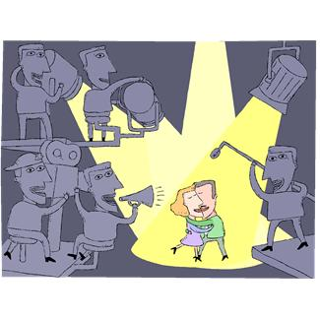
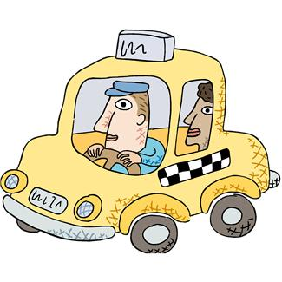
Who is it?
A person whose job is to appear in a film or theatre:
A person who drives a car or whose job is to drive:
ACTOR
DRIVER

Slide 4
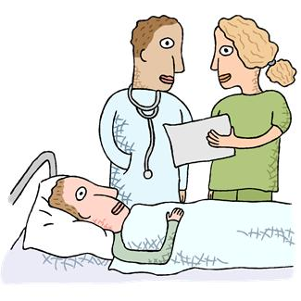
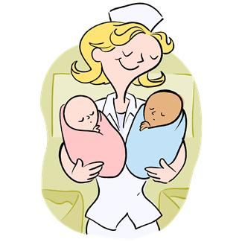
A person who works in a hospital and helps people who are ill:
A person who works in a hospital and takes care of patients:
DOCTOR
NURSE

Slide 5
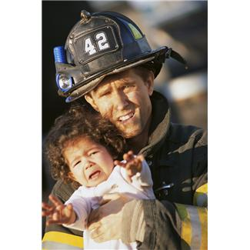

A person whose job is to stop the fire and save people:
A person who protects people from criminals:
FIREMAN
POLICEMAN

Slide 6

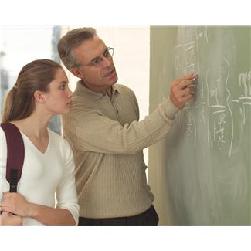
A person whose job is to sing songs:
A person who teaches in a school and works with children:
SINGER
TEACHER

Slide 7
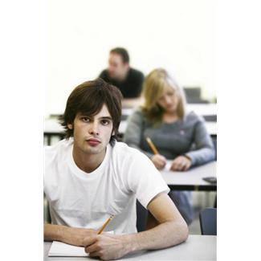
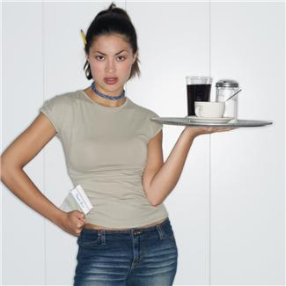
A person who goes to school and prepares for a future job:
A person who works in a restaurant and brings food and drinks to customers:
STUDENT
WAITER/WAITRESS

Slide 8

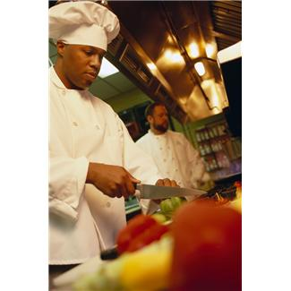
A person who designs, builds and repairs machines etc….:
A person who works in a restaurant and makes something to eat:
ENGINEER
COOK

Slide 9
Now complete your crossword with the names of jobs you have seen:
 | T |  |  |  |  |  | R
F
 |  | E |  |  |  |  | E | E
 |  |  |  |  |  |  | E
 |  |  |  |  |  | O |  |  | O
 |  |  |  |  |  | I |  |  | R
 | W
 |  |  |  |  |  |  |  |  |  | T
 |  |  |  |  |  | I |  |  |  |  | R
 | O |  |  |  |  |  | A
 | A

Slide 10
 | T | E | A | C | H | E | R
F | I | R | E | M | A | N
 |  | E | N | G | I | N | E | E | R
 |  |  | N | U | R | S | E
 |  |  |  |  | D | O | C | T | O | R
 |  |  |  | D | R | I | V | E | R
 | W | A | I | T | E | R
 |  |  |  |  | S | I | N | G | E | R
 |  |  |  |  | S | T | U | D | E | N | T
P | O | L | I | C | E | M | A | N
 | A | C | T | O | R

Slide 11
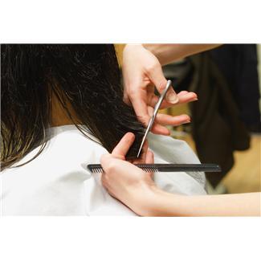

HAIRDRESSER
is a person who……

Slide 12
Complete the sentences:
Dustman is …
Mason/Brick layer is …
Stylist is …
Baker is …
Butcher is …
Farmer is …
Pilot is …
President is …
Postman is …
Fisherman is …
Train driver is …
Builder is …
Secretary is …
Writer is …
Dentist is …
Veterinarian/Vet is …

Slide 13
 | T |  |  |  |  |  | R
F
 |  | E |  |  |  |  | E | E
 |  |  |  |  |  |  | E
 |  |  |  |  |  | O |  |  | O
 |  |  |  |  |  | I |  |  | R
 | W
 |  |  |  |  |  |  |  |  |  | T
 |  |  |  |  |  | I |  |  |  |  | R
 | O |  |  |  |  |  | A
 | A
 | T |  |  |  |  |  | R
F
 |  | E |  |  |  |  | E | E
 |  |  |  |  |  |  | E
 |  |  |  |  |  | O |  |  | O
 |  |  |  |  |  | I |  |  | R
 | W
 |  |  |  |  |  |  |  |  |  | T
 |  |  |  |  |  | I |  |  |  |  | R
 | O |  |  |  |  |  | A
 | A

Slide 14
Použité zdroje:
Všechny použité obrázky:Www.office.microsoft.com [online]. c2011 [cit. 2011-10-03].

