Slide 1

Číslo projektu | CZ. 1. 07 / 1. 5. 00 /34. 0423
Číslo materiálu | 4.
název školy | Střední škola a Vyšší odborná škola cestovního ruchu, Senovážné náměstí 12, České Budějovice 370 01
Autor | Mgr.Alena Zelenková
Tématický celek | Geography – Gibraltar (British Overseas Territory)
Ročník | 1.-4.
Datum tvorby | Červen 2013

Slide 2
Anotace: Prezentaci je možné využít při výuce maturitních témat z anglického jazyka, konkrétně tématu Geography. V prezentaci jsou zajímavé informace o území, které patří k Velké Británii. Slouží k procvičení a rozšíření slovní zásoby. Lze využít pro studenty 1.-4. ročníku.
Metodické pokyny: Při prezentaci jednotlivých snímků se studenti seznamují se slovní zásobou,případně popisují obrázky, hovoří o tomto zajímavém území. Prezentaci je možné využít při výkladu i při opakování tématu.

Slide 3
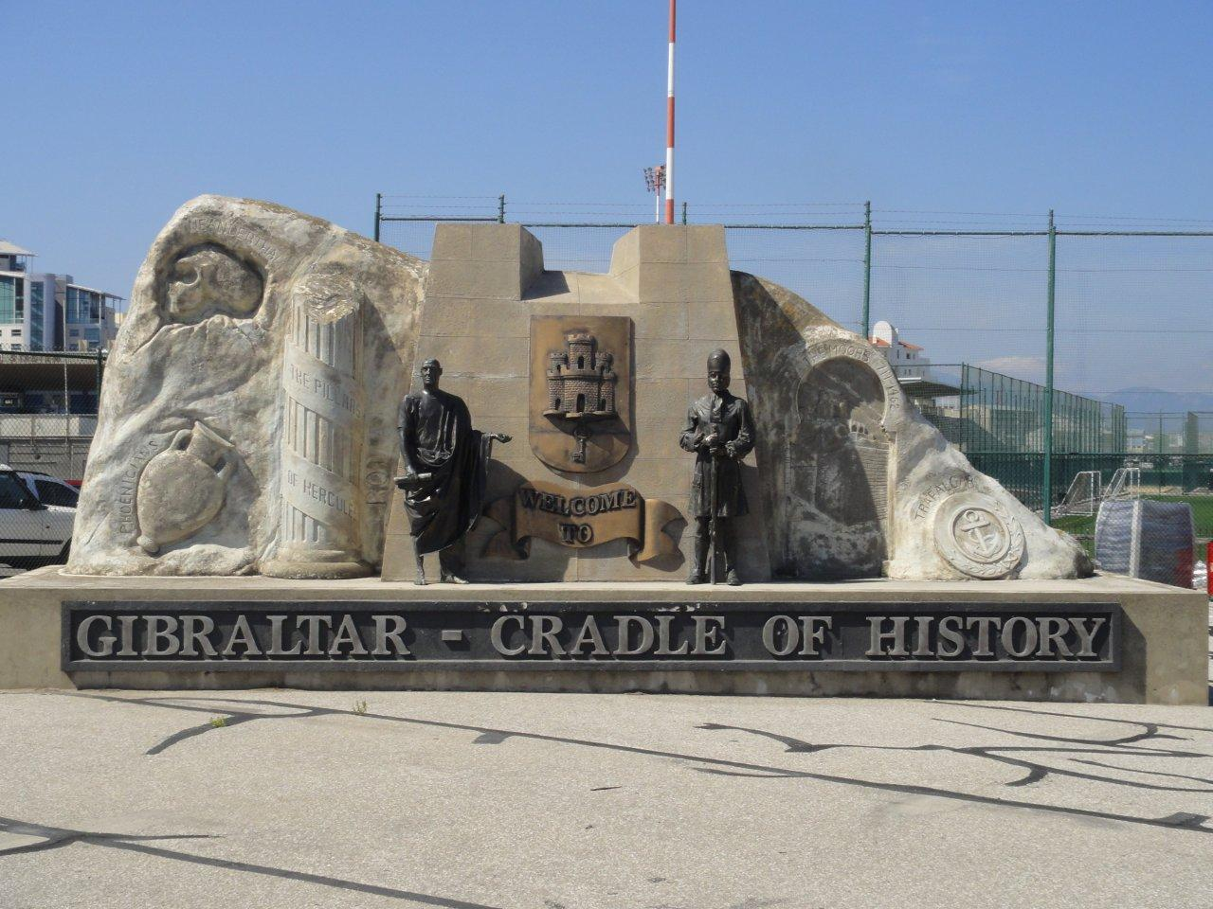
Gibraltar

Slide 4
The Significance of Gibraltar
a British Overseas Territory
Borders with Andalusia, Spain
A very small area – 6.8 square kilometres
Famous for its importance in Anglo-Spain relations

Slide 5
The history of gibraltar
12th century – Gibraltar was named City of Victory
1462 – Gibraltar captured in Spanish Reconquista (since 1501 it had been a part of the Spanish Empire)
1704 – captured, since 1713 part of the Great Britain
Nowadays - a part of the Great Britain

Slide 6
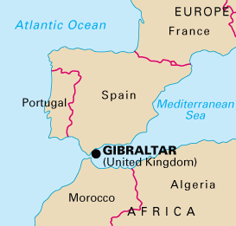
Geography
North of Gibraltar – Spain
East of Gibraltar – the Mediterranean Sea
West of Gibraltar – Bay of Algeciras
South of Gibraltar – Strait of Gibraltar

Slide 7
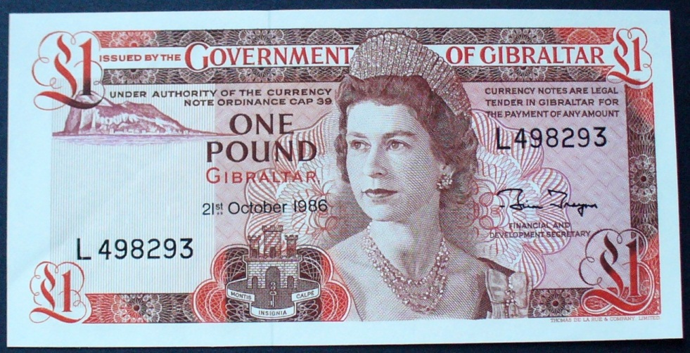
British citizenship
Since 1981, Gibraltarians have been British citizens
Spain claimed the territory
Citizens decided themselves in a referendum
(1967 and 2002) they want Gibraltar to be a part of the Great Britain
Currency – the Gibraltar Pound

Slide 8
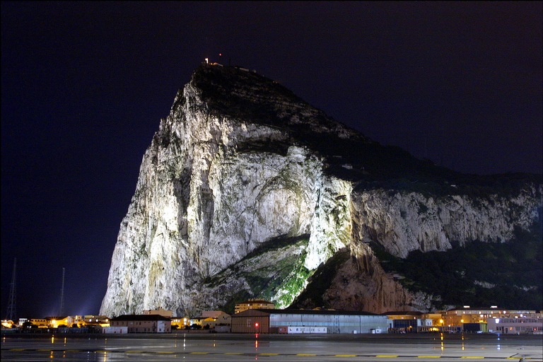
As a tourist there you must see
The Rock of Gibraltar - referred to simply as the Rock
The cruises around the Rock at night are very popular

Slide 9
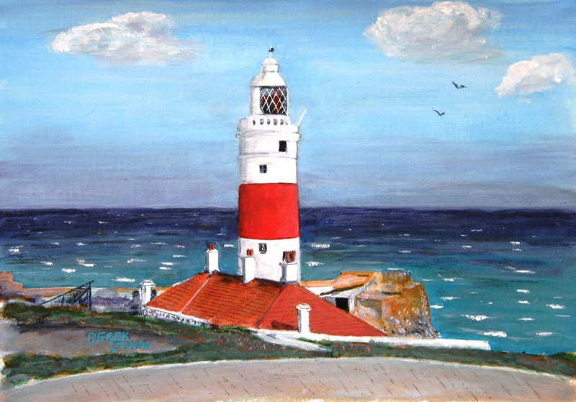
As a tourist there you must see
Europa Point = Punta de Europa
A place just 14 kilometres from Africa
Famous lighthouse

Slide 10
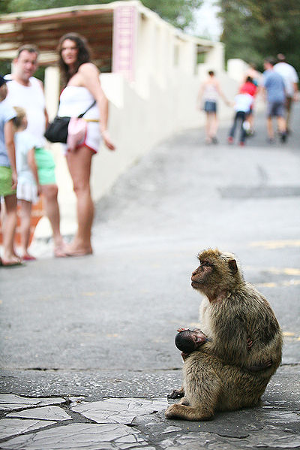
As a tourist there you must see
Barbary Macaques
Gibraltar’s famous animals are all over the place

Slide 11
Vocabulary related to gibraltar – match the definitions
macaque
lighthouse
shore
cruise
border
Pound
Andalusia
bay
referendum
to travel on a boat or ship as a vacation or sightseeing
a piece of land near a sea or an ocean
a part of an ocean surrounded by land
a region in Spain located in the south, borders with Gibraltar
when people of a country vote for or against something
A tower built on the shore to guide ships
a line that separates two or more countries
the currency of Gibraltar is the Gibraltar ...
a monkey with no tail that inhabits Gibraltar

Slide 12
Vocabulary related to gibraltar – match the definitions
Macaque = a monkey with no tail that inhabits Gibraltar
Lighthouse = A tower built on the shore to guide ships
Shore = a piece of land near a sea or an ocean
Cruise = to travel on a boat or ship as a vacation or sightseeing
Border = a line that separates two or more countries
the currency of Gibraltar is the Gibraltar Pound
Andalusia = a region in Spain located in the south, borders with Gibraltar
Bay = a part of an ocean surrounded by land
Referendum = when people of a country vote for or against something

Slide 13
Sources
Giblogswallop. In: [online]. [cit. 2013-06-07]. Dostupné z: http://www.giblogswallop.co.uk/wp-content/uploads/2011/09/Gibraltar-National-Day-036.jpg
Wikipedia. [online]. [cit. 2013-06-07]. Dostupné z: http://en.wikipedia.org/wiki/Gibraltar
How Stuff Works. [online]. [cit. 2013-06-07]. Dostupné z: http://geography.howstuffworks.com/europe/gibraltar.htm
Moon Cruise Gallery. In: [online]. [cit. 2013-06-07]. Dostupné z: http://www.mooncruisegallery.com/wp-content/uploads/2013/05/rock-of-gibraltar.jpg
The Art of Derek Dohren. In: [online]. [cit. 2013-06-07]. Dostupné z: http://www.derekdohren.com/apps/photos/photo?photoid=93279576
Wikipedia. In: [online]. [cit. 2013-06-07]. Dostupné z: http://en.wikipedia.org/wiki/File:Barbary_macaque_and_tourists.jpg

