Slide 1


VY_32_INOVACE_14_Konverzace v Aj 6.ročník_Shopping
ZŠ Týnec nad Labem
AUTOR: Lenka Hrnčířová
Téma: Shopping
CZ.1.07/1.4.00/21.1921

Slide 2
Anotace:
Konverzace v Aj, 6. ročník, Shopping (Nakupování)
Nakupování
Jména obchodů přiřadit k obrázkům
Obrázkový slovník – kasa, vozík, trh, stánek
Jak lidé mohou platit v obchodech
Otázky o nakupování

Slide 3
Shopping
It is a very important activity in our life.
We buy: food
drink
clothes
toys
things for hygiene and for cleaning
furniture
and so on.

Slide 4
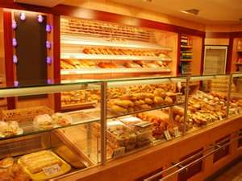
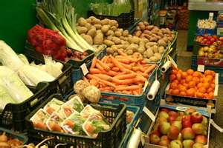
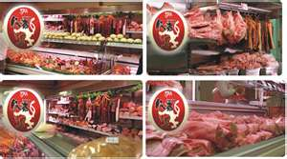
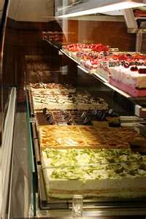
Match the names with the pictures
People can buy different things in different shops:
butcher´s baker´s sweet shop greeengrocer´s

Slide 5
Checking
People can buy different things in different shops:
baker´s greeengrocer´s butcher´s sweet shop

Slide 6
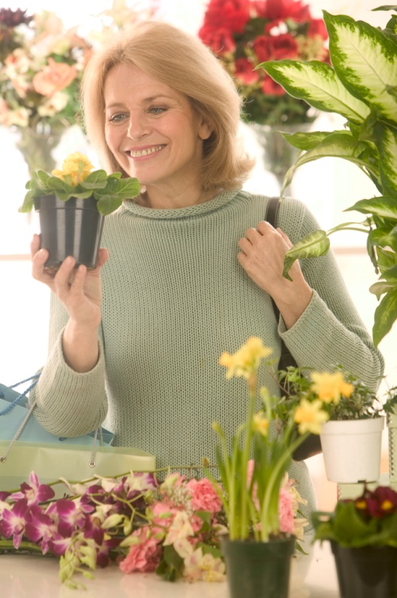

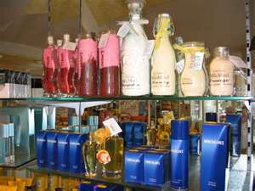
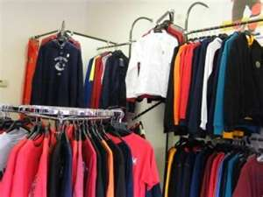
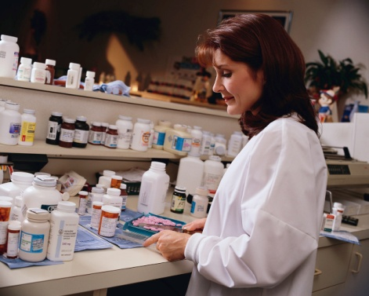
florist pharmacy clothes shop chemist´s

Slide 7
pharmacy florist chemist´s clothes shop

Slide 8
cash desk trolley

Slide 9
market stall

Slide 10
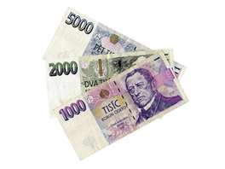
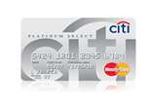
How can people pay in shops?
by money by credit card

Slide 11
Answer:
1) Where do people buy meat, ham and sausages?
Where do people buy flowers?
at butcher´ s
2) What is the large shop where people can
buy different things?
supermarket
at florist

Slide 12
4) Where do peple buy rolls and bread?
6) Where do people buy tablets, drops?
at baker´s
5) What is the place in shops where people stay
in the queue and must pay ?
at cash desk
in pharmacy

Slide 13
7) Where do peple put chosen things in shop
that they want to buy?
into a trolley
8) Where do people buy tomatoes, apples, oranges?
in greengrocer´s
9) How can peple pay in shops?
by money or credit card

Slide 14
10) Where do people buy cakes, chocolate?
in sweet shop

Slide 15
Zdroje:
http://microsoft.com

