Slide 1
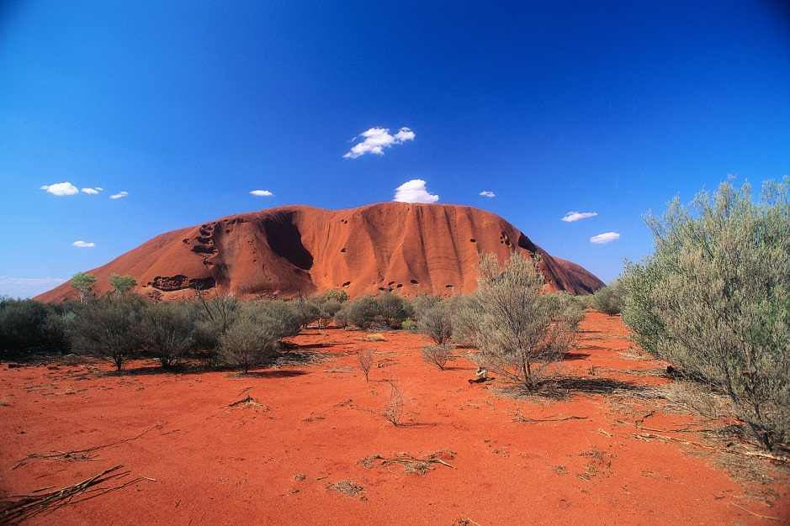
AUSTRALIA

Slide 2

NÁZEV: VY_32_INOVACE_ANGLICKÝ JAZYK_1.AUSTRALIA
NÁZEV ŠKOLY:ZŠ Pardubice - Spořilov
AUTOR:Mgr. Alena Vavříčková
TEMA:AUSTRALIA
ČÍSLO PROJEKTU:CZ.1.07/1.4.00/21.2349

Slide 3
ANOTACE
Materiál je určen pro žáky 8.-9. třídy.
Žáci se zde seznamují s konverzačním tématem Austrálie.

Slide 4
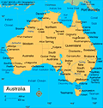
Facts about Australia
Area 7 617 931 square kilometres
Population 21 mil
Monetary unit: Australian dollar
Capital Canberra (384 000)
Largest cities: Sydney, Melbourne, Brisbane, Perth
Sovereign: Queen Elizabeth II, Governor-General, Prime Minister

Slide 5
Geography
Australia is the smallest continent but sixth largest state
mostly flat
It is bounded by the Pacific Ocean to the east, the Indian Ocean to the west
the highest peak is Mt. Kosciuszko (2228)
the Murray River and the Darling River
Interesting exotic flora and fauna

Slide 6
History
The Native Australians, or Aborigines, have lived in Australia for at least 40,000 years.
The first recorded European sighting of the Australian by the Dutch in 1606
26th January 1788 – first colony was established – Australia´s national day
Australia is still part of the British commonwealth.
multicultural country

Slide 7
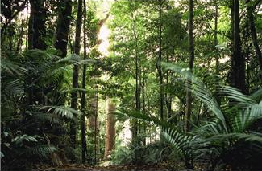
Flora
Because of the isolation of Australia for thousands of years, the plants are unique, different from the rest of the world
gumtree
baobab
eucalypt

Slide 8
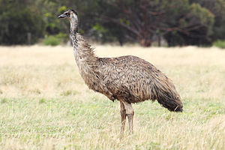
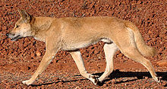
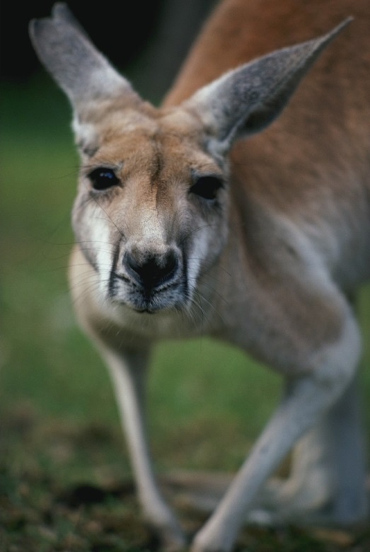
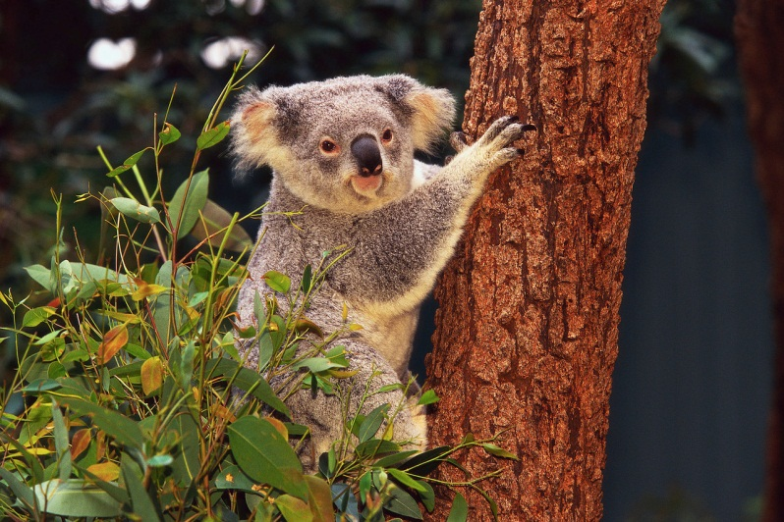
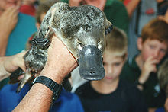
Fauna
Marsupials: koala, kangaroo
dingo
emu
platypus
kookaburra

Slide 9
6 states and 2 territories
Australia has six states — New South Wales, Queensland, South Australia, Tasmania, Victoria, and Western Australia and two territories — the Australian Capital Territory and the Northern Territory

Slide 10

The flag
The flag of Australia is a blue field with the Union Flag and a large white seven-pointed star known as the Commonwealth Star. It also has the Southern Cross constellation.

Slide 11
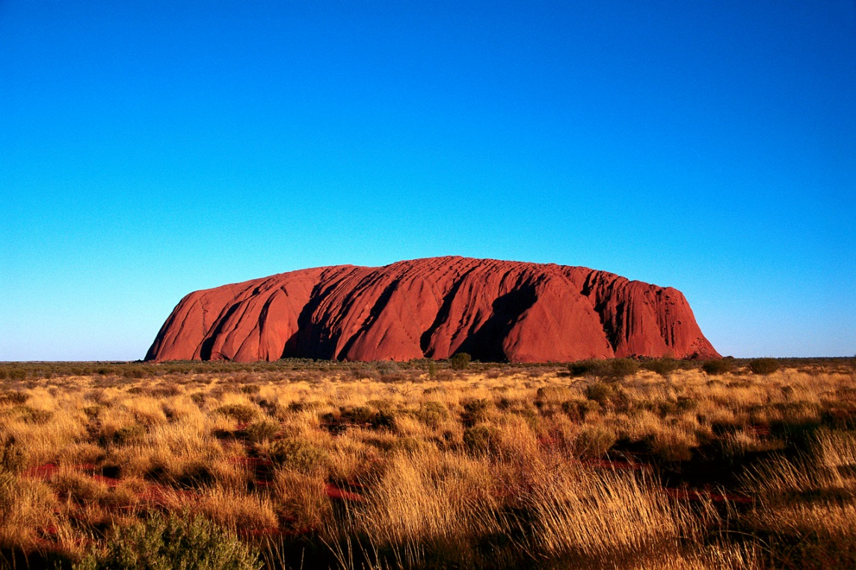
Places of interests
Ayers Rock – red rock monolith, 348 metres tall, 3.6 kilometres long
Aboriginal sacred place

Slide 12
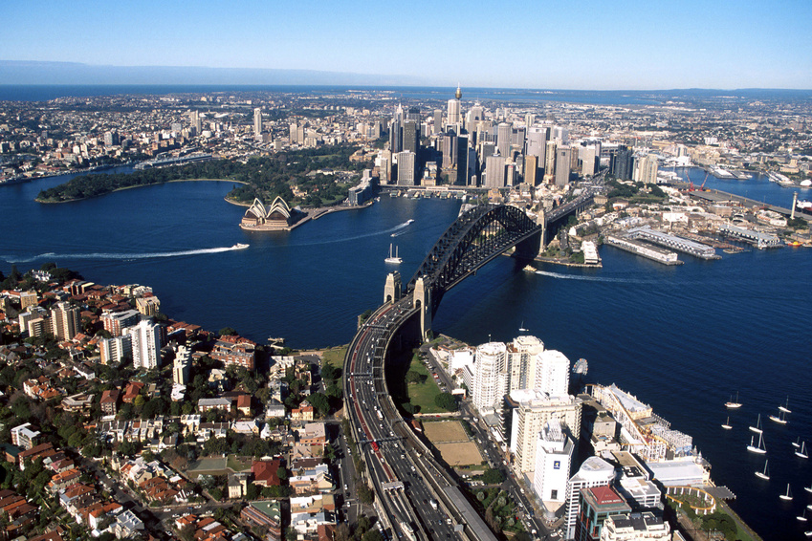
Sydney

Slide 13
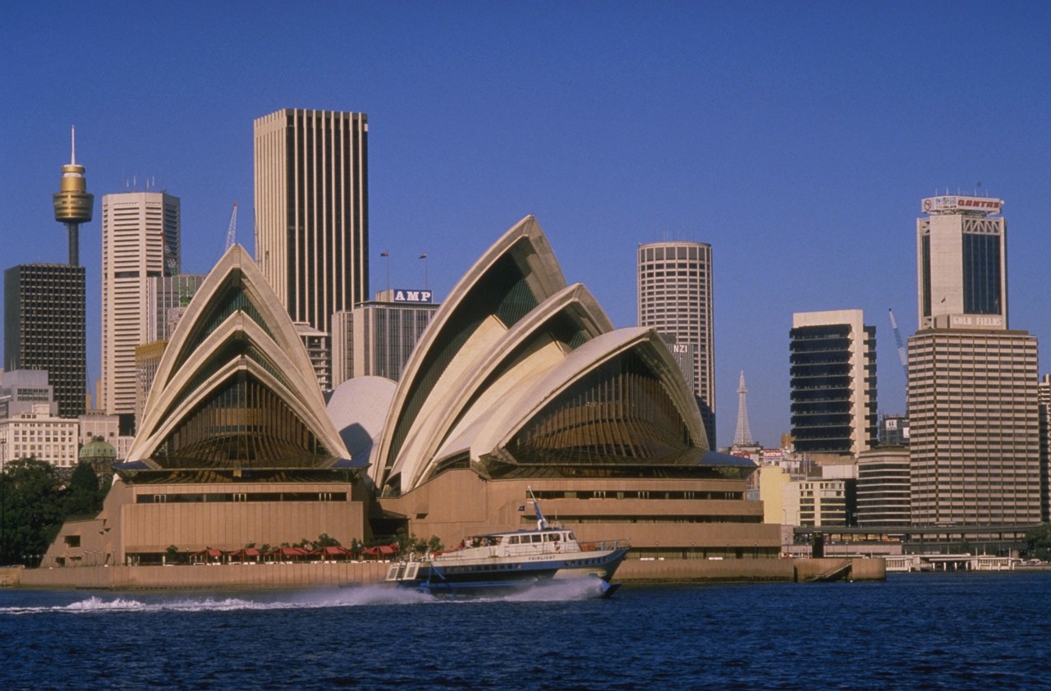
Sydney Harbour, Opera House

Slide 14
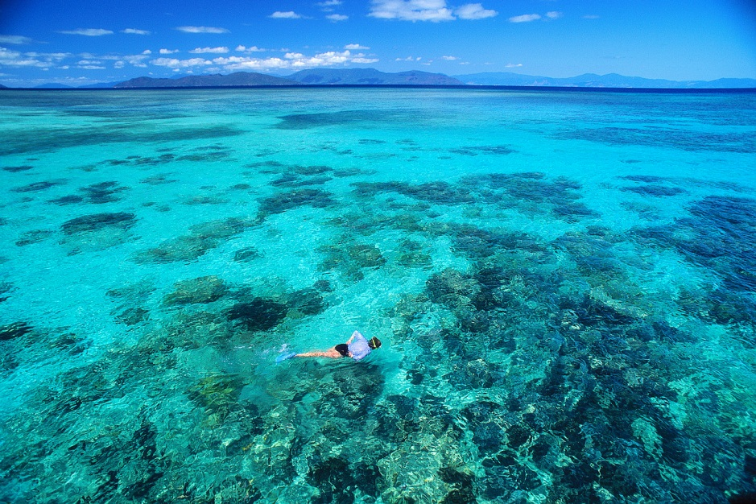
Great Barrier Reef

Slide 15

Australian anthem
http://www.dva.gov.au/commems_oawg/commemorations/commemorative_events/organise_events/Documents/AdvanceAustFair.mp3

Slide 16
CITACE
Web
[online]. [cit. 2013-06-23]. Dostupné z: http://www.dva.gov.au/commems_oawg/commemorations/commemorative_events/organise_events/Pages/audio%20files.aspx
[online]. [cit. 2013-06-23]. Dostupné z: http://upload.wikimedia.org/wikipedia/commons/thumb/3/3e/Uluru_Panorama.jpg/650px-Uluru_Panorama.jpg
[online]. [cit. 2013-06-23]. Dostupné z: http://upload.wikimedia.org/wikipedia/en/thumb/b/b9/Flag_of_Australia.svg/125px-Flag_of_Australia.svg.png
[online]. [cit. 2013-06-23]. Dostupné z: http://upload.wikimedia.org/wikipedia/commons/thumb/9/98/Dingo_walking.jpg/220px-Dingo_walking.jpg
[online]. [cit. 2013-06-23]. Dostupné z: http://upload.wikimedia.org/wikipedia/commons/thumb/f/fc/Emu-wild.jpg/300px-Emu-wild.jpg
[online]. [cit. 2013-06-23]. Dostupné z: http://upload.wikimedia.org/wikipedia/commons/thumb/4/48/Platypus_in_Geelong.jpg/220px-Platypus_in_Geelong.jpg

Slide 17
[online]. [cit. 2013-06-23]. Dostupné z: http://upload.wikimedia.org/wikipedia/commons/thumb/a/a0/Sydney_opera_house_and_skyline.jpg/120px-Sydney_opera_house_and_skyline.jpg
[online]. [cit. 2013-06-23]. Dostupné z: http://officeimg.vo.msecnd.net/en-us/images/MB900448349.jpg
Pokud není uvedeno jinak, obrazový materiál je použit z office.microsoft.com/cs-cz/images/

