Slide 1
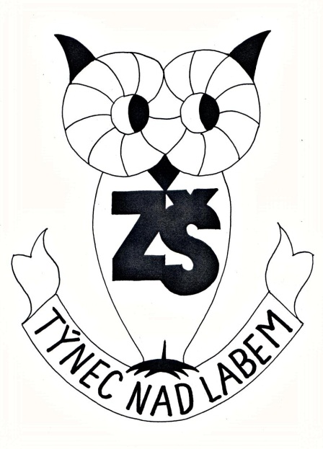

VY_32_INOVACE_19_Konverzace v Aj 6. ročník_London
ZŠ Týnec nad Labem
AUTOR:Lenka Hrnčířová
Téma:London
CZ.1.07/1.4.00/21.1921

Slide 2
Anotace:
Konverzace v Aj, 6. ročník, London
Prezentace k výkladu s procvičením
Motivační otázky o Londýnu
Fotografie známých míst Londýna
Informace o některých známých místech či budovách
Spojování jmen budov a míst s obrázky
Dopsat jména míst či budov
Otázky o Londýnu
Pomůcky: fixy na interaktivní tabuli

Slide 3
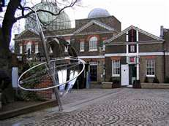
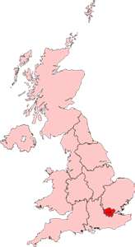
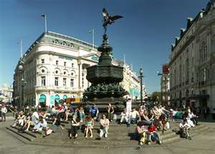
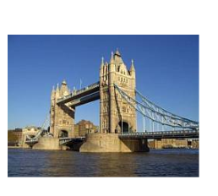
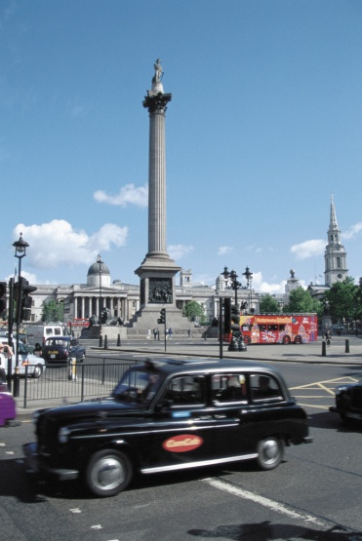
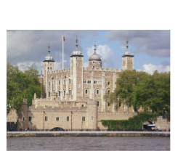
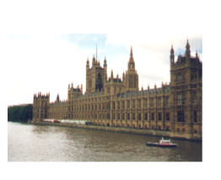
London
Do you know any places in London?
Did you visit London?
Where is London situated?

Slide 4
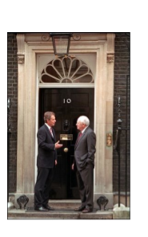
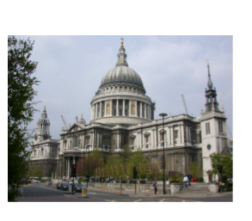
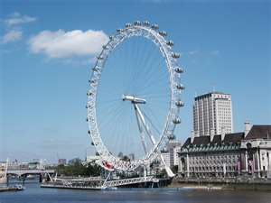
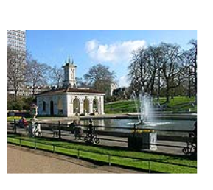
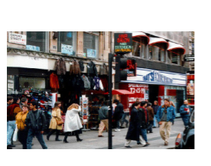
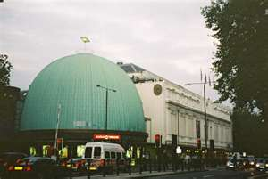
London Eye
10 Downing Street
St. Paul´s Cathedral
Oxford Street
Hyde Park
Madame Tussaud

Slide 5
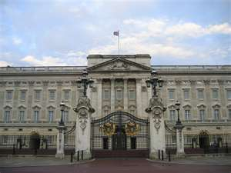
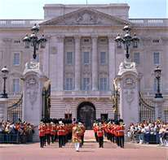
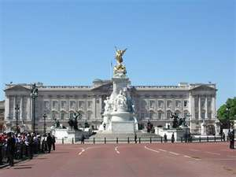
London is the capital of England and the UK.
Buckingham Palace
It is the seat of every British queen or king in London.
changing of guards

Slide 6
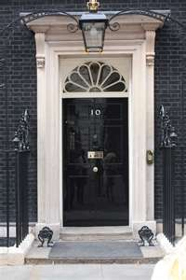
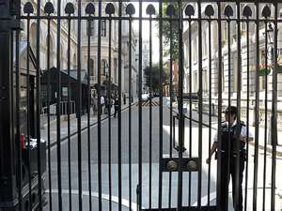
10 Downing Street
It is the seat of every British Prime Minister.

Slide 7
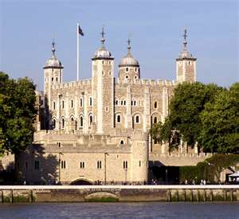
the Tower of London
It was built by William the Conqueror in the 11th
century.
It was in history:
a royal palace
a royal prison
a royal zoo

Slide 8
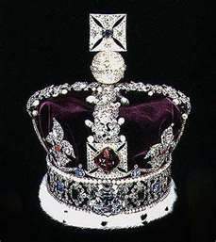
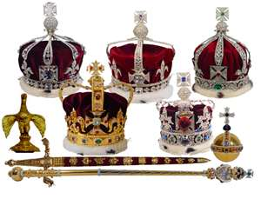
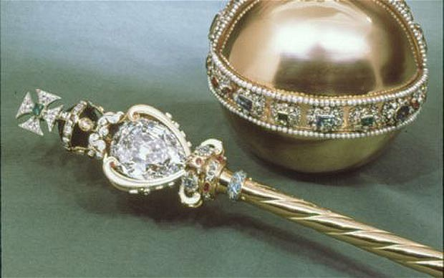
Now it is a museum.
People can see there the Crown Jewels and guns.
crown
sceptre and orb

Slide 9
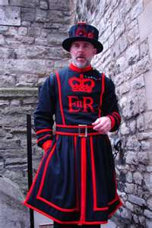
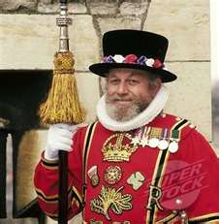
The Crown Jewels are guarded by Beefeaters.

Slide 10
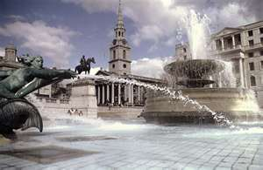
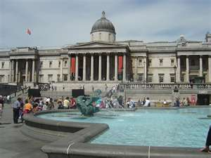
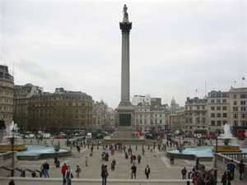
Trafalgar Square
It is the most famous square in London.
There are: fountains, the National Gallery and
Nelson´s Column.
fountains
Nelson´s Column
the National Gallery

Slide 11
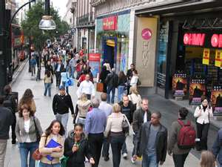
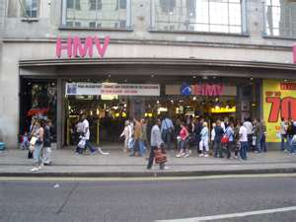
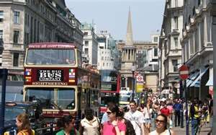
Oxford Street
It is the shopping centre of London.

Slide 12

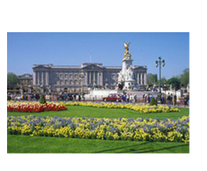
Match the pictures with names
Buckingham Palace
the Houses of Parliament
Tower Bridge
the Tower of London
the Tower of London
the Houses of
Parliament
Buckingham Palace
Tower Bridge

Slide 13
Write names of the place
……………………………………………………………………………………………………………………………………………….
10 Downing Street Hyde Park St. Paul´s Cathedral Oxford Street

Slide 14
Answer:
1) Where does every British Prime Minister live?
at 10 Downing Street

Slide 15
2) What is the most famous square in London?
Trafalgar Square
3) What can you see there?
fountains, Nelson´s Column, the National Gallery

Slide 16
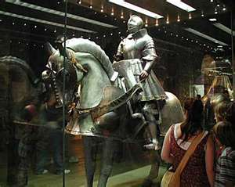
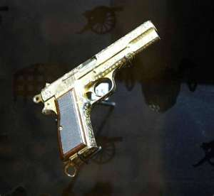
4) What was the Tower of London in history?
a royal palace, a prison, a royal zoo
5) What is it now?
a museum
6) What can people see there?

Slide 17
Zdroje:
http://microsoft.com
Text byl sestaven autorkou tohoto DUMu.

