Slide 1

Describing pictures
Číslo projektu: CZ.1.07./1.5.00/34.0938 Název projektu: Zlepšení podmínek pro vzdělávání na SUŠ, Ostrava
Present continuous
VY_32_INOVACE_AJ_1_44

Slide 2
Present continuous
When do we use present continuous?
Something is happening right now
Something is happening around now
An action is temporary
An action is incomplete

Slide 3
Task 1
Write a sentence for each of the four meanings
Something is happening right now
Something is happening around now
An action is temporary
An action is incomplete

Slide 4
What is the connection between present continuous and describing pictures?
We use present continous to describe what people are doing in the picture – because they are doing it at the moment the picture is taken.

Slide 5
Task 2
See the picture and make ten sentences about what the people are doing.

Slide 6
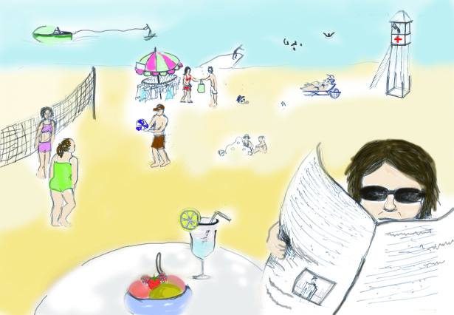
Kresba: vlastní

