Slide 1


VY_32_INOVACE_05_Anglický jazyk 6.ročník_The good old days
ZŠ Týnec nad Labem
AUTOR: Lenka Hrnčířová
Téma: The good old days
CZ.1.07/1.4.00/21.1921

Slide 2
Anotace
Anglický jazyk, 6. ročník
The good old days? – práce s textem v učebnici
Doplňování chybějících slov
Správně doplněná slova
Otázky k textu
Lze vytisknout – SP pro žáky
Pomůcky: fixy na interaktivní tabuli

Slide 3
The good old days?
Complete the missing words
1) Liam went to his ……………………… yesterday.
2) He needed a …………………….. in one of his
…………….. 3) It did not …………….. because
his dentist used a fast electric ………………
and an …………………………………… .
4) Liam is glad that he did not live two
……………………….. years ago.
dentist 2) filling, teeth 3) hurt, drill, anaesthetic
4) hundred 5) use

Slide 4
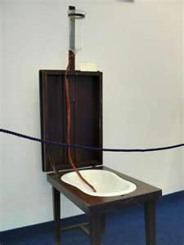
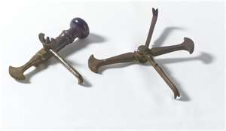
6) They did not have a ………………………., so
they worked in…………………. or …………………….. .
7) They did not wash their ……………………..
And did not clean their ………………………….. .
6) surgery, street, shops
7) hands, instruments

Slide 5
8) They made false teeth from ……………… teeth.
9) They took real teeth from ……………………. or ……………… people.
10) Poor people had ………………… teeth, so when they did not have money, they ……………….their teeth .
11) Today dentists make false teeth from …………………… .
8) real 9) dead, poor 10) good, sold
11) plastic

Slide 6
Right words for completing
dentist
filling, teeth
hurt, drill, anaesthetic
hundred
use
surgery, shops, street (slova shops a street
mohou být i v obráceném pořadí)
hands, instruments
real
dead, poor mohou být i v obráceném pořadí
good, sold
plastic

Slide 7
Answer
Where did Liam go yesterday?
to his dentist
2) Why?
He needed a filling.
3) Did it hurt?
No, it didn´t.

Slide 8
4) What did his dentist use?
fast electric drill, anaethetic
5) Where did dentist work two hundred
years ago?
in street or shops
6) What activities for hygiene did not the
dentists do?
They didn´t clean instruments and wash
their hands.

Slide 9
7) How did the dentists make false teeth?
They used real teeth.
8) Where did the dentists take real teeth?
from poor people or from dead
9) Why did poor people have good teeth?
Who had good teeth two hundred years ago – poor
or rich people?
9) Where did dentist take real teeth?
10)Why did poor people sell their teeth?
They didn´t eat a lot of sugar.

Slide 10
Zdroje
http://microsoft.com
Věty sestaveny autorkou tohoto DUMu.

