Slide 1


VY_32_INOVACE_06_Anglický jazyk 6.ročník_Space
ZŠ Týnec nad Labem
AUTOR: Lenka Hrnčířová
Téma: Space
CZ.1.07/1.4.00/21.1921

Slide 2
Anotace
Anglický jazyk, 6. ročník, Vesmír - Space
Opakování formou otázek a doplňování slovíček k obrázkům
Pomůcky: fixy na interaktivní tabuli

Slide 3
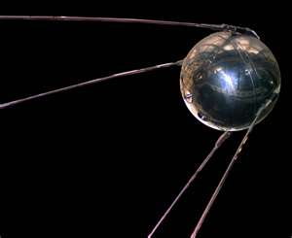
Space
1) What satellite was the first in space?
2) What country launched it?
3) What was in it?
Sputnik 1
Russia
a small radio

Slide 4
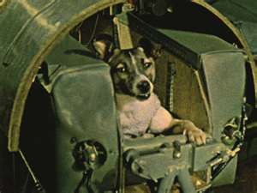
4) What country launched the second satellite?
5) What was in Sputnik 2?
Russia, too
Laika

Slide 5
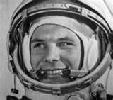
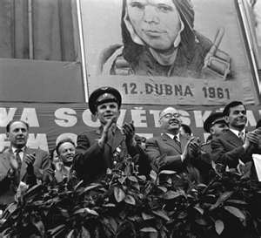
6) Who was the first astronaut in space?
7) Where did he come from?
8) How many orbits did he make?
Yuri Gagarin
from Russia
only one

Slide 6
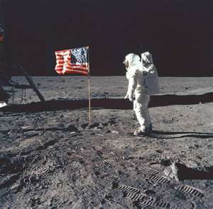
9) Who was the first astronaut on the Moon?
10) Where did he come from?
11) What did he place on the Moon?
Neil Armstrong
from the USA
American flag

Slide 7
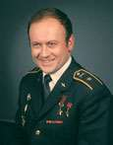
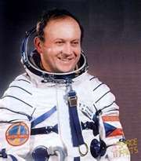
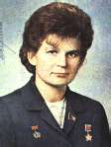
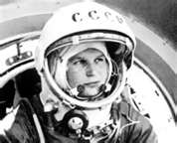
12) Who was the first Czech astronaut?
V. Remek
13) Who was the first woman astronaut?
V. Tereskova

Slide 8
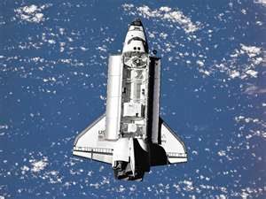
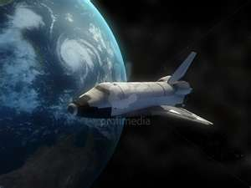
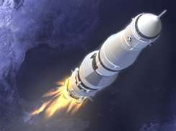
Forms of transport in space
space ship
space shuttle
space rocket

Slide 9
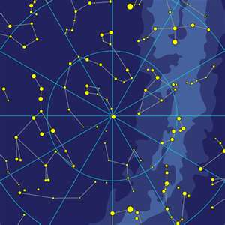
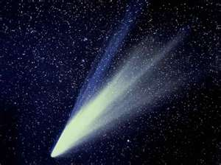
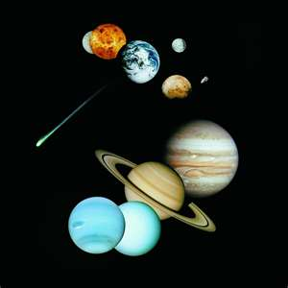
Call and write the parts of space
constellation
comet
planet
……………………………………………………………………………………………………………………..

Slide 10
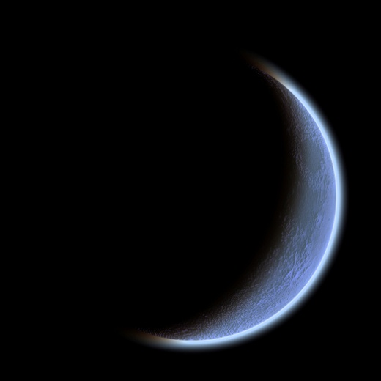

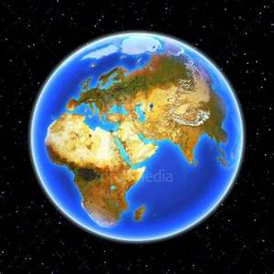
Moon
Earth
Sun
…………………………………………………………………………………………………………………

Slide 11
Použité zdroje
http://microsoft.com

