Slide 1


VY_32_INOVACE_09_Anglický jazyk 6.ročník_Valentine´s Day
ZŠ Týnec nad Labem
AUTOR: Lenka Hrnčířová
Téma: Valentine´s Day
CZ.1.07/1.4.00/21.1921

Slide 2
Anotace
Anglický jazyk, 6. ročník, Valentine ´s Day
Prezentace k výkladu
1)Datum a symboly
2)Dárky, karty
3)Rýmy
4)Otázky k procvičení

Slide 3


Valentine´s Day
It is a holiday of lovers, it is celebrated on February 14 .
Nobody knows exactly the origin of the day. There are
several legends.
Modern Valentine´s symbols are: a heart, a Cupid,
a dove.

Slide 4

Cupids are chubby little children with wings. They are
named after the Roman god of love – Cupid.
The day is wonderful chance to tell someone how much
he or she means to you.

Slide 5
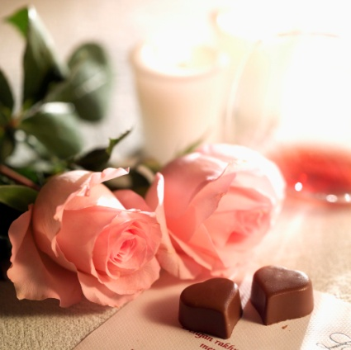
Lovers buy presents for the other, for example flowers,
chocolate, mugs.
Lovers send Valentine´s cards with a rhyme.
Very favourite rhyme is:
Roses are red, violets are blue,
sugar is sweet and so are you.

Slide 6

Other rhymes:
My love for you is as big as an elephant.
My love for you is as high as a mountain.
My love for you is as deep as the sea.

Slide 7
Answer
When is Valentine´s Day?
2) What are modern Valentine´s symbols?
on 14 February

Slide 8
3) What holiday is Valentine´s Day?
What do lovers buy on Valentine´s Day?
5) What can be written in Valentine´s card?
holiday of lovers
flowers, chocolate, ……
Be my Valentine.

Slide 9



Make Valentine´s card

Slide 10
Použité zdroje
http://microsoft.com
Text sestaven autorkou tohoto DUMu.

