Slide 1


Obchodní akademie, Střední odborná škola a Jazyková škola s právem státní jazykové zkoušky,
Hradec Králové
Autor: | Mgr. Vít Klimeš
Název materiálu: | VY_32_INOVACE_4_ANGLICKY_JAZYK_REALIE_01 Spojené království Velké Británie a Severního Irska
Téma sady: | ANJ - Reálie
Obor, ročník: | Ekonomické lyceum, Obchodní akademie, Veřejnosprávní činnost, Sociální činnost, 4. ročník
Datum vytvoření: | listopad 2013
Anotace: | Spojené království Velké Británie a Severního Irska - prezentace, základní fakta, geografie, fauna, významná města, vláda a politický systém
Metodický obsah: | Výklad nového učiva

Slide 2
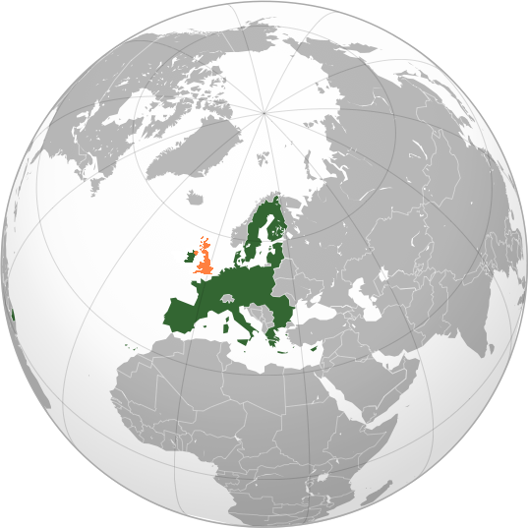
The UK – Basic Facts
The UK is located between the North Sea and the North Atlantic Ocean.
It is a part of Europe, but it lies on an archipelago called the British Isles.
The population of the UK is nearly 63 million.
English is the major language in the UK.
EUROPE
Obr. 1 the UK on a globe [1]

Slide 3
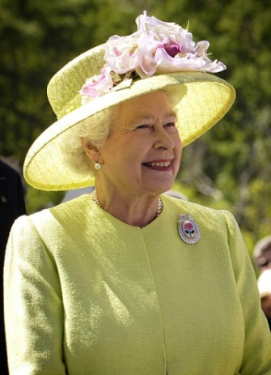
POLITICS
The UK is a part of the British Commonwealth.
It is a constitutional monarchy.
The head of state is the monarch Queen Elizabeth II.
The head of the government is the Prime Minister.
The parliament of the UK consists of the House of Lords and the House of Commons.
Queen Elizabeth II
Obr. 2 Queen Elizabeth II [2]

Slide 4
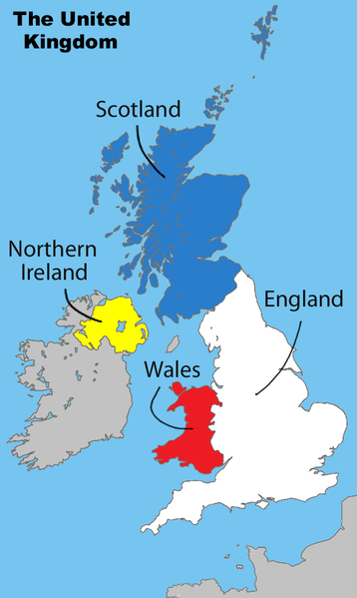
The UK
The United Kingdom of Great Britain and Northern Ireland consists of 4 countries: England, Scotland, Wales and Northern Ireland.
Obr. 3 The UK on a map [3]

Slide 5
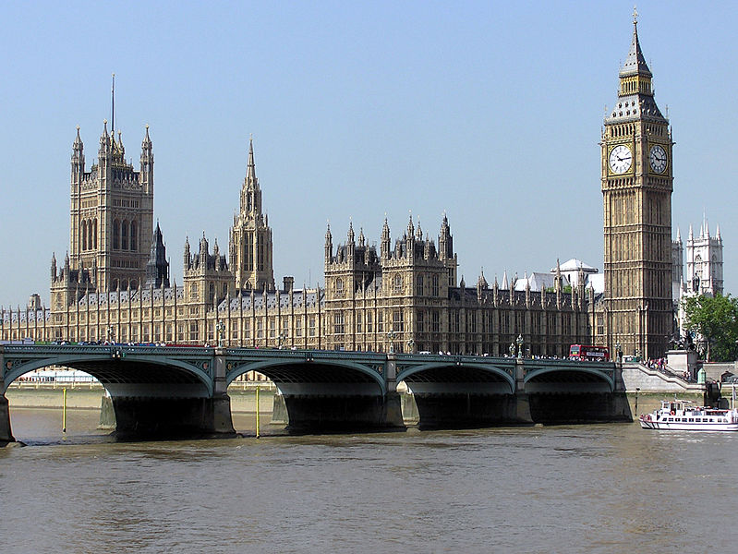
CITIES
The capital city of the UK is London.
It is also the capital of England.
Obr. 4 London – The Houses of Parliament [4]

Slide 6
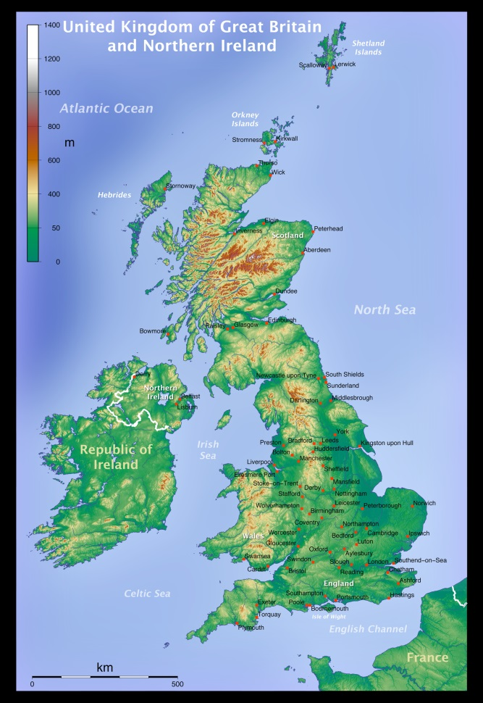
CITIES
It is in the south–east of the UK.
Obr. 5 London on a map [5]

Slide 7
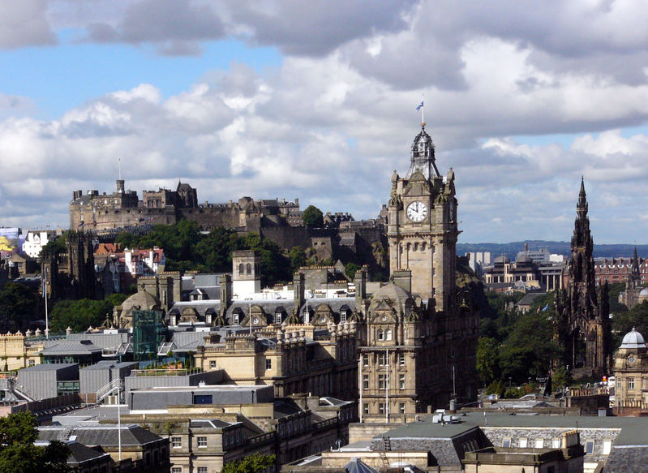
CITIES
Edinburgh is the capital of Scotland.
Obr. 6 Edinburgh [6]

Slide 8
CITIES
It is on the east coast in the northern part of the UK.
Obr. 7 Edinburgh on a map [7]

Slide 9
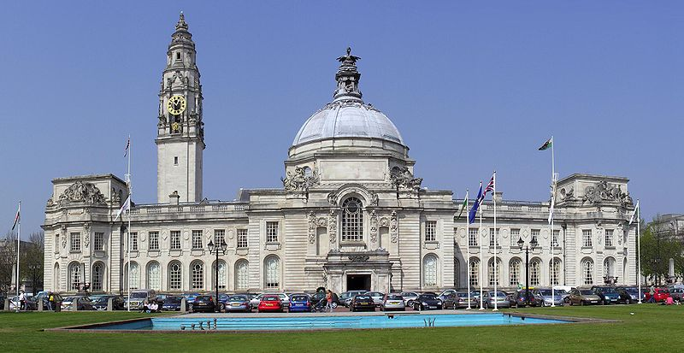
CITIES
Cardiff is the capital of Wales.
Obr. 8 Cardiff City Hall [8]

Slide 10
CITIES
It is in the south–west of the island of Great Britain.
Obr. 9 Cardiff on a map [9]

Slide 11
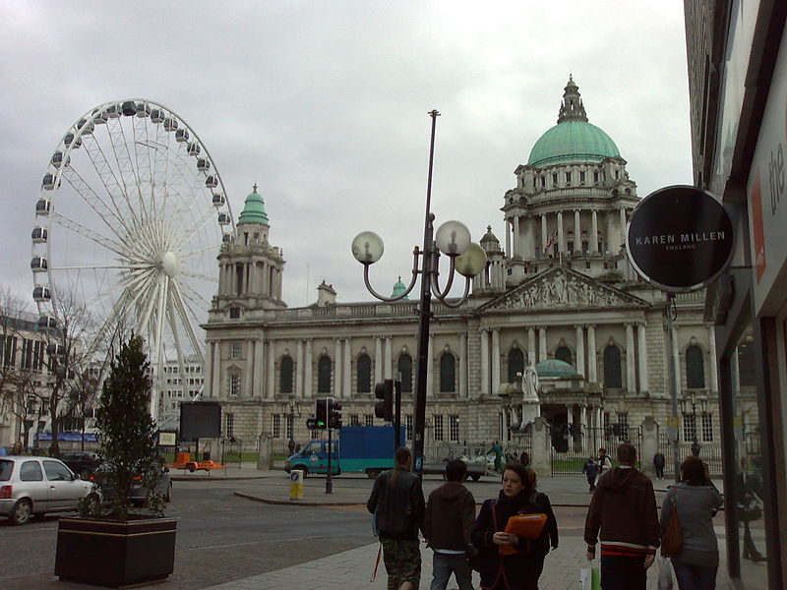
CITIES
Belfast is the capital of Northern Ireland.
Obr. 10 the Belfast Wheel and City Hall [10]

Slide 12
CITIES
It is in the north–east of the island of Ireland.
Obr. 11 Belfast on a map [11]

Slide 13
GEOGRAPHY
The country occupies the island of Great Britain, approximately one-sixth of the island of Ireland and several minor islands such as the Shetland Islands, the Orkney Islands and the Isle of Man.
There are stunning national parks such as the Lake District National Park in England, the Loch Lomond national park in Scotland and the Snowdonia National Park in Wales.
The UK has temperate climate and there is a lot of rainfall all year round.
Ben Nevis in Scotland, with its 1,344 metres above sea level, is the highest point in the UK.

Slide 14
THE PEOPLE OF NEW
THE UK
Celts, Romans, Anglo-Saxons, Vikings and Normans were the peoples who successively settled the British Isles.
The population of the UK mostly consists of the English, then the Scottish, Welsh and Irish.
Nowadays, particularly big cities in the UK are known for their multiculturalism.

Slide 15
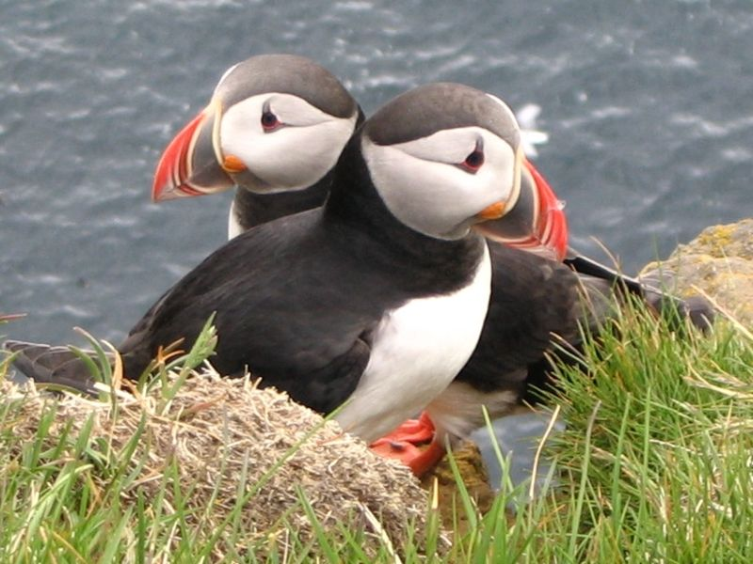
WILDLIFE
The puffin is a bird which occupies the Scottish coasts in spring and summer.
Obr. 12 Puffin s [12]

Slide 16
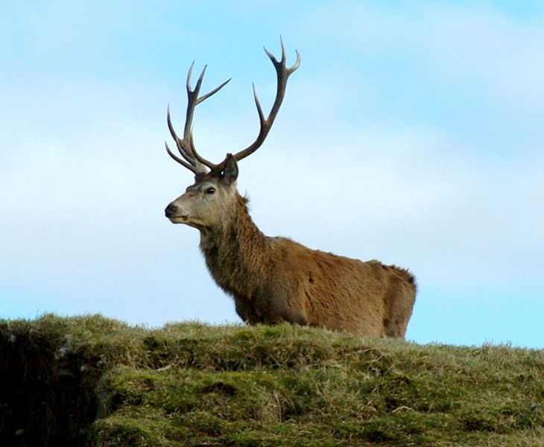
WILDLIFE
The red deer is a large ruminant which is abundant
in the UK, particularly in Scotland.
Obr. 13 a red deer stag [13]

Slide 17
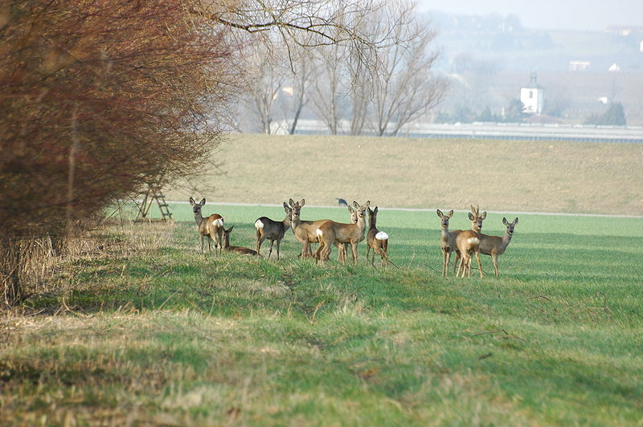
WILDLIFE
The roe deer is another ruminant which is plentiful
in the UK.
Obr. 14 Roe Deer [14]

Slide 18

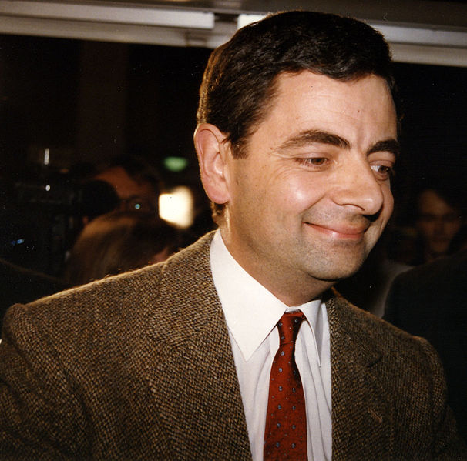
FAMOUS PEOPLE
One Direction is a popular boy band which comes from the UK.
Rowan Atkinson is a famous actor and comedian best known as Mr Bean.
Obr. 15 One Direction [15]
Obr. 16 Rowan Atkinson [16]

Slide 19
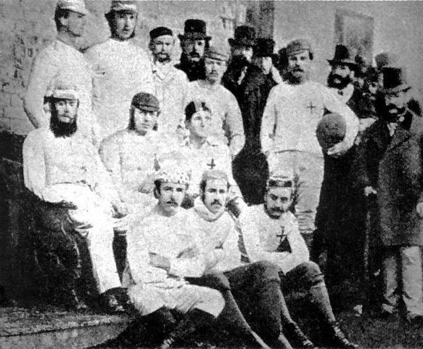
POPULAR SPORTS
Football, which was invented there, is the most popular sport in the UK.
People in the UK also enjoy cricket, golf, rugby, which were all also invented in the UK.
Obr. 17 the Game of football [17]

Slide 20
REFERENCES – PHOTOGRAPHS
(ZDROJE OBRÁZKŮ)
FRETWELL, Keyan. Wikimedia [online]. 2011 [cit. 2013-11-15]. Dostupné z: https://commons.wikimedia.org/wiki/File:United_Kingdom_(orthographic_projections).PNG?uselang=cs
Wikipedia [online]. 2012 [cit. 2013-03-07]. Dostupné z: http://en.wikipedia.org/wiki/File:Elizabeth_II_greets_NASA_GSFC_employees,_May_8,_2007_edit.jpg
LEWIS, Matt. Wikimedia [online]. 2013 [cit. 2013-11-15]. Dostupné z: http://commons.wikimedia.org/wiki/File:United_Kingdom_labelled_map7.png
PINGSTONE, Adrian. Wikimedia [online]. 2005 [cit. 2013-11-15]. Dostupné z: http://commons.wikimedia.org/wiki/File:Houses.of.parliament.overall.arp.jpg
EQUESTENEBRARUM. Wikimedia [online]. 2008 [cit. 2013-11-15]. Dostupné z: http://commons.wikimedia.org/wiki/File:Topographic_Map_of_the_UK_-_English.png
BICKEL, Christian. Wikimedia [online]. 2006 [cit. 2013-11-15]. Dostupné z: http://commons.wikimedia.org/wiki/File:Edinburgh_Overview03.jpg

Slide 21
REFERENCES – PHOTOGRAPHS
(ZDROJE OBRÁZKŮ)
EQUESTENEBRARUM. Wikimedia [online]. 2008 [cit. 2013-11-15]. Dostupné z: http://commons.wikimedia.org/wiki/File:Topographic_Map_of_the_UK_-_English.png
YUMMIFRUITBAT a HAM. Wikipedia [online]. 2007 [cit. 2013-11-16]. Dostupné z: http://en.wikipedia.org/wiki/File:Cardiff_City_Hall_cropped.jpg
EQUESTENEBRARUM. Wikimedia [online]. 2008 [cit. 2013-11-15]. Dostupné z: http://commons.wikimedia.org/wiki/File:Topographic_Map_of_the_UK_-_English.png
ADRIAO. Wikimedia [online]. 2007 [cit. 2013-11-16]. Dostupné z: http://commons.wikimedia.org/wiki/File:Belfast_wheel_and_city_hall.jpg
EQUESTENEBRARUM. Wikimedia [online]. 2008 [cit. 2013-11-15]. Dostupné z: http://commons.wikimedia.org/wiki/File:Topographic_Map_of_the_UK_-_English.png

Slide 22
REFERENCES – PHOTOGRAPHS
(ZDROJE OBRÁZKŮ)
ACONCAGUA. Wikimedia [online]. 2013 [cit. 2013-11-16]. Dostupné z: http://commons.wikimedia.org/wiki/File:Atlantic_Puffin_Latrabjarg_Iceland_05c.jpg
Wikimedia [online]. 2006 [cit. 2013-11-18]. Dostupné z: http://commons.wikimedia.org/wiki/File:RedDeerCaithness.jpg
BUHL, Vera. Wikimedia [online]. 2010 [cit. 2013-11-19]. Dostupné z: http://commons.wikimedia.org/wiki/File:2010-03-23_(13)_Reh,_Roe_deer,_Capreolus_capreolus.JPG
MCKINLAY, Fiona. Wikimedia [online]. 2012 [cit. 2013-11-19]. Dostupné z: http://commons.wikimedia.org/wiki/File:One_Direction_Glasgow.jpg
HEEKE, Gerhard. Wikimedia [online]. 2005 [cit. 2013-11-19]. Dostupné z: http://commons.wikimedia.org/wiki/File:Atkinson_Rowan.jpg
IGNOTO. Wikipedia [online]. 2007 [cit. 2013-11-19]. Dostupné z: http://it.wikipedia.org/wiki/File:Sheffield_FC_1857.jpg

Slide 23
REFERENCES AND COPYRIGHT
(ZDROJE A AUTORSKÁ PRÁVA)
BBC [online]. 2013 [cit. 2013-11-15]. Dostupné z: http://www.bbc.co.uk/news/world-europe-18027954
Nationsonline [online]. 2013 [cit. 2013-11-15]. Dostupné z: http://www.nationsonline.org/oneworld/map/united-kingdom-map.htm
Wikipedia [online]. 2013 [cit. 2013-11-16]. Dostupné z: http://en.wikipedia.org/wiki/United_Kingdom

Slide 24
REFERENCES AND COPYRIGHT
(ZDROJE A AUTORSKÁ PRÁVA)
Dílo smí být dále šířeno pod licencí CC BY-SA.
Materiály jsou určeny pro bezplatné používání pro potřeby výuky a vzdělávání na všech typech škol
a školských zařízení. Jakékoliv další využití podléhá autorskému zákonu.
Všechna neocitovaná autorská díla jsou dílem autora.
Všechny neocitované kliparty a další grafické objekty jsou součástí prostředků výukového sw Smart Notebook a MS Office.

