Slide 1


Obchodní akademie, Střední odborná škola a Jazyková škola s právem státní jazykové zkoušky,
Hradec Králové
Autor: | Mgr. Vít Klimeš
Název materiálu: | VY_32_INOVACE_4_ANGLICKY_JAZYK_REALIE_03 Londýn - prezentace
Téma sady: | ANJ - Reálie
Obor, ročník: | Veřejnosprávní činnost/Sociální činnost, 4. ročník
Datum vytvoření: | leden 2014
Anotace: | Londýn - prezentace , základní fakta, historie, důležitá místa, zajímavosti
Metodický obsah: | Výklad nového učiva

Slide 2
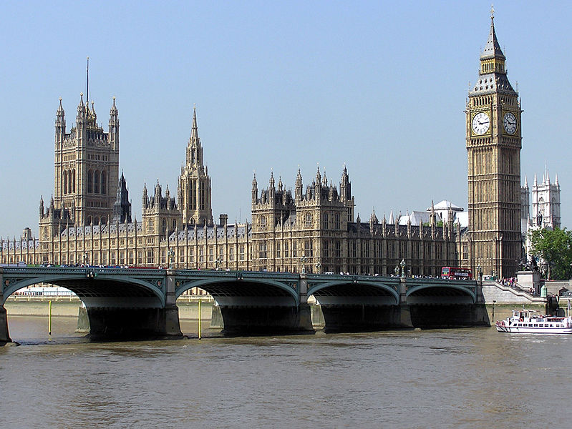
LONDON
London is the capital city of the UK.
It is also the capital of England.
Obr. 1 London – The Houses of Parliament [1]

Slide 3
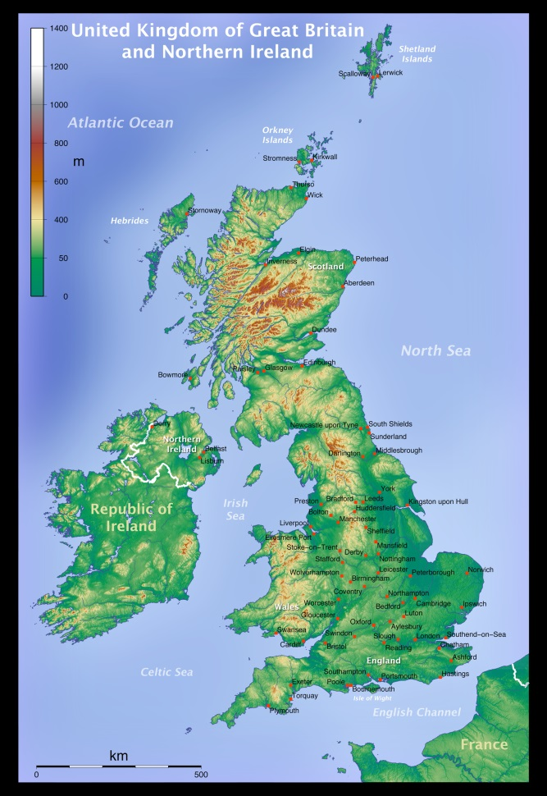
CITIES
It is in the south–east of the UK.
Obr. 2 London on a map [2]

Slide 4
LONDON – BASIC FACTS - HISTORY
It was founded by the Romans in 43AD after they invaded Britain.
It was called Londinium at that time.
After the Norman Conquest, which began in 1066, William the Conqueror was crowned at Westminster Abbey and started the construction of the Tower of London.
At that time it was called Lunduntown.
London became the real capital during Edward III’s reign (1327 -1377).

Slide 5
LONDON – BASIC FACTS - HISTORY
There were two really bad years for London in the second half of the 17th century:
The Great Plague in 1665 which killed nearly 100,000 people.
The Great Fire of London in 1666 burned to the ground almost 80% of the city.
The city grew over the centuries and by 1914 it had a population of 6,5 million.
It suffered a lot of bombardment during World War II.

Slide 6
LONDON – BASIC FACTS
The population of London is about 8 million.
It is the largest city in Europe.
London is divided into 33 boroughs.
It is a multicultural and multi-ethnic city.
London lies on the River Thames.

Slide 7
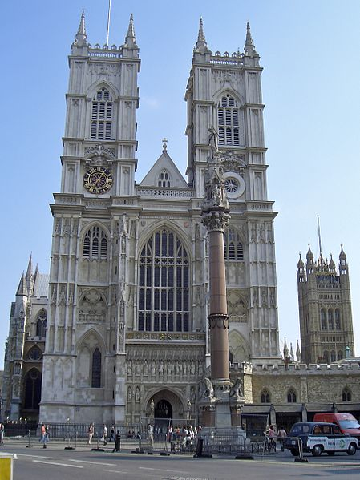
LONDON – FAMOUS PLACES
Westminster Abbey is a large gothic church in the centre of London.
It is the coronation and burial place for British monarchs.
Some of the royal weddings take place there as well.
Obr. 3 Westminster Abbey [3]

Slide 8
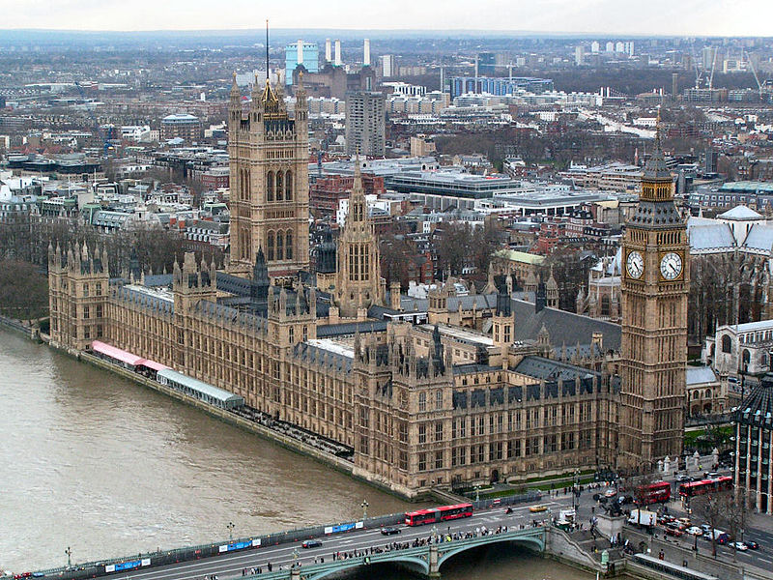
LONDON – FAMOUS PLACES
The Palace of Westminster, known as the Houses of Parliament, is the place where the House of Commons and the House of Lords meet.
It neighbours Westminster Abbey.
Obr. 4 The Palace of Westminster [4]

Slide 9
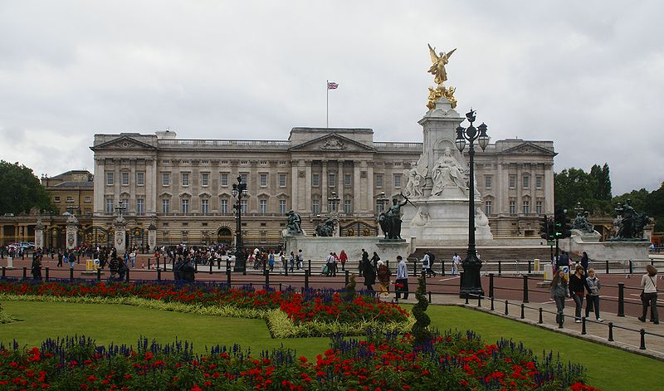
LONDON – FAMOUS PLACES
Buckingham Palace is the London residence and workplace of the British monarch.
Obr. 5 Buckingham Palace [5]

Slide 10
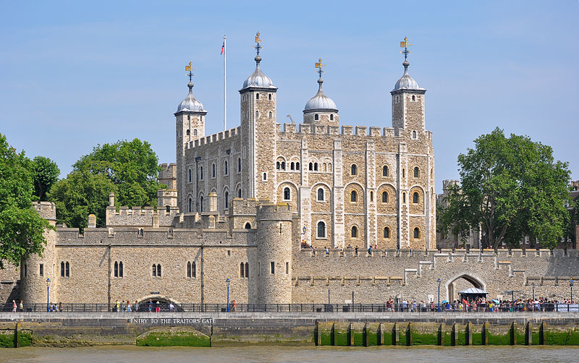
LONDON – FAMOUS PLACES
The Tower of London is a royal historic castle on the River Thames.
The Crown Jewels are kept there.
It served as a prison over the centuries.
Obr. 6 The Tower of London [6]

Slide 11
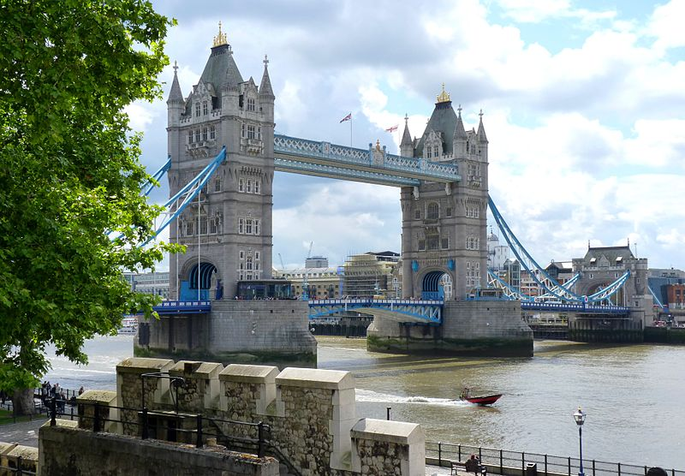
LONDON – FAMOUS PLACES
Tower Bridge on the River Thames is one of the symbols of London.
It is near the Tower of London.
Obr. 7 Tower Bridge [7]

Slide 12
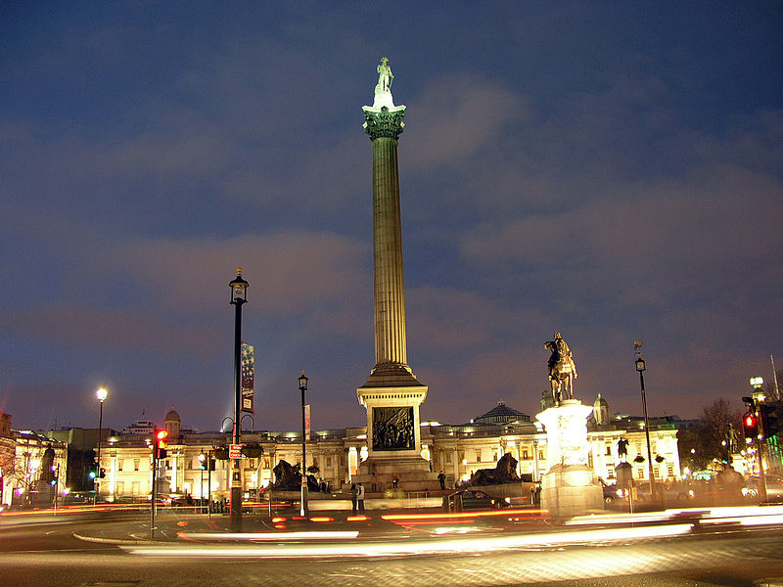
LONDON – OTHER PLACES TO VISIT
Trafalgar Square is a tourist sight in central London.
There is Nelson's Column guarded by four lion statues in honour of Admiral Lord Nelson who died in the Battle of Trafalgar in 1805.
Obr. 8 Trafalgar Square [8]

Slide 13
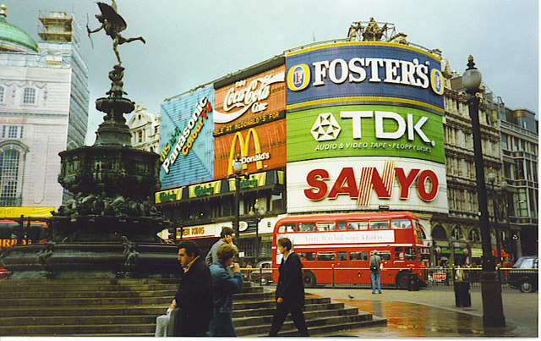
LONDON – OTHER PLACES TO VISIT
Piccadilly Circus is one of London's busiest squares.
It is famous for illuminated advertising on one of the corner buildings and for the statue of Eros.
Obr. 9 Piccadilly Circus [9]

Slide 14
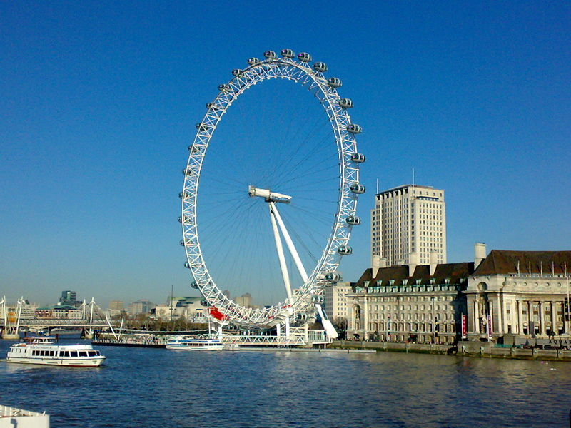
LONDON – OTHER PLACES TO VISIT
The London Eye is a famous tourist attraction located in the centre of London on the bank of the River Thames.
Some of its parts were made by Czech company Skoda.
Obr. 10 the London Eye [10]

Slide 15
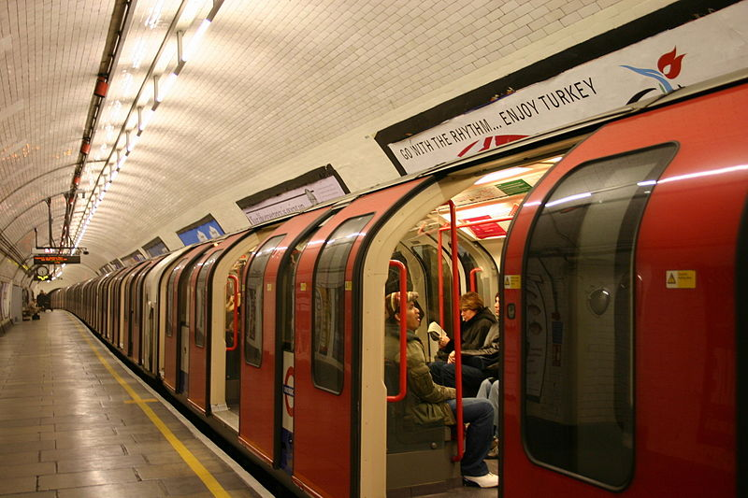
LONDON – OTHER PLACES TO VISIT
The London Underground, known as the Tube, is the oldest underground railway in the world.
Obr. 11 The London Underground [11]

Slide 16
REFERENCES – PHOTOGRAPHS
(ZDROJE OBRÁZKŮ)
PINGSTONE, Adrian. Wikimedia [online]. 2005 [cit. 2013-11-15]. Dostupné z: http://commons.wikimedia.org/wiki/File:Houses.of.parliament.overall.arp.jpg
EQUESTENEBRARUM. Wikimedia [online]. 2008 [cit. 2013-11-15]. Dostupné z: http://commons.wikimedia.org/wiki/File:Topographic_Map_of_the_UK_-_English.png
PEEL, Mike. <i>Wikimedia</i> [online]. 2010 [cit. 2014-01-03]. Dostupné z: http://commons.wikimedia.org/wiki/File:Westminster_Abbey,_2006.jpg
DANIKAUF. Wikimedia [online]. 2005 [cit. 2014-01-03]. Dostupné z: http://commons.wikimedia.org/wiki/File:Westminster_palace.jpg

Slide 17
REFERENCES – PHOTOGRAPHS
(ZDROJE OBRÁZKŮ)
SNOWMANRADIO. Wikimedia [online]. 2008 [cit. 2014-01-03]. Dostupné z: http://commons.wikimedia.org/wiki/File:Buckingham_Palace_-London-18Aug2008-4c.jpg
COLLOWÂN, Bob. Wikipedia [online]. 2013 [cit. 2014-01-03]. Dostupné z: http://cs.wikipedia.org/wiki/Soubor:Tower_of_London_viewed_from_the_River_Thames.jpg
DUDVA. <i>Wikimedia</i> [online]. 2013 [cit. 2014-01-03]. Dostupné z: http://commons.wikimedia.org/wiki/File:The_Tower_Bridge_in_London.jpg
VIBIN. Wikimedia [online]. 2012 [cit. 2014-01-03]. Dostupné z: http://commons.wikimedia.org/wiki/File:Trafalgar_Square_at_night_2.jpg
SMITH, Colin. Geograph [online]. 2013 [cit. 2014-01-03]. Dostupné z: http://www.geograph.org.uk/photo/265001

Slide 18
REFERENCES – PHOTOGRAPHS
(ZDROJE OBRÁZKŮ)
KALAHA. Wikimedia [online]. 2008 [cit. 2014-01-03]. Dostupné z: http://commons.wikimedia.org/wiki/File:London_Eye_from_Westminster_Bridge.jpg
JCORNELIUS. Wikimedia [online]. 2005 [cit. 2014-01-03]. Dostupné z: http://commons.wikimedia.org/wiki/File:London_Underground_Tube_Stock_1992.jpg

Slide 19
REFERENCES AND COPYRIGHT
(ZDROJE A AUTORSKÁ PRÁVA)
Victorianweb [online]. 2010 [cit. 2014-01-03]. Dostupné z: http://www.victorianweb.org/history/hist4.html
Wikipedia [online]. 2013 [cit. 2014-01-03]. Dostupné z: http://en.wikipedia.org/wiki/Westminster_Abbey
Wikipedia [online]. 2014 [cit. 2014-01-03]. Dostupné z: http://en.wikipedia.org/wiki/Palace_of_Westminster
EL-HMOUDOVÁ, Dagmar. <i>Angličtina maturitní témata</i>. Třebíč: Petra Velanová, 2006. ISBN 978-80-86873-04-6.

Slide 20
REFERENCES AND COPYRIGHT
(ZDROJE A AUTORSKÁ PRÁVA)
Dílo smí být dále šířeno pod licencí CC BY-SA.
Materiály jsou určeny pro bezplatné používání pro potřeby výuky a vzdělávání na všech typech škol
a školských zařízení. Jakékoliv další využití podléhá autorskému zákonu.
Všechna neocitovaná autorská díla jsou dílem autora.
Všechny neocitované kliparty a další grafické objekty jsou součástí prostředků výukového sw Smart Notebook a MS Office.

