Slide 1


Obchodní akademie, Střední odborná škola a Jazyková škola s právem státní jazykové zkoušky,
Hradec Králové
Autor: | Mgr. Vít Klimeš
Název materiálu: | VY_32_INOVACE_4_ANGLICKY_JAZYK_REALIE_17 New Zealand - prezentace
Téma sady: | ANJ - Reálie
Obor, ročník: | Veřejnosprávní činnost/Sociální činnost, 4. ročník
Datum vytvoření: | únor 2013
Anotace: | Nový Zéland, základní fakta, geografie, fauna, významná města, vláda a politický systém
Metodický obsah: | Výklad nového učiva

Slide 2
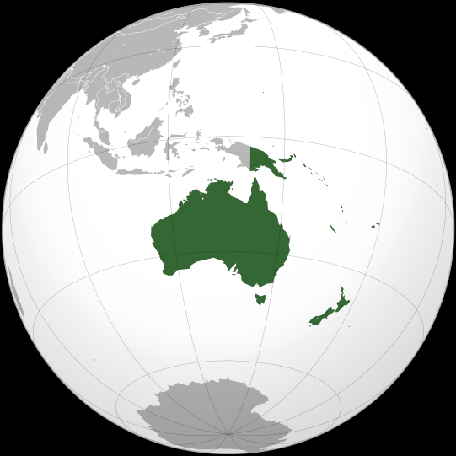
New Zealand – Basic Facts
New Zealand is located in the South Pacific.
It lies 2.000 km from Australia.
The population of New Zealand is about 4 million.
Both English and Maori are official languages in New Zealand.
Australia
Obr. 1 a globe of Oceania [1]

Slide 3
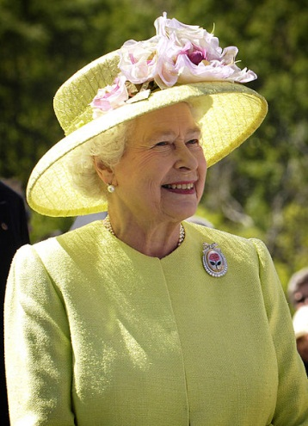
POLITICS
New Zealand is a part of the British Commonwealth.
It is a constitutional monarchy.
The head of state is the monarch of the United Kingdom.
Her representative is the Governor General.
The head of the government is the Prime Minister.
Queen Elizabeth II
Obr. 2 Queen Elizabeth II [2]

Slide 4
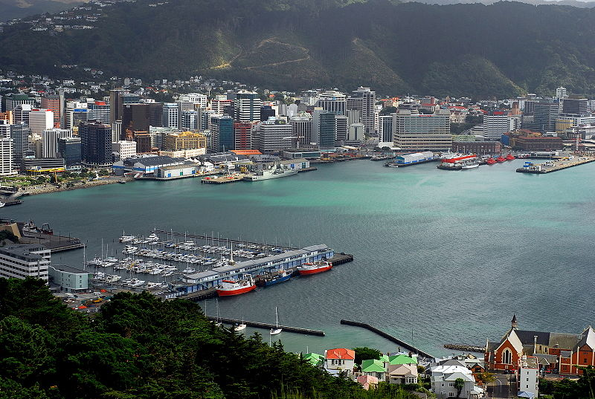
CITIES
The capital city of New Zealand is Wellington.
Obr. 3 Wellington [3]

Slide 5
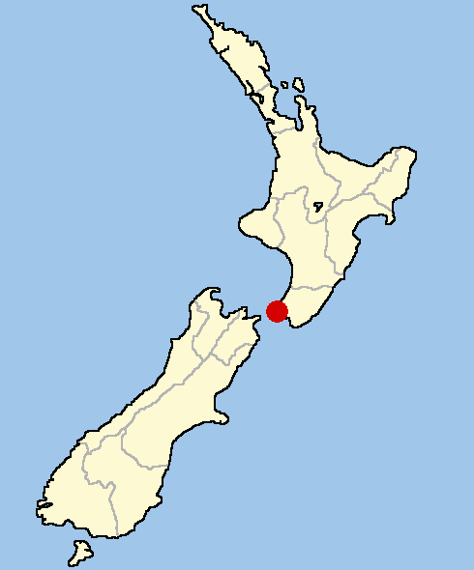
CITIES
It is in the south of the North Island.
Obr. 4 Wellington on a map [4]

Slide 6
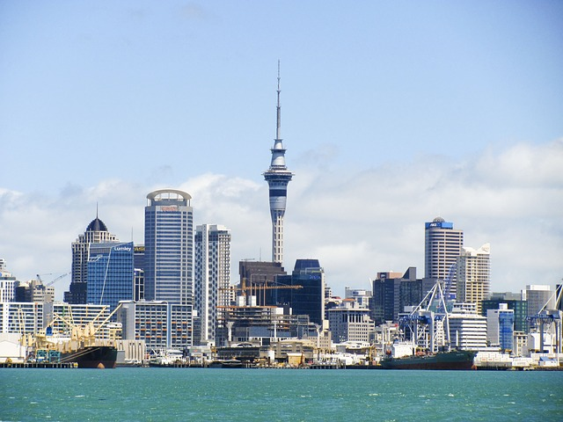
CITIES
Auckland is New Zealand’s largest city.
It is the economic centre of New Zealand.
Obr. 5 Auckland [5]

Slide 7
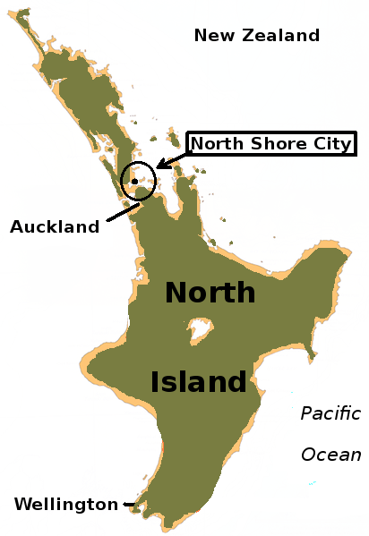
CITIES
It is in the north of the North Island.
Obr. 6 Auckland on a map [6]

Slide 8
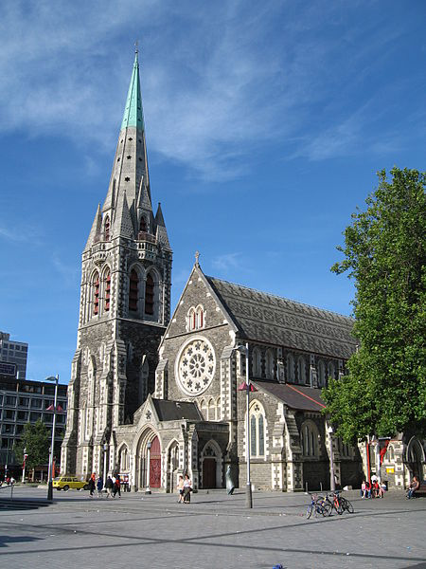
CITIES
Christchurch is the second largest city in New Zealand.
It is the largest city on the South Island.
Obr. 7 Christchurch [7]

Slide 9
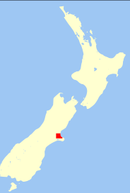
CITIES
It is on the east coast of the South Island.
Obr. 8 Christchurch on a map [8]

Slide 10
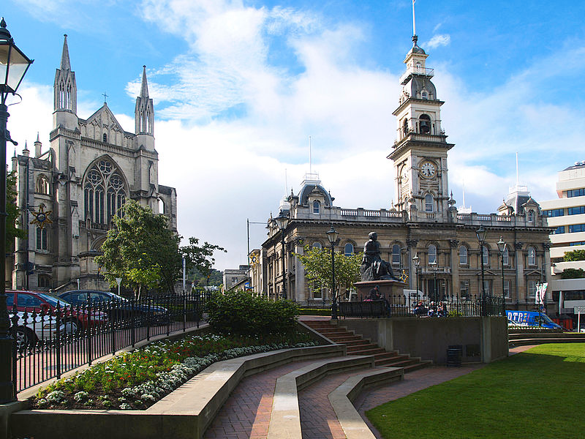
CITIES
Dunedin is the second largest city on the South Island.
It is a university town.
Obr. 9 Dunedin – Town House [9]

Slide 11
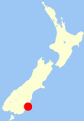
CITIES
It is on the south east coast of the South Island.
Obr. 10 Dunedin on a map [10]

Slide 12
GEOGRAPHY
New Zealand consists of two main islands and several minor islands.
The North Island is warmer than the South Island.
The South Island is more mountainous.
The North Island is smaller than the South Island but has three quarters of the country’s population.
Winter lasts from June to August and summer from December to February.

Slide 13
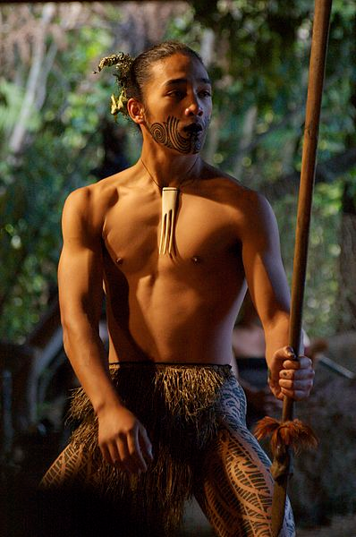
THE PEOPLE OF NEW ZEALAND
The Maori settled in New Zealand in the 13th century.
There were no people there before that.
The first Europeans started settling New Zealand in the 19th century.
Obr. 11 Young Maori man dancing [11]

Slide 14
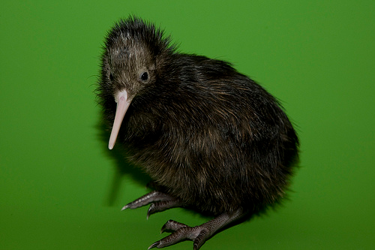
WILDLIFE
There are a lot of unique animals in New Zealand.
The most well-known is a flightless bird called the kiwi.
The kiwi is the symbol of the country.
Obr. 12 Kiwi bird [12]

Slide 15
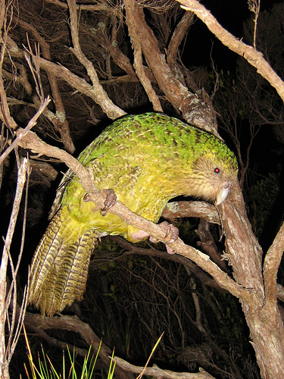
WILDLIFE
The kakapo is a parrot which can’t fly.
Obr. 13 Kakapo [13]

Slide 16
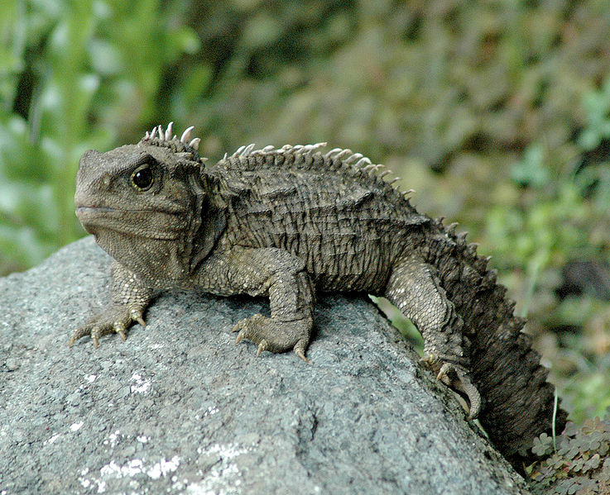
WILDLIFE
The tuatara is a unique kind of reptile.
Obr. 14 Tuatara [14]

Slide 17
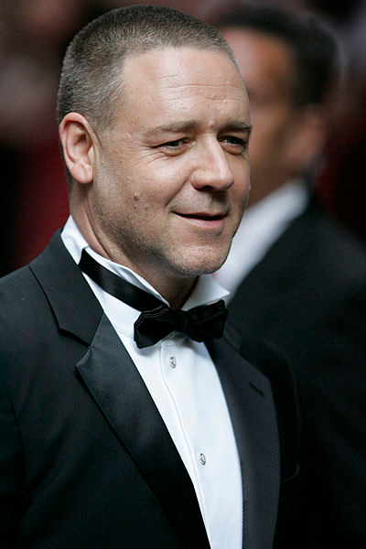
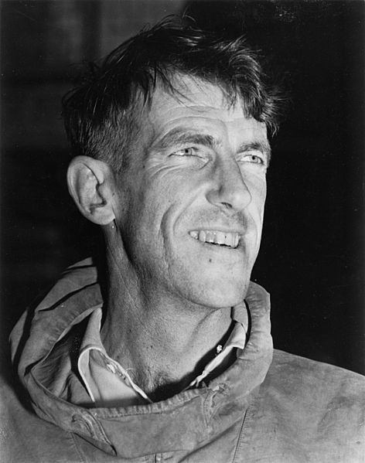
FAMOUS PEOPLE
The actor Russell Crowe comes from New Zealand.
Edmund Hillary was a mountaineer who was the first to climb Mount Everest.
Obr. 15 Russell Crowe [15]
Obr. 16 Edmund Hillary [16]

Slide 18
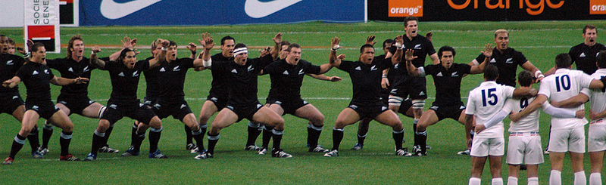
POPULAR SPORTS
Rugby Union is the most popular sport.
Cricket is a popular summer sport.
New Zealanders also enjoy basketball and tennis.
Obr. 17 All Blacks dancing the Haka [17]

Slide 19
REFERENCES – PHOTOGRAPHS
(ZDROJE OBRÁZKŮ)
Wikimedia [online]. 2012 [cit. 2013-03-07]. Dostupné z: https://commons.wikimedia.org/wiki/File:Oceania_%28orthographic_projection%29.svg
Wikipedia [online]. 2012 [cit. 2013-03-07]. Dostupné z: http://en.wikipedia.org/wiki/File:Elizabeth_II_greets_NASA_GSFC_employees,_May_8,_2007_edit.jpg
Wikimedia [online]. 2012 [cit. 2013-03-07]. Dostupné z: http://commons.wikimedia.org/wiki/File:Lambton_Harbour,_Wellington.jpg
Wikimedia [online]. 2010 [cit. 2013-03-12]. Dostupné z: http://commons.wikimedia.org/wiki/File:WellingtonNZ.png
Pixabay [online]. 2013 [cit. 2013-03-12]. Dostupné z: http://pixabay.com/cs/nov%C3%BD-z%C3%A9land-panorama-auckland-73230

Slide 20
REFERENCES – PHOTOGRAPHS
(ZDROJE OBRÁZKŮ)
Wikimedia [online]. 2011 [cit. 2013-03-13]. Dostupné z: http://commons.wikimedia.org/wiki/File:NZ-C_Reinga-2009-30-08_Map_NorthShoreCity_Auckland.png
Wikimedia [online]. 2011 [cit. 2013-03-13]. Dostupné z: http://commons.wikimedia.org/wiki/File:ChristChurchCathedral1_gobeirne.jpg
Wikimedia [online]. 2011 [cit. 2013-03-13]. Dostupné z: http://commons.wikimedia.org/wiki/File:Christchurch,_New_Zealand_map.svg
Wikimedia [online]. 2012 [cit. 2013-03-14]. Dostupné z: http://commons.wikimedia.org/wiki/File:Dunedin_Town_House.jpg
Wikimedia [online]. 2011 [cit. 2013-03-13]. Dostupné z: http://commons.wikimedia.org/wiki/File:Dunedin,_New_Zealand_location_map.PNG

Slide 21
REFERENCES – PHOTOGRAPHS
(ZDROJE OBRÁZKŮ)
Wikimedia [online]. 2012 [cit. 2013-03-14]. Dostupné z: http://commons.wikimedia.org/wiki/File:Young_Maori_man_dancing.jpg
Flickr [online]. 2013 [cit. 2013-03-14]. Dostupné z: http://www.flickr.com/photos/nationalzoo/6379061071/sizes/m/in/photostream/
Flickr [online]. 2013 [cit. 2013-03-14]. Dostupné z: http://www.flickr.com/photos/mollivan_laura/131278173/sizes/m/in/photostream/
Wikimedia [online]. 2012 [cit. 2013-03-15]. Dostupné z: http://commons.wikimedia.org/wiki/File:30-ish_male_tuatara.jpg
Wikimedia [online]. 2013 [cit. 2013-03-15]. Dostupné z: http://commons.wikimedia.org/wiki/File:Russell_Crowe_-_Flickr_-_Eva_Rinaldi_Celebrity_and_Live_Music_Photographer_(5).jpg

Slide 22
REFERENCES – PHOTOGRAPHS
(ZDROJE OBRÁZKŮ)
Wikimedia [online]. 2012 [cit. 2013-03-15]. Dostupné z: http://commons.wikimedia.org/wiki/File:Edmund_Hillary,_c._1953,_autograph_removed.jpg
Wikipedia [online]. 2007 [cit. 2013-03-15]. Dostupné z: http://uk.wikipedia.org/wiki/%D0%A4%D0%B0%D0%B9%D0%BB:Allblackhaka.jpg

Slide 23
REFERENCES AND COPYRIGHT
(ZDROJE A AUTORSKÁ PRÁVA)
NewScientist [online]. 2008 [cit. 2013-03-13]. Dostupné z: http://www.newscientist.com/article/mg19826595.200-rat-remains-help-date-new-zealands-colonisation.html
Wikipedia [online]. 2013 [cit. 2013-03-13]. Dostupné z: http://en.wikipedia.org/wiki/M%C4%81ori_people#cite_ref-7
BBC [online]. 2013 [cit. 2013-03-13]. Dostupné z: http://www.bbc.co.uk/news/world-asia-pacific-15370160

Slide 24
REFERENCES AND COPYRIGHT
(ZDROJE A AUTORSKÁ PRÁVA)
Dílo smí být dále šířeno pod licencí CC BY-SA.
Materiály jsou určeny pro bezplatné používání pro potřeby výuky a vzdělávání na všech typech škol
a školských zařízení. Jakékoliv další využití podléhá autorskému zákonu.
Všechna neocitovaná autorská díla jsou dílem autora.
Všechny neocitované kliparty a další grafické objekty jsou součástí prostředků výukového sw Smart Notebook a MS Office.

