Slide 1


Název projektu: Digitalizace výuky oboru Kosmetické služby |  |  |  | Číslo projektu: CZ.1.07/1.5.00/34.0535
Škola: Soukromá střední odborná škola Břeclav, s.r.o., Mládežnická 3, 690 02 Břeclav
Předmět: Anglický jazyk |  |  | Ročník: |  | 3.
 |  |  | Téma: Svátky a tradice v České Republice
Tematický okruh: Svátky a tradice
Jméno autora: Jana Adámková |  | Datum tvorby: 11.3.2014
Kód materiálu: OPVK_1.5_DUM_III/2_ANJ 03 AD Soubor: VYSTUPY/VY_32_inovace_ANJ 03 AD
Anotace: výukový materiál je určen k osvojení teoretických znalostí o českých svátcích a tradicích

Slide 2
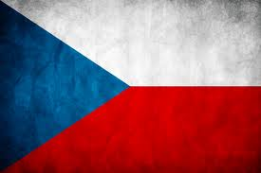
Holidays and traditions in the Czech Republic

Slide 3
Easter
Labour Day
Liberation Day
St. Cyril and Methodius
Jan Hus Day
St. Wenceslas
Independent Czechoslovak State Day
Struggle for Freedom and Democracy Day
Christmas

Slide 4
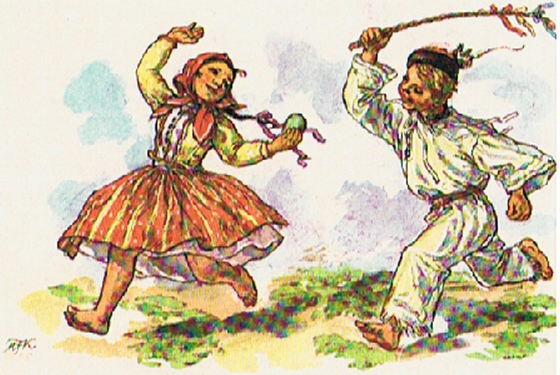
Easter
Celebrated in March or April
Girls hand - paint and decorate eggs to give them to boys
Boys make pussywillow sticks and whip the girls with them
Women bake a lamb
Baby animals such as bunny, chicken, lamb are Easter symbols

Slide 5
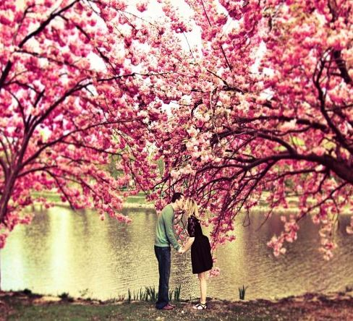
Labour Day
Celebrated on the 1st May
Commemorates an 1886 strike by workers in Chicago
who demanded an eight-hour workday
May First
Called the Time of Love
- this was firstly used in the love poem by K.H.Mácha
People kiss under the blooming cherry trees

Slide 6
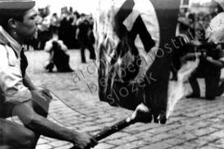
Liberation Day
Celebrated on the 8th May
Recalls the end of World War II
Politicians lay the wreaths at the memorials

Slide 7
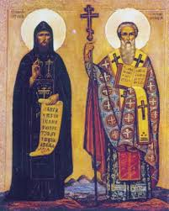
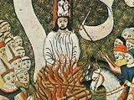
Saints Cyril and Methodius
On the 5th July we remember that Christianity was brought to Great Moravia
in the 9th century
Jan Hus Day
On the 6th July the church reformer was burnt on the stake in 1415

Slide 8
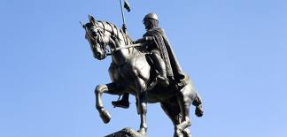
St. Wenceslas Day
the 28th September we remember the day when St. Wenceslas was murdered
Also called Czech Statehood Day
St. Wenceslas was the duke of Bohemia in the 10th century
he had a good reputation for his heroic goodness
after his death he was declared as the patron saint of the Czech state

Slide 9
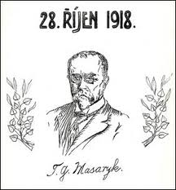
Independent Czechoslovak State Day
On 28th October we remember the day when Czechoslovakia was created in 1918
After the end of World War I and the break up of the Hapsburg Empire

Slide 10
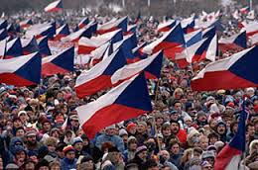
Struggle for Freedom and Democracy Day
17th November commemorates the student protests against the Nazis in 1939
after this protest all Czech universities were closed,
plus over 1200 Czech students were sent to concentration camps
we also remember the demonstration in 1989 that started the Velvet Revolution -
- the overthrow of the communist regime and the democracy was brought back
to the Czech Rep. after fifty years of lack of freedom

Slide 11
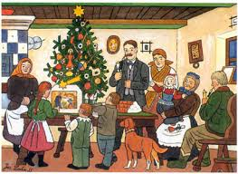
Christmas
We celebrate Christmas with our families and friends on the 24 December
Carp with potatoe salad is usually served for a dinner
Baby Jesus gives the presents under the Christmas tree
Some people attend the midnight mass
Christmas bread and biscuits are baked
People sing carols
December 25 and 26 are two other Christmas holidays

Slide 12
There are some other festivals and traditions which aren‘t
public holidays.
We celebrate St. Nicholas on December 5 in the evening
before his feast day.
November 2 - All Souls' Day Czechs visit cemeteries to remember
and pay respects to their deceased loved ones.
April 30 -The Burning of Witches
This Czech custom says a final farewell to winter.

Slide 13
When are these holidays celebrated?
Labour Day
Independent Czechoslovak State Day
St. Wenceslas Day
Struggle for Freedom and Democracy Day
Jan Hus Day
Christmas
Liberation Day

Slide 14
Zdroje:
http://www.myczechrepublic.com/
http://ff-basnicky-atd.blog.cz
promoravia.blog.cz/
http://zpravy.aktualne.cz/
http://www.bridge-online.cz/
http://www.magickydotek.cz/
http://www.expats.cz/
http://zena.centrum.cz/
http://www.kauza3.cz/.hahy.cz
www.prague.net
http://tavaana.org/
http://www.hostivickahistorie.cz/
http://www.marketoskop.cz/

