Slide 1

C O L O U R S prezentace - nová slovíčka
Autor: Vladimír Mizera
Vytvořeno v rámci v projektu „EU peníze školám“
OP VK oblast podpory 1.4 s názvem Zlepšení podmínek pro vzdělávání na základních školách

Slide 2

C O L O U R S

Slide 3

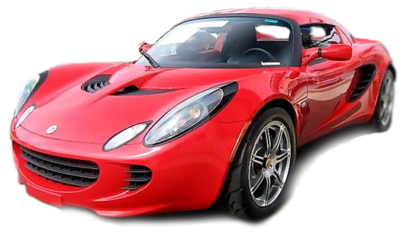
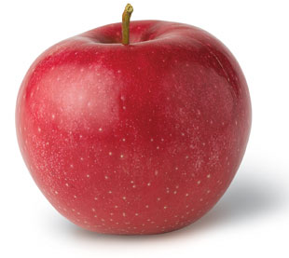
R E D

Slide 4
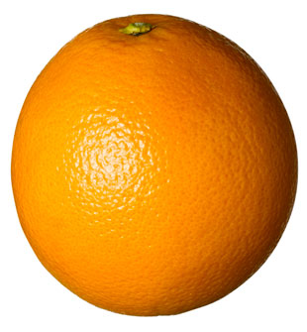
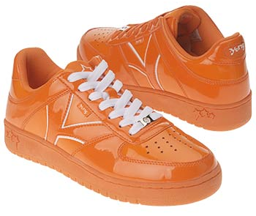
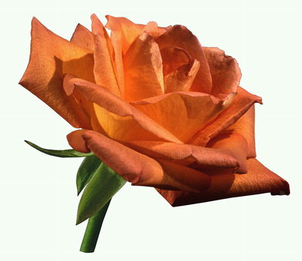
O R A N G E

Slide 5
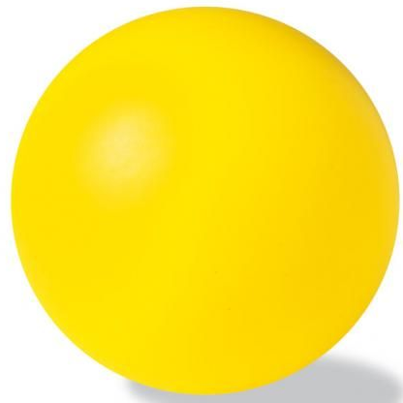
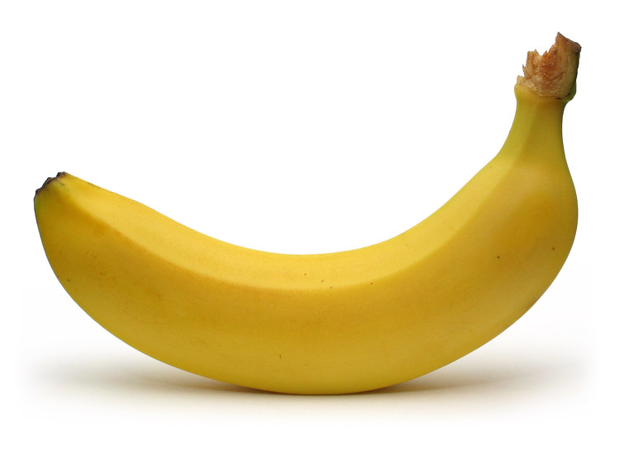
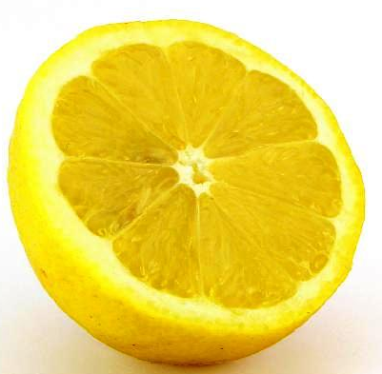
Y E L L O W

Slide 6
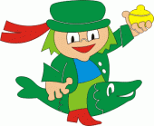
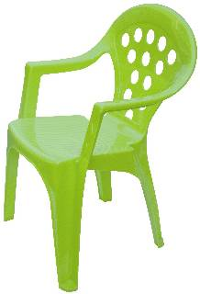
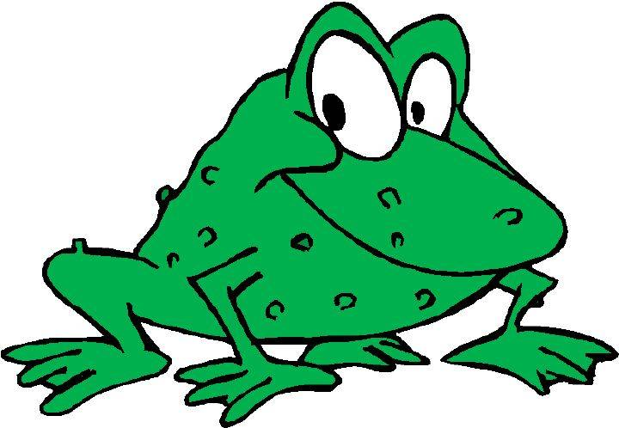
G R E E N

Slide 7
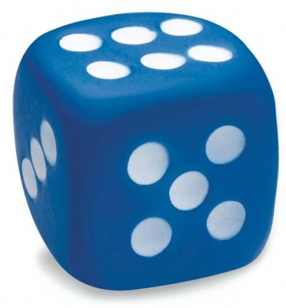

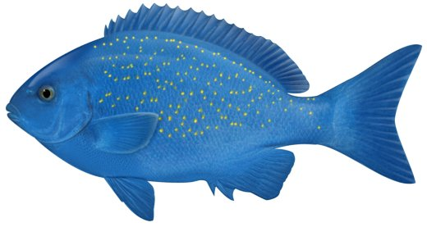
B L U E

Slide 8

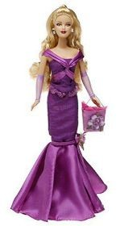
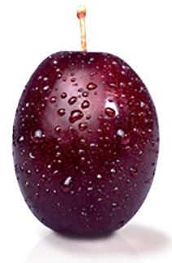
P U R P L E

Slide 9
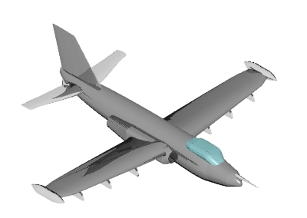
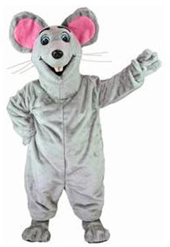
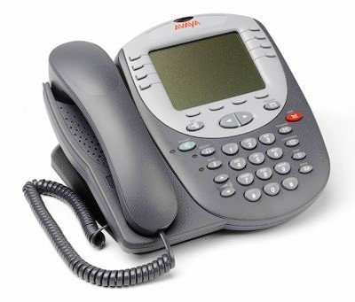
G R E Y

Slide 10

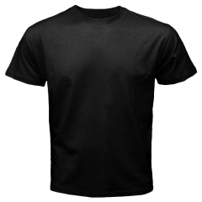
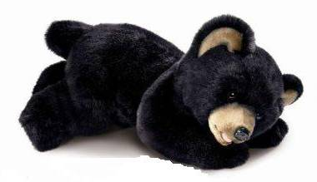
B L A C K

Slide 11
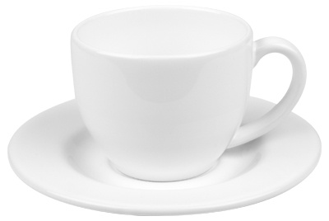

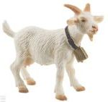
W H I T E

Slide 12
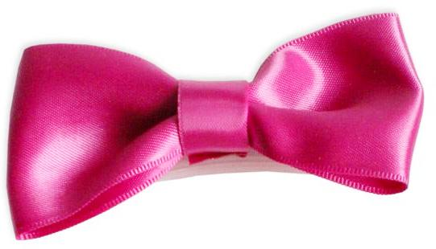
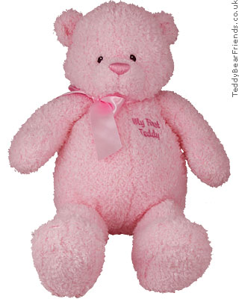
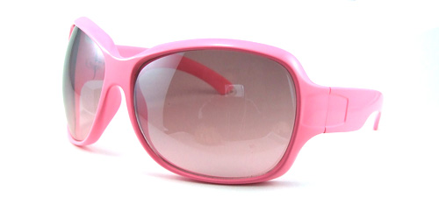
P I N K

Slide 13
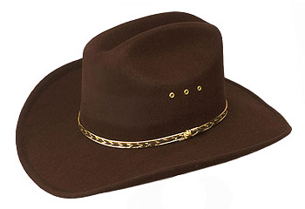
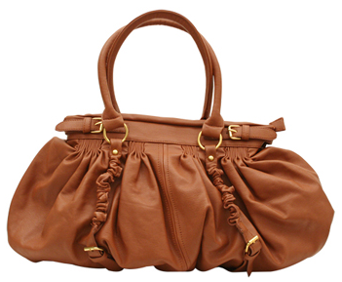
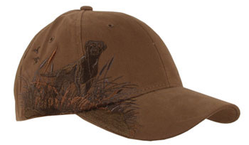
B R O W N

Slide 14
http://www.luminous-landscape.com/images/spectrum.jpg
http://all-free-download.com/free-vector/vector-clip-art/red_lips_clip_art_12547.html
http://www.nyapplecountry.com/redromephoto.htm
http://1800dingguy.com/about/
http://www.bonappetit.com/tipstools/ingredients/2008/04/orange_peel
http://inter-pix.com/cs/nature/flowers/flowers/002_023-see.html
http://www.shoes.com/productimages/shoes_iaec1113615.jpg
http://www.freakingnews.com/Banana-Pictures--1699.asp
http://varecha.cz/folie/obchod/samolepky-pro-deti/celorocni/vodnik.html
http://www.myspace.com/danherna78
http://www.zajimavy.cz/vybaveni-domacnosti-c-431.html?page=5&sort=20a
http://shop.dela.cz/index.php?main_page=product_info&products_id=36322
http://www.czplk.cz/redakce/index.php?clanek=12823&xuser=&lanG=cs&slozka=7626&xsekce=7627
http://www.dpi.nsw.gov.au/fisheries/recreational/saltwater/sw-species/bluefish

Slide 15
http://www.freeclipartnow.com/education/supplies/crayons/
http://www.google.cz/images?um=1&hl=cs&lr=&biw=1259&bih=823&tbs=isch%3A1%2Citp%3Aphoto&sa=1&q=purple+barbie&aq=f&aqi=&aql=&oq=&gs_rfai=
http://kotoko.blog.cz/
http://en.clipart-fr.com/Clipart/Planes/
http://www.google.cz/images?um=1&hl=cs&lr=&biw=1259&bih=823&tbs=isch%3A1%2Citp%3Aphoto&sa=1&q=grey+telephone&aq=f&aqi=&aql=&oq=&gs_rfai=
http://www.costumebox.com.au/Mouse-p-17798.html
http://www.google.cz/images?um=1&hl=cs&lr=&biw=1259&bih=823&tbs=isch%3A1%2Citp%3Aclipart&sa=1&q=%C4%8Dern%C3%A1+ko%C4%8Dka&aq=f&aqi=g2&aql=&oq=&gs_rfai=
http://www.plysovnik.cz/files/plysaci/ricoart/medved-cerny-yomiko-velky.jpg
http://www.vlastninavrh.cz/sections/produkty-nahled.php?id=14&barva=1&pohled=predek

Slide 16
http://www.mugshop.cz/index.asp?menu=1123&record=7155
http://www.vltava2000.cz/shops/9178/images-goods/bullyland-koza-v.jpg
http://www.spettmann.net/BLOG/DE/index.php/tag/schneemann/
http://www.google.cz/images?um=1&hl=cs&lr=&biw=1259&bih=823&tbs=isch%3A1%2Citp%3Aphoto&sa=1&q=r%C5%AF%C5%BEov%C3%A1+ma%C5%A1le&aq=f&aqi=g1&aql=&oq=&gs_rfai=
http://barbiebook.blog.cz/1001/ruzove-slunecni-bryle
http://1.bp.blogspot.com/_4JBkT1WJ-O8/TF6B1NqoTZI/AAAAAAAAACA/mBU56554IOE/s1600/large-pink-teddy-bear.jpg
http://www.halloweencostumeideas.com/adult-brown-cowboy-hat.html
http://www.bearpawsportswear.com/catalog/popup_image.php?pID=36
http://www.omiru.com/index.php/2009/05/01/shopping-guide-5-chic-handbags-under-50/

