Slide 1


Číslo projektu | CZ.1.07/1.4.00/21.1405
Název sady materiálů | MY COUNTRY
Název materiálu | VY_32_INOVACE_04_State symbols, anthem, currency
Autor | Svojtková Hana

Slide 2



STATE SYMBOLS
? ? ?
MAKE QUESTIONS (STUDENTS´OWN ANSWERS)
CZECH FLAG
NATIONAL
COAT OF ARMS
SMALL STATE COAT OF ARMS

Slide 3

ANTHEM
THE CZECH ANTHEM IS THE SONG
WHERE MY HOME IS
BY J. K. TYL

Slide 4

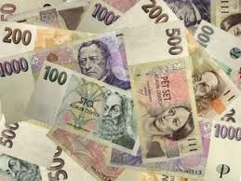
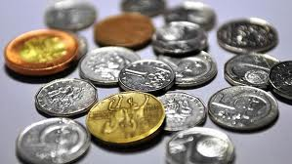
CURRENCY
KLIKNI NA OBRÁZEK
DO YOU KNOW CZECH MONEY?
THE CZECH CROWN HAS BEEN THE CURRENCY SINCE the 8th FEBRUARY 1993
BANKNOTES
COINS

Slide 5
Zdroje
http://cs.wikipedia.org/wiki/St%C3%A1tn%C3%AD_symboly_%C4%8Cesk%C3%A9_republiky
http://www.google.cz/search?hl=cs&cp=9&gs_id=18&xhr=t&q=%C4%8Desk%C3%A1+koruna&gs_sm=&gs_upl=&bav=on.2,or.r_gc.r_pw.&biw=1600&bih=701&um=1&ie=UTF-8&tbm=isch&source=og&sa=N&tab=wi
Klipart Microsoft Office
vlastní

